Slide 1
Population
Population Distribution
Measuring Population
Population Change
Overpopulation

Slide 2
The World Today: More Than Seven Billion People
Global Population today (1/22/2013): 7,061,353,338
More than 50% urban (in or near cities)
90% live north of the equator
90% live on 20% of the earth’s land
80% live at less than 500 m elevation
²/₃ live within 500 km of an ocean

Slide 3
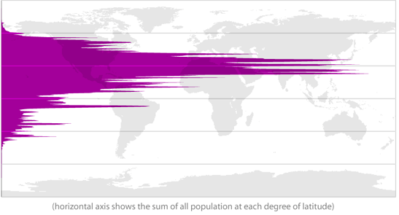
Distribution by Latitude
Source: http://paul.kedrosky.com/archives/2010/08/world_populatio.html

Slide 4
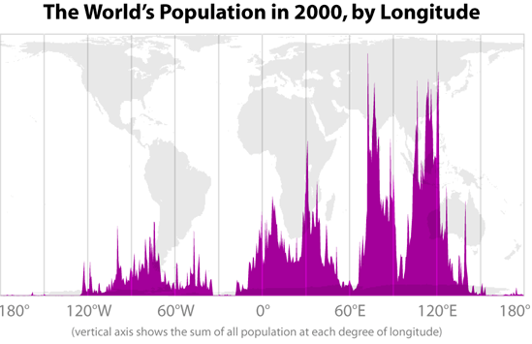
Distribution by Longitude
Source: http://paul.kedrosky.com/archives/2010/08/world_populatio.html

Slide 5
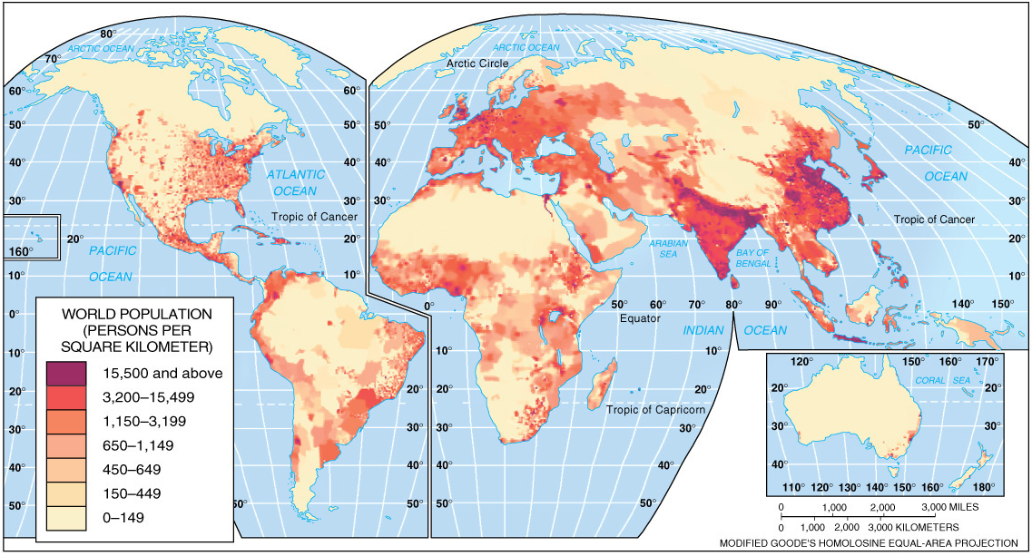
7 Billion People: Distribution

Slide 6
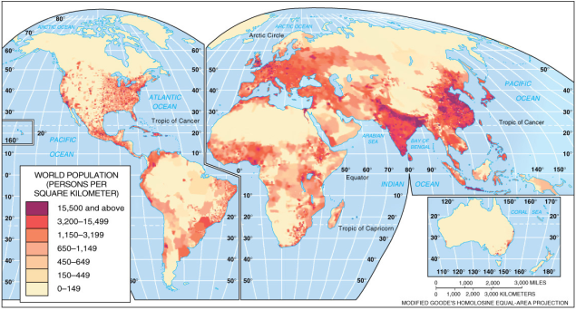
Global Population: ²/₃ of the World in 4 Major Clusters
East Asia
More than 1.5 billion people
More than 20% of humanity
About 20% of humanity in China
About 50% rural
South Asia
More than 1.5 billion people
About 20% of humanity
Nearly 20% of humanity in India
About 60% rural
Southeast Asia
About ½ billion people
8% of humanity
More than ²/₃ rural
Europe
About ¾ billion people
11% of humanity
About ¾ urban

Slide 7
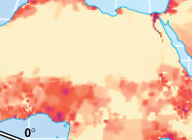
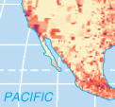
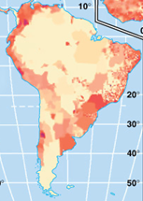
Other Clusters
Eastern North America
Egypt
West & East Africa
Urban South America & the Caribbean
US West Coast
Highland Mexico

Slide 8
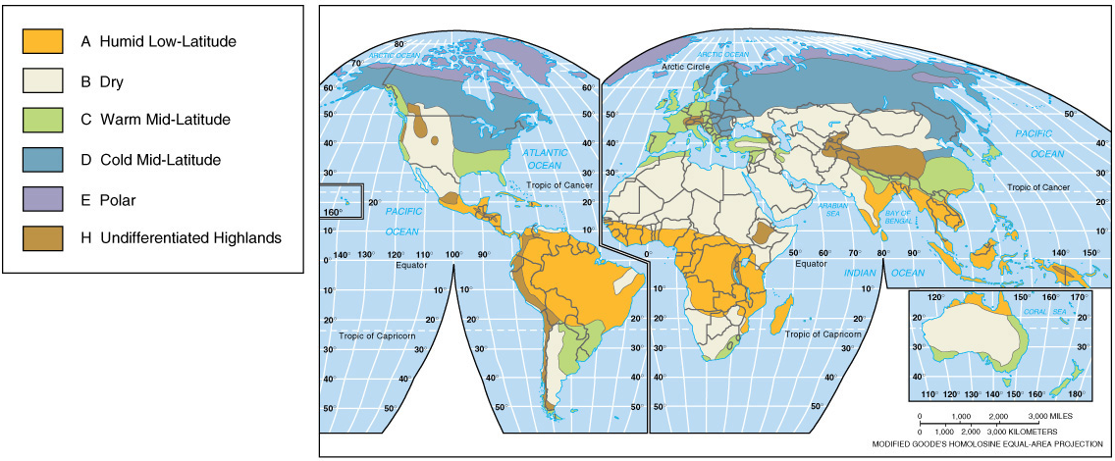
The “Ecumene”
The “ecumene” is the inhabited area of the earth.
Today, the only areas that aren’t inhabited are those that are too hot, dry, cold or at high elevations.

Slide 9
Population Density
Density is a measure of “how many per.”
The question is – what are we interested in finding out?
Different density measures give us different insights, such as:
Level of development
Type of economy
Clues about population growth, health, status of women, overall economy, etc.

Slide 10
Different Density Measures
ARITHMETIC DENSITY (“average density”)
(total population)/(total land area)
US population = 314,260,309 (August 2012)
US land area = 9,161,966 km²
(314,260,309)/(9,161,966) = 34.3
PHYSIOLOGIC DENSITY (“farmland density”)
(total population)/(total arable land area)
US population = 314,260,309
US arable land = 1,650,070 km²
(314,260,309)/(1,650,070) = 190.5
AGRICULTURAL DENSITY (“farmer density”)
(total number of farmers)/(total arable land area)
US farmers = 2,199,822 (2009 estimate)
US arable land = 1,650,070 km²
(2,199,822)/(1,650,070) = 1.33
(data on population, farmers and farmland from the CIA “World Factbook”: https://www.cia.gov/cia/publications/factbook/index.html
and the USDA Economic Research Service: http://www.ers.usda.gov/StateFacts/US.HTM#FC )

Slide 11
Density: Comparison Table (data from textbook)
 | Arithmetic Density | Physiologic Density | Agricultural Density | % Farmers | % Arable
CAN | 3 | 65 | 1 | 2% | 5%
USA | 32 | 175 | 2 | 2% | 18%
EGY | 80 | 2,296 | 251 | 31% | 3%
NTH | 400 | 1,748 | 23 | 3% | 22%
(data on arable land from the CIA “World Factbook”: https://www.cia.gov/library/publications/the-world-factbook/index.html)

Slide 12
Density: Comparisons
Arithmetic Density
Physiologic Density
people per km²
people per km² of farmland
Agricultural Density
farmers per km² of farmland

Slide 13
Basic Population Measures: Birth, Death & Natural Increase
Crude Birth Rate
CBR = (births per year)/(total population)
Crude Death Rate
CDR = (deaths per year)/(total population)
Rate of Natural Increase
CBR – CDR = NI
Note: The CBR & CDR are usually expressed in per thousand, while NI is usually expressed in percent.

Slide 14
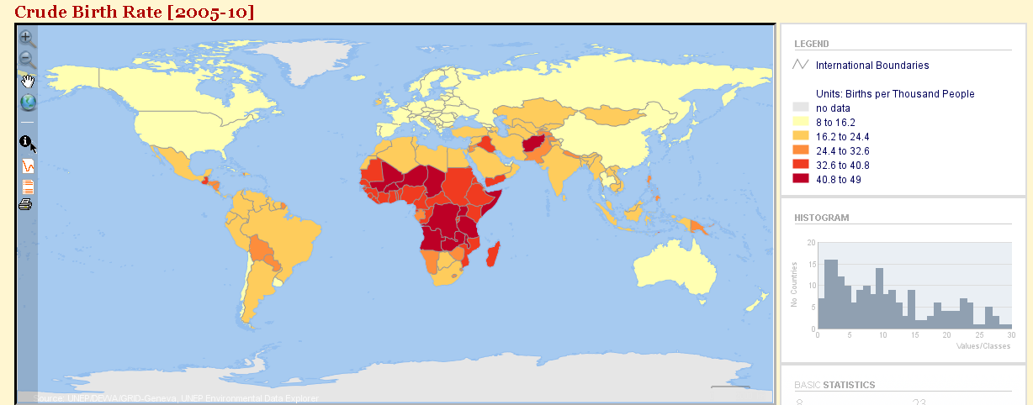
Crude Birth Rates (2005-2010)
Created online with the United Nations Environment Programme Environmental Data Explorer: http://geodata.grid.unep.ch/

Slide 15
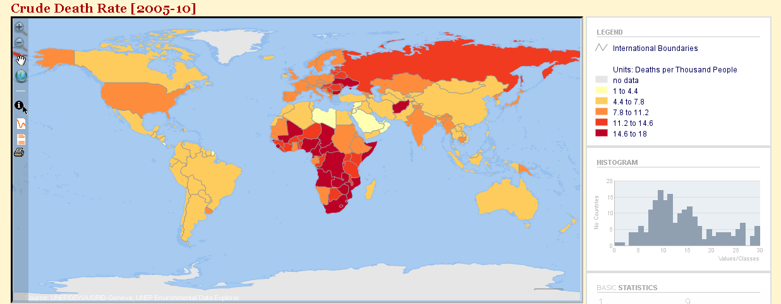
Crude Death Rates (2005-2010)
Created online with the United Nations Environment Programme Environmental Data Explorer: http://geodata.grid.unep.ch/

Slide 16
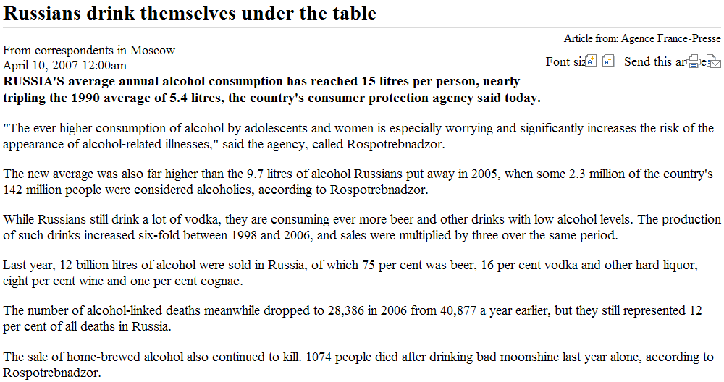
The Russian Problem
In fairness, in 2011, according to the World Health Organization, Russia ranked 4th in per capita alcohol consumption.
The top 5 in order (liters/per person): Moldova 18.22; Czech Republic 16.45; Hungary 16.27; Russia 15.76; and Ukraine 15.6.
The US ranked 57th (9.44 liters/per person).
Source: http://www.news.com.au/story/0,23599,21531240-401,00.html; http://www.everydayhealth.com/healthy-living/0201/the-worlds-drunkest-countries.aspx;
http://www.who.int/substance_abuse/publications/global_alcohol_report/msbgsruprofiles.pdf

Slide 17
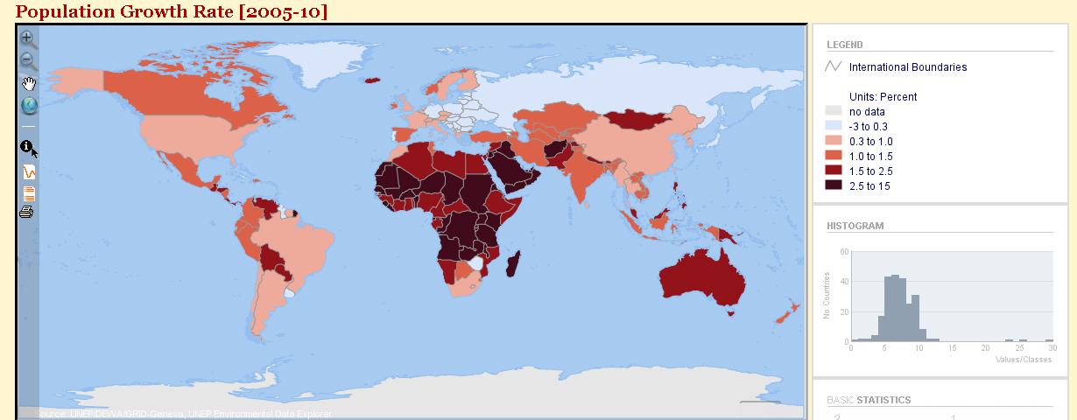
Rates of Natural Increase
Created online with the United Nations Environment Programme Environmental Data Explorer: http://geodata.grid.unep.ch/

Slide 18
Population Rates: Two Examples
Mexico 2011 (July est., CIA World Factbook)
Population: 113,724,226
Births: 2,175,544
Deaths: 552,699
CBR = 2,175,544/ 113,724,226 = 19.13/1,000
CDR = 552,699/ 113,724,226 = 4.86/1,000
NI = 19.13 – 4.86 = 14.27/1,000 = 1.43%
US 2011 (July est., CIA World Factbook)
Population: 313,232,044
Births: 4,331,999
Deaths: 2,624,885
CBR = 4,331,999/ 313,232,044 = 13.83/1,000
CDR = 2,624,885/ 313,232,044 = 8.38/1,000
NI = 13.83 – 8.38 = 5.45/1,000 = 0.55%
Note that Mexico’s growth rate is almost 3 times the US rate

Slide 19
Doubling Time: Interest
Simple vs. Compound Interest
Initial amount: $100 Interest: 10%
Simple
Compound
$100.00 + $10.00 = $110.00
$110.00 + $10.00 = $120.00
$120.00 + $10.00 = $130.00
$130.00 + $10.00 = $140.00
$140.00 + $10.00 = $150.00
$150.00 + $10.00 = $160.00
$160.00 + $10.00 = $170.00
$170.00 + $10.00 = $180.00
$100.00 + $10.00 = $110.00
$110.00 + $11.00 = $121.00
$121.00 + $12.10 = $133.10
$133.10 + $13.31 = $146.41
$146.41 + $14.64 = $161.05
$161.05 + $16.10 = $177.15
$177.15 + $17.72 = $194.87
$194.87 + $19.49 = $214.36
At 10% compound interest, the initial amount doubles in less than 8 years.

Slide 20
Population Doubling Times

Slide 21
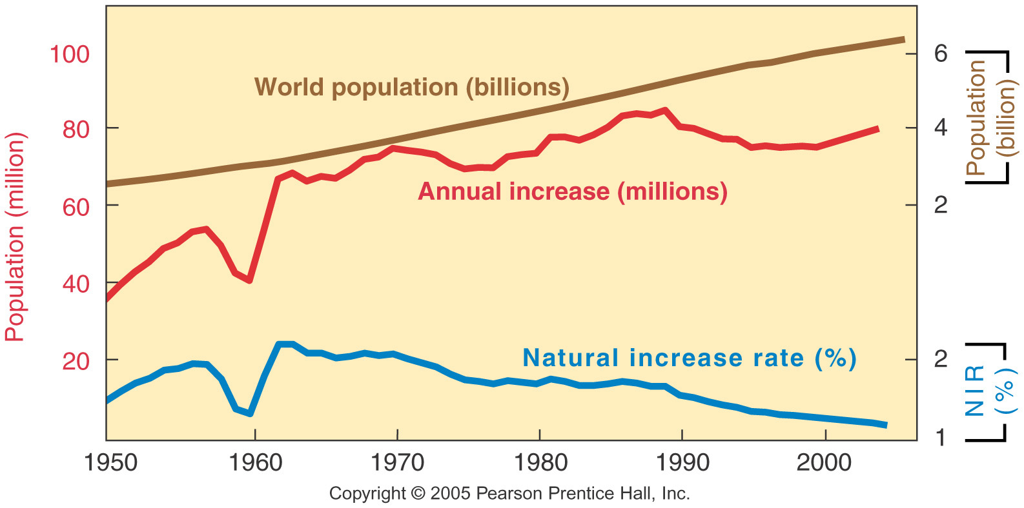
World Population Growth
The rate of natural increase declined between 1950 and 2000 – but the number of people added to the world’s population each year has remained fairly steady for about 40 years.
Why? Because global population increased from 2.5 billion to over 6 billion during this time period!
This is sometimes called “population momentum.”
See: http://www.latimes.com/news/nationworld/world/population/la-fg-population-matters1-20120722-html,0,7213271.htmlstory

Slide 22
Other Population Measures
Total Fertility Rate (TFR)
An estimate of how many children a woman will have during her childbearing years.
Assumes women in the future will act exactly as women today do.
Infant Mortality Rate (IMR)
Deaths of infants less than 1 year old, divided by total births per year.
(total infant deaths)/(total births)
Life Expectancy
An estimate of the number of years a child born today can expect to live at current mortality levels.

Slide 23
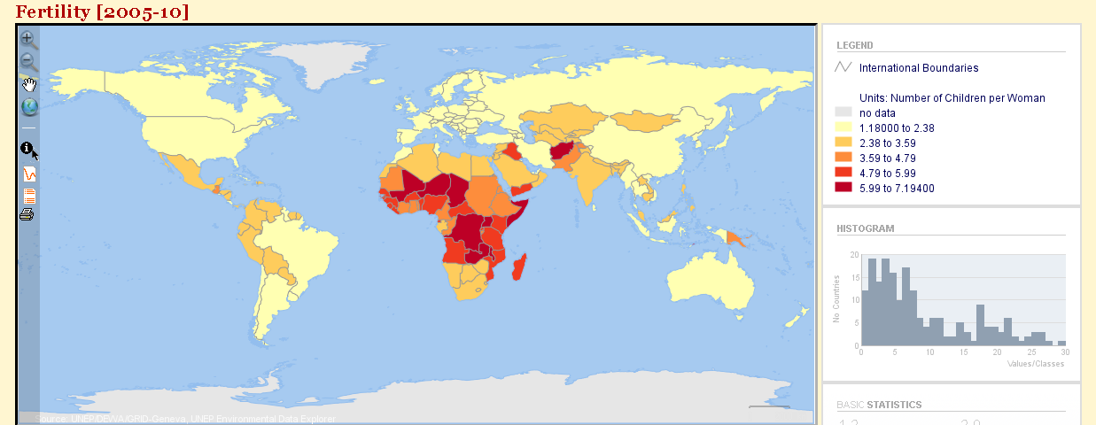
Total Fertility Rate
Created online with the United Nations Environment Programme Environmental Data Explorer: http://geodata.grid.unep.ch/

Slide 24
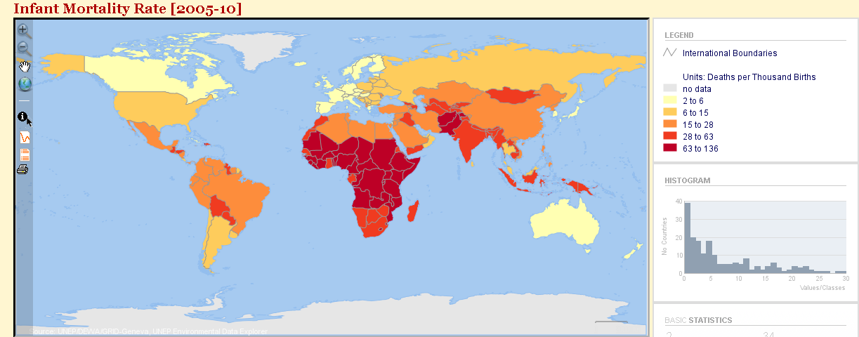
Infant Mortality Rate
Created online with the United Nations Environment Programme Environmental Data Explorer: http://geodata.grid.unep.ch/

Slide 25
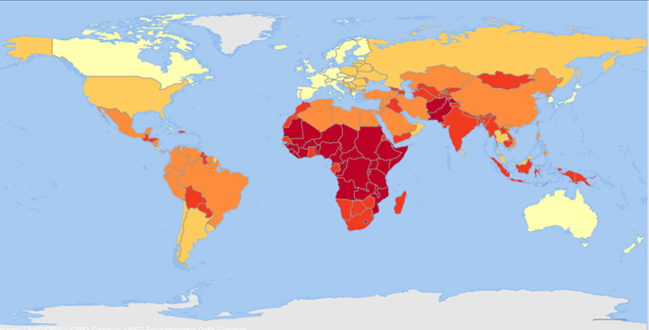
Infant Mortality Figures, 2012
The Five Worst:
Afghanistan 121.63
Mali 108.70
Somalia 103.72
Cent. Af. Rep. 97.17
Guinea-Bissau 94.40
The Five Best:
Sweden 2.74
Singapore 2.65
Bermuda 2.47
Japan 2.21
Monaco 1.80
Figures are infant deaths per 1,000 live births.
The US ranks 173rd, at 6.00/1,000
Data source: https://www.cia.gov/library/publications/the-world-factbook/rankorder/2091rank.html

Slide 26
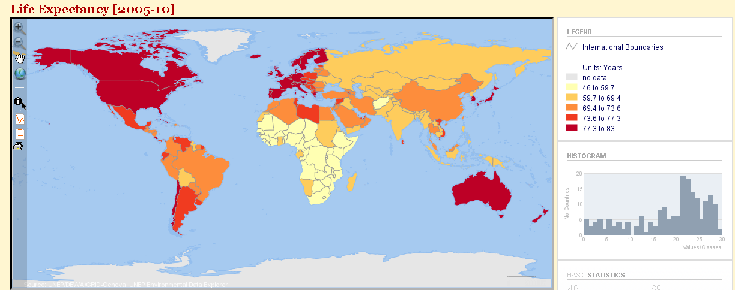
Life Expectancy (at birth)
Created online with the United Nations Environment Programme Environmental Data Explorer: http://geodata.grid.unep.ch/

Slide 27
The Demographic Transition
Q: Why do the US and Mexico have different rates of natural increase and different fertility rates? Why do these rates change?
A: The Demographic Transition
The demographic transition is a model of how birth and death rates change
Birth and death rates change because of
Changes in the economic system
Changes in information about health and health care
Changes in people’s attitudes about family size

Slide 28
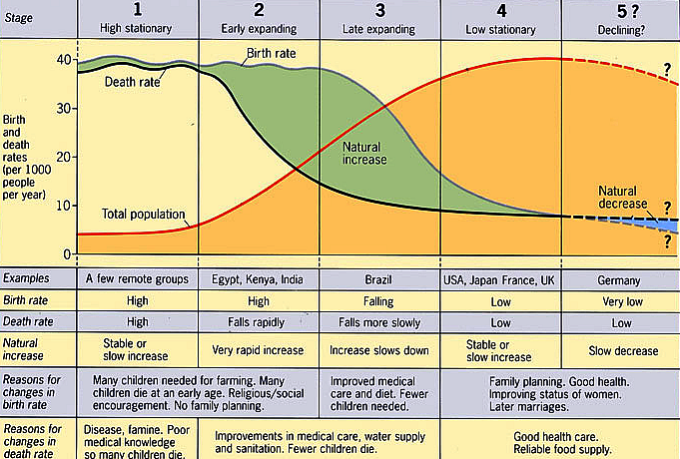
The Demographic Transition
Source: http://hs-geography.ism-online.org/files/2010/09/demographic_transition_detailed.jpg

Slide 29
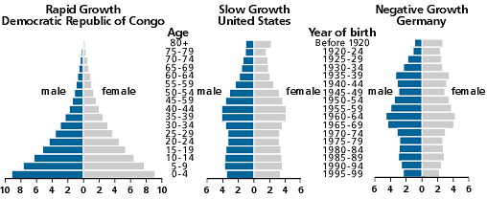
Population Pyramids
One way of visualizing how a country is changing (and how it may change in the future) is by using a population pyramid, a kind of bar chart that shows the age and sex structure of the population.
Source: http://www.prb.org/

Slide 30
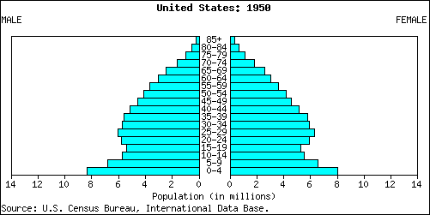
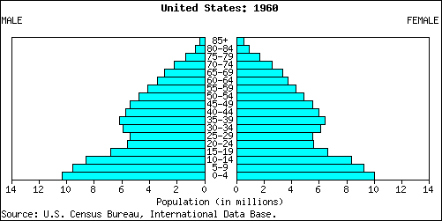
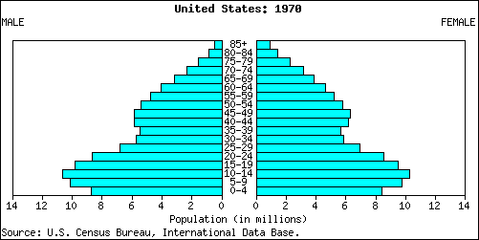
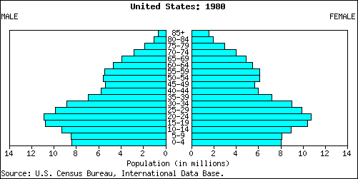
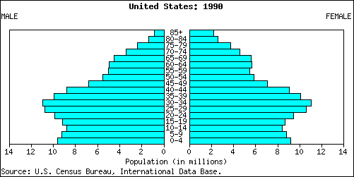
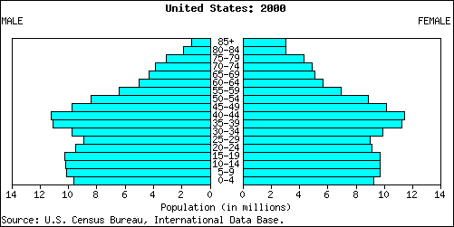
Population Changes: US Pyramids, 1950-2000

Slide 31
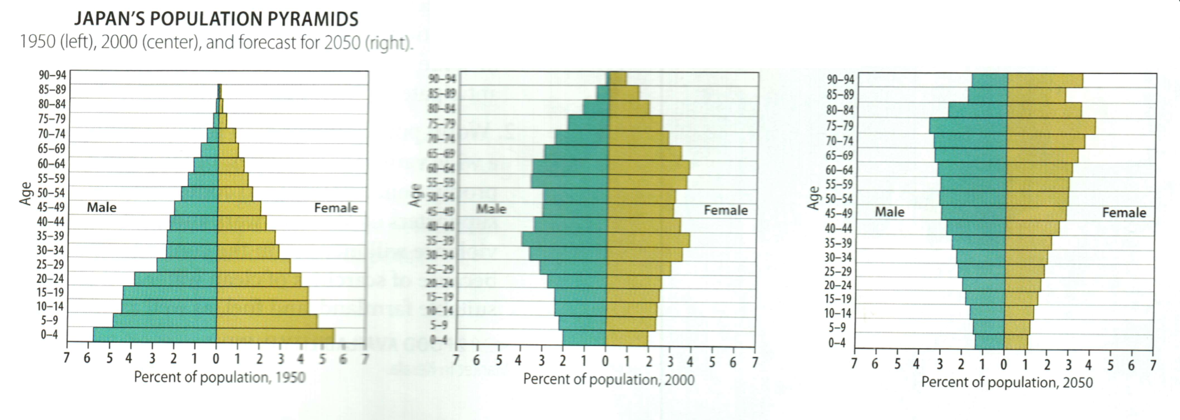
Population Changes: Japan, 1950-2050
1950: 84 million
2000: 127 million
2050: 109 million
Note: in 1960 Japan’s population was the 4th largest in the world. In 2050 it will be 16th largest.
Data Source: http://www.photius.com/rankings/world2050_rank.html

Slide 32
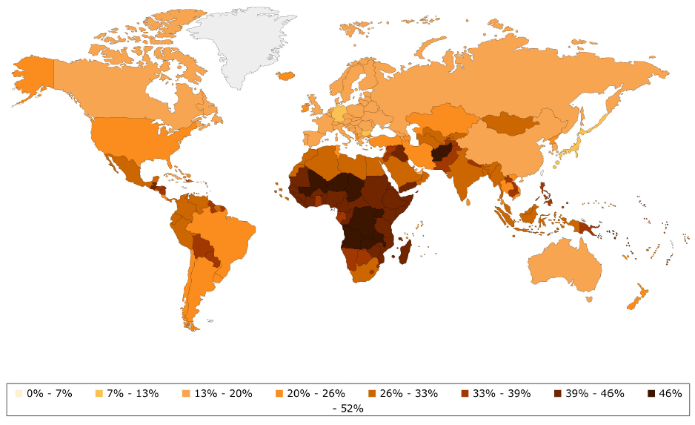
Population Changes: Population Under Age 15
Source: http://www.globalhealthfacts.org/data/topic/map.aspx?ind=82

Slide 33
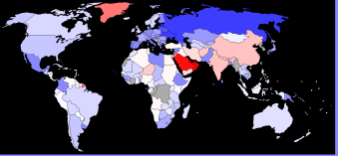
Sex Ratios (males per hundred females, 2011 estimate)
12 Highest
UAE 219
Qatar 200
Kuwait 154
Bahrain 124
Oman 122
SaudiArabia 118
Palau 114
Bhutan 110
Jordan 110
Pakistan 109
India 108
China 106
12 Lowest
Estonia 84
Djibouti 86
Latvia 86
Russia 86
Ukraine 86
Belarus 87
Armenia 89
Lithuania 89
Antigua 90
Georgia 91
Hungary 91
Moldova 91
Global average: 101 males per 100 females
Data Source: https://www.cia.gov/library/publications/the-world-factbook/fields/2018.html;
Image Source: http://en.wikipedia.org/wiki/List_of_countries_by_sex_ratio#cite_note-cia-0

Slide 34
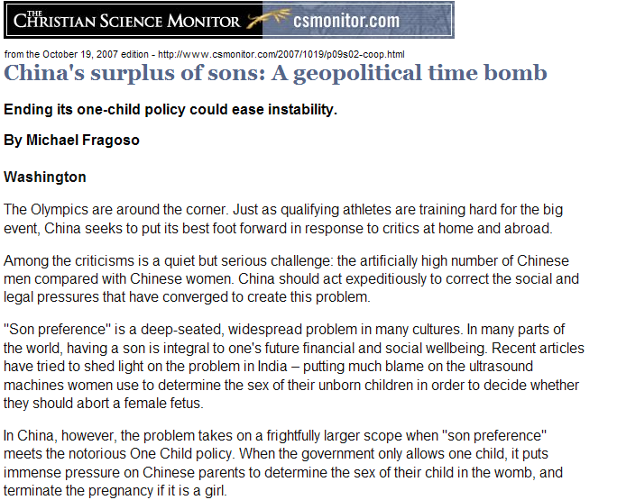
In China…
The estimated overall sex ratio for China is 106.
Source: http://www.csmonitor.com/2007/1019/p09s02-coop.htm

Slide 35
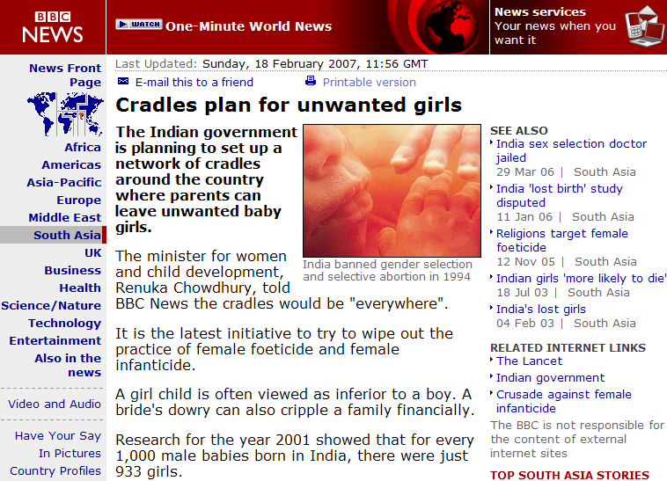
…and in India
The estimated overall sex ratio for India is 108.
Source: http://news.bbc.co.uk/2/hi/south_asia/6373043.stm

Slide 36
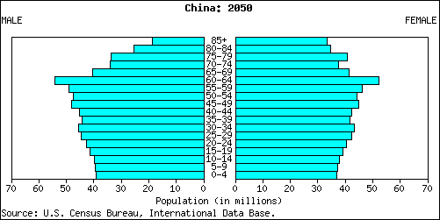
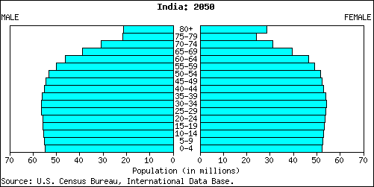
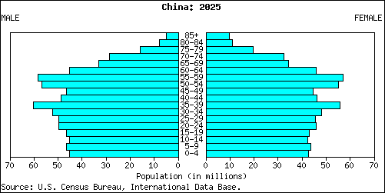
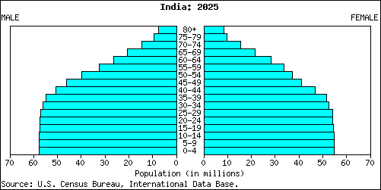
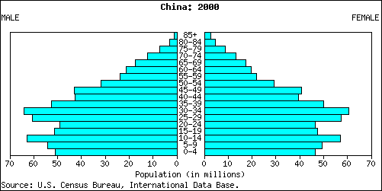
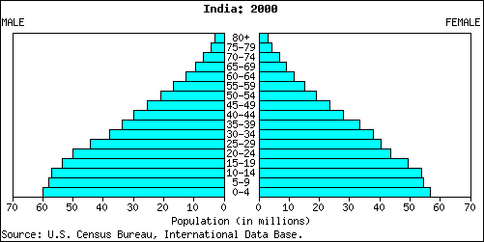
Population Growth: China vs. India
2050
Sex ratios
At birth
China: 113
India: 112
Under age 15:
China: 117
India: 113
Overall:
China: 106
India: 108
2025
2000
Data Source: https://www.cia.gov/library/publications/the-world-factbook/fields/2018.html;
Image Source: http://www.census.gov/population/international/data/idb/informationGateway.php

Slide 37
Overpopulation?
The only rational way to define over-population is to say that if the population is too great for the local environment to support it, a place is overpopulated.
Any other defin-ition is based on cultural values – basically, what you approve of!

Slide 38
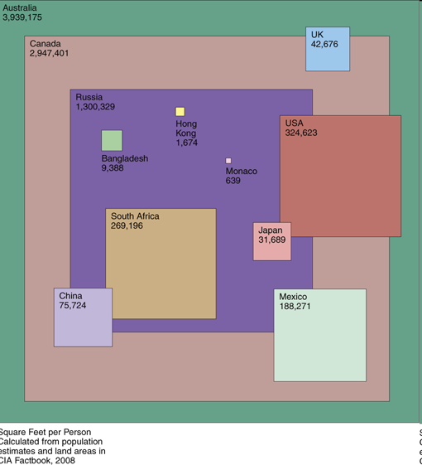
Density Comparison: In the Abstract
Source: http://www.boingboing.net/2009/01/30/charts-3.html

Slide 39
Thomas Malthus
Thomas Malthus (1766-1834), British clergyman and economist.
Published An Essay on the Principle of Population in 1798.
Crucial insight: Population tends to grow faster than the food supply.
Population growth can be stopped:
FAMINE
“MORAL RESTRAINT”
Was Malthus right?
For animal populations – yes.
For people – not so far!
“Neomalthusians” vs. “cornucopians”

Slide 40
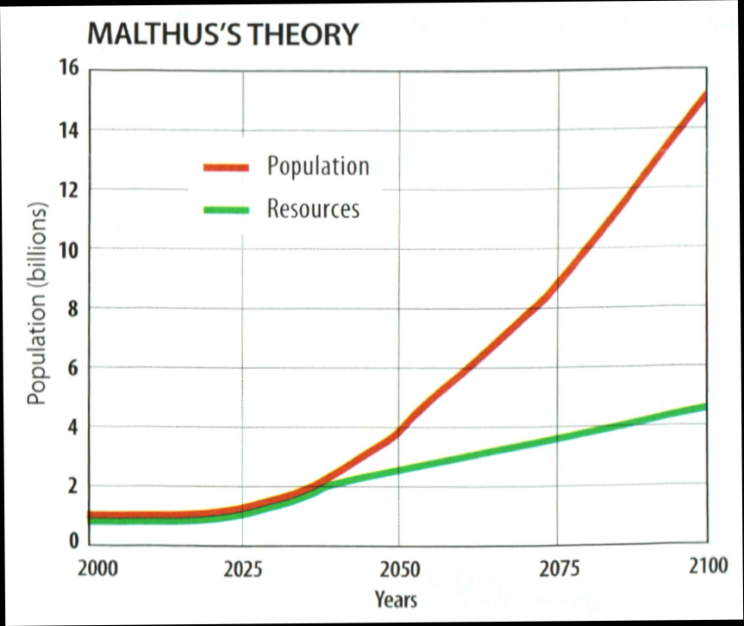
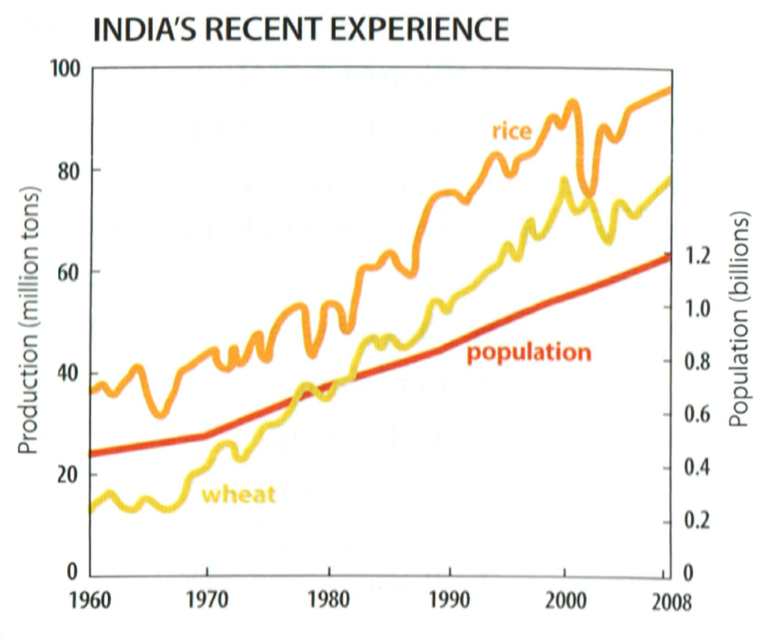
Malthus: Theory vs. Reality

Slide 41
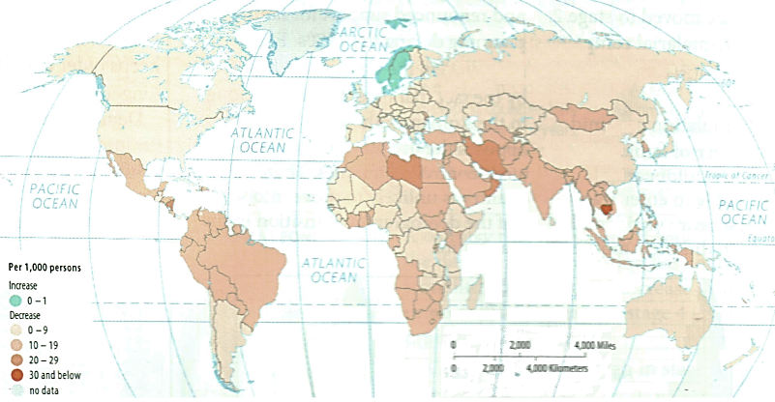
Declining Birth Rates

Slide 42
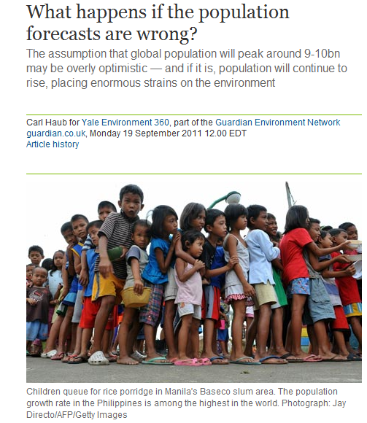
However…
There are some who worry that population won’t decline.
They worry that the pattern we see in the US, Japan, etc. is not universal – that not everybody will stop having larger families, that the decline in the TFR can “stall,” and point to countries such as Jordan (with a TFR of 4) or Indonesia (TFR 2.5).
Is it possible? Hard to say – the Demographic Transition model has been successful at predicting how populations change – but we can’t be certain it always will be.
Source: http://www.guardian.co.uk/environment/2011/sep/19/environment-population-forecasts-wrong

Slide 43
Reducing Natural Increase
The rate of natural increase can only decline if either birth rates decline or death rates increase.
Normal people prefer the first – but even this approach is controversial!
Reducing birth rates:
Economic development
Contraception

Slide 44
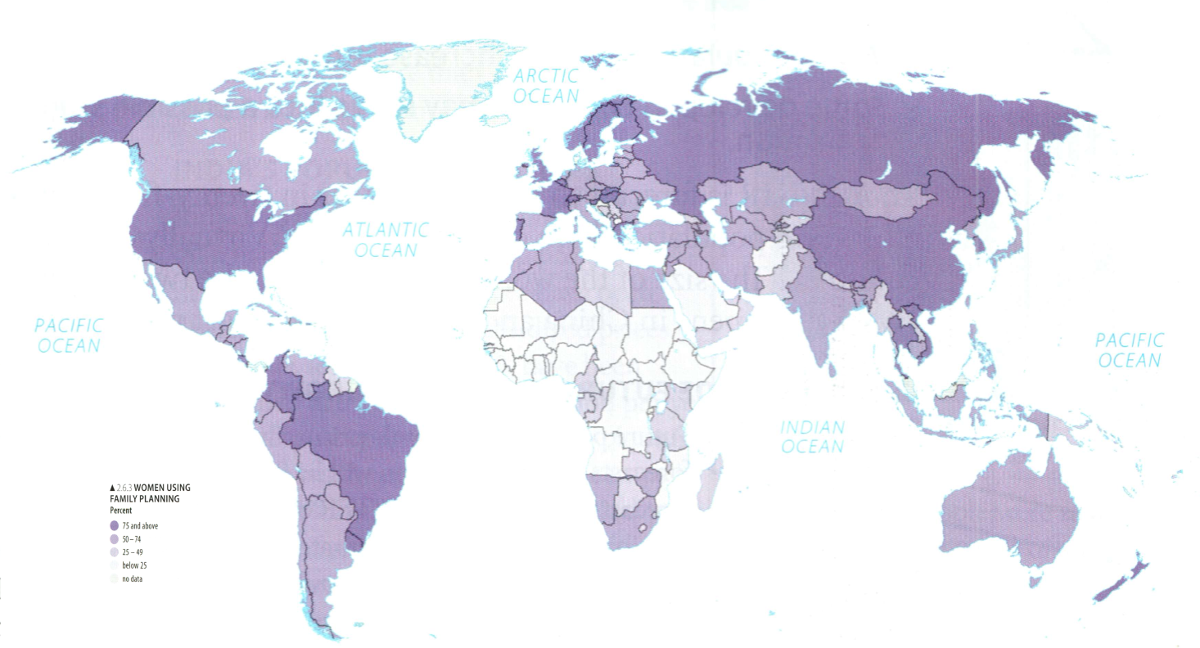
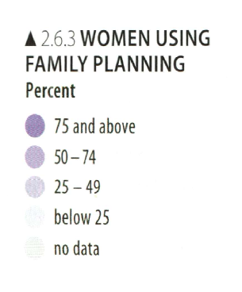
Contraception

Slide 45
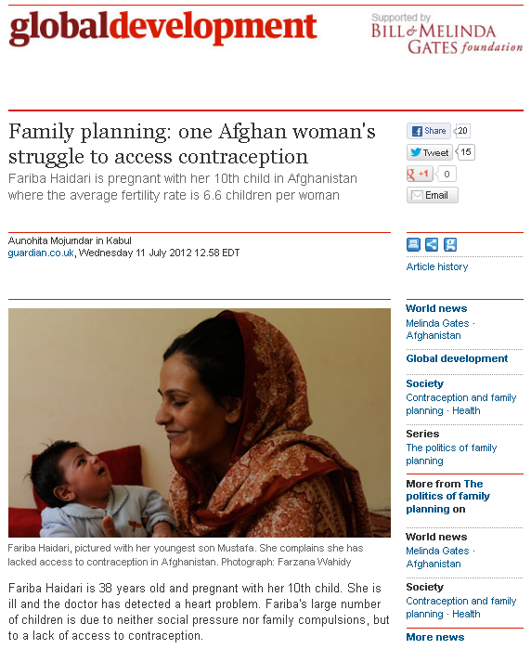
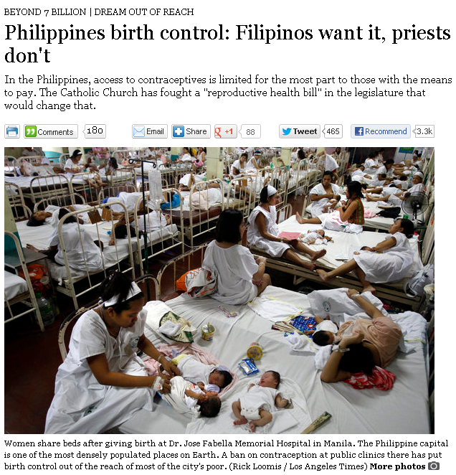
Contraception Controversies
Sources: http://www.latimes.com/news/nationworld/world/population/la-fg-population-matters5-20120729-html,0,5897961.htmlstory;
http://www.guardian.co.uk/world/2012/jul/11/family-planning-struggle-to-access-contraception

Slide 46
The Epidemiologic Transition
At different stages of development there are different processes that affect the death rate.
Different countries have different levels of technological development – and different health problems.
Stage 1: Pestilence & famine (“Black Plague”)
Stage 2: Receding pandemics (“Cholera”)
Stage 3: Degenerative & human-caused diseases (“heart attack & cancer”)
Stage 4: Delayed degenerative diseases (“cardiovascular disease & oncology”)
Stage 5: Reemergence of infectious & parasitic diseases (“AIDS,” “SARS,” “TB,” “Ebola,” “Bird Flu,” etc.)

Slide 47
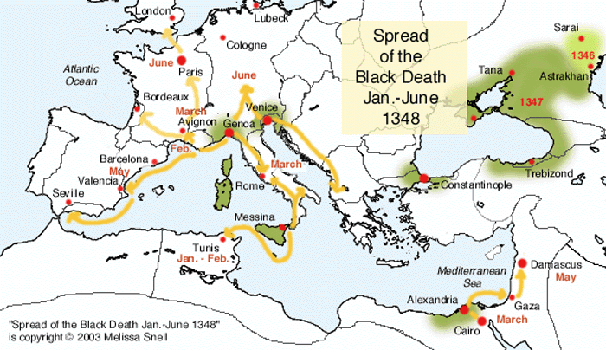
Stage 1 Example: The Black Death
Source: http://historymedren.about.com/library/atlas/natmapbd2.htm

Slide 48
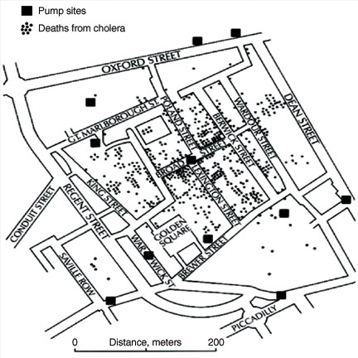
Stage 2 Example: Snow’s 1854 Cholera Map
Source: http://www.llnl.gov/str/September02/Hall.html

Slide 49
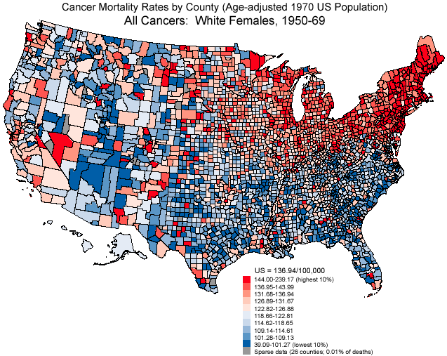
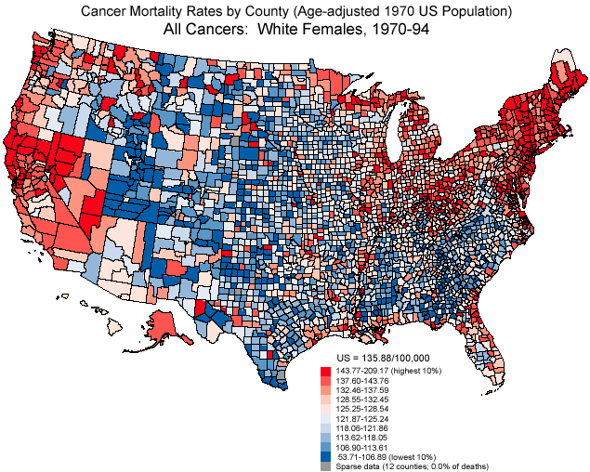
Stages 3 & 4 Examples: Cancer Mortality: 1950-1994
Source: http://dceg.cancer.gov/cgi-bin/atlas/avail-maps?site=acc

Slide 50
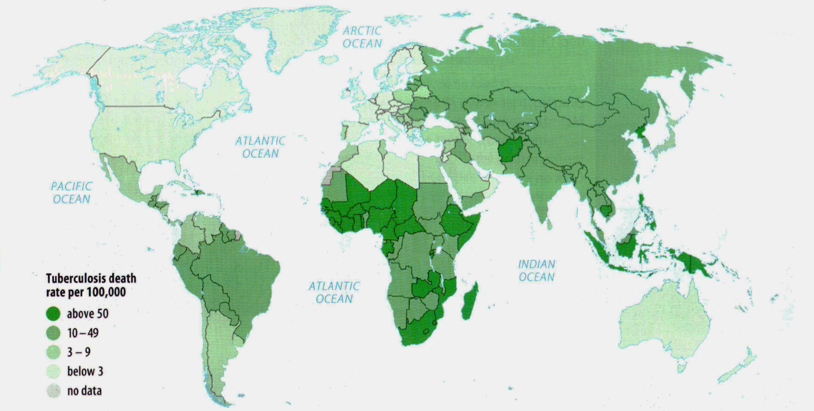
Stage 5 Example: Tuberculosis

Slide 51
Tuberculosis and Instability
Like many diseases, tuberculosis is strongly correlated with poverty and political instability.
Source: http://www.nature.com/embor/journal/v4/n6s/fig_tab/embor842_f2.html

Slide 52
Stage 5 Example: AIDS (2009)
Source: http://wwwnc.cdc.gov/travel/yellowbook/2012/chapter-3-infectious-diseases-related-to-travel/hiv-and-aids.htm

