Slide 1
The Geography of Language
“Language is not an abstract construction of the learned, or of dictionary makers, but is something arising out of the work, needs, ties, joys, affections, tastes, of long generations of humanity, and has its bases broad and low, close to the ground.”
Noah Webster (1758-1843)

Slide 2
Language origins
The Danish linguist Otto Jesperson (1860-1943) classified theories of language origin into five groups:
“Bow-Wow”
People imitate sounds from their environment
“Pooh-Pooh”
People make instinctive sounds related to emotions, body functions, pain
“Ding-Dong”
People make “oral gestures”
“Yo-He-Ho”
People work together and produce rhythmic sounds
“La-La”
People make sounds associated with love, play and singing
Most of the examples in this presentation come from The Cambridge Encyclopedia of Language (1987)

Slide 3
Language is…
Language is Universal
No group of people anywhere has ever been found that does not have a spoken language.
Many languages do not have a written form.
There are occasional physically normal individuals, “wolf children,” who have no language at all – but they’re rare.
Language is Fundamental
Language is crucial for social interaction, and to express complex emotions and ideas.
Language lets us deal with – and try to control – the world around us:
Naming
Faith, magic and the supernatural
Language is fundamental to who we are – our identity.

Slide 4
Languages come in families
A language family is a group of languages which are descended from a single common ancestor language.
How many languages are there?
Living vs. Dead Languages? New Discoveries?
“Languages” vs. “Dialects”?
So – maybe 4,000 Languages are spoken today?
How many families are there?
Families are constructed on the basis of similarities in: vocabulary, phonology and grammar.
So – maybe as many as 100 families? More?

Slide 5
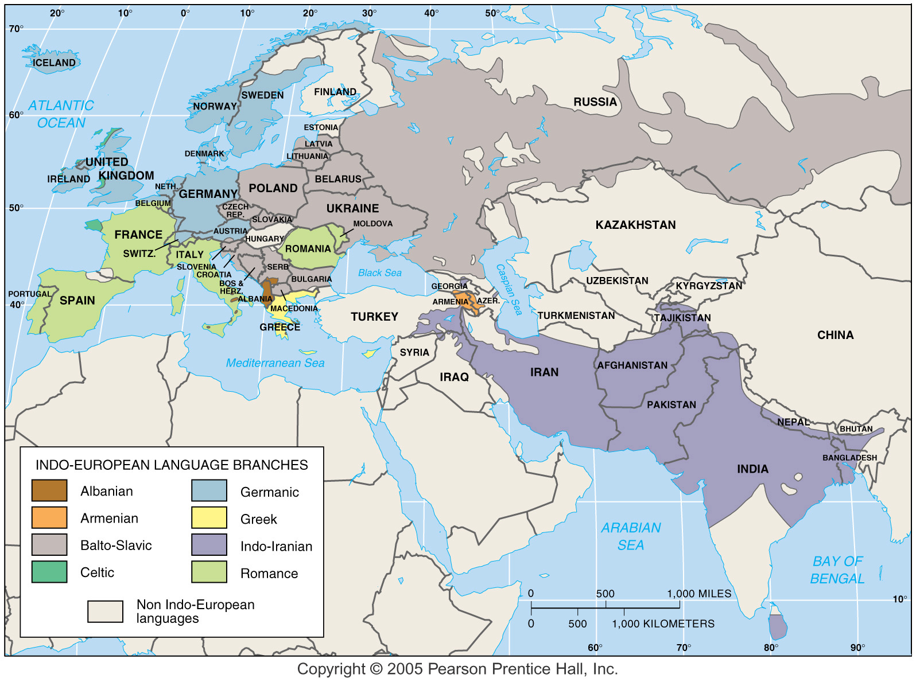
The Indo-European family

Slide 6
Language families contain…
Branches
“a collection of languages related through a common ancestor several thousand years ago. Differences are not as extensive or as old as with language families.”
Example: Indo-European has eight (surviving) branches: Germanic, Romance, Balto-Slavic, Indo-Iranian, Greek, Albanian, Armenian, and Celtic.
Groups
“a collection of languages within a branch that share a common origin in the relatively recent past and display relatively few differences in grammar and vocabulary”
Example: English is a language in the West Germanic Group.

Slide 7
Language >> Group >> Branch >> Family
Indo-European Family
Germanic Branch
West Germanic Group
English

Slide 8
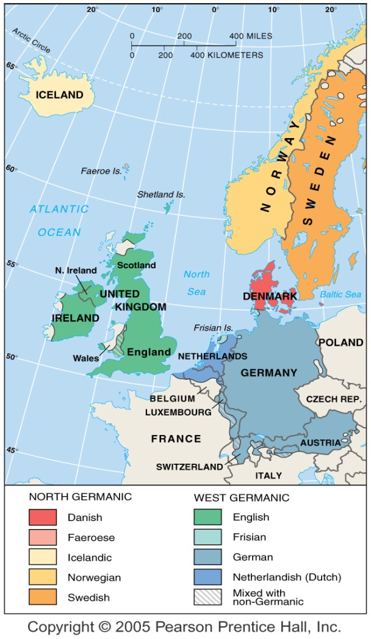
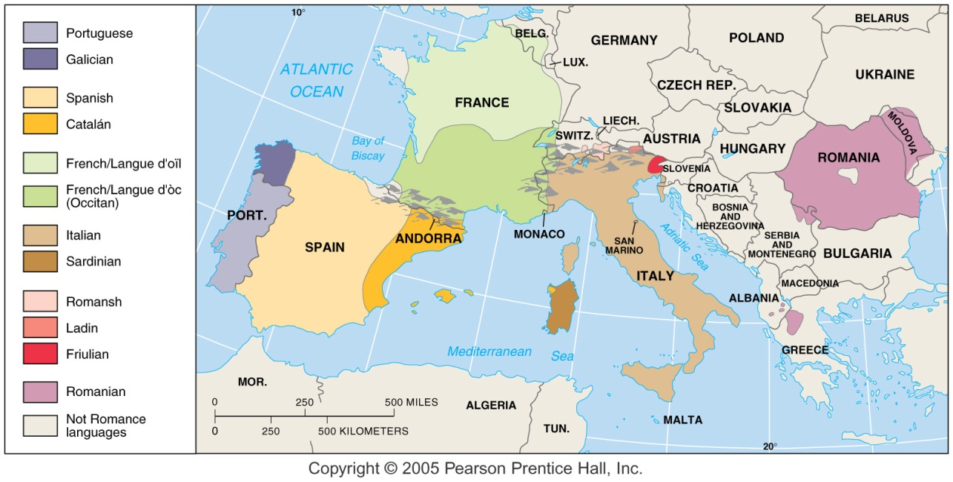
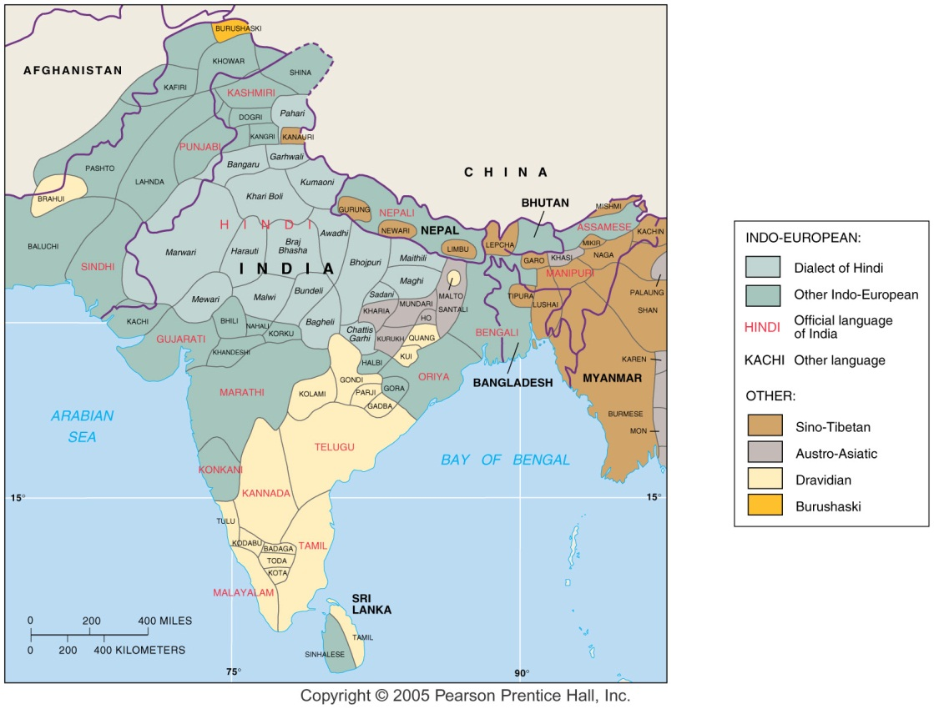
Indo-European branches & groups

Slide 9
Indo-European: mutual comprehension?
Dutch: “Onze Vader, die in de hemelen zijt …”
Spanish: “Padre nuestro, qe estás en los cielos …”
Polish: “Ojcze nasz, którys jest w niebiesiech …”
Greek: “Patera mas, poù eïsai stoùs ouranoùs …”
Albanian: “Ati ynë që je në qiell…”
Kurdish: “Yä bäwk-ï ëma, ka la äsmän-ä-y …”
Romany: “Dáde amaré, kaj isién k’o devlé …”
Sanskrit: “Bho asmäkham svargastha pitah …”
English: “Our Father, who art in heaven …”

Slide 10
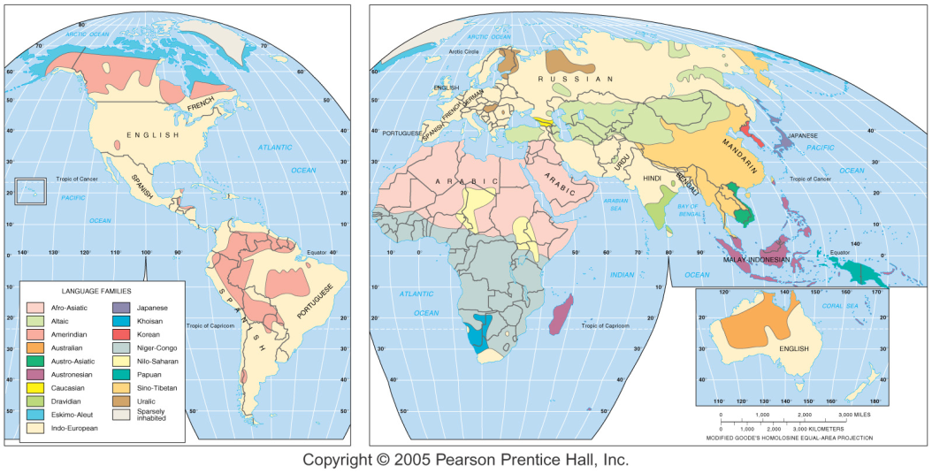
The world’s major language families today

Slide 11
The major language families (families with more than 100,000,000 speakers)
Indo-European [ex: English, Russian, Farsi, Hindi]
About 3 billion speakers; originally Europe-Asia, now worldwide
Sino-Tibetan [ex: Chinese, Tibetan]
About 1.5 billion speakers; mostly in China and surrounding areas.
Afro-Asiatic (also called “Hamitic-Semitic”) [ex: Arabic, Hebrew]
About ½ billion speakers; mostly in North Africa and Southwest Asia.
Austronesian (also called “Malayo-Polynesian”) [ex: Hawaiian, Malagasy]
More than ¼ billion speakers; Pacific Ocean to Madagascar.
Dravidian [ex. Tamil, Malayalam]
About ¼ billion speakers; Southern India, Sri Lanka.
Niger-Congo [ex. Swahili, Yoruba]
About 200,000,000 speakers; Sub-Saharan Africa.
Altaic [ex. Turkish, Mongol]
About 200,000,000 speakers; Turkey to Mongolia.
Japanese [ex. Japanese!]
About 125,000,000 speakers; Japan.
Add it up – these 8 families account for nearly 90% of humanity.

Slide 12
Some of the minor language families
Austro-Asiatic
Major language: Vietnamese
About 60,000,000 speakers.
Korean
Major language: Korean
About 50,000,000 speakers.
Tai (part of Sino-Tibetan?)
Major language: Thai
About 50,000,000 speakers.
Nilo-Saharan
Major language: Masai
About 30,000,000 speakers.
Amerindian
Not a family – a geographic group
Major languages: Quechua, Navajo
About 25,000,000 speakers.
Uralic
Major languages: Finnish, Hungarian
About 25,000,000 speakers.
Caucasian (Caucasus Mountains)
Major language: Georgian
About 6,000,000 speakers.
Indo-Pacific (or Papuan)
Not a family – a geographic group
More than 800 languages!
About 3,000,000 speakers.
Khoisan (the “click” languages!)
Major language: Khoikhoi
About 50,000 speakers.
Australian Aborigine
Not a family – a geographic group
Major language: Arunta
About 50,000 speakers.
Isolates (e.g. Basque, Zuni, etc.)

Slide 13
Seeing Families
One, two, three Indo-European, Germanic (English)
Eins, zwei, drei Indo-European, Germanic (German)
Einn, tveir, þrír Indo-European, Germanic (Icelandic)
Uno, dos, tres Indo-European, Romance (Spanish)
Uno, due, tre Indo-European, Romance (Italian)
Unu, doi, trei Indo-European, Romance (Romanian)
Amháin, dhá, trí Indo-European, Celtic (Welsh)
Un, dau, tri Indo-European, Celtic (Irish)
Jedan, dva, tri Indo-European, Slavic (Czech)
Jeden, dwa, trzy Indo-European, Slavic (Polish)
Üks, kaks, kolm Uralic (Estonian)
Yksi, kaksi, kolme Uralic (Finnish)
Bat, bi, hiru ???????????? (Basque)

Slide 14
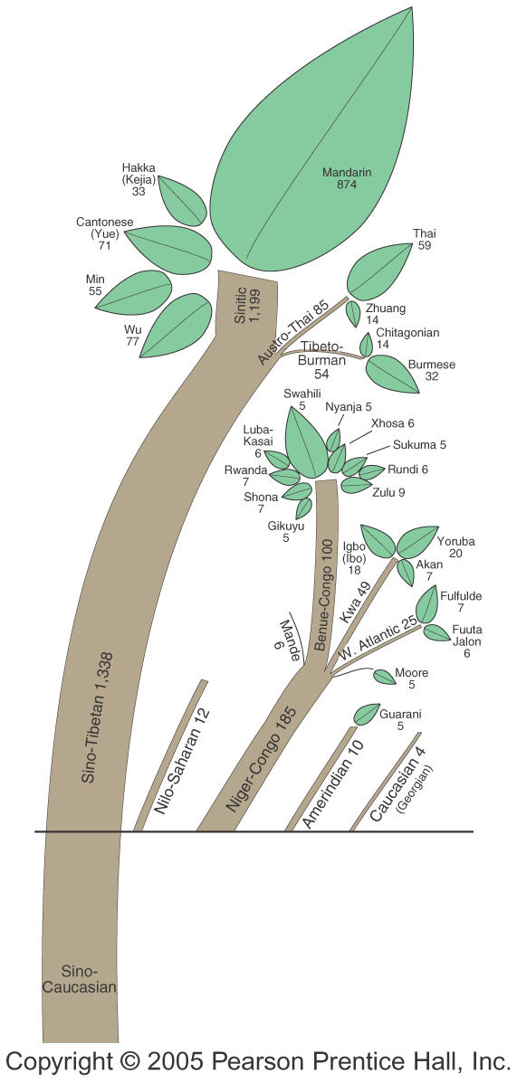
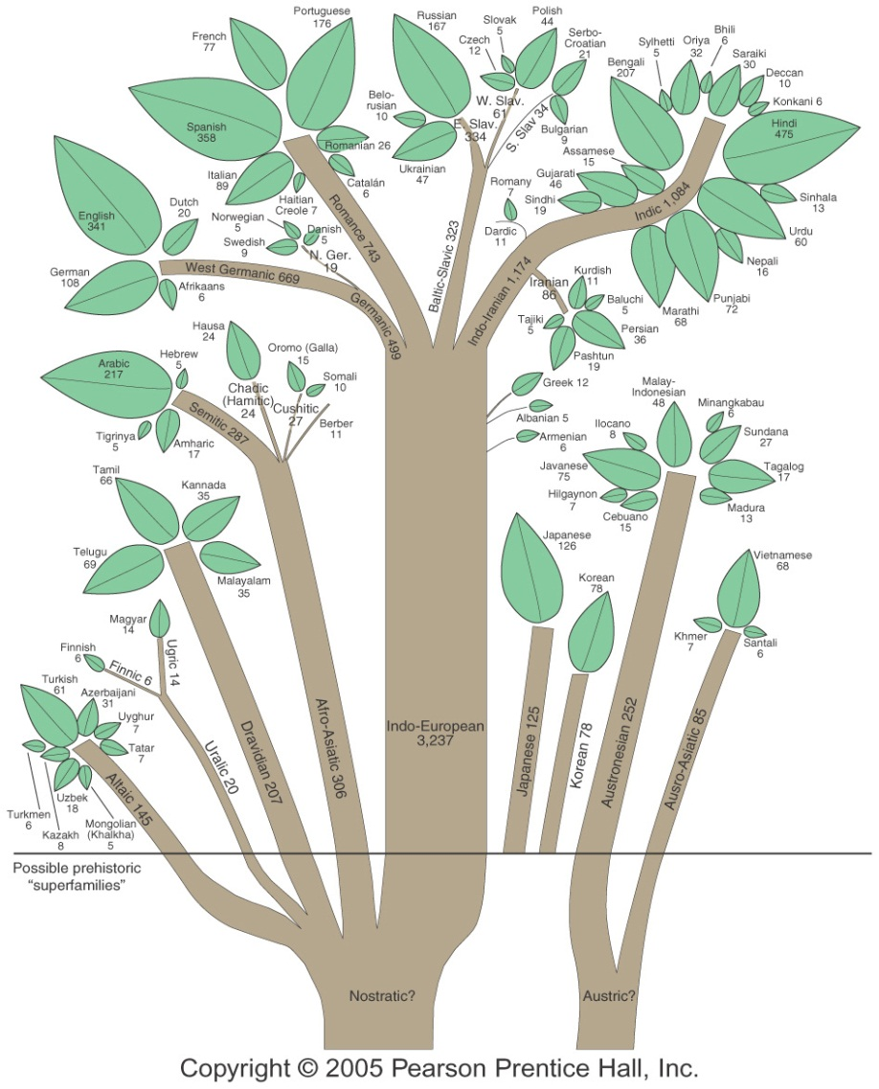
Language families: Origins & relationships

Slide 15
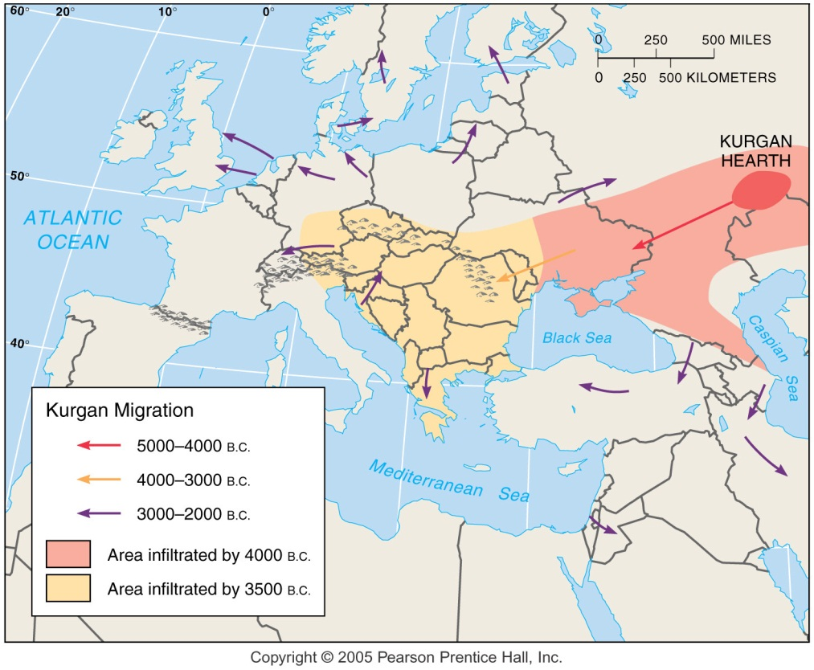
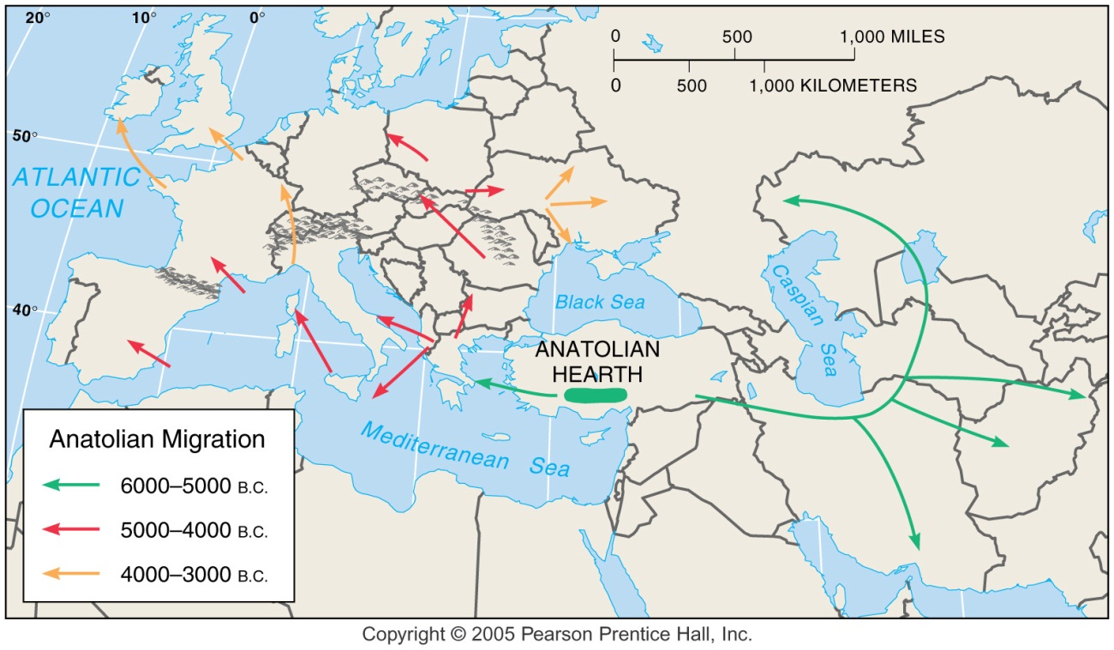
Origins of Indo-European: two hypotheses
The Kurgan hypothesis (conquering barbarians).
The Anatolian hearth theory (expanding farmers).

Slide 16
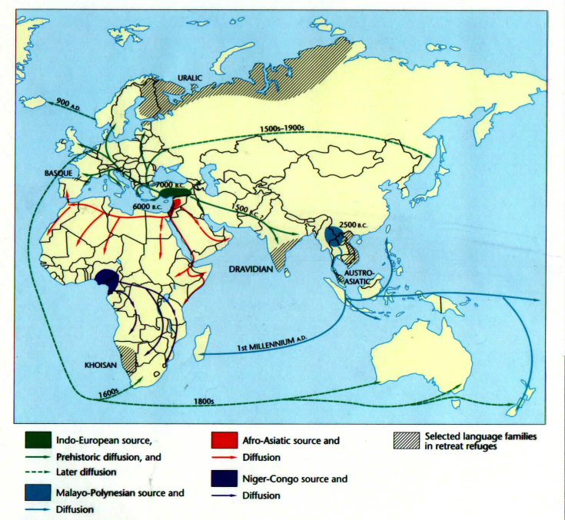
The movement of languages
Throughout history, most languages have spread by relocation diffusion.
A few languages – including Chinese, Latin, French and English – have also spread by expansion diffusion.
• Barriers to expansion may be either physical or cultural.

Slide 17
The world’s top ten languages
By Mother Tongue (first language)
• By Official Status
Why the difference? Actual vs. Official speakers

Slide 18
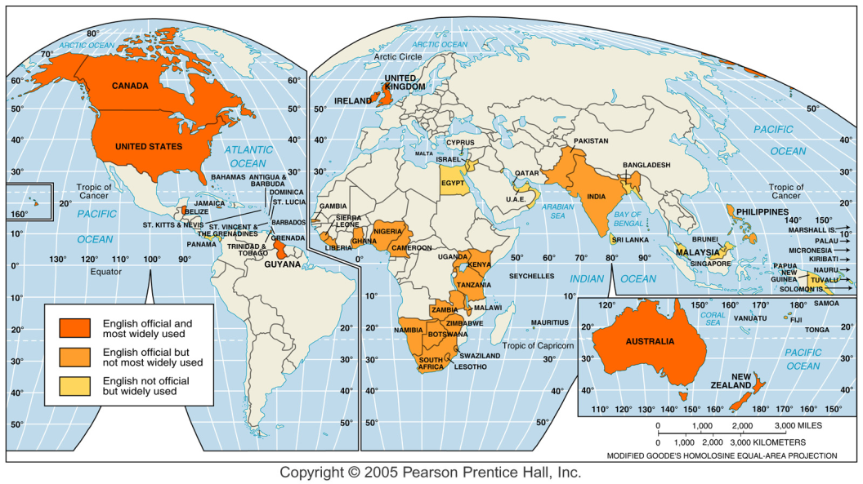
The English-speaking world today

Slide 19
Origins of English
Nothing is known about the languages of Great Britain prior to the Celtic invasion (c. 2,000 BCE). The Celts provided some loan words, but English is mostly a Germanic and Romance-descended language).
Celtic loan words: Bard, Bog, Clan, Crag, Flannel, Glen, Pet, Whiskey, etc.
Old English (“Anglo-Saxon”):
Invasion by West Germanic peoples (Jutes, Angles, Saxons) from Northern Germany, beginning 449 CE.
Periodic invasions from Scandinavia starting c. 700 CE.
Middle English:
Invasion by Normans 1066 CE (mixture with Romance branch).
“The Great Vowel Shift”
Between 1350-1750 CE; spelling frozen.
Hear examples:
Modern English: 1700-1800 CE English vocabulary enlarged, grammar simplified, codified.
http://eweb.furman.edu/~mmenzer/gvs/dialogue.htm

Slide 20
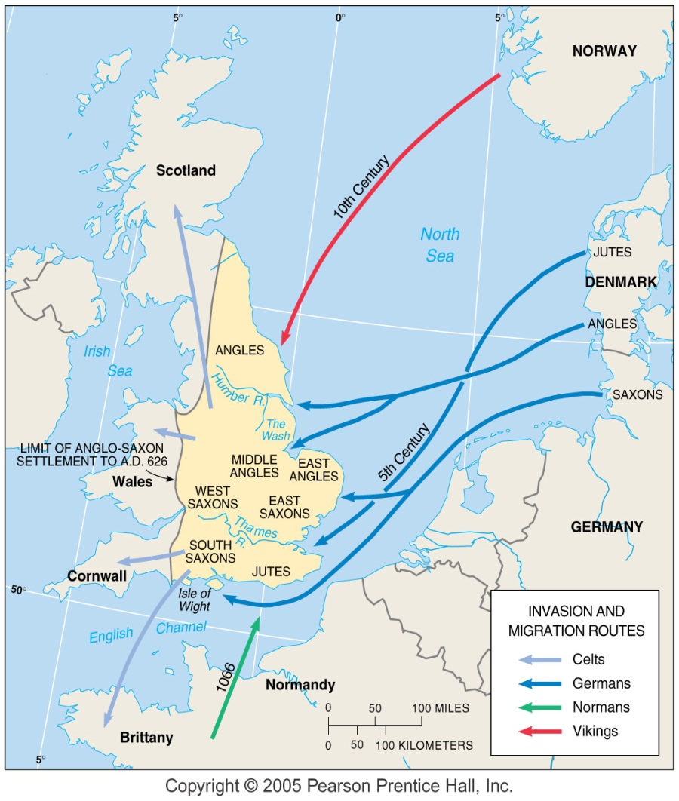
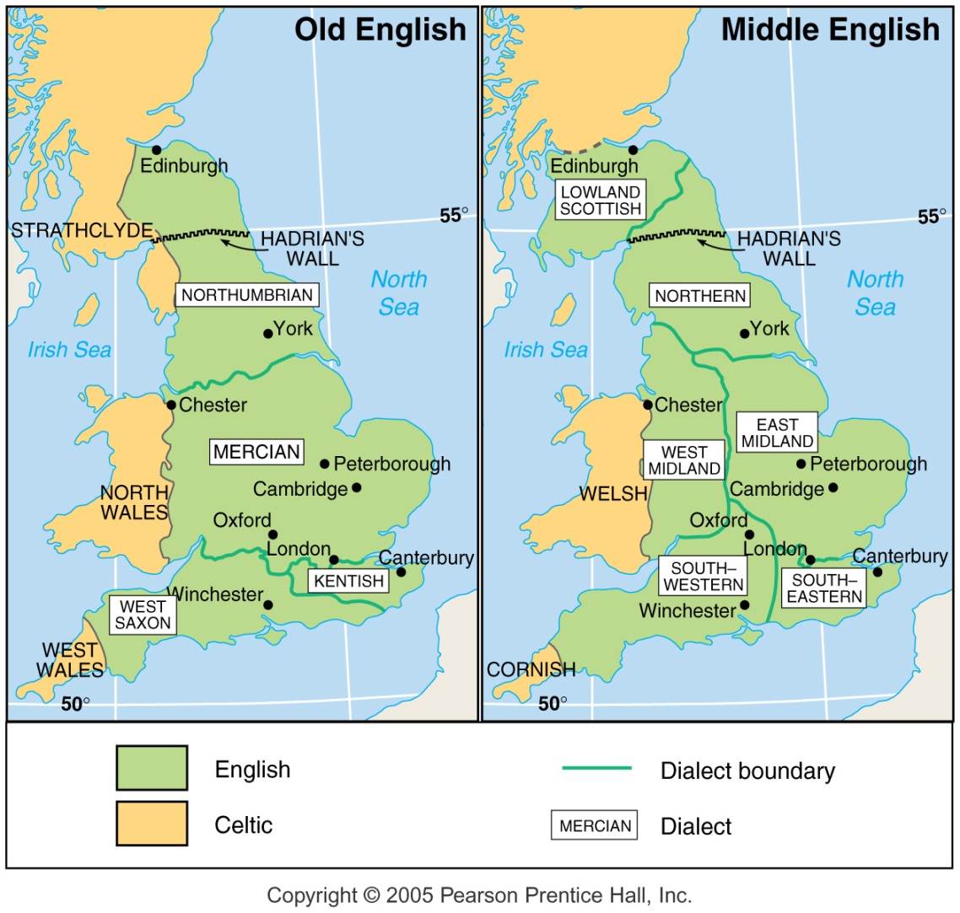
The Development of English

Slide 21
Old, Middle & Early Modern English
Old English (c. 400-1000 CE)
Fæder ure þuþe eart on heofonum si þin nama gehalgod tobecume þin rice gewurþe þin willa on eorðan swa on heofonum urne gedæghwamlican hlaf syle us to dæg and forgyf us ure gyltas swa we forgyfað urum gyltendum and ne gelæd þu us on costnunge ac alys us of yfele soþlice.
Middle English (c. 1100-1450 CE)
Oure fadir þat art in heuenes halwid be þi name; þi kyngdom come to be. Be þi wille don in herþe as it is dounin heuene. Yeue to us today oure eche dayes bred. And foryeue to us oure dettis þat is oure synnys as we foryeuen to oure dettouris þat is to men þat han synned in us. And lede us not into temptacion but delyuere us from euyl.
Early Modern English (c. 1600 CE)
Our father which art in heaven, hallowed be thy name. Thy kingdom come. Thy will be done in earth as it is in heaven. Give us this day our daily bread. And forgive us our debts as we forgive our debtors. And lead us not into temptation, but deliver us from evil.
After (2-14-2005): http://www.wordorigins.org/histeng.htm

Slide 22
The pleasures and perils of English
Pleasures
Most widely spoken language; global dominance of media, internet.
No gender, number or case changes; easy formation of plurals.
Relatively simple verb forms (most of the time!)
Huge, flexible vocabulary.
Perils
Idiomatic verb and preposition combinations (“put up,” “get down”)
Irregular plurals (ox & oxen; foot & feet, sheep & sheep etc.)
Spelling (25% irregular, 27 graphemes vs. 40 phonemes)
Bizarre written forms:
“Though the rough cough and hiccough plough me through, I ought to cross the lough.”
No rules for pronunciation and stress; many homonyms
Polish vs. polish; dove vs. dove; to, too, two; there, their, they’re

Slide 23
Silly English
The bandage was wound around the wound.
The farm was used to produce produce.
The landfill was so full it had to refuse more refuse.
He could lead if he'd get the lead out.
The soldier decided to desert his dessert in the desert.
Since there's no time like the present, he decided to present the present.
I did not object to the object.
The insurance was invalid for the invalid.
They were too close to the door to close it.
In the fable, the cow taught the sow to sow.
I saw the tear in the painting, and I shed a tear.
I had to subject the subject to tests.

Slide 24
Improving written English?
Other proposed systems:
Cut Spelng, New Follick, Checked Clipped Spelling, Sound Spell, Spell Right, NuSpel, EnglSpel, Alt Spell, Inglish, AnJel
And if these look funny – remember, American spelling was “simplified” over a hundred years ago!
“tire” vs. “tyre”
“jail” vs “gaol”
“curb” vs. “kerb”
“program” vs. “programme”

Slide 25
Languages, dialects, accents
Standard Language: Accepted norms of syntax, vocabulary and pronunciation.
Dialect: A recognizable speech variant.
Accent: A distinctive way of speaking typical of a group or a region. Accents can be distinctive in terms of:
Pronunciation
Tone
Inflection
Word choice

Slide 26
Languages and dialects: the spectrum

Slide 27
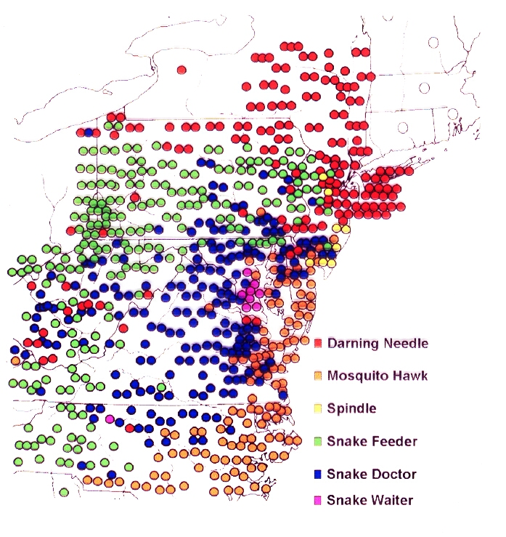
Drawing dialect boundaries: isoglosses
Care to guess what these different colored dots represent terms for?
Isoglosses are a kind of isoline – in this case, they are word-usage boundaries.
Ideally, researchers go out, ask people what words they use for common things, draw dots on a map, draw lines around the dots, and define boundaries between different dialects.
That’s the ideal. In reality, it’s much messier.
These are all local words for “dragonfly!”

Slide 28
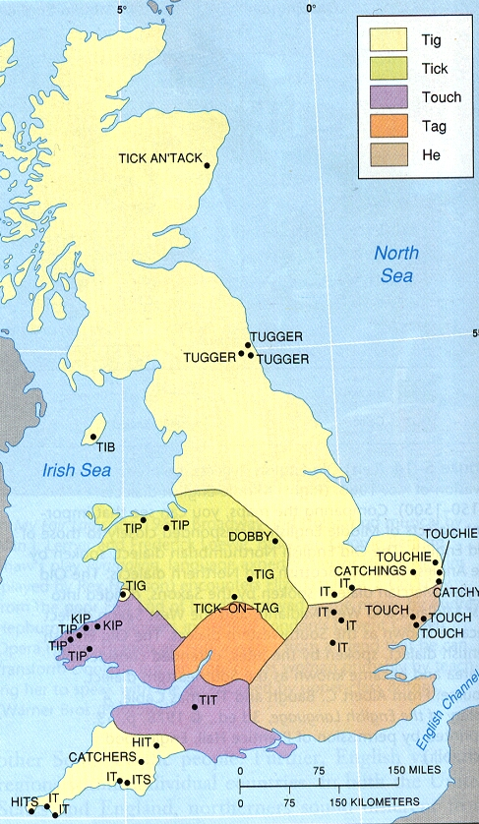
Dialects of English
In England, there are still at least three main dialect groups:
NORTHERN
MIDLAND
SOUTHERN
Note the isoglosses

Slide 29
American dialects
In the US
Isolation (physical and political) created differences in vocabulary, spelling and pronunciation.
Today, US dialects are most pronounced in the East, and there are at least three main groups:
NORTHERN
MIDLAND
SOUTHERN
Note the major
and minor
isoglosses

Slide 30
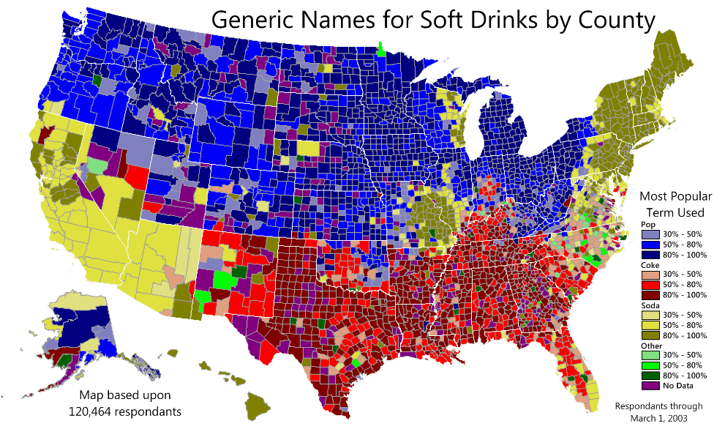
US regional variations

Slide 31
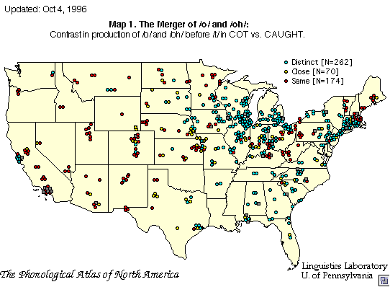
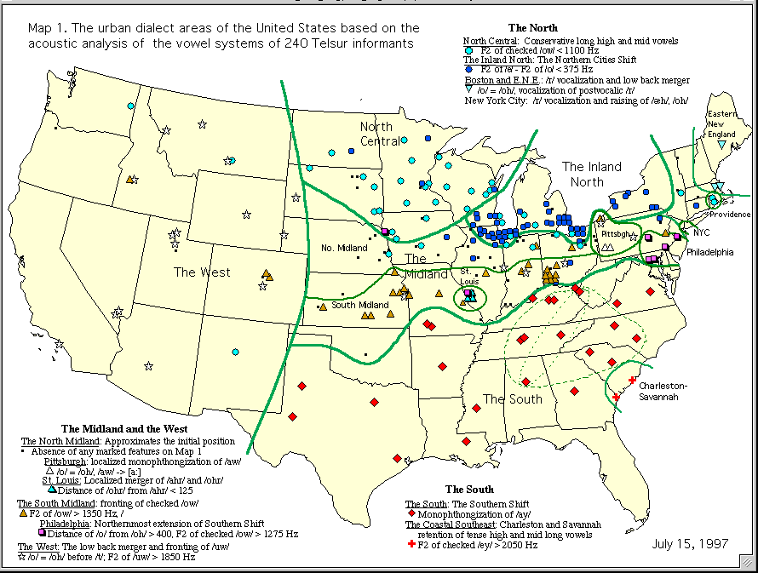
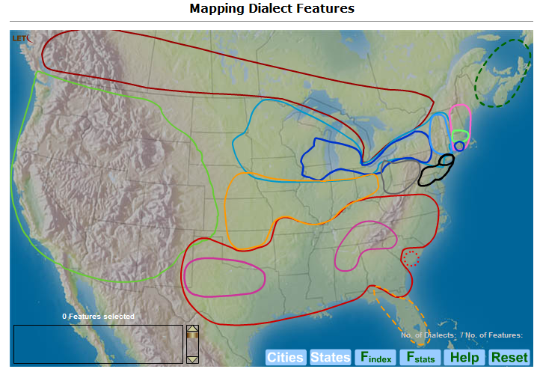
Recent work on American dialects
Sources (2-2-2006): http://www.ling.upenn.edu/phono_atlas/NationalMap/NatMap1.html; http://www.ling.upenn.edu/phono_atlas/ICSLP4.html; http://linguistics.online.uni-marburg.de/free/mouton/free/courses/atlas_of_nae/atlas_main.html

Slide 32
“Ebonics”
Also known as “Black English Vernacular” & “African-American Vernacular English”
The Idea
Students and teachers need to understand each other.
Some African-American children’s English is so different from standard English they cannot be understood by their teachers.
Schools often treat such children as sloppy, wrong or stupid.
Schools should help children to learn standard English by building on the language they already have, and treat that language as distinct and worthy, not “wrong.”
The Controversy begins (from the Oakland California School District)
“African people possess and utilize a language described as “Ebonics” … studies have … demonstrated that African Language Systems are genetically-based and not a dialect of English …” (December 18, 1996)
The Controversy ends
“African-American students as a part of their culture and history as African people possess and utilize a language described in various scholarly approaches as “Ebonics” … these studies have … demonstrated that African Language Systems have origins in West [African] and Niger-Congo languages …” (January 15, 1997)

Slide 33
Official English? No, but …
‘English Language Empowerment Act of 1996’.
The Congress finds and declares the following:
(1) The United States is comprised of individuals and groups from diverse ethnic, cultural and linguistic backgrounds.
(3) Throughout the history of the United States, the common thread binding individuals of differing backgrounds has been a common language.
(4) In order to preserve unity in diversity, and to prevent division along linguistic lines, the Federal Government should maintain a language common to all people.
(9) English should be recognized in law as the language of official business of the Federal Government.
Excerpts from HR 123, July 30, 1996 (Available http://ftp.loc.gov/pub/thomas/c104/h123.rh.txt)

Slide 34
… 2007 …
‘National Language Act of 2007’.
English shall be the official language of the Government of the United States.
The Government of the United States shall preserve and enhance the role of English ... no person has a right, entitlement, or claim to services, or ... materials in any language other than English.
This ... does not apply to the use of a language other than English
(1) for religious purposes;
(2) for training in foreign languages for international communication;
(3) to programs in schools designed to encourage students to learn foreign languages.
This ... does not prevent the Government ... from providing interpreters for persons over 62 years of age.
BILINGUAL ELECTION REQUIREMENTS ... [are] repealed.
Excerpts from HR 769, January 31, 2007 (Available http://thomas.loc.gov/cgi-bin/query/z?c110:H.R.769:)

Slide 35
… 2009
English Language Unity Act of 2009
Section 2
(1) The United States is comprised of individuals from diverse ethnic, cultural, and linguistic backgrounds, and continues to benefit from this rich diversity.
(2) Throughout the history of the United States, the common thread binding individuals of differing backgrounds has been the English language.
(3) Among the powers reserved to the States respectively is the power to establish the English language as the official language of the respective States, and otherwise to promote the English language within the respective States, subject to the prohibitions enumerated in the Constitution of the United States and in laws of the respective States.
Section 3 [Amending Title 4, USC]
Representatives of the Federal Government shall have an affirmative obligation to preserve and enhance the role of English as the official language of the Federal Government.
Official Functions- The official functions of the Government of the United States shall be conducted in English.
Excerpts from HR 997, February 11, 2009 (Available http://thomas.loc.gov/cgi-bin/query/z?c111:H.R.997.IH:)

Slide 36
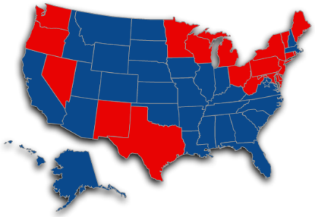
Official English laws in the US
As of today, 28 (?) US States have some kind of “official English” law.
The impact and scope of the laws vary – from being little more than a simple statement (as in Illinois: “The official language of the State of Illinois is English”), to forbidding any activity by State or local governments from doing anything which could be considered “supporting” the use of any language other than English.
Two States – Hawaii and Louisiana – have a language in addition to English as official (Hawaiian & French, respectively).
Fours states -- New Mexico, Oregon, Rhode Island, and Washington – have passed “English Plus” ordinances.
Oregon, for example, says that “we wish to protect and promote the multilingual nature of communication that currently exists in Oregon and to build trust and understanding.”
Sources: http://www.proenglish.org/official-english/state-profiles; http://www.languagepolicy.net/archives/or-ep.htm

Slide 37
California’s Proposition 63 (1986)
This section is intended to preserve, protect and strengthen the English language, and not to supersede any of the rights guaranteed to the people of this Constitution.
English is the official language of the State of California.
The Legislature and officials of the State of California shall take all steps necessary to insure that the role of English as the common language of the State of California is preserved and enhanced. The Legislature shall make no law which diminishes or ignores the role of English as the common language of the State of California.
Any person who is a resident of or doing business in the State of California shall have standing to sue the State of California to enforce this action, and the Courts of record of the State of California shall have jurisdiction to hear cases brought to enforce this section.
Excerpts from California Constitution, Article III, Section 6: http://www.leginfo.ca.gov/.const/.article_3

Slide 38
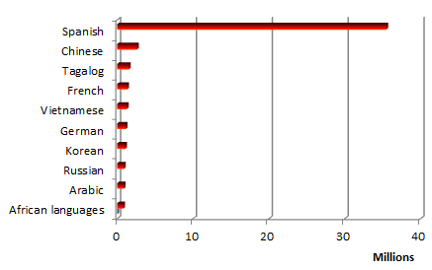
Top 20 US Languages (after English, 2009)
US population 5 years and older: 285,797,349
English only spoken at home: 228,699,523
Other language spoken at home: 57,097,826
Spanish 35,468,501
Chinese* 2,600,150
Tagalog 1,513,734
French 1,305,503
Vietnamese 1,251,468
German 1,109,216
Korean 1,039,021
Russian 881,723
Arabic 845,396
African* 777,553
Navajo is the Native American language with the largest number of speakers in the US today – 169,009.
Connect to the MLAs interactive Map of Languages in the United States
Data source: http://www.census.gov/hhes/socdemo/language/data/acs/Ortman_Shin_ASA2011_paper.pdf

Slide 39
The urge to understand
Mixing languages : Languages that are in contact often begin to blend together (pidgins, creoles, “Franglais,” “Spanglish,” etc.).
Lingua franca: A major language used over a large area for commerce and diplomacy (Latin, English, etc.).
Multilingualism: Knowing and using more than one language.
Artificial languages: A constructed language which is supposed to be logical, practical and easy to learn (Esperanto, etc.).
Translation and interpretation:
Translation: Words and concepts expressed in one language are rendered more-or-less faithfully in another.
Interpretation: A less literal translation, emphasizing overall meaning.

Slide 40
Mixing languages
Languages that come in contact always mix and borrow from each other.
Examples:
SPANGLISH
Dolores dice: Need advice? Escríbeme. (on home page for the magazine Latina)
Tengo que ir al bus stop para pick up mi hija. (Overheard in the Western US)
Haz clic aquí. (Commonly seen on Spanish-language Web sites)
Llamenos para delivery. (Seen on advertising signs in Peru)
Tips para marketing. (Advertisement in Mexico)
JAPLISH (or ENGRISH)
BRANDO NEW! (Brochure rack in Shiga)
NOTICE: We have touched at point in under the boxes heads, for keeping qualities. It's very excuse. (notice above the door of a Yutaka drugstore)
Welcome to Mother Nature! In here,everyone are heroes. Let's play your YOUR drama. (advertisement for a camping mattress).
Sources: http://spanish.about.com/library/weekly/aa042301a.htm;
http://www.tanuki.org.uk/japlish.html

Slide 41
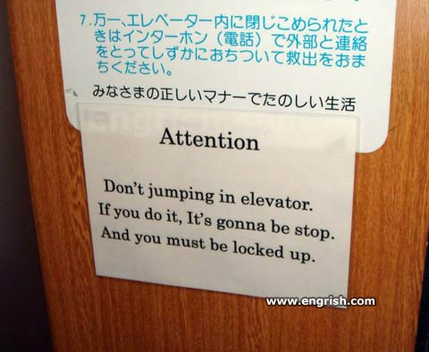
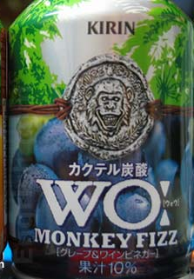
Images source: http://www.engrish.com/

Slide 42
Pidgins and creoles
Pidgin: A system of communication developed among people who do not share a common language but need to talk for trading or other reasons.
Pidgins usually have:
Limited vocabulary
Simplified grammatical structure
Narrow range of functions, expressions
Short useful lifespan
“Nobody’s native language”
Creole: A language created by blending elements of two or more other languages; “a pidgin which has become a native language.”

Slide 43
A Comparison: standard and creole
English
Friends, Romans, countrymen, lend me your ears; I come to bury Caesar, not to praise him. The evil that men do lives after them; the good is oft interred with their bones; so let it be with Caesar. The noble Brutus hath told you Caesar was ambitious. If it were so, it was a grievous fault; and grievously hath Caesar answer’d it. Here, under leave of Brutus and the rest — for Brutus is an honorable man; so are they all honorable men — come I to speak in Caesar’s funeral.
Tok Pisin
Pren, man bolong Rom, wantok, harim nau. Mi kam tasol long plantim Caesar. Mi noken beiten longen. Sopos sampela wok bolong wompela man i stret; sampela i no stret; na man i dai; of i wailis long wok i no stret tasol. Gutpela wok bolong i slip; i lus nating long giraun wantaim long Kalopa. Fesin bolong yumi man. Maski Caesar tu, gutpela wok i slip. Brutus ia tokim yu long Caesar i mangal. Sopos, olosem, bikpela pekato tru. Tasol Caesar Kalopa bekim pinis long virua belongen. Tru, Brutus, na ol pren bolongen, gutpela man. I orait. Ol i gipimmi orait long mi toktok sore hia long Caesar.

Slide 44
Lingua franca
A “lingua franca” (either from “language of the Franks” or from “free language”) is any widely-used language used for commerce, diplomacy, science and technology.
Lingua francas are often second languages, and may be a mixture of several languages.
Historically, a number of languages have served as lingua franca:
Koine Greek (ancient Eastern Mediterranean)
Swahili (Eastern Africa)
French (international diplomacy)
English (science, commerce, travel)

Slide 45
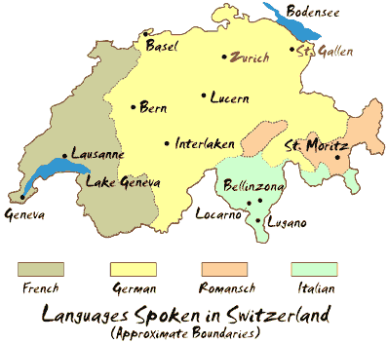
Multilingualism
Most of the world’s population is at least somewhat multilingual – that is, most people have at least some knowledge of more than one language.
Some nations are officially multilingual:
Paraguay (Spanish, Guarani)
Switzerland (German, French, Italian, Romansch)
South Africa (IsiZulu, IsiXhosa, Afrikaans, Sepedi, English, Setswana, Sesotho, Xitsonga, siSwati, Tshivenda, and isiNdebele.)
India (Hindi, Bengali, Telugu, Marathi, Tamil, Urdu, Gujarati, Malayalam, Kannada, Oriya, Punjabi, Assamese, Kashmiri, Sindhi, and Sanskrit; also English and Hindustani)
Sources: http://goeurope.about.com/library/bl_switzerland_resources.htm;
http://www.cia.gov/cia/publications/factbook/fields/2098.html

Slide 46
Artificial languages
English
For of the things that humanity possesses in common, nothing is so truly universal and international as science.
Esperanto
Char el la komunaj posedajhoj de la homaro, neniu estas tiel vere ghenerale kaj internacia kiel la sciencio.
Ido
Nam del kozi, quin la homaro posedas komune, nula es tam vere universala ed internaciona kam la ciencio.
Latino Sine Flexione
Nam, de commune possesiones de genere humano, nihil es tam generale et internationale quam scientia.

Slide 47
Incubus – an excerpt from the only full-length movie ever made in Esperanto
Source: http://www.youtube.com/watch?v=xwp6B05JyyI&feature=relmfu

Slide 48
Translation
The problem: It usually isn’t possible to do a simple “word-for-word” translation.
The translator must interpret and take into account context and meaning – which means that this is a subjective art.
Some words or concepts are almost untranslatable:
Saudade (Brazil): the feeling of missing a person who is gone.
Mamihlapinatapei (Tierra del Fuego): a look shared by two people with each wishing that the other will initiate something that both desire but which neither one wants to start.
Some common English words are very difficult to translate – the verb “to be” has no real equivalent in Chinese; “to have” has no real equivalent in Arabic; “trade-off” takes at least a paragraph to explain, etc.

Slide 49
Machine translation (English >> Japanese >> English)
Four score and seven years ago our fathers brought forth on this continent a new nation, conceived in liberty, and dedicated to the proposition that all men are created equal
Devise freely that they are created equal, dedicated to the proposition, 87 years ago, and our ancestors for the score, everyone has created a new nation on this continent.
Translation via Google Translate: http://translate.google.com/

Slide 50
Specialized and restricted languages
Occupational languages (professional jargon, etc.)
Hidden & secret languages (criminal codes, cryptography, cryptolects, etc)
Slang
Primary use of slang is to mark identity (and exclude others).
Other reasons (after Eric Partridge (1894-1979)): Fun; Demonstrate ingenuity; Shock value; Escape clichés; Reduce seriousness.
Cursing and swearing
Primary use is to express frustration and emotion (frequently intended to shock).
Usually refer to sex, excretion and the supernatural.
Frequency varies among languages
Arabic and Turkish are famous for range and imagination.
Swearing is almost absent from Japanese, Inuit (Eskimo).
Euphemism
Literally “good speech” – substitute terms for things we don’t (or can’t, or don’t want to) talk about openly.
In general, euphemisms are used to refer the same things we use when we curse – things too awful or too important to talk about directly.

Slide 51
Occupational language: SEASPEAK
Some of the rules of SEASPEAK (used by the Merchant Marine):
Standard phrases; avoid alternatives.
Fixed syntax:
The word “reason” is the only connective allowed.
Days of the week never used, dattes always in fixed format: “Day 04 Month 02.”
Compass bearings always given in 3-digit form: “zero-zero-nine degrees.”
Special marker words indicate message type and responses:
“Question” is always followed by “Answer.”
“Instruction” is always followed by “Instruction-received.”
A sample SEASPEAK conversation (from The Cambridge Encyclopedia of Language):
“Singapore Port Operations. This is Western Sky. Information: My ETA position: East Johore pilot station is time: one-three-four-five UTC. Over.”
“Western Sky. This is Singapore Port Operations. Mistake. Time is: one-four-three-zero UTC now. Over.”
Singapore Port Operations. This is Western Sky. Correction. My ETA is one-five-four-five UTC. Over.”

Slide 52
1337 5p34(h
1337 (0r "31337") 5p34(h pr08481y d4735 84(k 70 teh 19805 0r 34r1y 19905. !7 d3v310p3d 45 4 k!nd 0f "!n 9r0up" 514n9 4m0n9 h4(k3r5 4nd 94m3r5.
(0mm0n phr4535
"WHeRE @Re J00" (0r "Wh3re aer j00?")
"wH4+'S j00R nAME"
"1 4t3 j00r r4m3n n00d135"
"j00 suX0rz!" (0r "j00 i5 t3h sux0rz")
"PH34R MEH!!!"
"ph33r teh 1337 h4x0r5"
"n00b" (0r "noob" 0r "nubcake" 0r "nubcaek")
Adapted from : http://en.wikipedia.org/wiki/Leet;
see also the 1337 Converter from http://molotov.b0x.com

Slide 53
Cursing and swearing: a classic examples
“… [thou art] a knave, a rascal, an eater of broken meats; a base, proud, shallow, beggarly, three-suited, hundred-pound, filthy, worsted-stocking knave; a lily-livered, action-taking knave; a whoreson, glass-gazing, super-serviceable finical rogue; a one-trunk inheriting slave; one that wouldst be a bawd in way of good service, and art nothing but the composition of a knave, beggar, coward, pandar, and the son and heir of a mongrel bitch; one whom I will beat into clamorous whining if thou deniest the least syllable of thy addition.” William Shakespeare, (c. 1608) King Lear (Act 2, scene 2)

Slide 54
Euphemism
The use of euphemisms (“good speech”) is ancient - the ancient Greeks called the Furies, their spirits of vengeance, “the kindly ones”; Eric the Red called the land he discovered (which is about ²/₃ glacier-covered) “Greenland.”
There are two basic categories of euphemism:
Positive euphemisms: make the euphemized subject seem bigger or more important (such as job titles like "chief senior personal assistant" instead of “clerk.").
Negative euphemisms: make the euphemized subject seem less important or dangerous (such as "the facility experienced a transient superprompt critical power excursion" instead of "the nuclear reactor started to melt down.")

Slide 55
Making euphemisms
There are several different forms of euphemism:
Foreign words (“schmuck,” “merde,” “triage,” “lingerie”)
Abbreviations (“TB,” “SOB,” “BS,” “CYA,” even “the f-word”)
Abstractions (terms “the situation” or “the unfortunate event”)
Indirections (“bite the dust” instead of “died,” “clean up” instead of “destroy evidence,” “separate but equal” instead of “racist”)
Understatements (“collateral damage,” “friendly fire,” “ethnic cleansing,” “final solution,” “non-operative personnel”)
Lengthening (“post traumatic stress disorder” instead of “shell shock”; “normal involuntary attrition” instead of “fired”)
(Much of the above after Hugh Rawson's A Dictionary of Euphemisms and Other Doubletalk, New York: Crown 1981);
See also http://www.cracked.com/article_16884_p2.html.

Slide 56
Preserving language diversity
Languages can die. Today, in the face of the global dominance of English and other “world languages,” some people are trying to preserve and even revive languages.
Maintaining survivors: Celtic languages (Scottish Gaelic, Irish Gaelic, Welsh (Cymru), Breton.
Bringing back the dead: Hebrew.
Why bother? Because language is about more than just “communicating facts.” Language is about identity, history, continuity – language is a fundamental part of who you are.

Slide 57
The dying …
US Languages with fewer than 100 speakers today
Achumawi
Ahtena.
Kiowa.
Lipan.
Arikara.
Atsugewi.
Caddo.
Cahuilla.
Chetco.
Chinook.
Clallam.
Coeur d'Alene.
Coos.
Degexit'an.
Eyak.
Gros Ventre.
Haida.
Han.
Holikachuk.
Hupa.
Kalapuya.
Kansa.
Karok.
Kashaya.
Kawaiisu.
Klamath.
Kuskokwim.
Kutenai.
Luiseño.
Lushootsed.
Maidu.
Mandan.
Menominee.
Miwok.
Mono.
Nisenan.
Osage.
Panamint.
Pawnee.
Pomo.
Quapaw.
Quileute.
Salish.
Serrano.
Snohomish.
Tanacross.
Tanaina.
Tanana.
Tolowa.
Tübatulabal.
Tuscarora.
Tututni.
Wasco-Wishram.
Washo.
Wichita.
Wintu.
Yokuts.
Yuchi.
Yurok.
Sources: http://news.bbc.co.uk/2/hi/americas/7206411.stm; http://www.ethnologue.com/nearly_extinct.asp#Americas

Slide 58
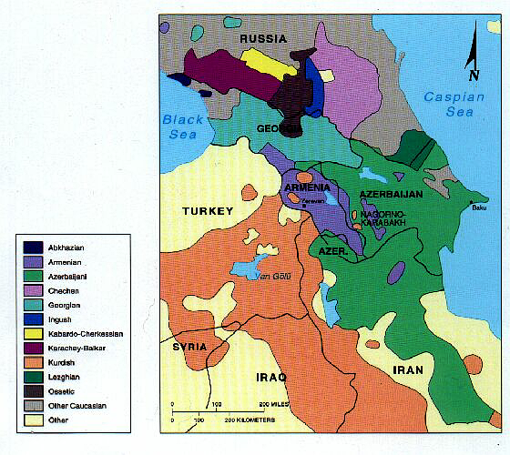
Linguistic refuge areas
Languages and dialects survive in some areas because they are isolated and protected by inhospitable terrain.
Example: Cajun, a form of French which survives in Louisiana’s bayou country.
Example: Abaza, Avar, Bats, Chechen, and perhaps 36 other languages that survive in the Caucasus Mountains between the Black and Caspian Seas.
The Caucasian patchwork

Slide 59
Language and the physical environment
Some languages have developed extensive vocabularies that let them easily and concisely describe certain kinds of terrain.
Selected Spanish Words for Hills and Mountains
Peña (needle-like peak)
Candelas (collection of peñas)
Cejita (low escarpment)
Cordillera (rope; mass of mountains)
Mesa (table; flat-topped eminence)
Selected English Words for Rivers and Streams
Branch (stream that flows into another stream)
Creek (small stream)
Fork (confluence of streams)
Prong (small fork)
Slough (swamp, river inlet)

Slide 60
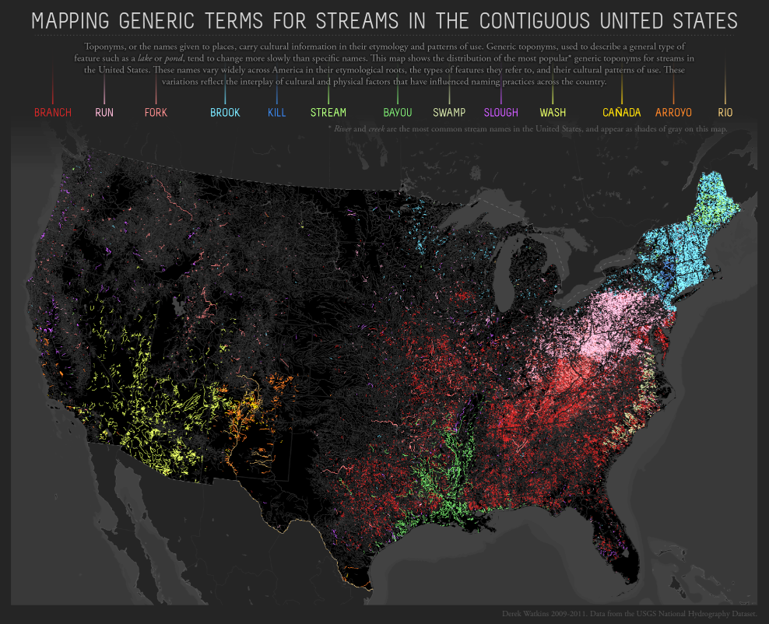
Language and the physical environment: US streams
Source: http://derekwatkins.files.wordpress.com/2011/07/dwatkins_usstreamnames.png

Slide 61
Language and the physical environment: colors!
Some languages have words for colors that can’t be described concisely in English — and English has words for colors that can’t be easily described in other languages.
Latin - Originally had no words for gray or brown (borrowed from Germanic)
Navajo - The same word - dootl'izh - can mean blue or green
Japanese - The word awo can mean green, blue or pale depending on context
Welsh - The word gwyrdd means some (but not all) shades of green - The word glas means some (but not all) shades of green, blue and gray - - The word llwyd means some (but not all) shades of gray and brown
Papuan - Some languages in the highlands of New Guinea have only two color words, black and white (or perhaps dark and light)

Slide 62
Color & language: a universal scheme?
About 10% of males and perhaps 1% of females suffer some form of color blindness. Everyone else sees colors. But are they the same colors?
In 1969 Brent Berlin and Paul Kay published Basic Color Terms: Their Universality and Evolution. They argued that there is a “universal inventory” of color terminology, and that it is possible to express the linguistic relationships among languages using a simple scheme:
According to this scheme, all languages have at least two, and no more than 12, “basic” color terms – terms that aren’t modified, are common, and are generally agreed on by speakers of the language.
English has 11 terms; some languages (Russian, Italian) have 12.

Slide 63
Language and culture: toponyms
Toponyms (or places names) tell us about history and the movements peoples and cultures.
All inhabited places have names.
Toponyms often have a structure: generic + specific (Cape Town, Oklahoma City, etc.).
Types of toponyms:
Commemorative (explorers; famous people; other places).
Natural features (Colorado, Florida, Long Beach).
Special Sites (military; religious; historical).
Other:
Animals & Plants (Chicken AK, Redwood City CA).
Inherited (Minnetonka MN, Mojave CA).
Humor (Truth or Consequences NM, No-Name Island AK).
Miscellaneous and uncertain (Oregon, Rhode Island).

Slide 64
Language and culture: change and stability
Change: technology and new ways of living
Changes in technology require a new vocabulary
Changes in ways of living require a new vocabulary
Stability: institutions
Education
Law
Religion
Financial Advantage
Status

Slide 65
Technospeak? Imagine a confused 18th century time traveler…
“The commute was a nightmare – some leadfoot in an SUV was on his cell and got into a fender-bender with an old bug. I ended up in the breakdown lane. Complete gridlock until the CHP called in a tow.”

Slide 66
Writing
Earliest use of symbol tokens c. 10,000 years ago.
From The Columbia Encyclopedia of Language (1987), p. 196.
This is the earliest example of writing ever found. It was discovered at a site called Harappa on the Indus River in Pakistan. It has been dated to 5,500 years ago. It is believed that the symbols may indicate what this pottery originally contained, but the Harappan language died out about 4,000 years ago.
Available (5/4/99) http://news.bbc.co.uk/hi/english/sci/tech/newsid_334000/334517.stm

Slide 67
Ways of writing
Logograms
Pictograms
Earliest system of writing
Begin as simple pictures of things (but this quickly becomes unsatisfactory)
Example: Earliest Egyptian hieroglyphs
Ideograms
Abstract or conventional meanings, often combining two or more pictograms
No longer have a clear pictorial link
Often "impure," with clues to pronunciation
Examples: Late Egyptian hieroglyphs, Chinese?
Syllabaries
Each symbol corresponds to a spoken syllable (usually consonant + vowel)
Examples: Japanese Katakana, Cherokee
Alphabets
A small number of arbitrary symbols represent all sounds
All alphabets appear to be descendants of the first Phoenician (Semitic)
Many consist of consonants only, vowels understood in context

Slide 68
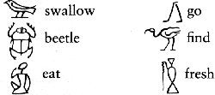
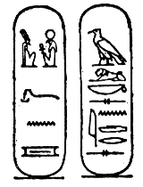
Pictograms and ideograms
The hieroglyphs ("sacred carvings") to the left are true pictograms. Each symbol has a fixed meaning, and that meaning is implicit in the symbol.
This is the late Egyptian hieroglyph for "Alexander the Great" (Royal Name on the left, personal name on the right). These are considered ideograms, not pictograms, since each symbol has a conventional meaning that is not implicit and usually has a sound associated with it.
From The Cambridge Encyclopedia of Language (1987), p. 199

Slide 69
Syllabary: Katakana
In a syllabary there is an arbitrary symbol for each sound in the language.
The Japanese katakana syllabary is made up of 75 symbols, three of which can be used to make 36 more symbols.
Katakana are primarily used to write foreign words.
From The Cambridge Encyclopedia of Language (1987), p. 201

Slide 70
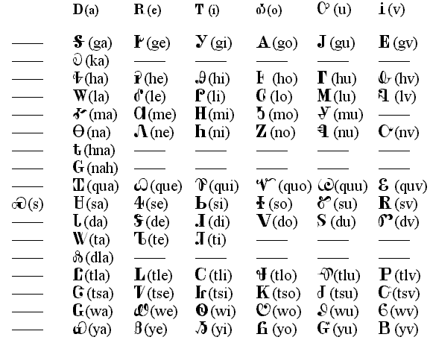
Syllabary: Cherokee
This syllabary was developed about 1821 by Sequoya (c. 1770-1843), the great Cherokee leader.
Its 85 symbols were obviously influenced by European alphabets, but usage is entirely different.
Available (9-25-99): http://joyce.eng.yale.edu/~joant/Cherokee.html

Slide 71
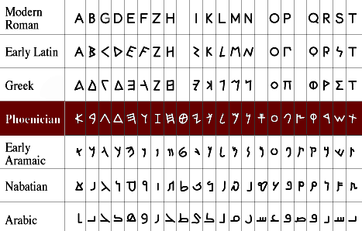
From Phoenician to modern alphabets
Available (2-15-04): http://phoenicia.org/imgs/evolchar.gif

Slide 72
Fonts

Slide 73
Direction
There is no particular reason for us to read or write in any one direction.
Some languages, such as English, are written left-to-right.
(Arabic as such) right-to-left written are Some.
Traditional Japanese and Mongolian were written
top-to-bottom.
bottom-up. written were Greek of forms Some
And one of the earliest ways of
boustrophedon called is writing
("as the ox plows") in which
then and direction one in read you
in the opposite direction...

Slide 74
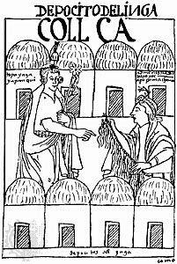
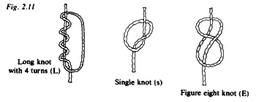
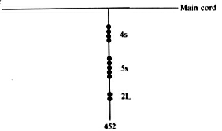
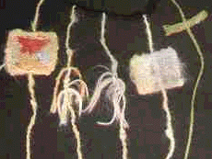
Non-written “writing”: the quipu
The Incas used quipu to keep complex records.
Specially trained “rememberers” could interpret the complex series of knots and colored strings.

