Slide 1
Ethnicity

Slide 2
Terms
Ethnic: from the Greek ethnikos, or “national.”
Ethnicity:
“identity with a group of people who share the cultural traditions of a particular homeland or hearth.”
Race:
“identity with a group of people who share a biological ancestor.”

Slide 3
No Single Defining Trait
No single trait always defines a person’s ethnicity.
Ethnicity can be based on any trait or combination of traits, including:
Language (Quebec, Belgium)
Religion (Northern Ireland)
National Origin (Italian-Americans, etc.)
Regional Origin (territorial isolation, e.g. Appalachian “hillbillies,” Texans, etc.)
Race

Slide 4
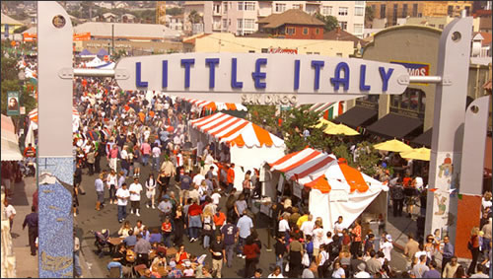
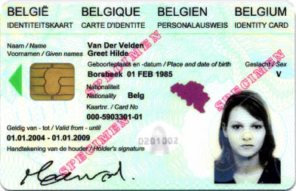
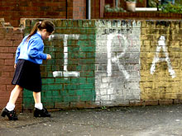
Defining Ethnicity?
Sources: http://en.wikipedia.org/wiki/Belgian_national_identity_card; http://www.sandiegomagazine.com/Blogs/Out-in-San-Diego/Winter-Spring-2010/Gay-Out-of-the-Gayborhood-I-Heart-Little-Italy/; http://www.cbc.ca/news/background/northernireland/timeline.html; http://www.hillbillycycle.com/aboutus.htm

Slide 5
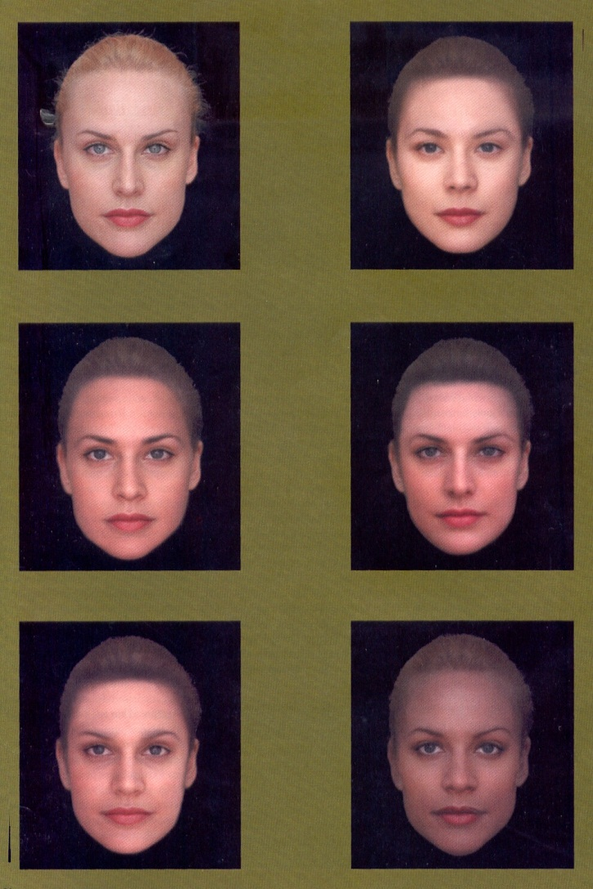
Race: Reality?
Research into genetic diseases has shown that “race” is not a very good predictor of who is and who isn’t going to get various genetic diseases (e.g. cystic fibrosis, Tay-Sachs, etc.).
Since the human genome has been sequenced, we know that skin color, eye color, etc. aren’t very good at predicting what our genetic heritage really is.
For example, in America,
African-American’s West African genetic heritage varies from 20% to 100%.
30% of Americans who consider themselves “white” have less than 90% European ancestry.
Data & illustration from Bamshad, MJ and Olson, SE. 2003. Does race exist? Scientific American 289:6 78-85.

Slide 6
Race vs. Ethnicity
A person's race may not be the same as a person's ethnicity.
In the US the concepts of race and ethnicity are often confused – sometimes by law!
"Asian" is recognized by the US Census Bureau as a race (so that people from Pakistan, China, or Japan will all be classified as the same "race").
"African-American" is recognized as a race, but it is not necessarily the same as "black." There are many "Blacks" who trace their cultural heritage – and their ethnicity – to countries in the Caribbean or Latin America.
"Hispanic" (Latino) is considered an ethnicity, not a race. Hispanics may therefore be of any race.

Slide 7
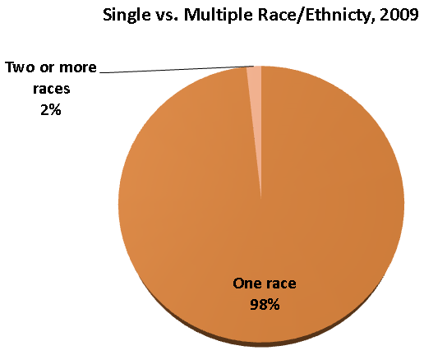
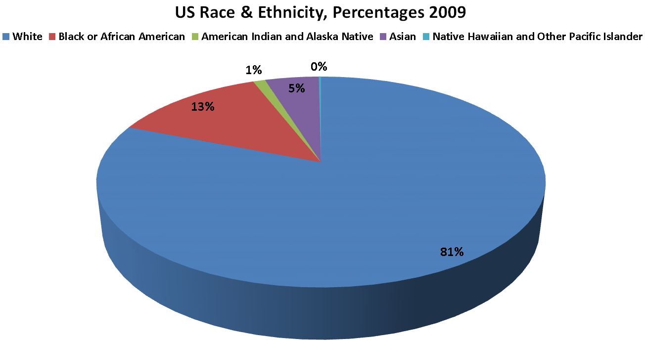
US Race and Ethnicity Today
Source: http://www.census.gov/compendia/statab/2012/tables/12s0012.pdf

Slide 8
Race, Racism & Prejudice
Racism: “the belief that race is the primary determinant of human traits and capacities and that biological differences produce an inherent superiority of a particular race."
Racist: "a person who subscribes to the beliefs of racism."
Prejudice: a preformed, unsupported judgment or opinion about a person or a group of people, based on stereotypes.

Slide 9
Hate Crimes in the US
Also known as “bias motivated crimes.”
The Federal Government does not classify “hate crimes.”
State and local authorities collect and classify data, and send it to the FBI.
Standards vary from place to place, so national statistics are questionable.
Despite these problems, we can say that there are thousands of hate crimes in the US each year.

Slide 10
US Hate Crimes
Bias Motive | 2000 | 2001 | 2002 | 2003 | 2004 | 2005 | 2006 | 2007 | 2008 | 2009 | 2010
Race | 5,397 | 5,545 | 4,580 | 4,754 | 5,119 | 4,895 | 5,020 | 4,956 | 4,934 | 3,816 | 3,135
Religion | 1,699 | 2,118 | 1,659 | 1,489 | 1,586 | 1,405 | 1,750 | 1,628 | 1,732 | 1,376 | 1,322
Sexual Orientation | 1,558 | 1,664 | 1,513 | 1,479 | 1,482 | 1,213 | 1,472 | 1,512 | 1,706 | 1.436 | 1,277
Ethnicity | 1,216 | 2,634 | 1,409 | 1,326 | 1,254 | 1,228 | 1,305 | 1,347 | 1,226 | 1.050 | 847
Disability | 36 | 37 | 50 | 43 | 73 | 54 | 95 | 84 | 85 | 97 | 43
Single-Bias | 9,906 | 11,998 | 9,211 | 9,091 | 9,514 | 8,795 | 9,642 | 9,527 | 9,683 | 7,785 | 6,624
Multiple-Bias | 18 | 22 | 11 | 9 | 14 | 9 | 10 | 8 | 8 | 4 | 4
Total | 9,924 | 12,020 | 9,222 | 9,100 | 9,528 | 8,804 | 9,652 | 9,535 | 9,691 | 7,789 | 6,628
Please note: The Southern Poverty Law Center has estimated that these figures may be as much as 31 times too low, mostly because of poor reporting.
Sources: http://www.fbi.gov/about-us/investigate/civilrights/hate_crimes; http://www.fbi.gov/about-us/cjis/ucr/hate-crime/2010/tables/table-1-incidents-offenses-victims-and-known-offenders-by-bias-motivation-2010.xls; http://www.splcenter.org/get-informed/intelligence-report/browse-all-issues/2005/winter/hate-crime

Slide 11
Hate Groups
According to a 2008 article in the Washington Post, the number of US hate groups has increased by 48% since 2000.
Hate groups are divided into six basic categories:
Ku Klux Klan
Neo-Nazis
White Nationalists
Racist Skinheads
Neo-Confederates
Black Separatists
See the article for maps: http://www.washingtonpost.com/wp-dyn/content/graphic/2008/03/07/GR2008030702914.html

Slide 12
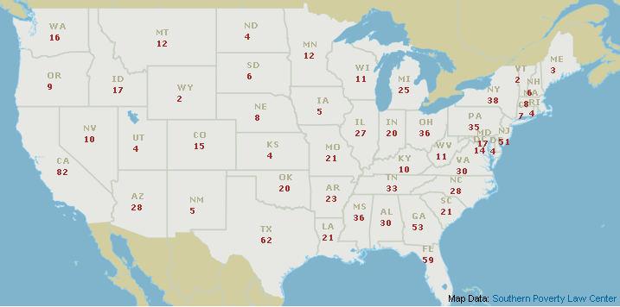
The Hate Map, 2012
This is the most recent “Hate Map” from the Southern Poverty Law Center.
The SPLC defines a “hate group” as a group that has “beliefs or practices that attack or malign an entire class of people, typically for their immutable characteristics.”
As of 2012 the SPLC estimates there are 1,007 active hate groups in the US.
Source: http://www.splcenter.org/get-informed/hate-map

Slide 13
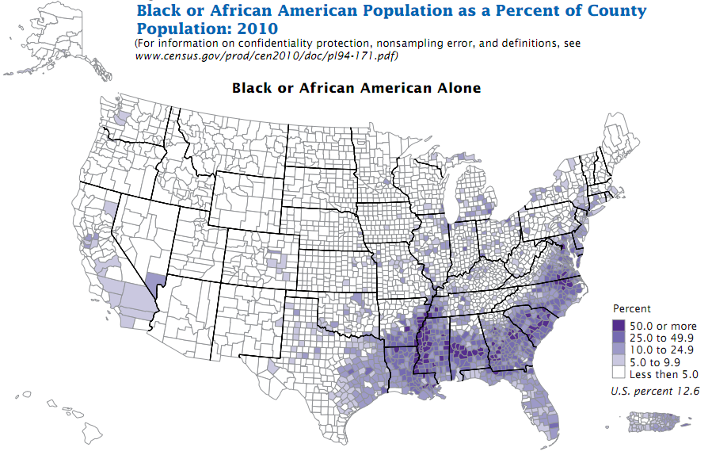
US Ethnicities: Distribution of African-Americans by County, 2010
Source: http://www.census.gov/prod/cen2010/briefs/c2010br-06.pdf

Slide 14
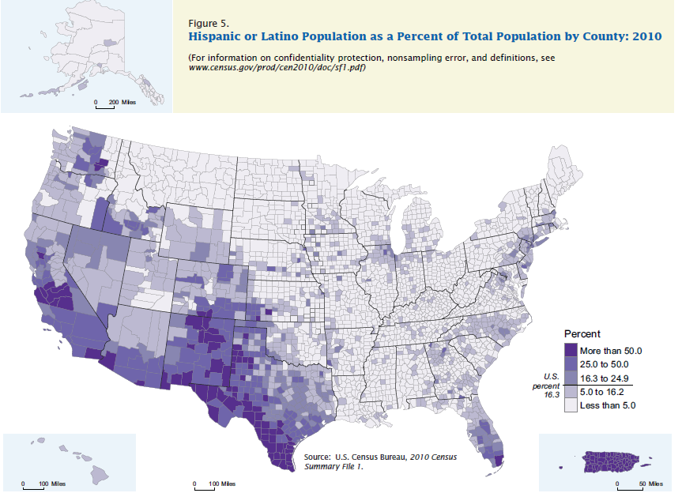
US Ethnicities: Distribution of Latinos by County, 2010
Source: http://www.census.gov/prod/cen2010/briefs/c2010br-04.pdf

Slide 15
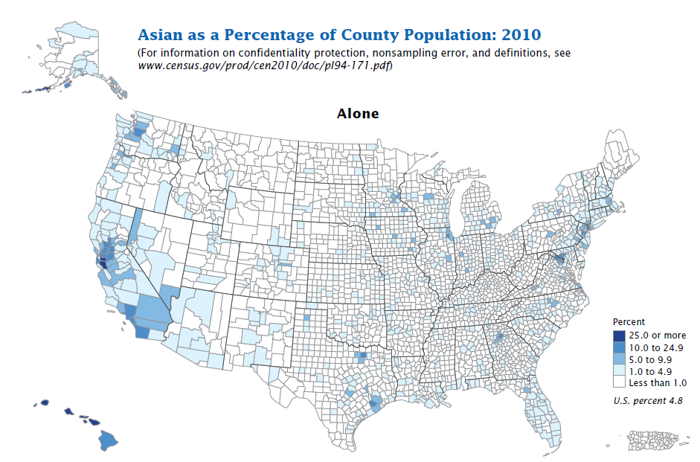
US Ethnicities: Distribution of Asian-Americans by County, 2010
Source: http://www.census.gov/prod/cen2010/briefs/c2010br-11.pdf

Slide 16
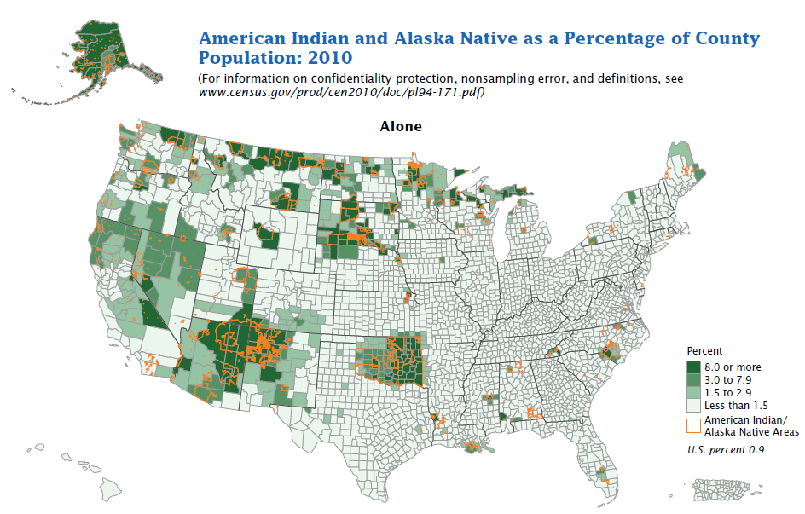
US Ethnicities: Distribution of Native Americans by County, 2010
Source: http://www.census.gov/prod/cen2010/briefs/c2010br-10.pdf

Slide 17
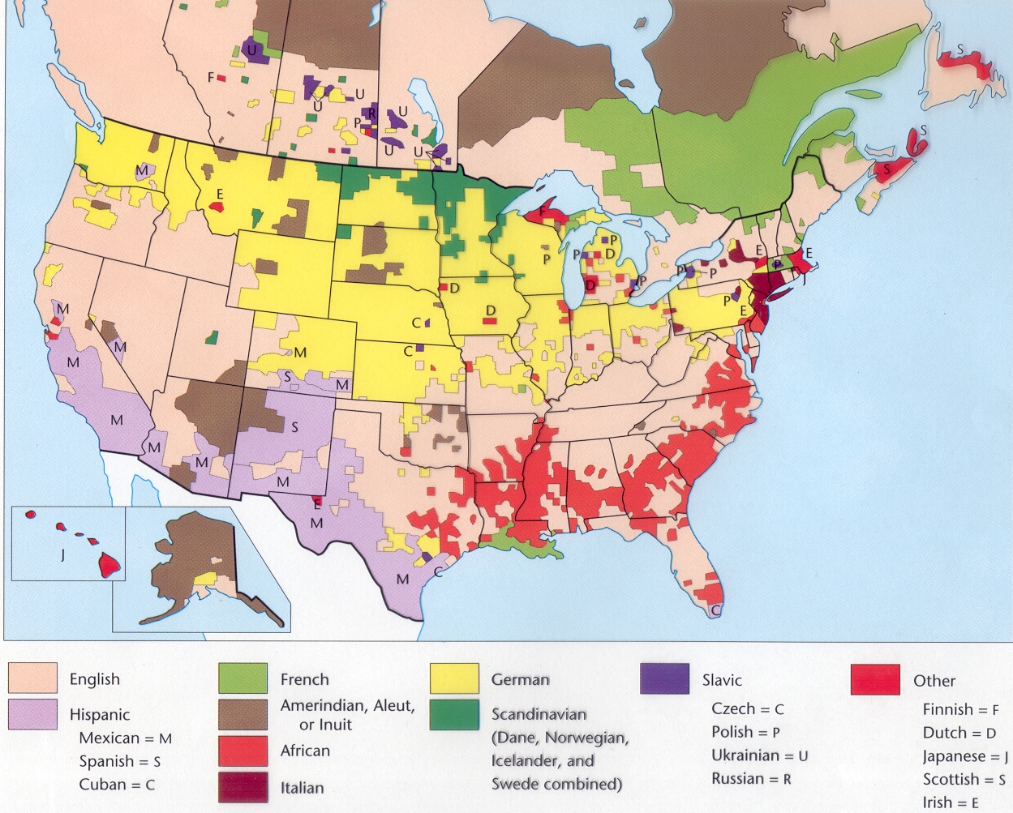
US Ethnicities: Overall Distributions
Until the early 20th century Eastern and Midwestern cities had large populations from Eastern and Southern Europe.
Today most (not all – “Little Italy,” etc.) have moved out of the cities.
Ethnic identity for them is maintained mostly through cultural elements music, religion, food), not location (but there are exceptions).

Slide 18
US Ethnicities: Regional Concentrations
General Patterns:
African-Americans are concentrated in the Southeastern US.
Hispanics are concentrated in the Southwest, and in Florida.
Asians are concentrated in the West.
Native Americans are concentrated in the Southwest and in the Plains States, and in Alaska.
Major cities throughout the US tend to be more ethnically diverse (but not always!)

Slide 19
US Ethnicities: Urban Concentrations
Some ethnicities are highly concentrated in urban areas in some parts of the US (for reasons we'll be getting to in just a moment).
In some States the urban concentration can be extreme:
Detroit is 84% African-American; the rest of Michigan is 6% African American.
Chicago is 39% African-American; the rest of Illinois is 7% African-American.
New York City is 24% Hispanic; the rest of New York State is 4% Hispanic.
Data source: http://www.infoplease.com/ipa/A0884135.html

Slide 20
African-Americans: Urban Areas
US Metropolitan areas with the largest numbers of African-Americans:
New York 2,228,145
Chicago 913,009
Philadelphia 686,870
Detroit 601,988
Houston 514,217
Memphis 414,928
Baltimore 403.998
Los Angeles 402,448
Washington 314,352
Dallas 308,087
Cities (over 100,000) with the highest percentage of African-Americans:
Detroit, MI 84.3%
Jackson, MS 80.1%
Miami Gardens, FL 77.9%
Birmingham, AL 74.0%
Baltimore, MD 65.1%
Memphis, TN 64.1%
New Orleans, LA 61.2%
Flint, MI 59.5%
Montgomery, AL 57.4%
Savannah, GA 56.7%
Data source: http://www.census.gov/prod/cen2010/briefs/c2010br-06.pdf

Slide 21
Latinos: Urban Areas
US Metropolitan areas with the largest numbers of Latinos:
New York 2,336,076
Los Angeles 1,838,822
Houston 919,668
San Antonio 838,952
Chicago 778,862
Phoenix 589,877
El Paso 523,721
Dallas 507,309
San Diego 376,020
San Jose 313,636
Cities (over 100,000) with the highest percentage of Latinos:
E. Los Angeles* 97.1%
Laredo TX 95.6%
Hialeah FL 94.7%
Brownsville TX 93.2%
McAllen TX 84.6%
El Paso TX 80.7%
Santa Ana CA 78.2%
Salinas CA 75.0%
Oxnard CA 73.5%
Downey CA 70.7%
Data source: http://www.census.gov/prod/cen2010/briefs/c2010br-04.pdf

Slide 22
Asian-Americans: Urban Areas
US Metropolitan areas with the largest numbers of Asian-Americans:
New York 1,134,919
Los Angeles 483,585
San Jose 326,627
San Francisco 288,529
San Diego 241,293
Honolulu* 230,071
Chicago 166,770
Houston 139,960
Fremont 116,755
Philadelphia 106,720
Cities (over 100,000) with the highest percentage of Asian-Americans:
Honolulu* 68.2%
Daly City CA 58.4%
Fremont CA 54.5%
Sunnyvale CA 43.7%
Irvine CA 43.3%
Santa Clara CA 40.8%
Garden Grove CA 38.6%
Torrance CA 38.2%
San Francisco 35.8%
San Jose CA 34.5%
Data source: http://www.census.gov/prod/cen2010/briefs/c2010br-11.pdf

Slide 23
Native Americans: Urban Areas
US Metropolitan areas with the largest numbers of Native Americans:
New York 111,749
Los Angeles 54,236
Phoenix 43,724
Oklahoma City 36,752
Anchorage 36,062
Tulsa 35,990
Albuquerque 32,571
Chicago 26,933
Houston 25,521
San Antonio 20,137
Cities (over 100,000) with the highest percentage of Native Americans:
Anchorage 12.4%
Tulsa 9.2%
Norman 8.1%
Oklahoma City 6.3%
Billings 6.0%
Albuquerque 6.0%
Green Bay 5.4%
Tacoma 4.0%
Tempe 3.9%
Tucson 3.8%
Data source: http://www.census.gov/prod/cen2010/briefs/c2010br-10.pdf

Slide 24
Ethnic Neighborhoods
In many US cities there are neighborhoods that are mostly made up of people from one or two ethnic groups.
The composition of these neighborhoods has changed over time:
In the 19th and early 20th Centuries, cities in the American East and Midwest had large ethnic neighborhoods made up of European immigrants.
Today, many of these have changed composition, to being predominantly made up of people from Latin America, Asia, or African-Americans.
Ethnic neighborhoods can form on the basis of affinity and chain migration.
Ethnic neighborhoods can also be made by discrimination.

Slide 25
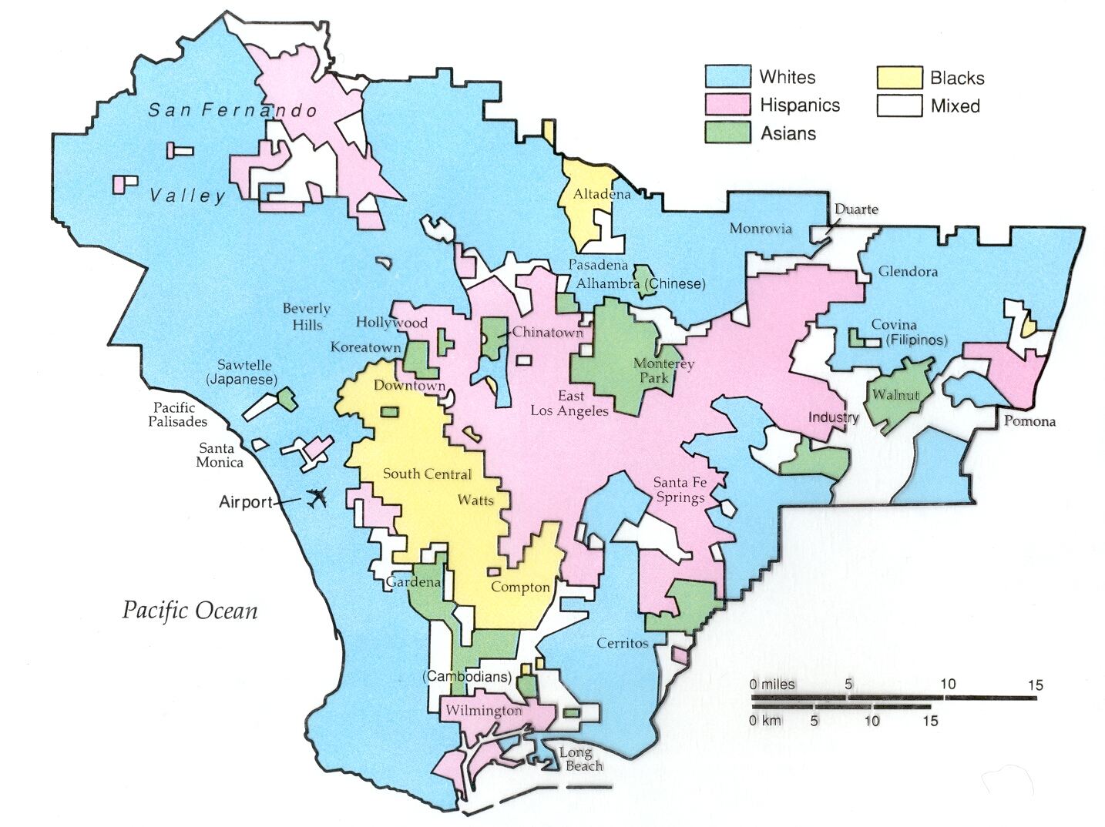
Ethnic Neighborhoods: Los Angeles

Slide 26
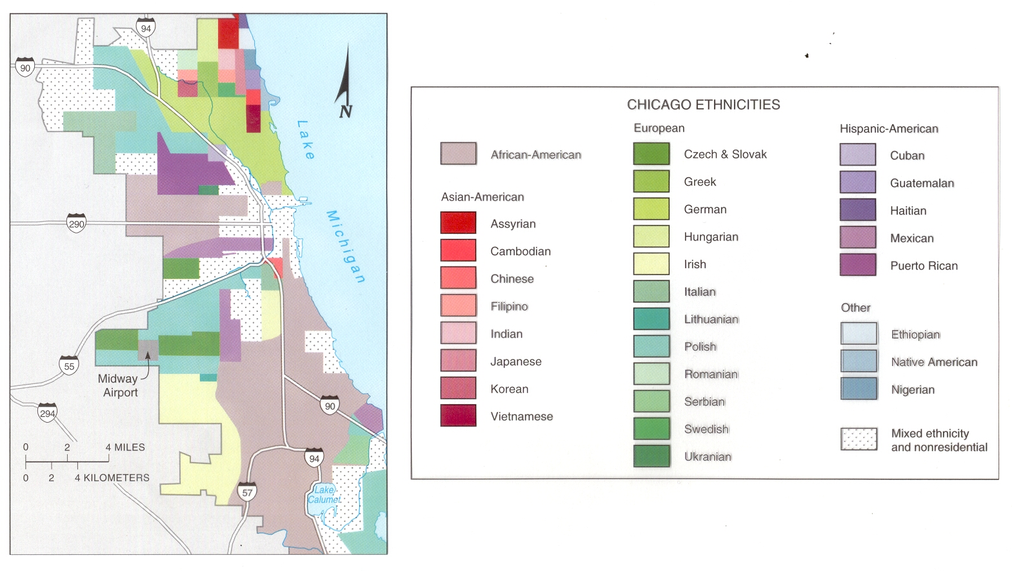
Ethnic Neighborhoods: Chicago

Slide 27
African-Americans
Four major migration flows have shaped the distribution of African-Americans in the US:
Forced migration from Africa (17th to 19th centuries).
Southern rural to Northern urban migration (late 19th and early 20th centuries: “The Great Migration”).
Inner-city to suburban migration (late 20th century).
Northern urban to Southern urban (late 20th and early 21st centuries)

Slide 28
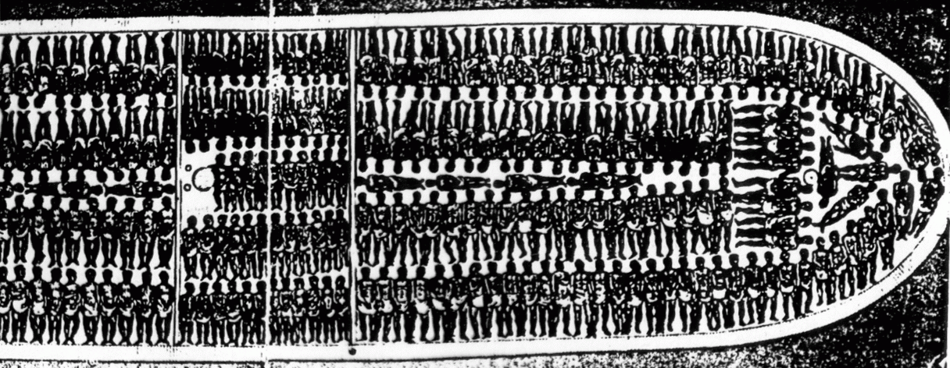
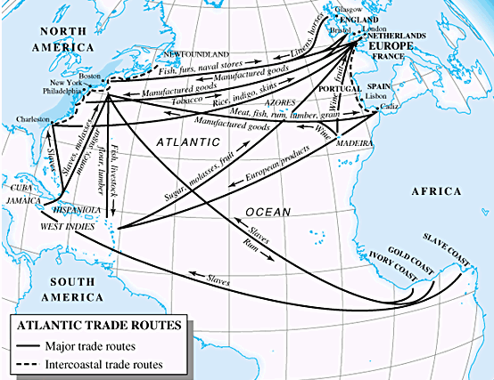
African-Americans: Forced Migration
During the era of the African slave trade, 10-30 million Africans were sold into slavery.
During the 17th, 18th and 19th centuries, between one-half and one million Africans were brought to the British Colonies and US.

Slide 29
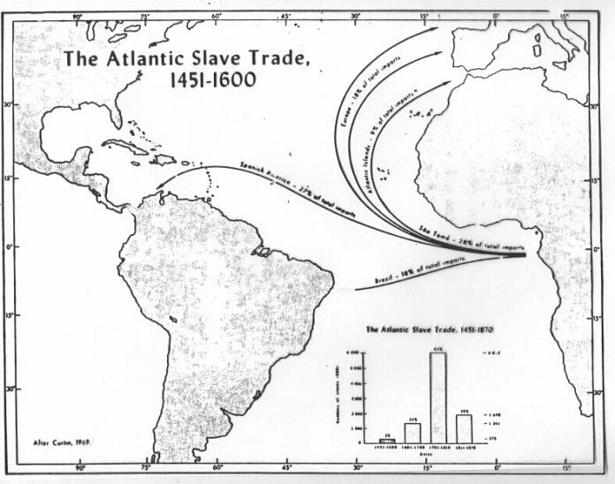
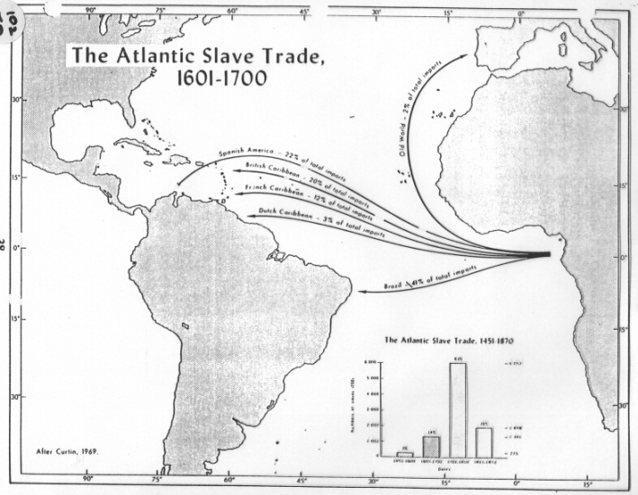
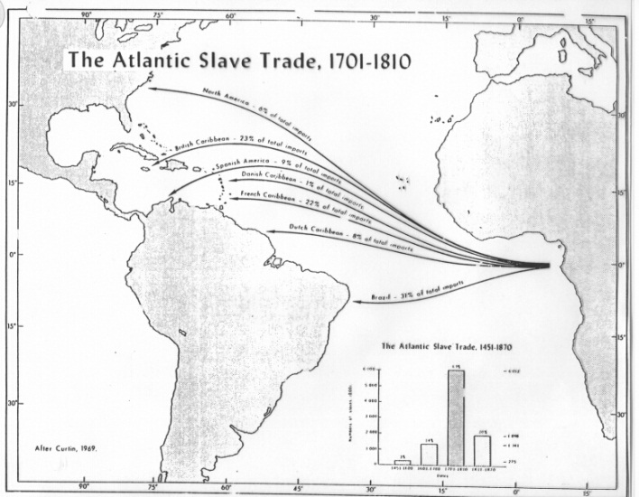
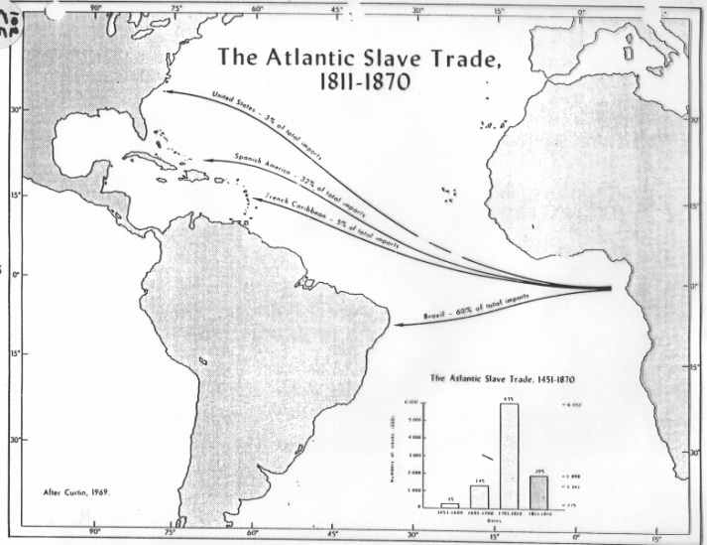
African-Americans: Forced Migration 1451-1870

Slide 30
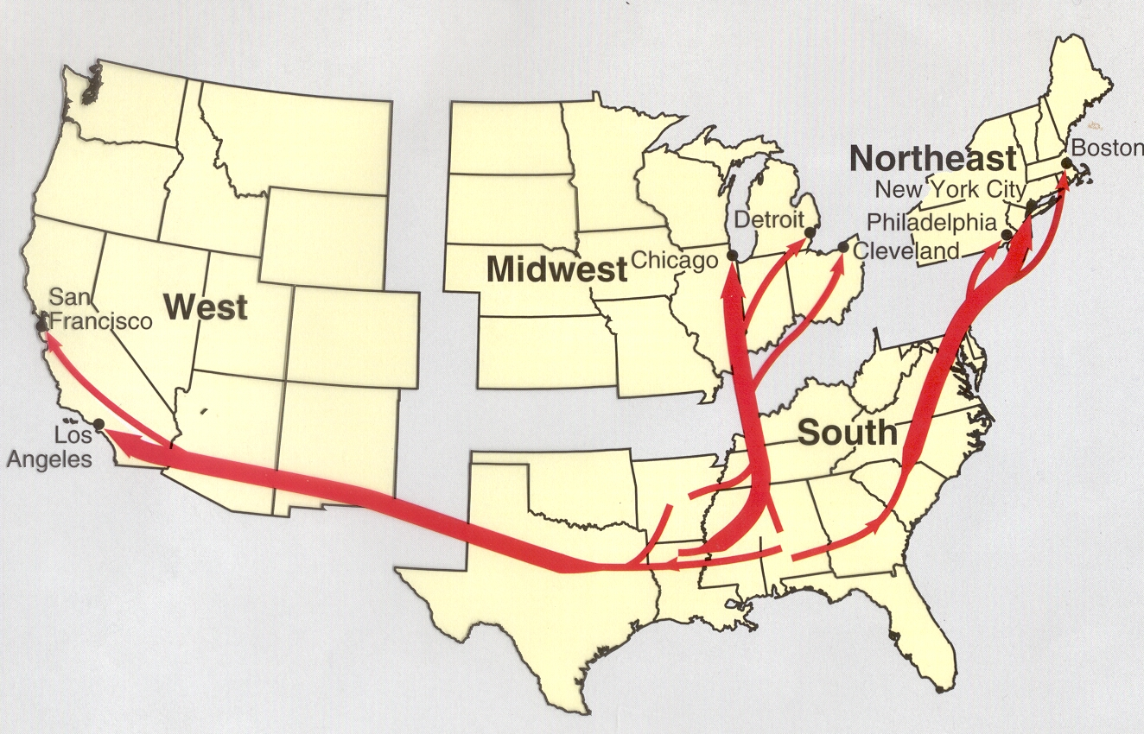
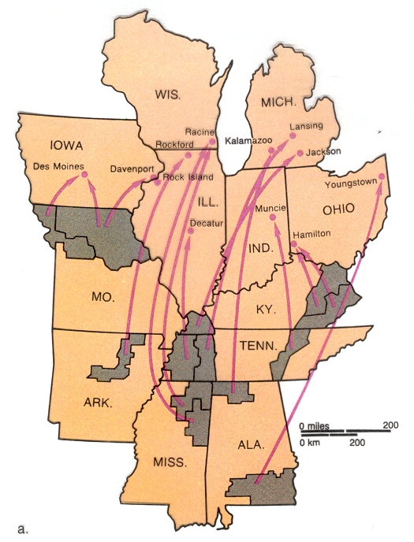
African-Americans: Southern Rural to Northern Migration
Channeled migration flows

Slide 31
African Americans: Legal Status
“Representatives and direct Taxes shall be apportioned among the several States … according to their respective Numbers, which shall be determined by adding to the whole Number of free Persons, including those bound to Service for a Term of Years, and excluding Indians not taxed, three fifths of all other Persons.” US Constitution Article I
“[Persons of color have] no rights which any white man [is] bound to respect … Persons of color, in the judgment of Congress, were not included in the word citizens, and they are described as another and different class of persons…” Scott vs. Sanford, 1857
“… on the 1st day of January, A.D. 1863, all persons held as slaves within any State or designated part of a State the people whereof shall then be in rebellion against the United States shall be then, thenceforward, and forever free…” Emancipation Proclamation 1862
“Every civil officer shall, and every person may, arrest and carry back to his or her legal employer any freedman, free Negro or mulatto who shall have quit the service of his employer …” Mississippi “Black Code,” 1870
“… separate but equal … However apparent the injustice of such legislation may be, we have only to consider whether it is consistent with the constitution of the United States.” Plessy vs. Ferguson 1896
“We conclude that in the field of public education the doctrine of 'separate but equal' has no place. Separate educational facilities are inherently unequal.” Brown vs. Board of Education 1954

Slide 32
Creating Ghettos: Redlining & Blockbusting
Redlining: "drawing lines on a map to identify areas … [where banks, realtors, insurance agents, etc.] will refuse to loan money [or provide other services]."
Blockbusting: "real estate agents convinced white homeowners living near a black area to sell their houses a low prices, preying on their fears that black families would soon move into the neighborhood and cause property values to decline. The agents then sold the houses at much higher prices to black families desperate to escape the overcrowded ghettos."

Slide 33
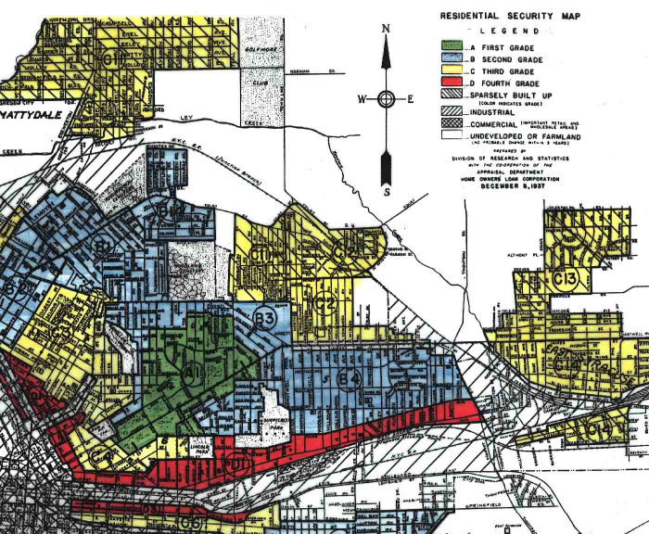
Redlining
From an original 1937 “Home Owners Loan Corporation” map of Syracuse, NY.
Note the area in red, designated “4th Grade,” which had an “undesirable population” and where loans were “not available.”
Source: http://www.syracusethenandnow.net/Redlining/OldRedlining/HOLC_Redline_Maps.htm

Slide 34
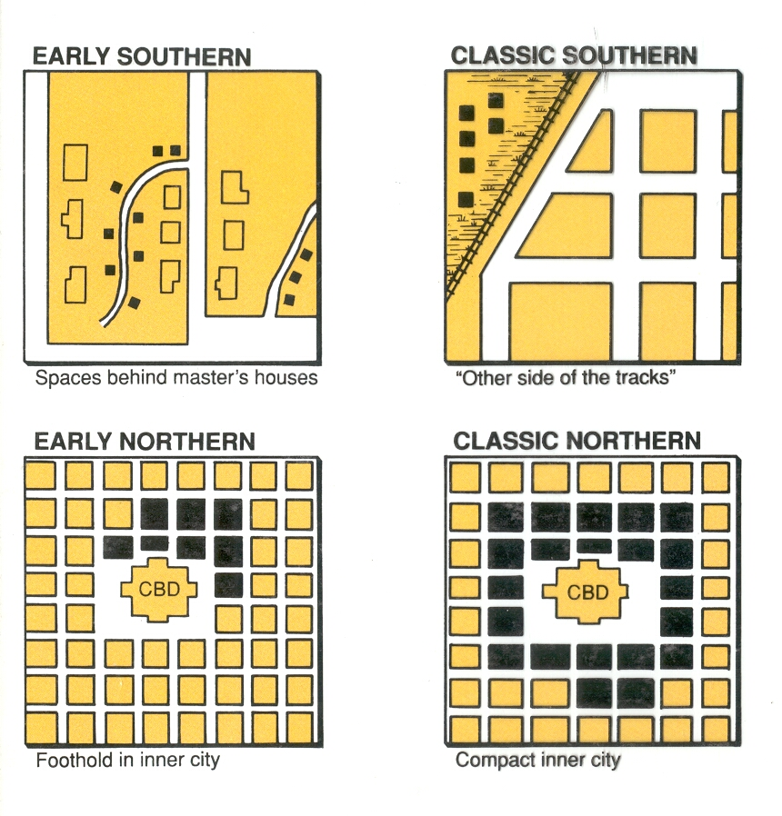
Making Ghettos

Slide 35
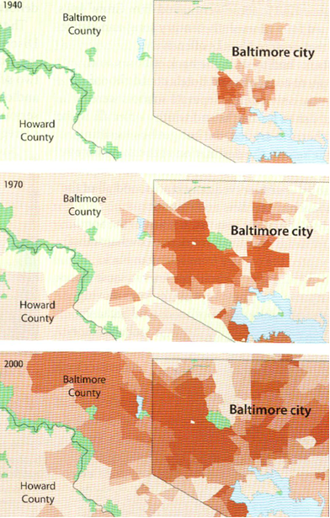
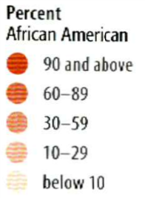
Expanding Ghettos: Baltimore

Slide 36
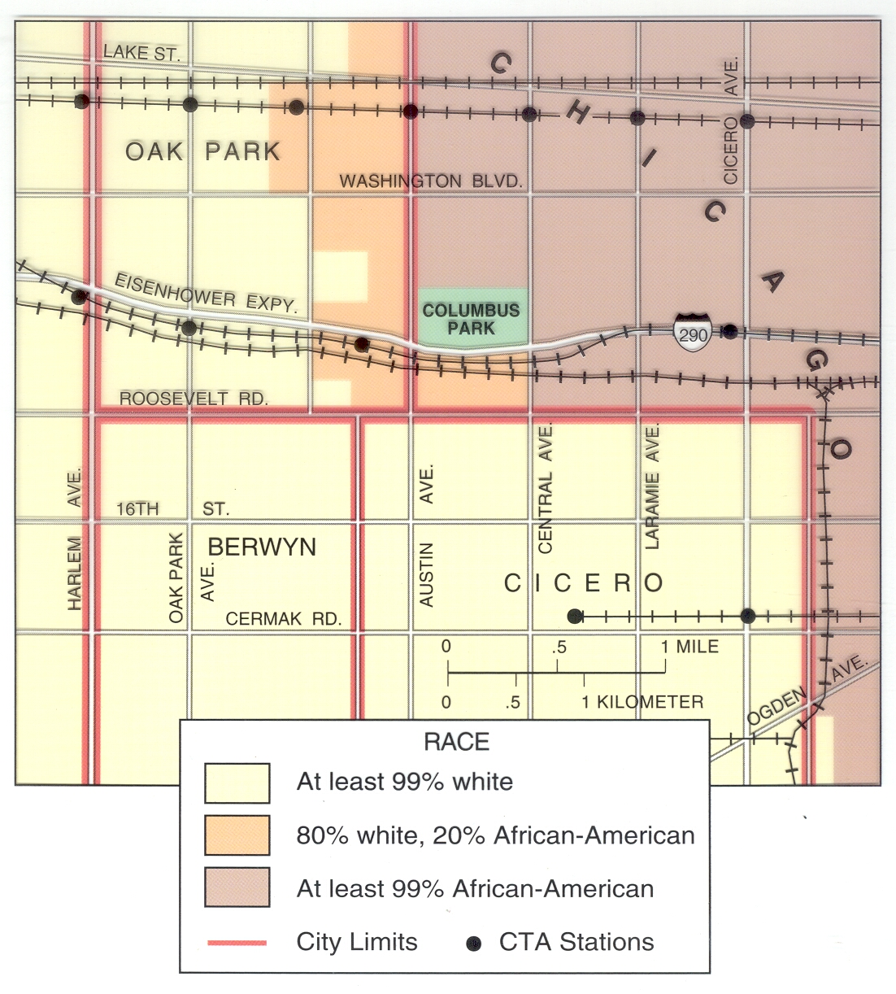
The Color Line: Chicago

Slide 37
African-Americans: Inner-city to Suburban Migration
Segregation laws were eliminated in the 1950s and 1960s; racial separation was legally ended.
Courts ordered the integration of schools. Some whites refused; rather than integrate, they fled to the suburbs.
Cities became increasingly black (and increasingly poor).
African-Americans who can afford to have also tended to migrate out of the cities, and into the suburbs.

Slide 38
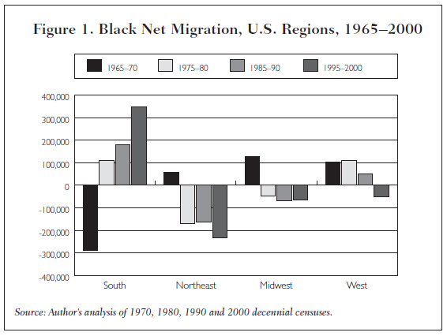
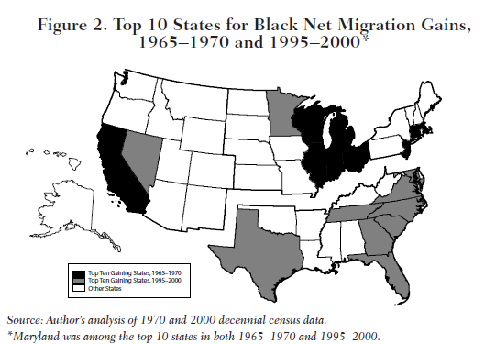
African-Americans: Recent Northern-to-Southern Migration
Data source: http://www.brookings.edu/urban/pubs/20040524_Frey.pdf

Slide 39
Race in South Africa: Historical Background
Originally occupied by Khoikhoi (“Hottentot”) peoples.
1652 Dutch (“Afrikaners”) arrived, established Cape Town.
Competition between Afrikaners & Bantu peoples in the 18th & early 19th centuries.
British seized the Cape Colony twice in 1795 and 1806; purchased the Colony from the Dutch in 1814 for £6 million.
Slavery was abolished in 1833. In protest, 12,000 “Boers” (from a word meaning “farmer”) made the voortrek inland, establishing Transvaal & the Orange Free State.
1886 Diamonds and gold discovered in Transvaal; British miners were denied civil rights and taxed heavily; Britain began policies resulting in the Boer War (1899-1902).
1902 the Afrikaner states became colonies of British Empire.
In 1948 Afrikaners won national elections and began the policy of "apartheid" (separation – or "apartness" – by race).

Slide 40
Apartheid
Between 1948 and 1994 there were four official “races” in South Africa:
White (13% of the population).
Black (76% of the population).
Asian (3% of the population – descendants of migrants from India and Pakistan).
Coloured (9% of the population – people of mixed race).
Under apartheid races were kept legally separate – where you lived, worked, went to school, shopped, owned land, who you could marry, etc. – was determined by your “race.”

Slide 41
South African “Homelands”
Because of its racial policies, many countries cut off political and economic relations with South Africa during the 1970s & 1980s.
In what is perhaps the cleverest (and most twisted) racial scheme of the 20th century, South Africa devised a plan – since other countries objected to South Africa's disenfranchising ¾ of its citizens – make them citizens of somewhere else!
Ten "homelands" were established: Bophuthatswana, Ciskei, Gazankulu, KaNgwane, KwaNdebele, KwaZulu, Lebowa, Qwaqwa, Transkei, and Venda.
One Black group would be dominant in each region, and every black South African would become a citizen of one of the ten homelands, based on tribal affiliation.
The homelands were supposed to be "independent," but could not possibly support the Black population of South Africa – so they were totally dependent on South Africa.
Four homelands – Transkei, Bophuthatswana, Ciskei, and Venda – were actually declared independent between 1976 and 1981, but no other country recognized them.

Slide 42
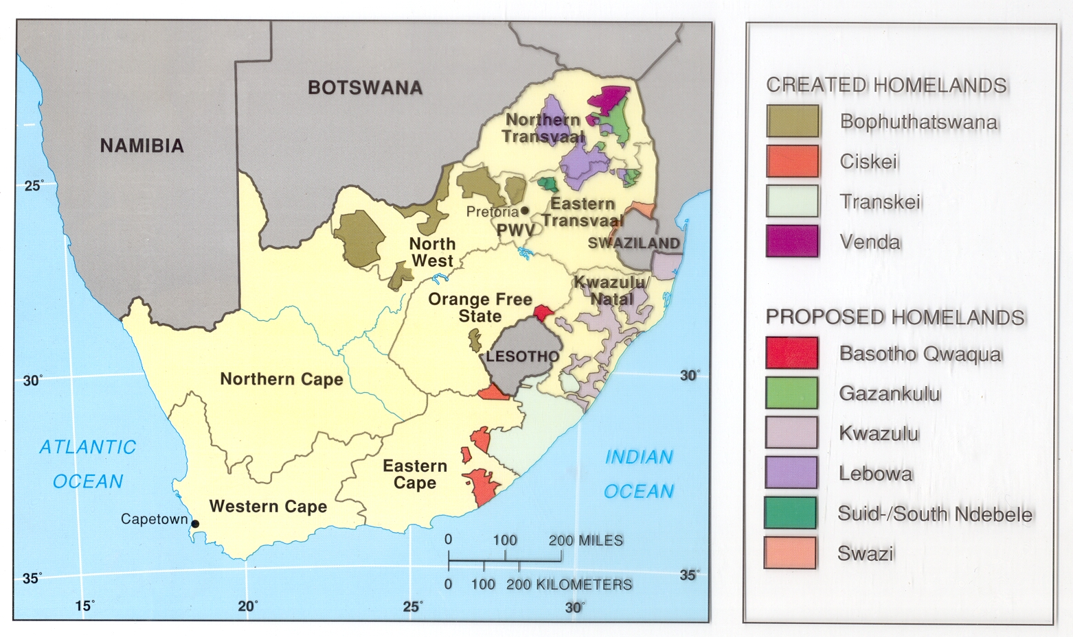
“Homes”

Slide 43
Dismantling Apartheid
In 1991, in response to continuing internal unrest and military defeat in Angola, the South African government began to dismantle apartheid.
The African National Congress Party, after being banned for 30 years, was legalized, and its leader, Nelson Mandela, was released from prison after 27½ years.
In 1994 Mandela was elected South Africa's first black President.

Slide 44
Truth & Reconciliation
However, “The state, … was … the primary perpetrator of gross violations of human rights in South Africa…”
“Racism … constituted the motivating core of the South African political order… This created a climate in which gross atrocities … were seen as legitimate.”
In 2003 the TRC began paying reparations to 22,000 identified victims of victims of Apartheid.
There have been similar Commissions established in at least 10 other countries.
Established in 1995, the Truth & Reconciliation Commission investigated human rights abuses.
The TRC concluded that all sides – black and white – were guilty of crimes.
Sources: http://www.doj.gov.za/trc/;
http://news.bbc.co.uk/1/hi/special_report/
1998/10/98/truth_and_reconciliation/204015.stm;
http://www.southafrica.info/public_services/
citizens/your_rights/reparations_171103.htm

Slide 45
Ethnicity & Nationalism
National: from a Latin word, "nasci," "to have been born" (the Greek "ethnikos" meant "national").
Nationality:
"identity with a group of people who share legal attachment and personal allegiance to a particular country."
"a group of people tied together to a particular place through legal status and cultural tradition."
Nationalism: "loyalty and devotion to a nationality. Nationalism typically promotes a sense of national consciousness that exalts one nation above all others"
Nationality and ethnicity may be closely related or totally separate.
In the US, nationality and ethnicity are (usually) kept distinct; you can be of any ethnicity and still be an American.
In other countries the situation can be very different.

Slide 46
Nations, Nation-States and Nationalism
For over a century, the idea of self-determination – the idea that groups of people have a right to choose their own governments without outside interference – has been among the most important political principles.
Nation-States – independent political states that are made up of a single nation (or ethnicity) – are an ideal for many nationalists.
States encourage nationalism:
Symbols (flags, songs, public events)
Nationalism can be an important centripetal force – a force encouraging unification.
Nationalism can have negative impacts – creating unity with stereotypes and new enemies.

Slide 47
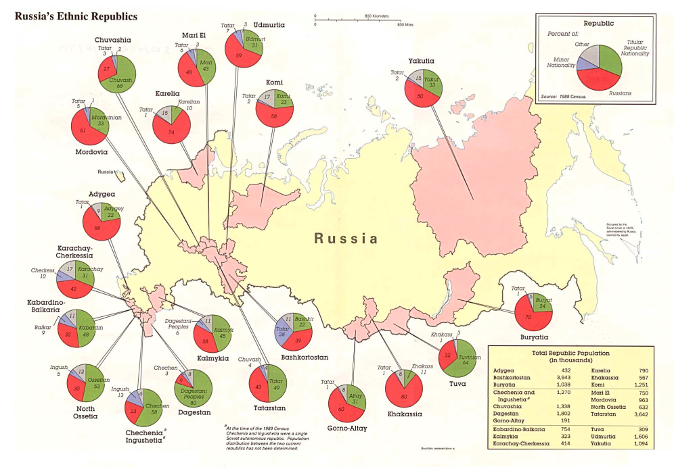
A Multinational State: Russia
The USSR was made up of 15 Republics – all of which are now independent nations (Ukraine, Georgia, etc.)
Within Russia there are 39 recognized nationalities, most of which have some sort of autonomous region (republic, oblast, okrug).
Theoretically, the concept of self-determination here is balanced by giving each nationality limited autonomy.
Recent independence movements (in Chechnya, for example) are centrifugal forces that could tear Russia apart.
The area of each pie chart in red on the map above indicates the percentage of ethnic Russians in the region.
Source: http://www.lib.utexas.edu/maps/commonwealth/russia_ethnic94.jpg

Slide 48
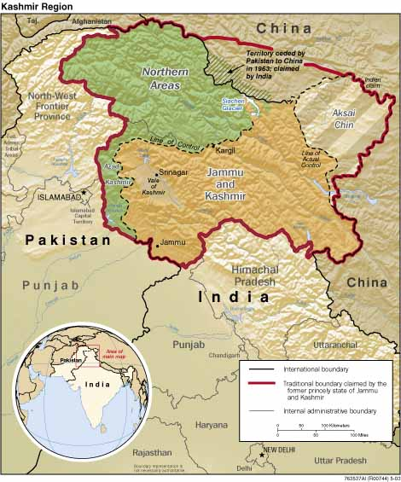
Divided Nationalities: South Asia
India and Pakistan
Kashmir
Sri Lanka
Source: http://www.cia.gov/cia/publications/mapspub/maps/Kashmir_region.htm

Slide 49
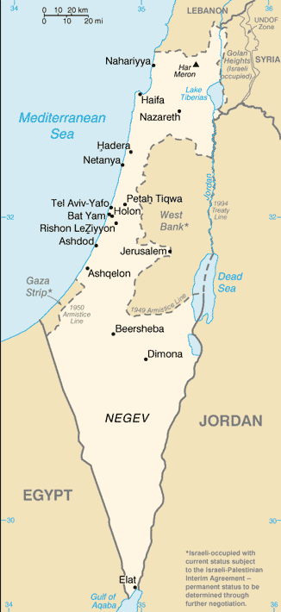
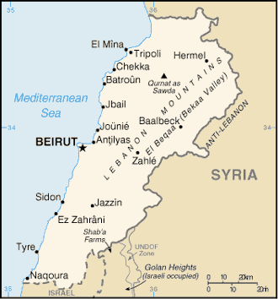
Competing Nationalities: Middle East
Israel
Lebanon
Sources: http://www.cia.gov/cia/publications/factbook/geos/is.html; http://www.cia.gov/cia/publications/factbook/geos/le.html

Slide 50
Who Are the Palestinians?
Five distinct groups of people may reasonably consider themselves “Palestinians”:
People living in the West Bank, Gaza and East Jerusalem.
Israeli citizens who are Muslim, rather than Jewish.
People who left Israel after the 1948-1949 war.
People who left the West Bank or Gaza after the 1967 war,
Citizens of other Middle Eastern countries who consider themselves to be Palestinians (usually the descendants of refugees from either the 1948 or 1967 wars).

Slide 51
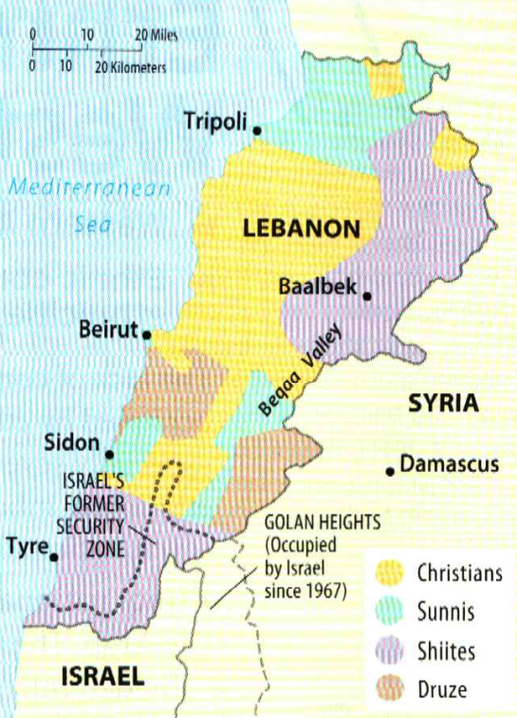
Lebanon: Nationalities, Ethnicities, & Conflict
Lebanon, smaller than Connecticut and with a population of less than four million, has 17 officially recognized ethnicities.
No census has been taken since 1932, so there are no accurate population figures for the different groups.
Current estimates:
55% Muslim (66% Sunni, 34% Shi'ite)
38% Christian (60% Maronite, 5% Greek Orthodox, also Greek Catholic, Armenian, Syrian Orthodox, etc.)
7% Druze

Slide 52
Lebanon: Background
Lebanon's 1943 Constitution required each group be represented in Parliament based on its population in the 1932 census:
Chamber of Deputies
54 Christians (30 Maronites, 11 Greek Orthodox, 6 Greek Catholics, 4 Armenian Christians, 3 Other Christians)
49 Muslims (20 Sunni, 19 Shi’ites)
6 Druze
By agreement, the Executive Branch was also represented on the basis of ethnicity:
President – Maronite Christian
Prime Minister – Sunni Muslim
Speaker of the Chamber of Deputies – Shi’ite Muslim
Foreign Minister – Greek Orthodox Christian

Slide 53
Lebanon Today
Though the ethnic percentages from 1932 may have been correct at the time, they were hopelessly wrong by the 1970s.
Palestinian refugees took control of Southern Lebanon, civil war broke out between Christians and Muslims in 1975, Israel occupied Lebanese territory beginning in 1978, and the Lebanese government collapsed. In 2000 Israel withdrew, and Syria became the dominant force throughout the country.
In 2005 the Lebanese Prime Minister was assassinated; the Cabinet resigned, and Syria withdrew from Lebanon.
Today
Representation in the Chamber of Deputies is officially divided equally between Muslims and Christians.
In 2006 a month of cross-border violence with Israel resulted in nearly a thousand dead (mostly Lebanese), and about 1¼ million refugees (about one million Lebanese, about 250,000 Israelis).
In 2007, because of Parliamentary maneuvering, there was no President for six months.
In 2008 radicals took over West Beirut in an abortive coup. A deal was brokered by the Arab League, and a new unity government was formed with Michel Suleiman, a Maronite Christian, as President.
In 2011 the unity government collapsed. Najib Mikati, a Sunni, was appointed Prime Minister, and formed a new government.
2012-2013, continued fear that the Syrian civil war will spill over into Lebanon.

Slide 54
Combining & Dividing Ethnicities; Creating Nationalities
In the 18th and 19th centuries, competing European Empires encouraged the development of national identity in each other's territories.
In the 20th century (especially after World War II) former European colonies became independent – there were now dozens of new nations, new nationalities.
Problems
Overlapping ethnicities and nationalities – lines drawn on maps to separate European colonies rarely corresponded well to where ethnicities were located.
Different ethnicities competed to become dominant in the newly-created countries.

Slide 55
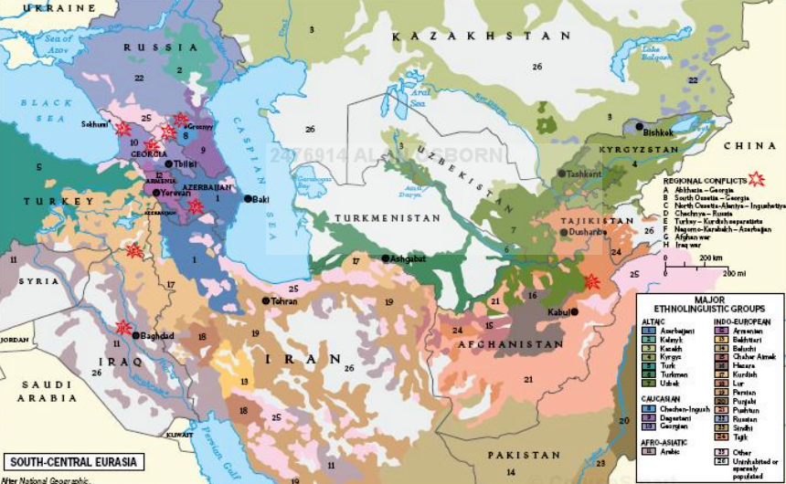
Ethnic Diversity in Western Asia
Note the distribution of the Kurds

Slide 56
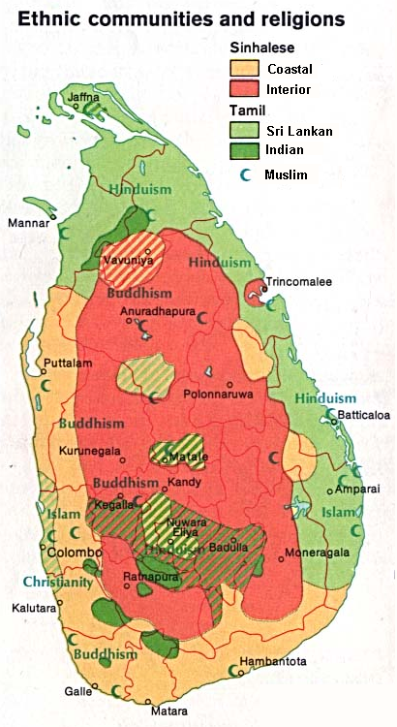
Ethnic Warfare in Sri Lanka
The Sri Lankan war lasted from 1983-2009.
A mostly ethnic conflict between the Hindu Tamil minority (12.6% of the population) and the Buddhist Sinhalese (74%).
The Tamils were excluded from government and deprived of civil rights. A separatist movement that started in the 1970s, “The Liberation Tigers of Tamil Eelam,” became outright warfare in 1983.
Tactics used by the Tamil Tigers – including the assassination of a Sri Lankan President and an Indian Prime Minister – caused them to be labeled a terrorist organization.
After a series of failed peace talks, the Sri Lankan military began a campaign in the northern part of the island. In 2009, after a brutal final assault, the Sri Lankan government defeated the rebels.
As many as 100,000 died as a result of the civil war .
Source: http://ccat.sas.upenn.edu/plc/clpp/images/langmaps/index.html

Slide 57
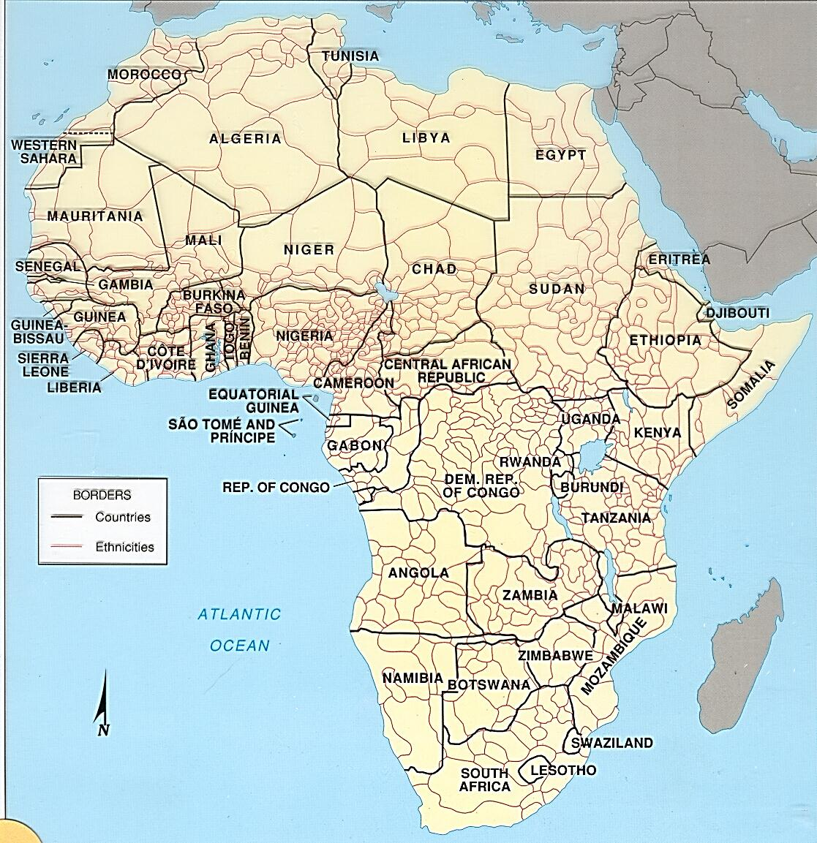
Competing Nationalities: Africa
Ethiopia & Eritrea
Somalia
Nigeria
Sudan
South Sudan
Darfur

Slide 58
Forced Migration and Ethnic Cleansing
Forced migration has occurred throughout history - people of a certain ethnicity compelled to move by another ethnic group's armies.
In the 1990s a new term was coined, "ethnic cleansing," to describe what some groups in Europe were doing to each other.
Ethnic cleansing:
“a process in which a more powerful ethnic group forcibly removes a less powerful one in order to create an ethnically homogenous region.”
“Ethnic cleansing is undertaken to rid an area of an entire ethnicity, so that the surviving ethnicity can be the sole inhabitants.”

Slide 59
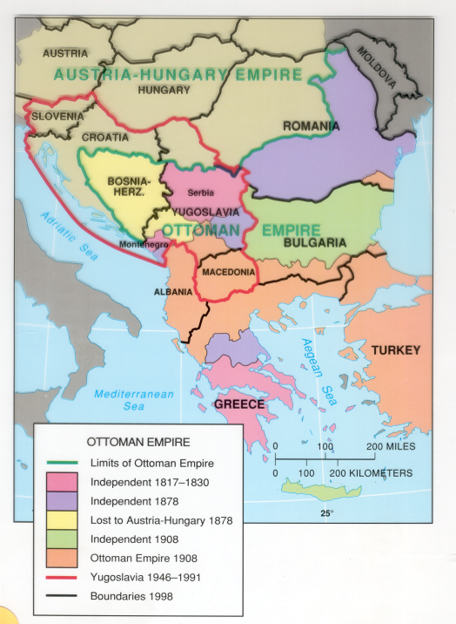
Balkanization
At the end of the 19th century political leaders were deeply worried about something called "Balkanization":
"The process by which a state breaks down through conflicts among its ethnicities."
Balkanization was considered a threat to world peace, because conflicts between ethnic groups could drag larger powers into war.
Balkanization certainly lead to World War I.
To prevent Balkanization from causing problems in the future, a multi-ethnic state was created in the region – Yugoslavia.

Slide 60
Yugoslavia
After World War I the Balkan peninsula was unified into a new multi-ethnic nation, “Yugoslavia,” “Land of the Southern Slavs.”
Ethnic diversity in Yugoslavia was enormous:
Seven ethnic neighbors (Austria, Greece, Italy, Albania, Bulgaria, Hungary & Romania) with significant populations inside Yugoslavia.
Four languages (Croatian, Serbian, Macedonian, Slovene).
Three religions (Roman Catholicism, Eastern Orthodoxy, Islam).
Two alphabets (Roman for Croatian & Slovene, Cyrillic for Macedonian & Serbian).
Six “Republics” within Yugoslavia - Bosnia & Herzegovina, Croatia, Macedonia, Montenegro, Serbia and Slovenia.
Five of the Republics were established on the basis of ethnicity; Bosnia & Herzegovina was a mixture of ethnicities.
Yugoslav ethnicities were suppressed during most of the 20th century,
The collapse of the Communist government in the 1980s lead politicians in several Republics to use ethnicity and hate to gain power.
All the Republics except Serbia and Montenegro broke away (Montenegro became independent in 2006).
Because ethnic regions and political boundaries did not coincide - and because of the concept of self-determination - Serbs and Croats both used ethnic cleansing as a way of claiming territory.

Slide 61
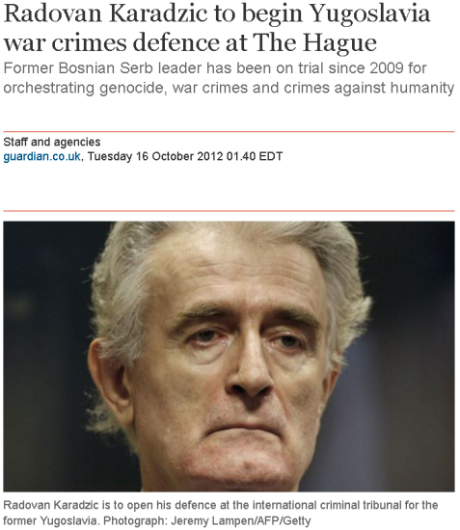
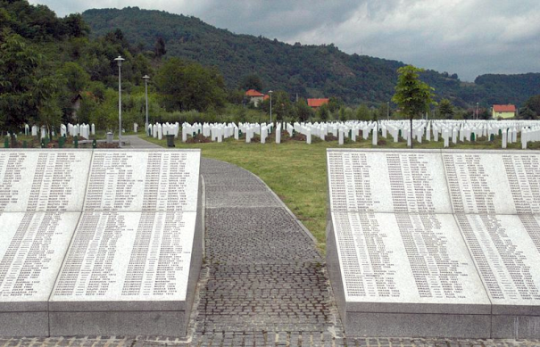
War Crimes Trials: A Slow Process
1993: ICTY: “International Criminal Tribunal for the former Yugoslavia,” established by the UN at The Hague, Netherlands.
1994: First indictments issued; first arrests made.
1995: First trial (Duško Tadić).
Since 1995 161 individuals have been indicted:
13 acquitted.
20 had indictments withdrawn.
16 died before their trials.
13 transferred to other courts.
17 currently being tried.
82 sentenced to terms ranging from 2 years to life imprisonment.
All trials should be completed by 2014 (appeals may continue).
Srebrenica Genocide Memorial
Sources: http://www.guardian.co.uk/world/2012/oct/16/radovan-karadzic-defence-hague; http://www.icty.org/x/cases/mladic/cis/en/cis_mladic_en.pdf

Slide 62
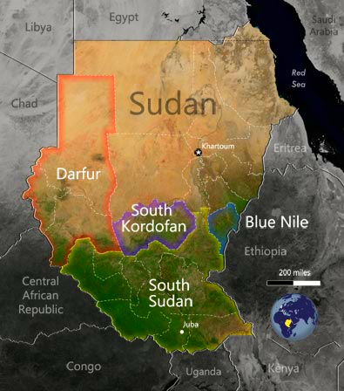
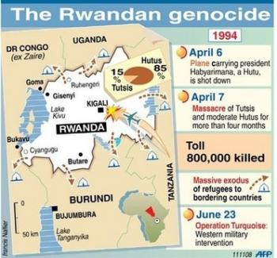
Ethnic Competition & Genocide in Africa
Sudan
South Sudan
Darfur
Rwanda
Hutu vs. Tutsi
DR Congo
Spillover from Rwanda
Sources: http://www.msnbc.msn.com/id/43657361/ns/world_news-africa/t/birthday-wish-lost-boys-pin-hopes-independent-south-sudan/;
http://needlessbloodshed.wordpress.com/

Slide 63
Genocide
Beyond removing an ethnic group, there is genocide: Destroying a national, ethnic, racial, or religious group.
In the 20th & 21st centuries there have been several spectacular examples of genocide and attempted genocide:
1915-1923 between 600,000 and 1½ million Armenians were killed or forced to flee Turkey [this is denied by Turkey today]
1930s-1945 six million Jews, and hundreds of thousands of Slavs, Gypsies and others were killed by the Nazis.
1975-1979 three million Cambodians were killed by the Khmer Rouge in Cambodia.
1994 800,000 Rwandan Tutsis were killed by Rwandan Hutus.
2004-2011 an estimated 300,000 Sudanese have been killed (or starved to death) in Darfur by state supported militias.
Genocide has been a crime under International Law since 1948, whether committed during wartime or peacetime.
All signatories to the “Convention on Prevention and Punishment of the Crime of Genocide” are obligated to enforce the treaty, and punish individuals responsible for acts of genocide – but what that means in practice isn’t always clear.

Slide 64
The 8 Stages of Genocide
Classification ("us" vs. "them")
Symbolization (hate speech)
Dehumanization ("swine," "vermin")
Organization (special units)
Polarization (propaganda)
Preparation (lists, targets)
Extermination (murder)
Denial (complete denial, “accidents,” etc.)
Source: http://www.genocidewatch.org/aboutgenocide/8stagesofgenocide.html

