Slide 1
Development
Development
Measuring Development
Distribution of More & Less Developed Countries
Development Issues
Obstacles to Development

Slide 2
Development: Terms
Development: “the process of improving the material conditions of people through diffusion of knowledge and technology.”
Every country lies at some point along a “continuum of development.”
Many countries cluster at either the high or the low end of the continuum, so we can divide countries into groups:
MORE DEVELOPED COUNTRIES (also called “MDCs,” “Relatively Developed Countries,” and “Developed Countries.”)
LESS DEVELOPED COUNTRIES (also called “LDCs,” and “Developing Countries.”)

Slide 3
Loaded Terms?
Any discussion of development tends to get into issues of pride and resentment – after all, when we describe one place as “developed” and another as “less developed” – are we really saying that:
“More Developed” ≈ “Developed” ≈ “Modern”??
“Developing” ≈ “Less Developed” ≈ “Backward”??

Slide 4
Measuring Development
How do you measure “material conditions?” For around 200 countries??
For many years the basic measure used to compare development was economic – gross domestic product (GDP: the total value of a country’s goods and services).
But “material conditions” for a country as a whole aren’t well described by GDP alone.
So, starting in 1990, building on the work of Indian economists Partha Dasgupta and Amartya Sen, the Pakistani economist Mahbub ul Haq worked to devise a better measure: the human development index.

Slide 5
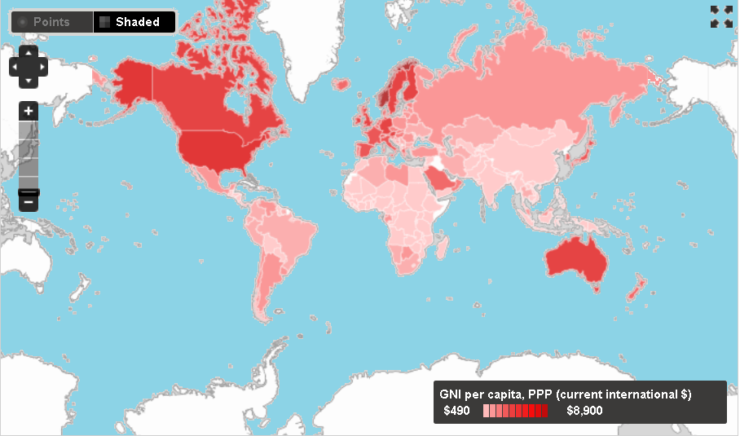
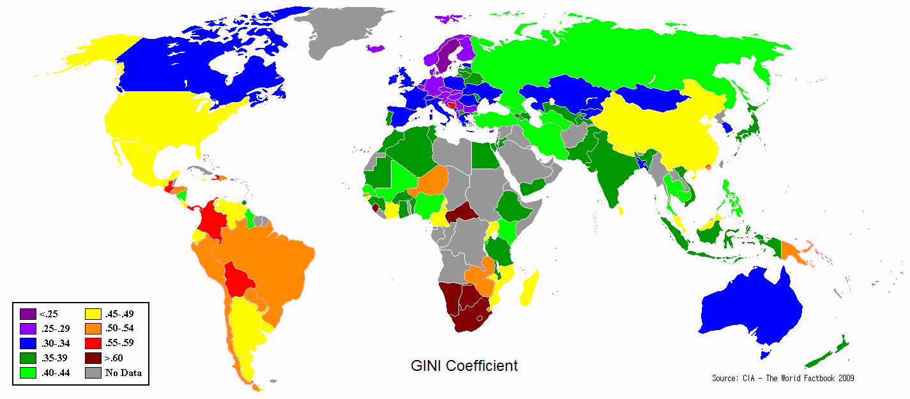
GNI vs. Gini
Please note: some of the statistics we’re going to look at use “Gross Domestic Product”; some use “Gross National Income.”
GDP measures the total value of goods and services in a country.
GNI measures the total value of goods and services PLUS money that leaves or enters a country.
These are NOT identical – but for our purposes, the distinction isn’t very important.
Gross National Income
This map shows the Gini Coefficient – a measure of income inequality that varies from 0 to 1 (lower values indicate greater equality).
“Average income” figures can be misleading if incomes are highly unequal.
GINI Coefficient
Adapted from: http://data.worldbank.org/indicator/NY.GNP.PCAP.PP.CD?display=map

Slide 6
The HDI
The United Nations Development Programme creates the Human Development Index (HDI) using a combination of measures:
One economic indicator of development.
Two social indicators of development.
One demographic indicator of development.
A single value – an index number – is then computed, and every one of the nearly 200 countries in the world can be ranked.

Slide 7
Possible Economic Measures
Gross National Income (per capita, PPP)
Total value of goods and services produced in a country.
Sector of Employment
Jobs fall into three categories: primary (agriculture, fishing), secondary (manufacturing) and tertiary (services). Workers in the secondary and tertiary sectors earn more than those in the primary sector; high numbers in the primary sector means getting food is a major difficulty.
Availability of Consumer Goods
After necessities are taken care of, “luxuries” drive an economy – more consumer goods means more manufacturing and a higher level of development.

Slide 8
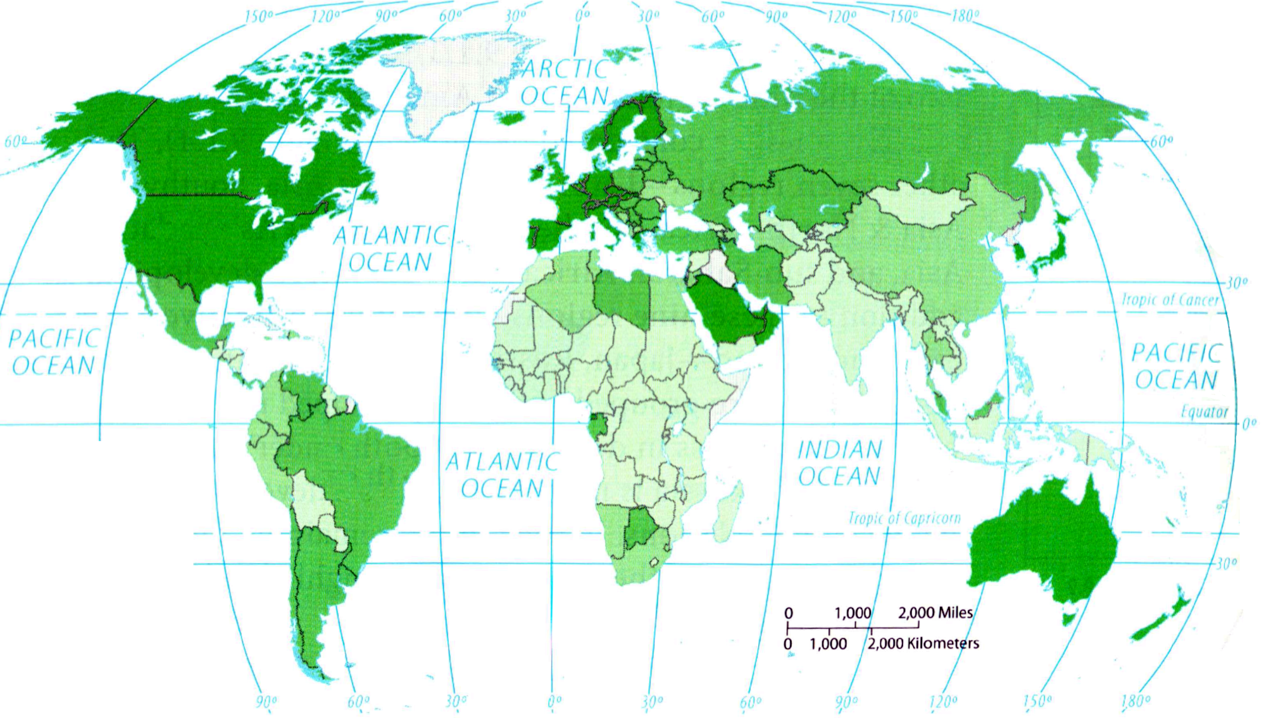
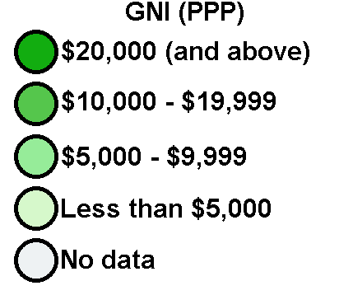
Possible Economic Measures: GNI

Slide 9
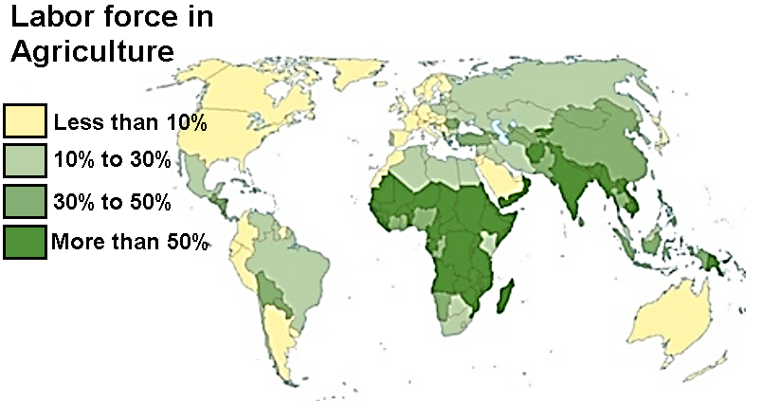
Possible Economic Measures: Primary Employment Sector
Adapted from: http://www.mapscd.com/world/world-primary-sector-map/

Slide 10
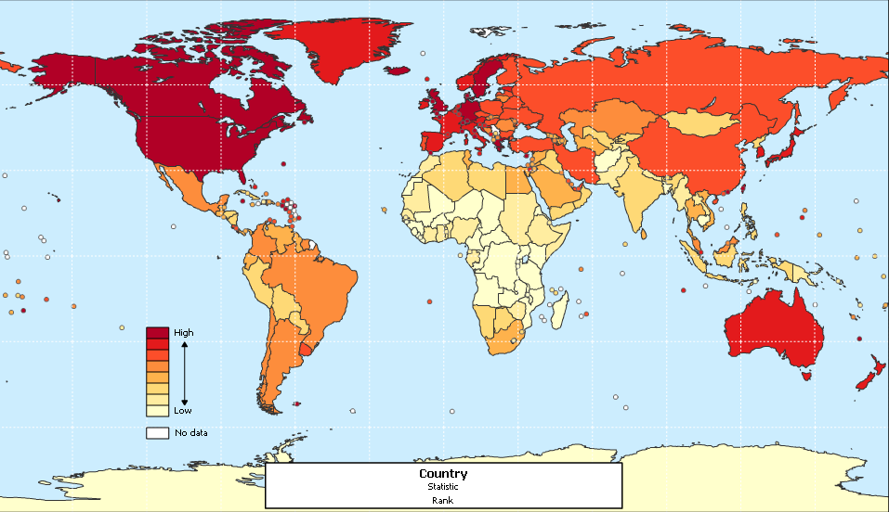
Possible Economic Measures: Consumer Goods
Telephones (land lines) per thousand
Adapted from: http://www.sitesatlas.com/Thematic-Maps/Telephone-main-lines-per-capita.html

Slide 11
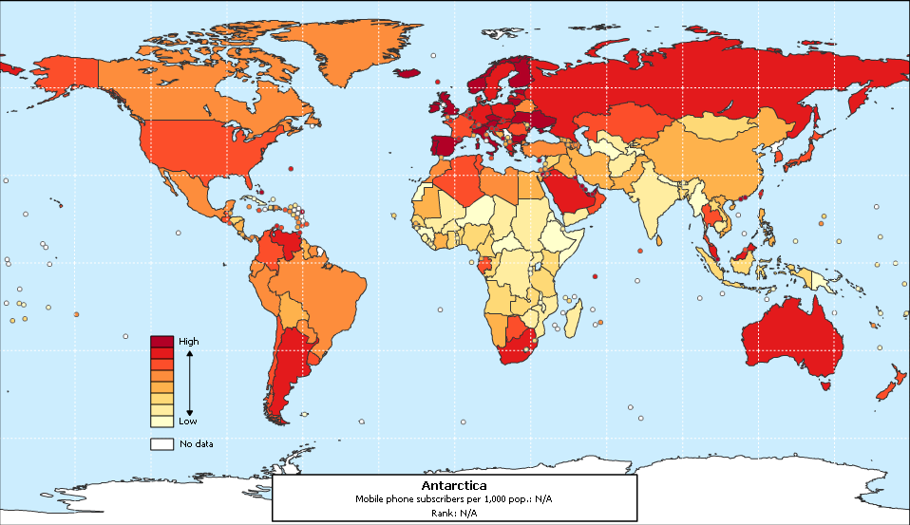
Possible Economic Measures: Consumer Goods
Telephones (mobile) per thousand
Adapted from: http://www.sitesatlas.com/Thematic-Maps/Mobile-phone-subscribers-per-capita.html

Slide 12
Possible Social Measures
Education & Literacy
Generally, the higher the quantity of education and literacy, the higher the level of development.
Measures of education:
Years of schooling.
Expected years of schooling.
Student/teacher ratio.
Literacy rate (percentage that can read and write).
Education measures can also be analyzed for differences between male and female levels of education.
Health and Welfare
Measuring "healthiness" is tricky, so surrogate measures are used, such as:
Ratio of people to hospitals, doctors and/or nurses.
Hunger.

Slide 13
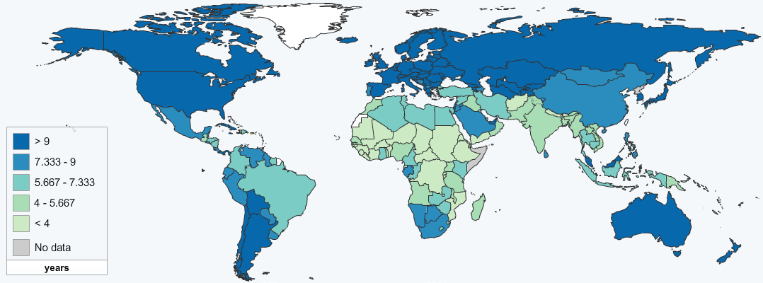
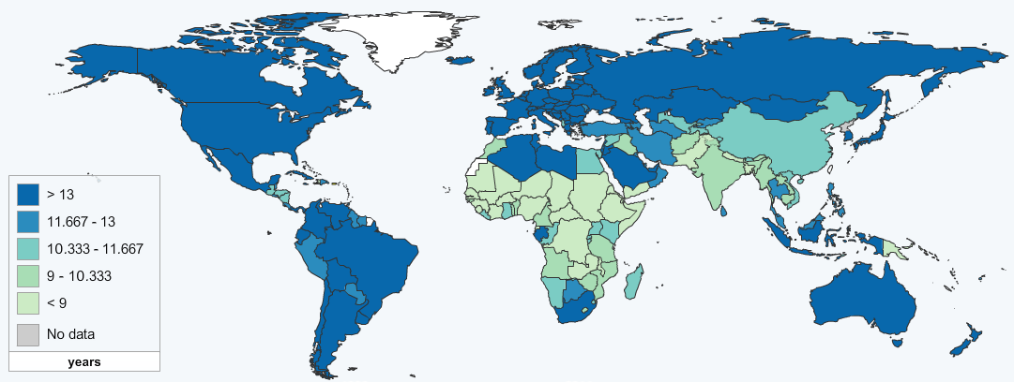
Years of Schooling
Average years of education
Expected years of education
Adapted from: http://hdr.undp.org/en/data/map/

Slide 14
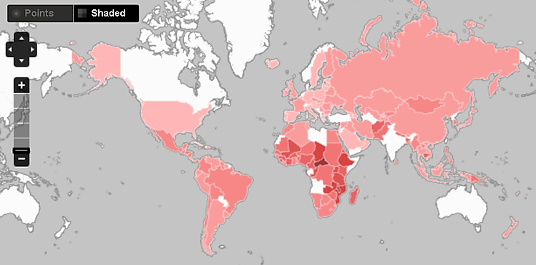
Possible Social Measures: Pupil-Teacher Ratios
Adapted from: http://data.worldbank.org/indicator/SE.PRM.ENRL.TC.ZS?display=map

Slide 15
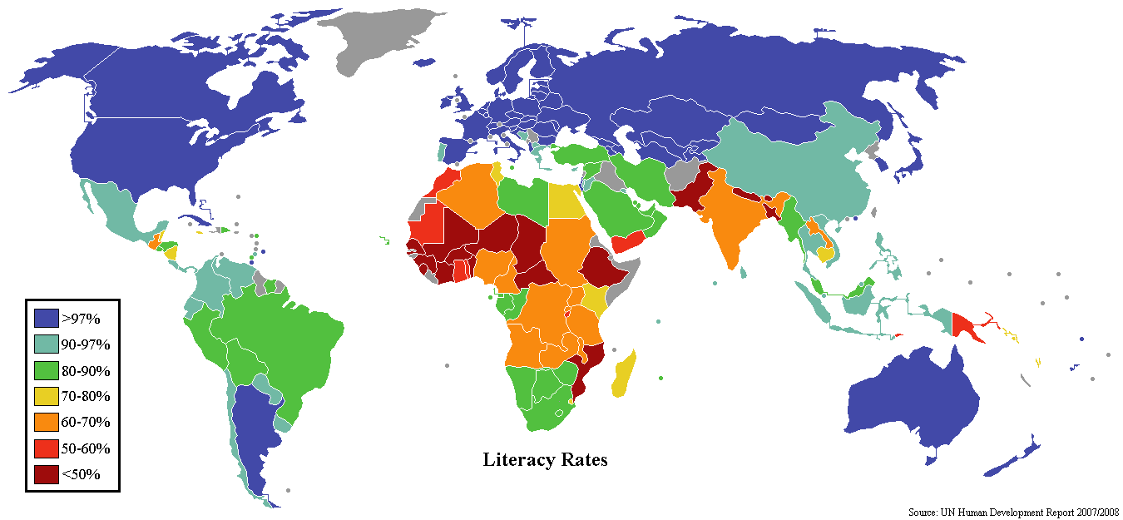
Possible Social Measures: Literacy Rates
Adapted from: http://leadingfromtheheart.org/2008/07/26/perpetuating-the-story-of-difference-or-literacy-revisited/

Slide 16
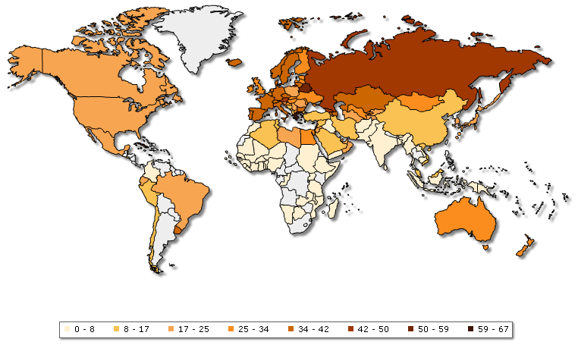
Possible Social Measures: Physicians per 10,000
Adapted from: http://www.globalhealthfacts.org/data/topic/map.aspx?ind=74

Slide 17
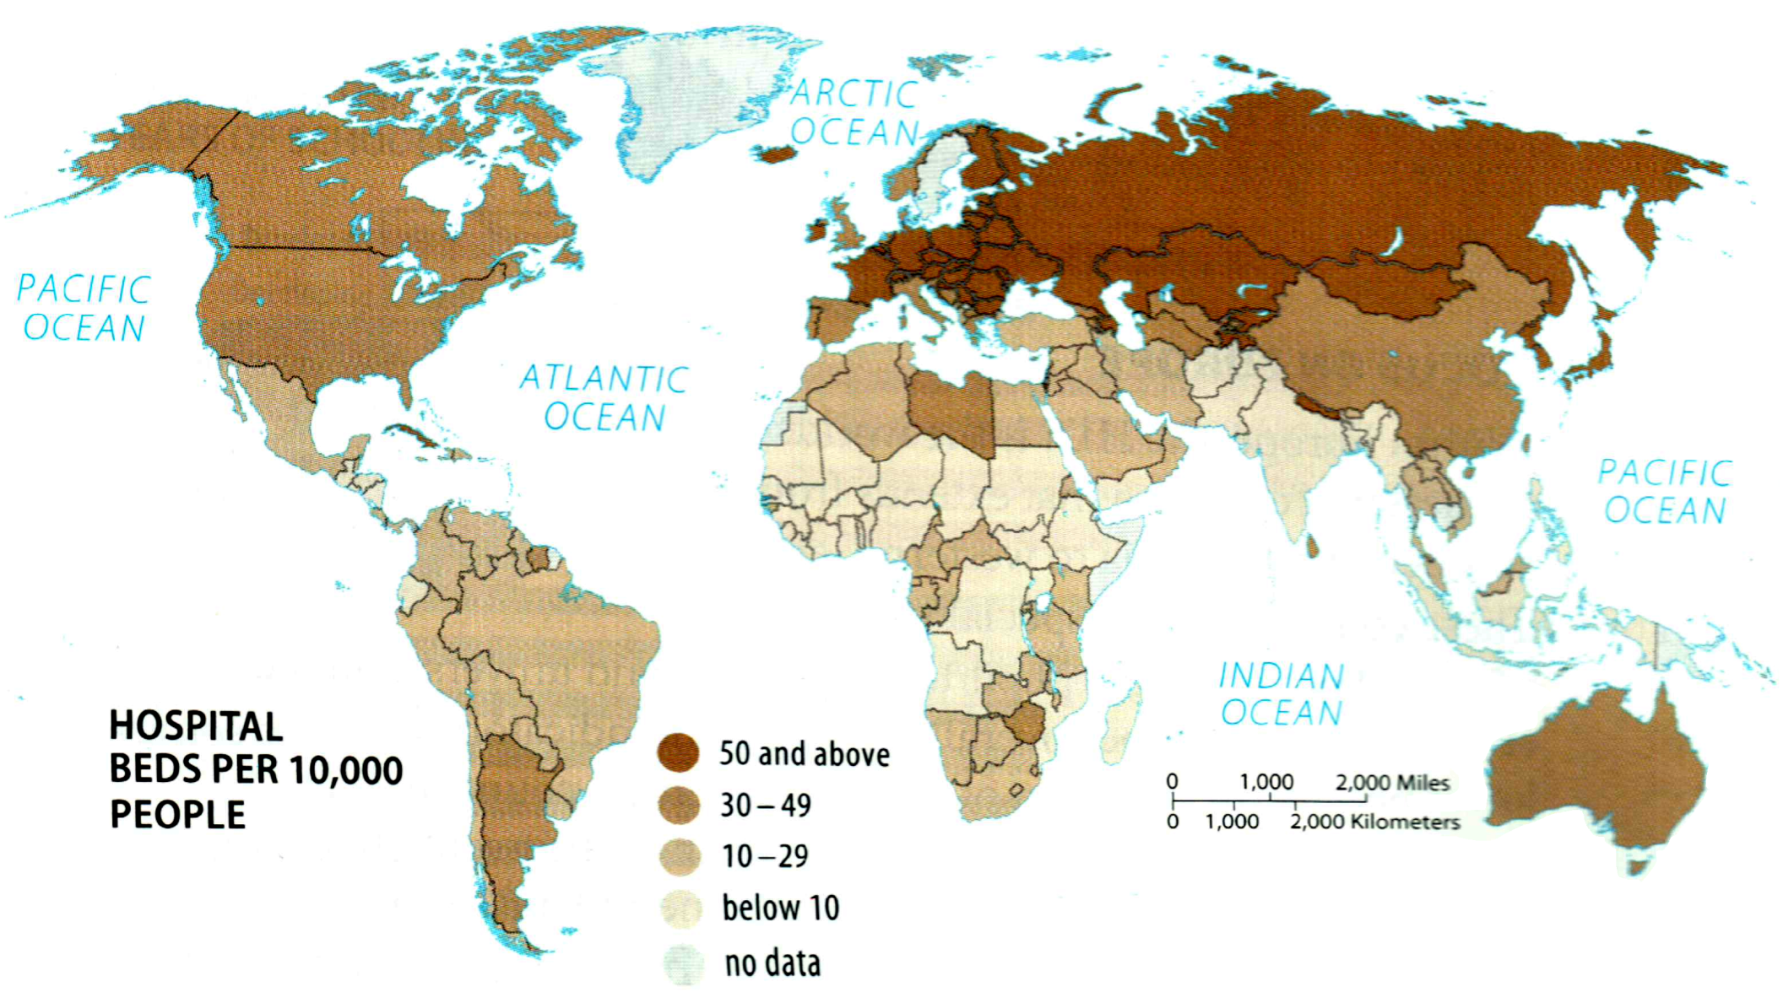
Possible Social Measures: Hospital Beds per 10,000

Slide 18
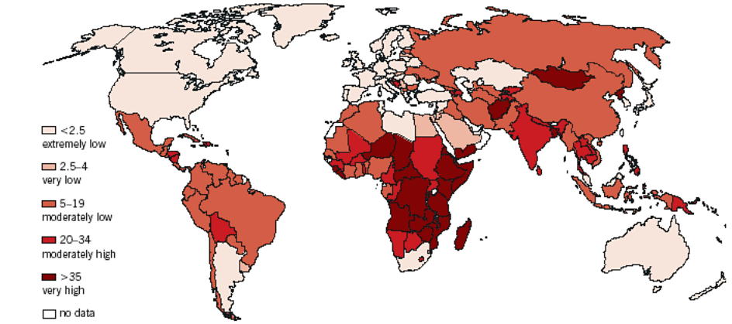
Possible Social Measures: Percent Undernourished
Adapted from: http://www.grida.no/publications/other/geo3/?src=/geo/geo3/english/fig308.htm

Slide 19
Possible Demographic Measures
There are many measurable demographic differences between MDCs and LDCs. Possible choices include:
Life expectancy at birth (average number of years a newborn is expected to live).
Child Mortality Rate
Rate of Natural Increase
Crude Birth Rate
Crude Death Rate is not a good indicator:
Better medical technology in LDCs means a low death rate may not indicate high development.
MDCs have more elderly populations, so a high death rate doesn’t necessarily mean low development.

Slide 20
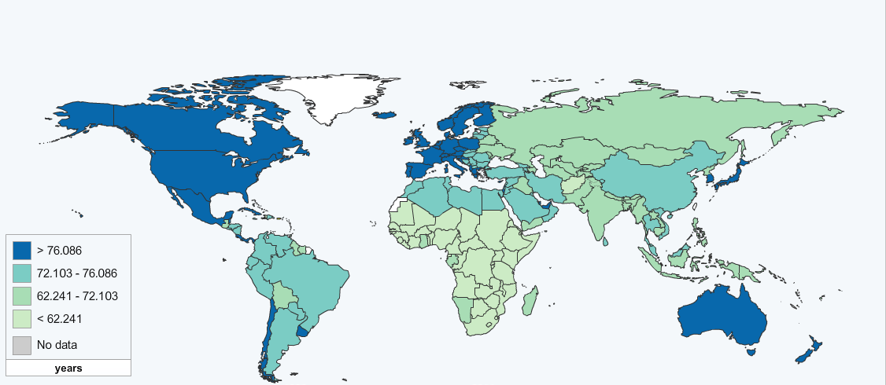
Possible Demographic Measures: Life Expectancy
Life expectancy at birth
Adapted from: http://hdr.undp.org/en/data/map/

Slide 21
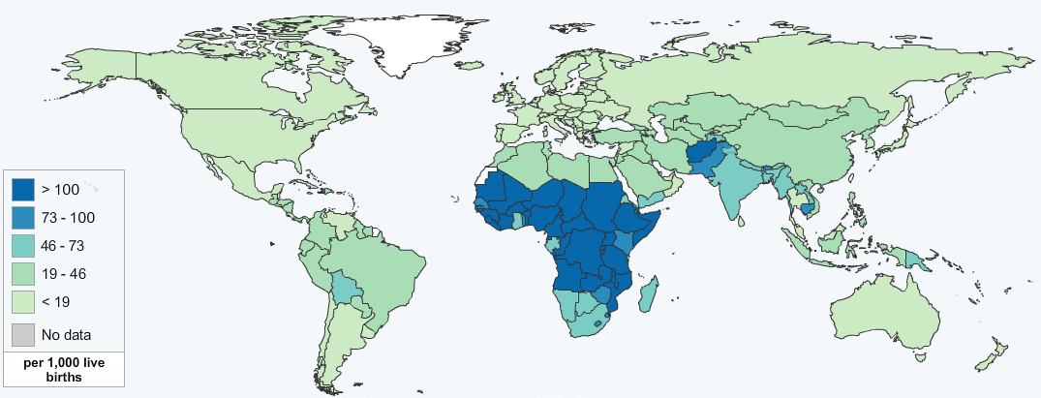
Possible Demographic Measures: Under 5 Mortality
Adapted from: http://hdr.undp.org/en/data/map/

Slide 22
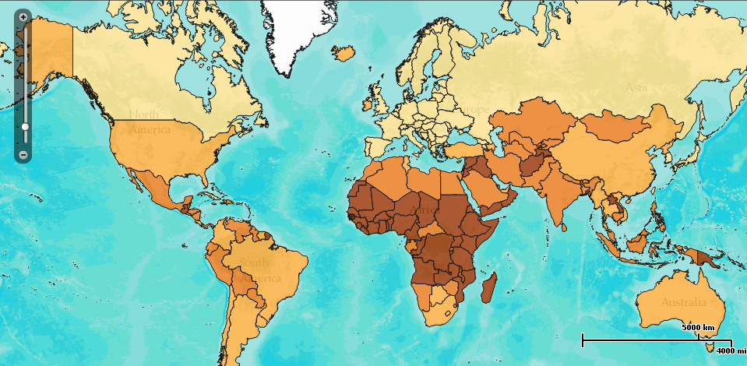
Possible Demographic Measures: Natural Increase
Adapted from: http://www.prb.org/DataFinder/Topic/Map.aspx?ind=16&fmt=16&tf=3&loct=3

Slide 23
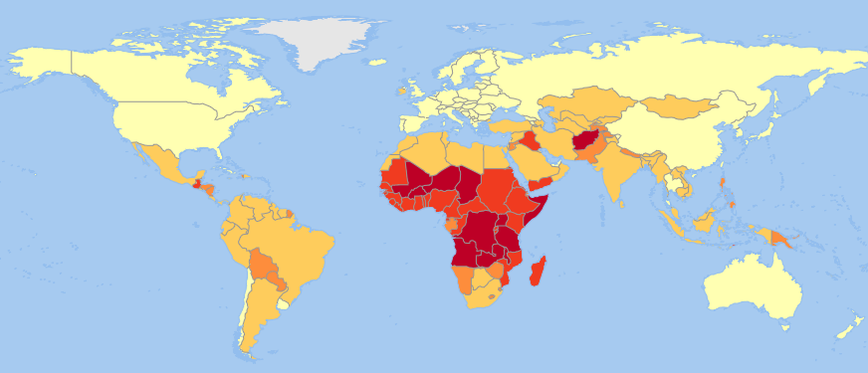
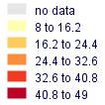
Possible Demographic Measures: Birth Rate
Adapted from: http://geodata.grid.unep.ch/mod_map/map.php

Slide 24
Computing the HDI
The variables the UN currently uses:
ECONOMIC: Gross National Income (per capita, Purchasing Power Parity).
SOCIAL: Education (this is calculated based on mean years of schooling and expected years of schooling).
DEMOGRAPHIC: Life expectancy at birth.
HDI= (¹/₃ * economic)+(¹/₃ * social)+(¹/₃ * demographic)

Slide 25
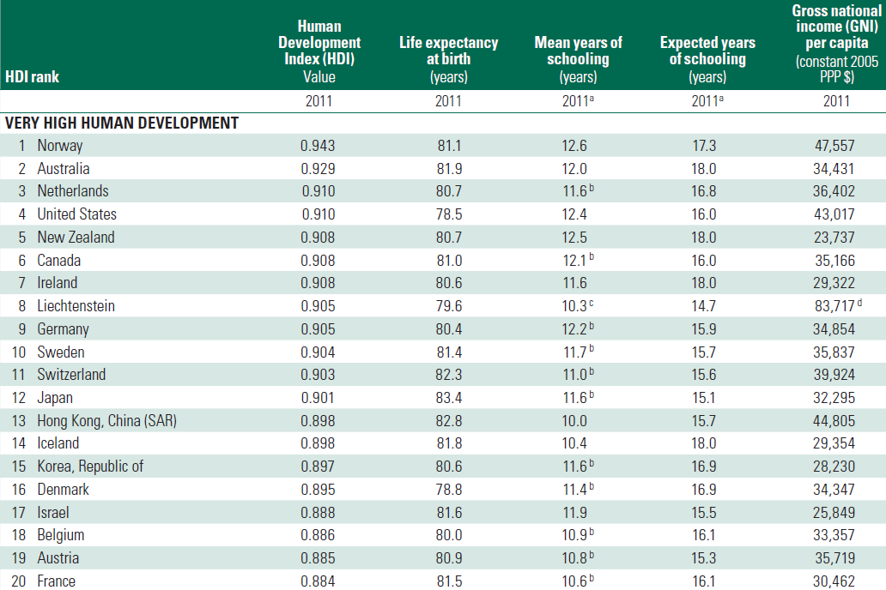
The 2011 HDI Figures
Source: http://hdr.undp.org/en/media/HDR_2011_EN_Complete.pdf

Slide 26
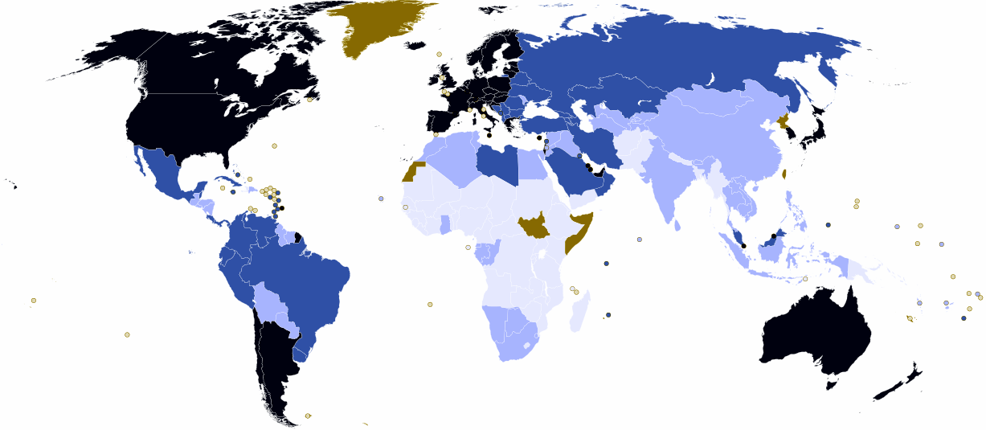
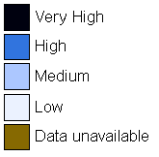
2011 HDI Rankings

Slide 27
The HDI: Criticisms
Failure to include ecological considerations.
Focusing exclusively on national performance and ranking.
Ignoring the global/regional perspective.
Redundant.
Lacking year-to-year comparability.
Lacking region-to-region comparability.
For more information see: http://www3.interscience.wiley.com/journal/10005622/abstract;
http://ideas.repec.org/p/ags/aaea09/49763.html

Slide 28
The HDI: Is There Anything Else?
The HDI is certainly a better measure of "material conditions" than GNI, but it may not measure what we are interested in.
There are many, many other possible ways of looking at development.
A sample of other possible measures could include:
The Multidimensional Poverty Index (MPI)
The Gender Inequality Index (GII)

Slide 29
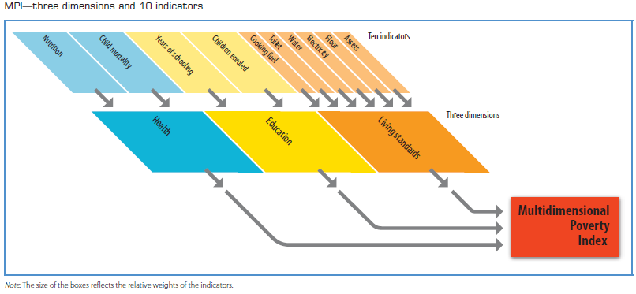
Multidimensional Poverty Index: Components
Source: http://hdr.undp.org/en/media/HDR_2010_EN_Complete_reprint.pdf/

Slide 30
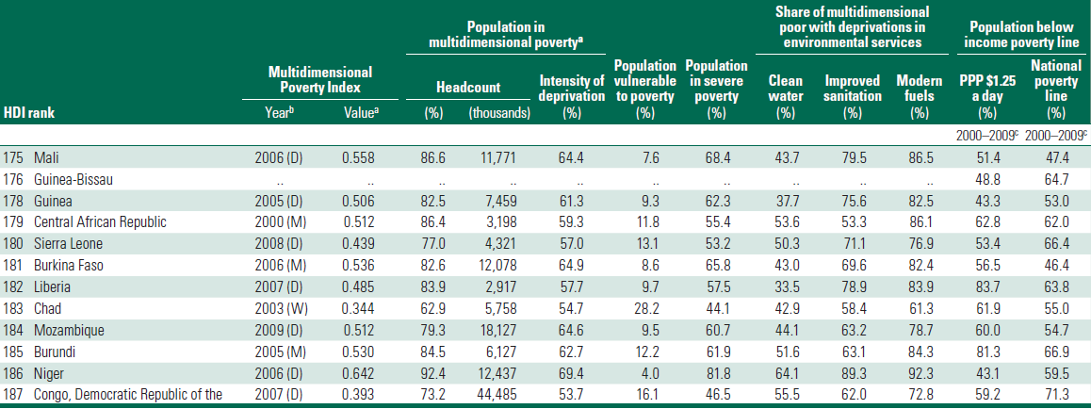
Multidimensional Poverty Index: The Lowest Figures
Source: http://hdr.undp.org/en/media/HDR_2011_EN_Complete.pdf

Slide 31
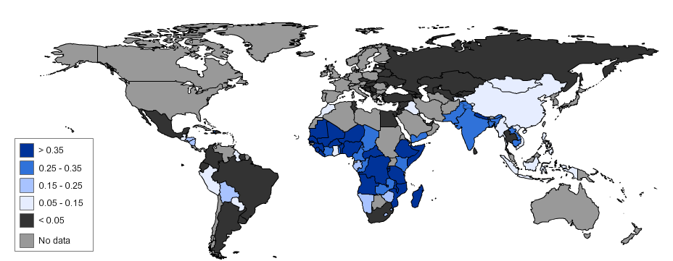
Multidimensional Poverty Index: Ranks
Source: http://hdr.undp.org/en/media/HDR_2010_EN_Complete_reprint.pdf/

Slide 32
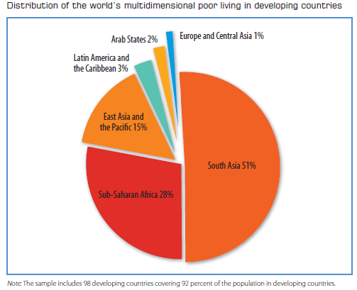
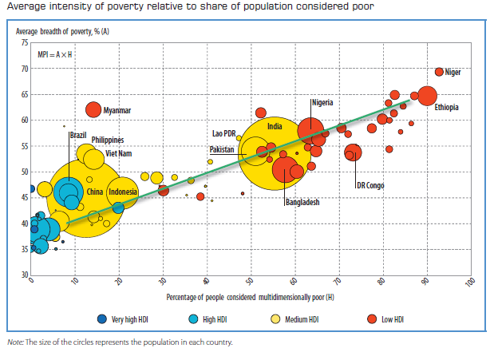
Multidimensional Poverty Index: Locations
Based on data from 98 developing countries.
Most of the world’s poor are in South Asia (51%) or Sub-Saharan Africa (28%).
The total percent of multidimensionally poor varies from less than 3% in South Africa to 93% in Niger.
Source: http://hdr.undp.org/en/media/HDR_2010_EN_Complete_reprint.pdf/

Slide 33
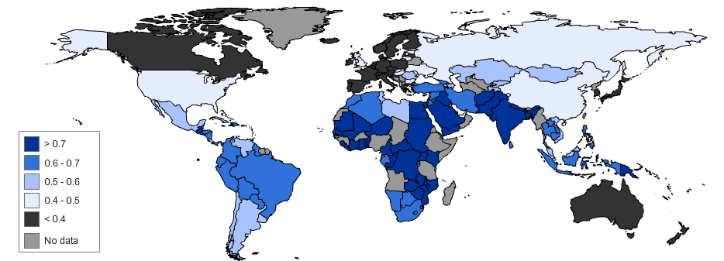
Multidimensional Poverty Index: Ranks
Source: http://hdr.undp.org/en/media/HDR_2010_EN_Complete_reprint.pdf/

Slide 34
The GII: Gender Inequality Index: Components
Source: http://hdr.undp.org/en/media/HDR_2011_EN_Complete.pdf

Slide 35
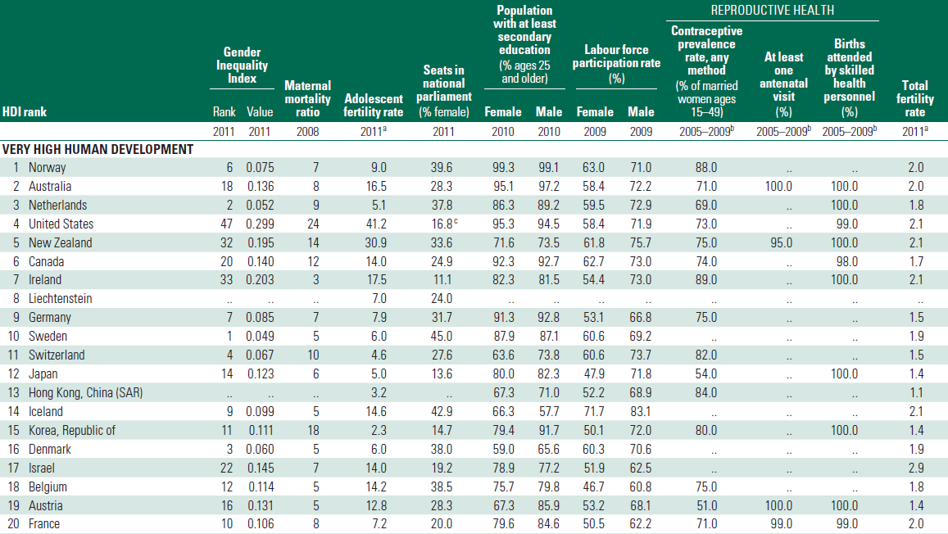
Gender Inequality Index: Table
Note that HDI ranks do not always equal GII ranks!
Source: http://hdr.undp.org/en/media/HDR_2011_EN_Complete.pdf

Slide 36
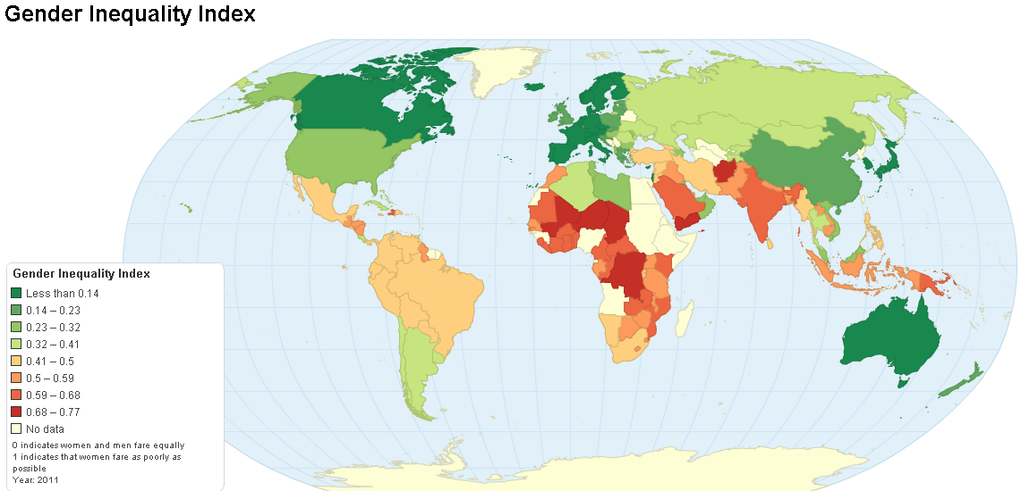
Gender Inequality Index Map
Source: http://chartsbin.com/view/4319

Slide 37
GEM: The Gender Empowerment Measure
No longer calculated by the UN Development Programme (figures and data are available for 1995-2009).
Focused on women’s opportunities in two areas:
Political participation and decision-making power (women’s and men’s percentage shares of legislative seats).
Economic participation and decision-making power:
Women’s and men’s percentage shares of positions as legislators, senior officials and managers;
Women’s and men’s percentage shares of professional and technical positions.
Power over economic resources (women’s and men’s estimated earned income).
Computing the GEM is complicated, but the results make comparisons among countries fairly simple.

Slide 38
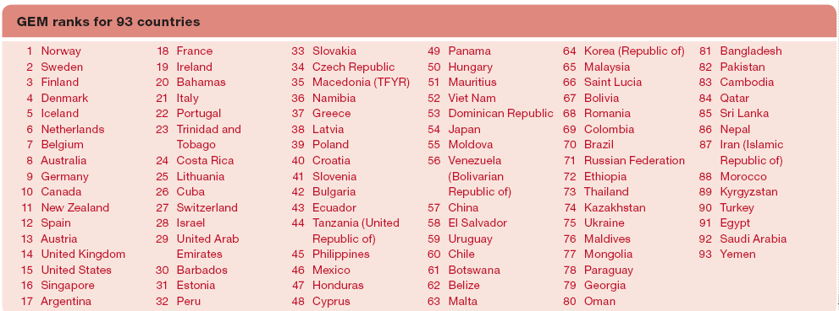
The 2007 GEM Rankings

Slide 39
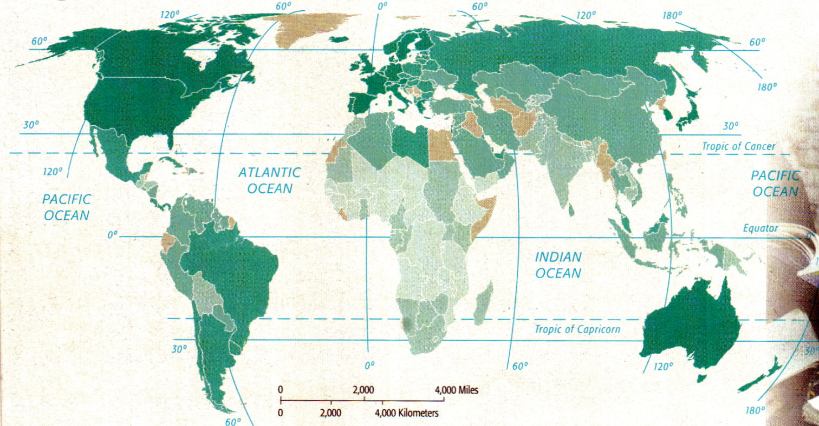
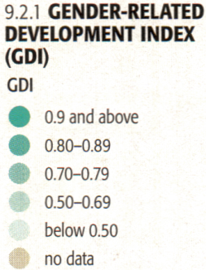
The Gender-Related Development Index (GDI)
No longer calculated by the UNHDP.
Similar to the GEM, but using:
Female & male life expectancy (at birth).
Female & male literacy rates, and school enrollment ratios.
Female & male income.

Slide 40
The “Hedonometer” – “Gross National Happiness”?
Proposed as a sort of thought exercise – instead of comparing “material well being,” comparing “happiness.”
Uses six variables:
Understanding and controlling one's environment
Social support from family and friends
Satisfaction of sex and parental drives
Physical well-being
Esthetic and sensory satisfaction
Satisfaction of exploratory drives (learning)
An interesting concept – but hard to get data!
Perhaps in response to this, the UNHDP is now collecting data on “well-being and the environment.”
For more information see: http://www.msu.edu/course/prr/213/Russell,ch5.doc;
See also: http://www.gnh-movement.org/

Slide 41
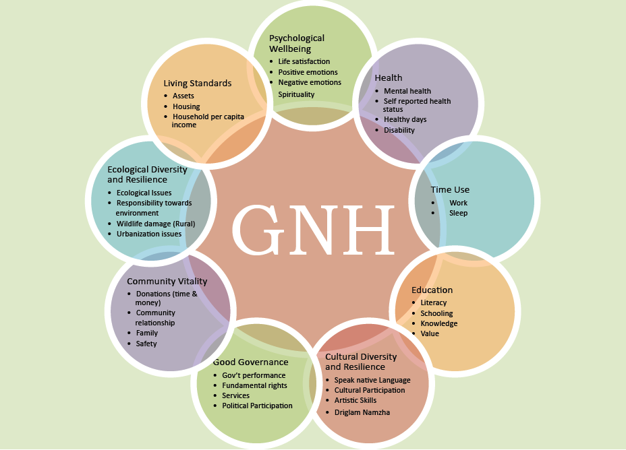
Bhutan’s Gross National Happiness Index
Source: http://www.grossnationalhappiness.com/wp-content/uploads/2012/04/Short-GNH-Index-edited.pdf

Slide 42
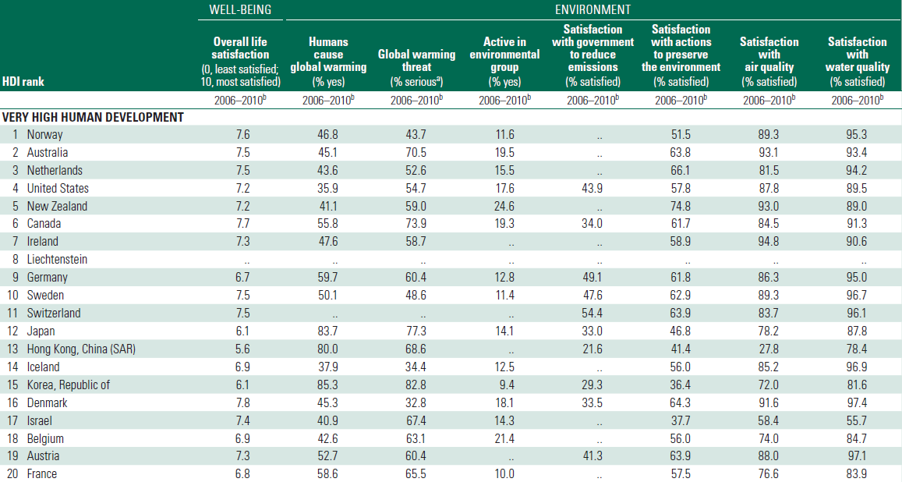
Civic & Community Well-Being
Note that HDI ranks do not always equal well-being ranks!
Source: http://hdr.undp.org/en/media/HDR_2011_EN_Complete.pdf

Slide 43
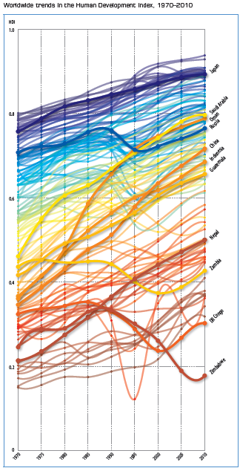
Worldwide HDI Trends, 1970-2010
The fastest progress has been in East Asia and the Pacific, followed by South Asia, then the Arab States.
All but 3 of the 135 countries have a higher level of human development today than in 1970—the exceptions are
Democratic Republic of the Congo
Zambia
Zimbabwe.
Source: http://hdr.undp.org/en/media/HDR_2010_EN_Complete_reprint.pdf/

Slide 44
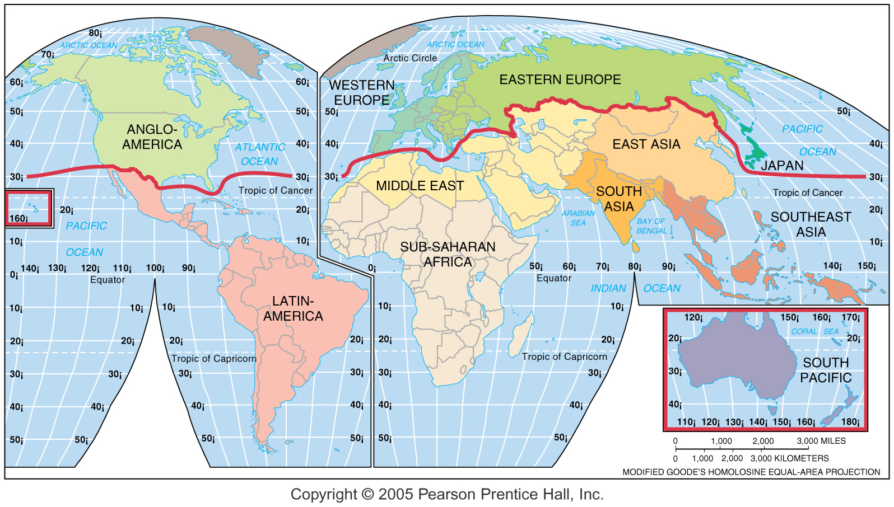
The More and Less Developed Regions
“North” vs. “South”

Slide 45
Development: Why? How?
Why develop? Is it just some kind of cultural imperialism?
Well yes, sometimes – but not necessarily!
Economic, social and demographic measures indicate that people in MDCs are wealthier, healthier, better educated, and better off (in terms of material well being, anyway).
How to Develop?
Two basic approaches:
Self-sufficiency
International Trade

Slide 46
The Self-Sufficiency Model of Development
Emphasis on balanced growth, spreading investment evenly, in all regions, in all economic sectors.
Emphasis on fairness and reducing poverty.
Necessary to insulate domestic industries (“import substitution”) from outside competitors, through use of:
Quotas (limits on numbers of imports)
Tariffs (taxes on imports, increasing their costs, and making local goods more attractive to buyers)
Problems with self-sufficiency:
Inefficiency
Bureaucracy
The self-sufficiency model was very popular in Asia and Africa during much of the 20th century, but has been mostly replaced today by the international trade model.

Slide 47
The International Trade Model of Development
Countries should invest in “distinctive or unique” assets.
Concentrate on developing local industries, exports, services. Selling on the world market brings in money, which can be used to finance other development.
This model has been very successful for some countries.
However, there are problems with this approach:
Uneven resource distribution.
What do you do if the only resources you have are pretty much the same as what your neighbors have?
What do you do if you don't have much of anything?
“The drive to the bottom”
Market stagnation and saturation
Sales take place mostly in the MDCs – where population isn't growing, and markets are already tight and highly competitive.
Dependence on MDCs (as markets)

Slide 48
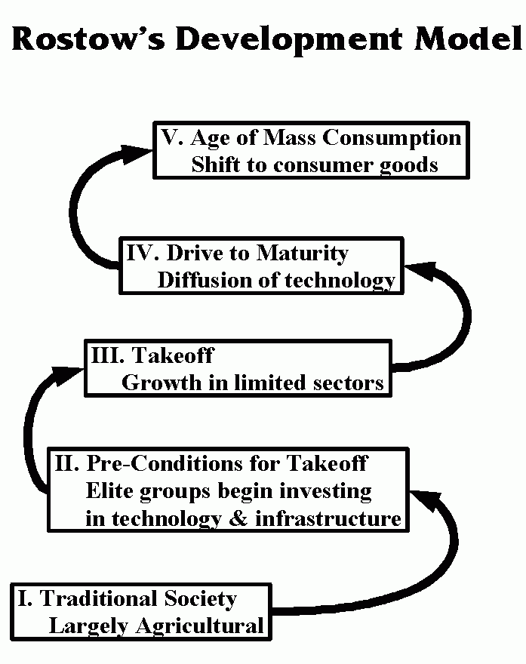
Rostow's Development Model
In the 1950s W.W. Rostow proposed a five-stage model of development based on international trade:
“The Traditional Society”
“Preconditions for Takeoff”
“The Takeoff”
“The Drive to Maturity”
“The Age of Mass Consumption”
Some would now add a sixth stage: “Post-Industrial”

Slide 49
International Trade Model: Successful Examples
The Four “Asian Dragons”
South Korea, Singapore, Taiwan, Hong Kong
Concentration on manufacturing, especially electronics and clothing.
Middle-Eastern Oil States
Saudi Arabia, Kuwait, Bahrain, Oman, UAE.
Use revenue from oil exports to finance development (schools, housing, etc.)

Slide 50
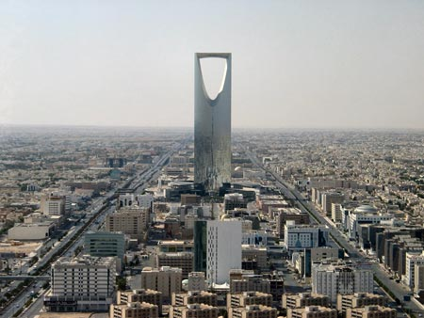
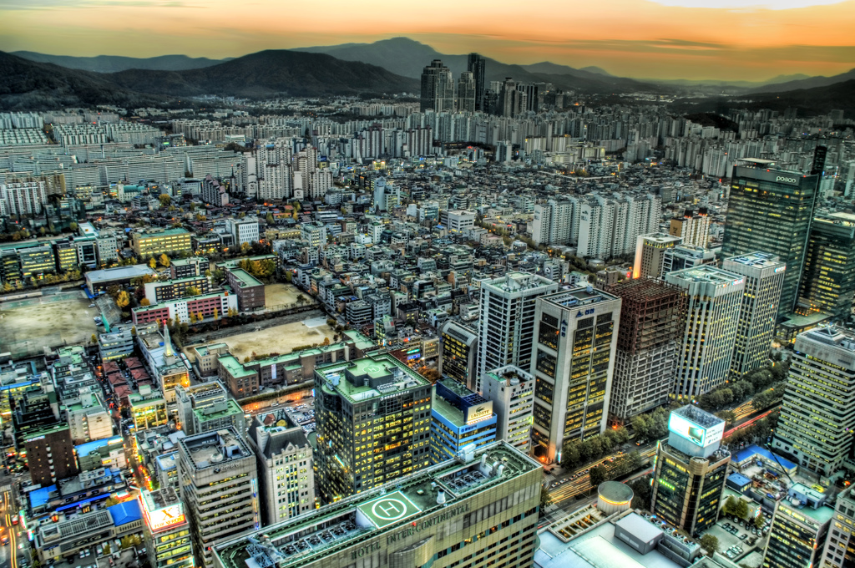
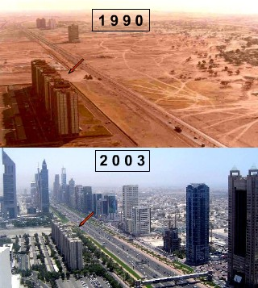
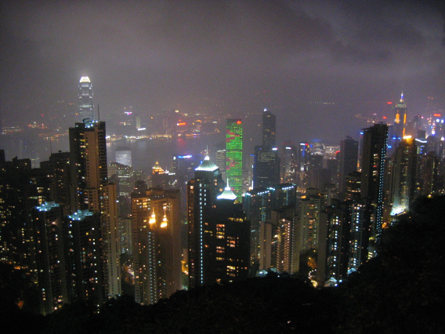
Kingdom Center, Saudi Arabia
Seoul, South Korea
Hong Kong
Dubai, UAE
Sources: http://www.toursaudiarabia.com/images/riyadh-3.html;
http://www.edibek.com/2007/03/13/dubai/; http://stuckincustoms.com/index.php?tag=seoul; http://conneva.com/blog/archives/2006/04/

Slide 51
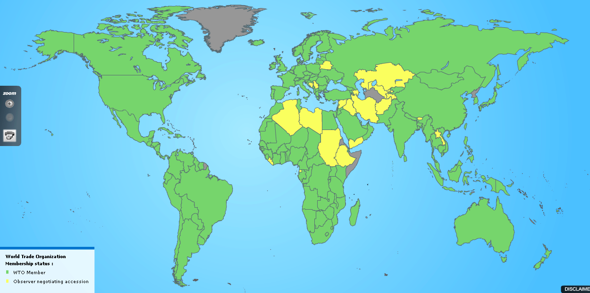
World Trade: The WTO
Russia joined August 2012
As of 2012, the World Trade Organization has 157 members.
The mission of the WTO: “to help trade flow as freely as possible — so long as there are no undesirable side effects — because this is important for economic development and well-being.”
Source: http://www.wto.org/english/thewto_e/countries_e/org6_map_e.htm

Slide 52
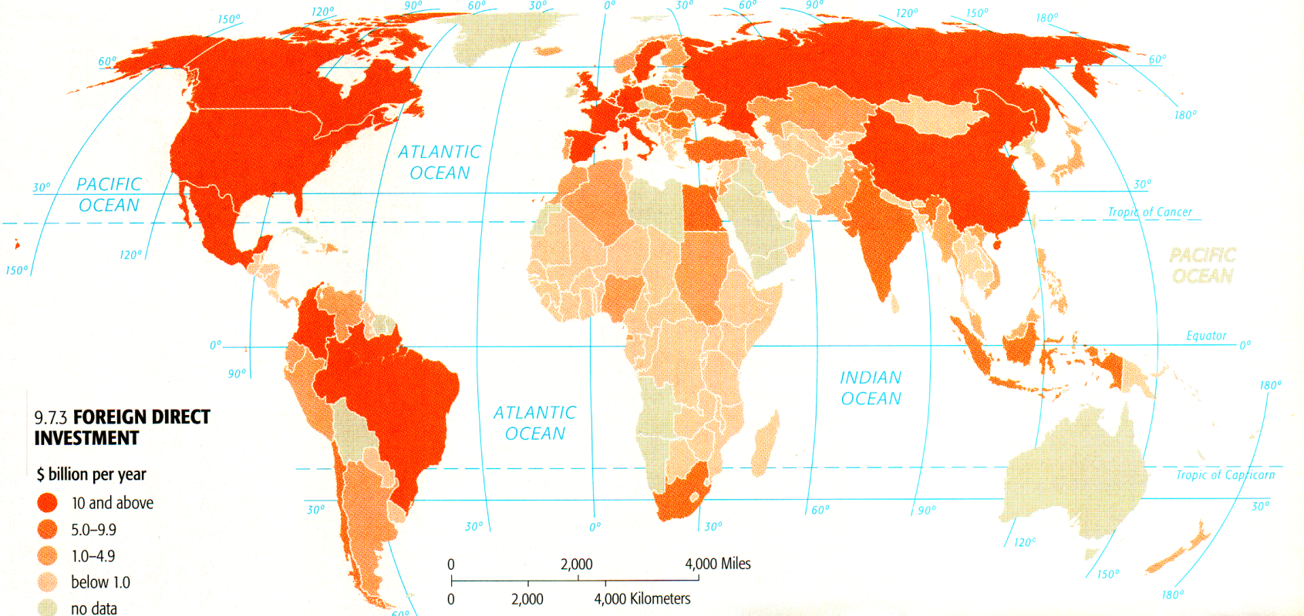
Foreign Investment Flows
Most foreign investment flows from one MDC to another.
Only about 30% goes from an MDC to an LDC.
The main sources of foreign direct investment are transnational corporations.

Slide 53
Financing Development
LDCs cannot afford to fund their own development – it would take too long, and it costs too much.
LDCs have to get the money they need from the MDCs in one of two ways:
Loans (from banks, individual countries, or from international organizations)
Investment by transnational corporations

Slide 54
Loans for Development
The two major lenders for development are the World Bank and International Monetary Fund. Private banks and individual countries also make loans to LDCs for investment in projects such as dams, irrigation, etc.
Total value of all loans to LDCs: more than two trillion dollars. But not all the loans have turned out well.
Expensive failures (poor engineering, failure to attract investors).
Corruption and mismanagement.
The result: some LDCs are unable to repay their loans (or even the interest on their loans). So what happens?
If you can't pay your off you loans, the bank seizes your assets, and you go bankrupt. Countries don't usually have those options.
Banks are forced to restructure loans, and the LDCs find it harder and harder to get money for development.

Slide 55
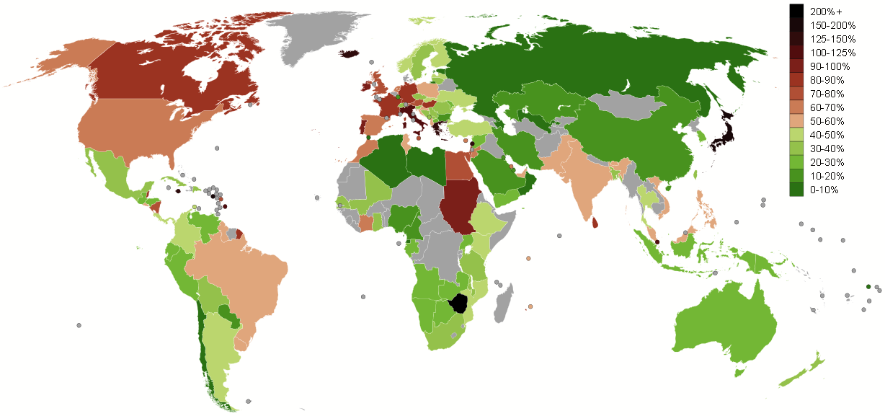
Debt Service as GDP%

Slide 56
The Jubilee 2000 Proposal
In the late 1990s an organization called Jubilee 2000 came up with an interesting idea:
Total outstanding debt: $2,000,000,000,000
Outstanding debt of poorest 41 nations: $200,000,000,000
So the poorest of the poor only owe about 10% of the total – write it off.
Idea endorsed (in some form) by Pope John Paul II, Archbishop Desmond Tutu, Bono, the G8 Nations at their 1999 meeting, etc.
Lots of endorsements – but until 2004 little major action.
Jubilee 2000 disbanded in 2001, but organizations such as Jubilee 2000 USA Network continue.

Slide 57
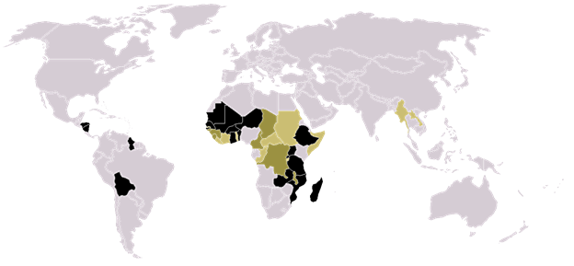
Global Debt
As of 2012, 36 “Highly Indebted Poor Countries” (HIPCs), mostly in Africa, have begun to have some or all of their debt cancelled:
Afghanistan
Benin
Bolivia
Burkina Faso
Burundi
Cameroon
Central African Republic
Chad*
Republic of the Congo
D.R. of the Congo
Comoros*
Ivory Coast
Ethiopia
Gambia
Ghana
Guinea
Guinea-Bissau
Guyana
Haiti
Honduras
Liberia
Madagascar
Mali
Mauritania
Mozambique
Nicaragua
Niger
Rwanda
São Tomé
Senegal
Sierra Leone
Tanzania
Togo
Uganda
Zambia
For more information see: http://www.imf.org/external/np/exr/facts/hipc.htm; Map source: http://en.wikipedia.org/wiki/Heavily_Indebted_Poor_Countries

Slide 58
Structural Adjustment Programs
“The IMF, World Bank, and MDCs fear that granting, canceling, or refinancing debts without strings attached will perpetuate bad habits in LDCs.”
LDCs who want to have debt reduced or eliminated must make structural adjustments its economy.
Adjustments may involve “efficiency” and involve privatizing public institutions (water, power, etc.)
This often means that Transnational Corporations take control of these resources.
Critics say that this forces governments to cut health, education and social programs, and threatens national sovereignty. Lenders say that economic growth benefits everyone in the long run.

Slide 59
Transnational Corporations
Transnational (or "multinational") corporations are major private companies that operate in many countries.
LDCs that seek investment from transnationals have several issues to deal with:
Creating attractive infrastructure.
Competition with other LDCs – “The Race to the Bottom”
Problems of regulation.
Keeping the company happy – making the job, environmental, tax and other laws as attractive as possible.
Remember – a transnational corporation's primary loyalty must be to its stockholders, not to whatever countries it happens to be operating in at the moment.

Slide 60
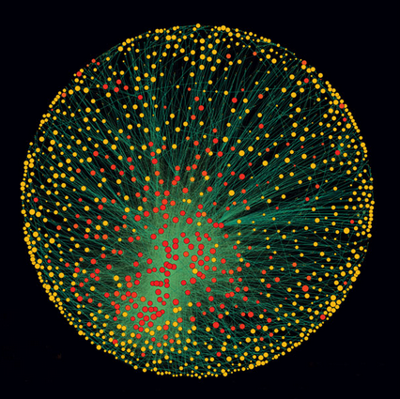
The Major Transnationals
A recent study by Swiss researchers looking at the financial inter-relationships among the largest transnational corporations.
Using a database of 37 million companies and investors worldwide, the researchers identified major 43,060 transnational corporations.
Among these, 1,318 had ties to more than one other major transnational and controlled 60% of all global revenues.
A smaller subset of just 147 companies, whose ownership was within the larger group, controlled 40% of all wealth within the network.
Source: http://www.newscientist.com/article/mg21228354.500-revealed--the-capitalist-network-that-runs-the-world.html

Slide 61
Companies Owning Companies: A Partial Example
Walt Disney Corporation
FILM
MUSIC
TV
OTHER
Hollywood Records
Disney Records
ABC
Miramax
Pixar
ESPN
Muppet Holdings
Baby Einstein
Data source: http://www.cjr.org/resources/

Slide 62
Fair Trade
Fair Trade is a social and a market-based movement to end poverty and promote sustainable development.
Standards for worker and producer safety, rights and income are set by trading and Fairtrade labeling organizations. If a company does not meet producer does not meet the standard, they may not use the fair trade label.
Critics say that fair trade labeling distorts markets and is bad for trade in the long run.
FLO International is the umbrella organization representing 23 national labeling organizations and several hundred producer organizations.
Fairtrade commodities include handicrafts, coffee, cacao, tea, etc.
For more information see: http://www.fairtrade.net/home.html

Slide 63
Micro-Credit Banks
One of the most interesting approaches to development in recent years has been the development of “micro-credit” lending – lending tiny amounts of money (typically a few hundred dollars) to individuals (often women) in poor countries to start “micro-businesses.”
The first micro-credit lender was the Grameen Bank in Bangladesh. Today similar institutions exist in 34 countries. For more information see:
http://www.grameen-info.org/
http://www.gfusa.org/
The Grameen Bank received the Noble Peace Prize in 2006.
Unfortunately, there has been recent criticism of Micro-Credit – that it can lead to increased poverty, that women are exploited by their families, that some institutions (not Grameen) have refused to adjust or restructure loans – even in the face of disasters.

Slide 64
The Grameen Bank
http://www.youtube.com/watch?v=HBBkoUHsBUg

Slide 65
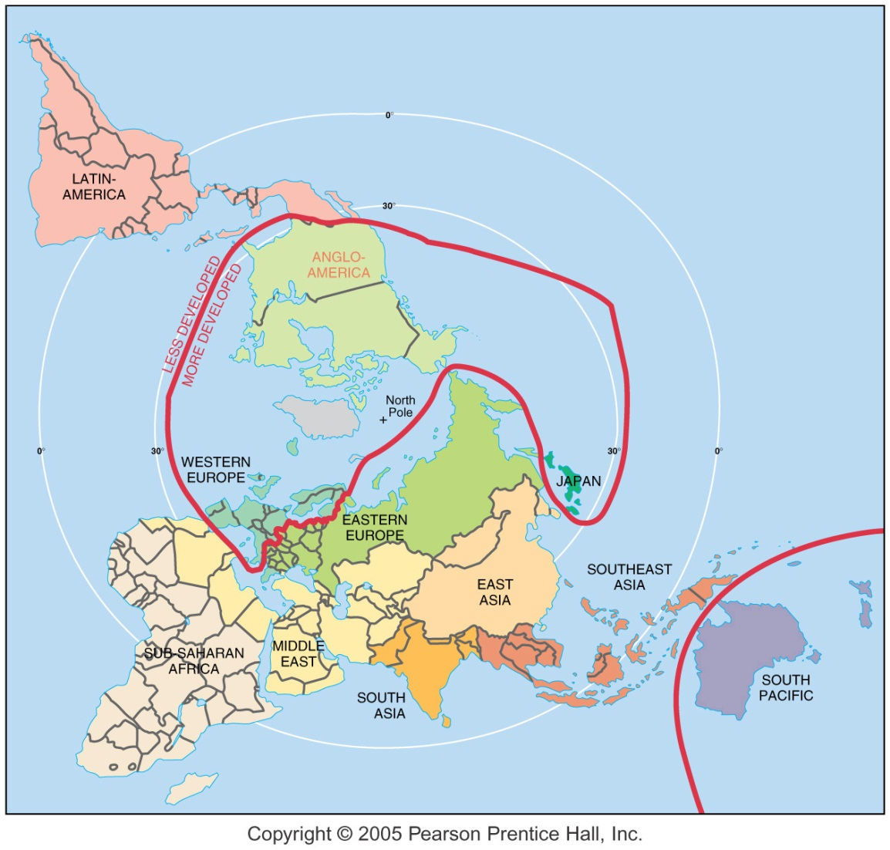
Core and Periphery in the World Economy Today

Slide 66
Millennium Development Goals
End poverty & hunger.
Achieve universal primary education.
Promote gender equality.
Reduce child mortality.
Improve maternal health.
Combat disease (HIV, malaria, etc.)
Ensure environmental sustainability.
Develop a global partnership for development.

