Slide 1
Resource Issues

Slide 2
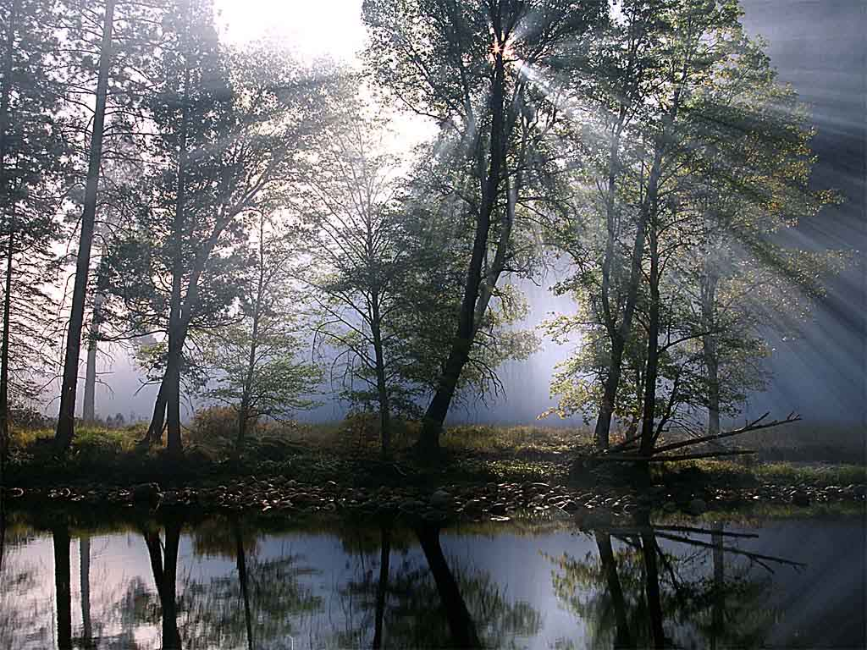
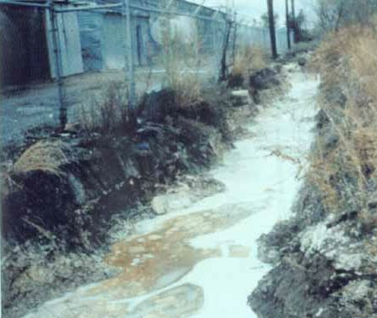
People & The Environment
Like all living things, people interact with their environment.
Unlike other living things, we have the ability to radically alter our environment
We can choose how we will affect the natural world — constructively or destructively.
Source: http://www.nmenv.state.nm.us/gwb/pps.html

Slide 3
Resources
A resource is a substance in the environment that is useful to people, is economically and technologically feasible to access, and is socially acceptable to use.
There are two basic categories of resources: renewable and non-renewable.
  Renewable resources – like fertile soil, trees, fish – can be used without being used up – they can renew themselves in a reasonable period of time.
  Non-renewable resources – like oil and minerals – can be exhausted. Once they are used up, they’re gone.

Slide 4

The Tragedy of the Commons
If they are mismanaged or wasted, renewable resources can be made non-renewable.
Solutions?
  Legal (policing);
  Moral (shame);
  Structural (privatize).

Slide 5
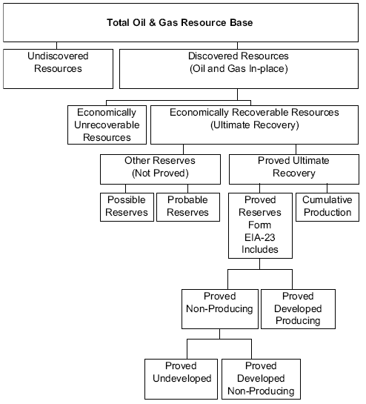
“Proven” vs. “Potential” Reserves
Proven reserves can be measured with reasonable accuracy – we can be confident about how much is available, and that it can be recovered economically.
Potential reserves have not been discovered. So how do we know they exist? We don’t – but based on what we know we can make a good guess about their existence.
Source: http://www.eia.doe.gov/emeu/international/petroleu.html#Reserves

Slide 6
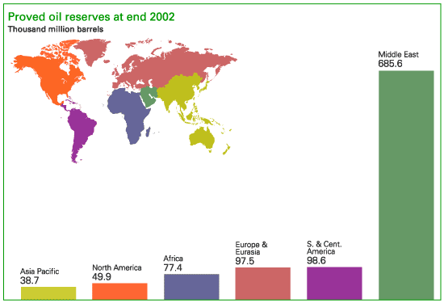
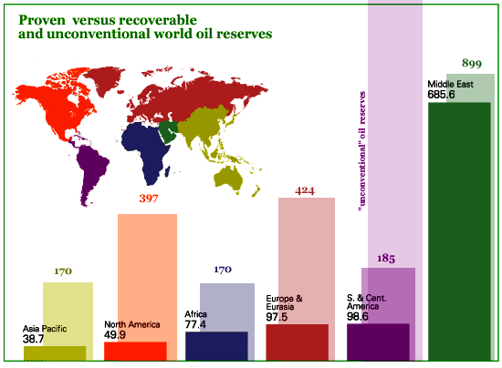
Proven vs. Potential, 2002
Source: http://www.radford.edu/wkovarik/oil/oilcharts.html

Slide 7
Energy: Fossil Fuels
In the late 1800s coal became more important than wood (at least in the MDCs).
Oil became the most important source of power in the 20th Century.
Fossil fuels have two important characteristics:
  The supply is finite.
  The supply is unevenly distributed.

Slide 8
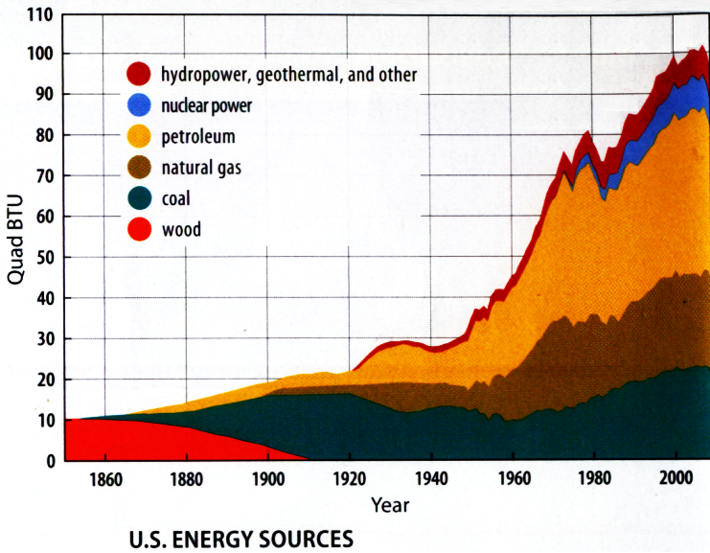
Changing US Energy Sources 1850–2010

Slide 9
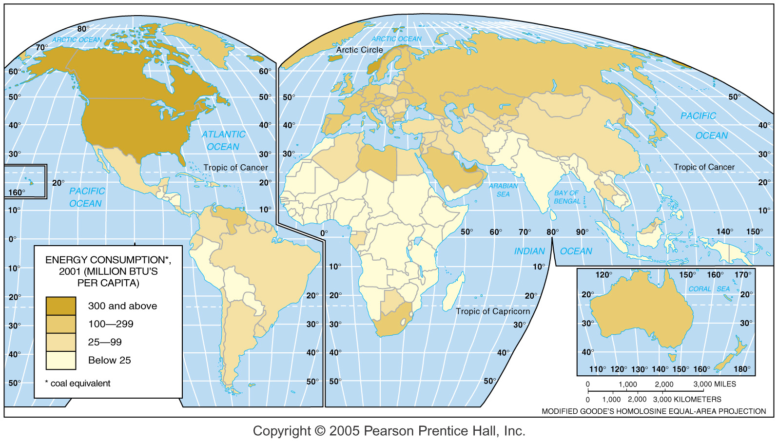
Per Capita Energy Consumption

Slide 10
Reserves, Production (2011):
COAL
Total proven reserves: 860,938 million tonnes
Major proven reserves:
  US (28%)
  Russia (18%)
  China (13%)
Annual global production: 3,956 million tonnes (oil equivalent)
Major Producers (million tonnes oil equivalent):
  China (50%)
  US (14%)
  Australia (6%)
  India (6%)
  Indonesia (5%)
Adapted from the BP Statistical Review of World Energy, June 2012. See http://www.bp.com/assets/bp_internet/globalbp/globalbp_uk_english/reports_and _publications/statistical_energy_review_2011/STAGING/local_assets/pdf/statistical_review_of_world_energy_full_report_2012.pdf

Slide 11
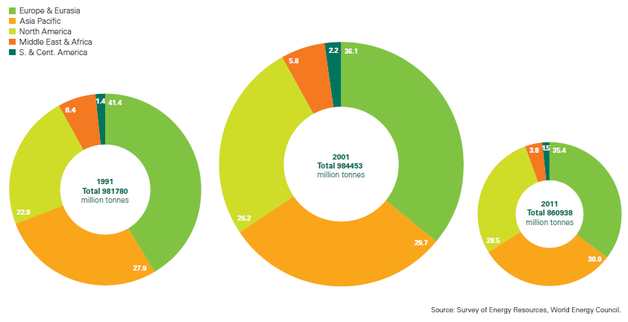
Proven Coal Reserves
Adapted from the BP Statistical Review of World Energy, June 2012. See http://www.bp.com/assets/bp_internet/globalbp/globalbp_uk_english/reports_and _publications/statistical_energy_review_2011/STAGING/local_assets/pdf/statistical_review_of_world_energy_full_report_2012.pdf

Slide 12
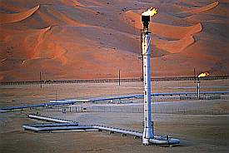
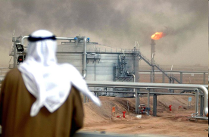
Reserves, Consumption (2011):
OIL
Total proven reserves: 1,652.6 billion barrels
Major proven reserves:
  Saudi Arabia (16.1%)
  Iran (9.1%)
  Iraq (8.7%)
  Kuwait (6.1%)
Daily global production: 83,576 thousand barrels
Major consumers:
  US (20.5% of global daily production)
  China (11.4%)
  Japan (5.0%)
  India (4.0%)
  Russian Federation (3.4%)
Adapted from the BP Statistical Review of World Energy, June 2012. See http://www.bp.com/assets/bp_internet/globalbp/globalbp_uk_english/reports_and _publications/statistical_energy_review_2011/STAGING/local_assets/pdf/statistical_review_of_world_energy_full_report_2012.pdf

Slide 13
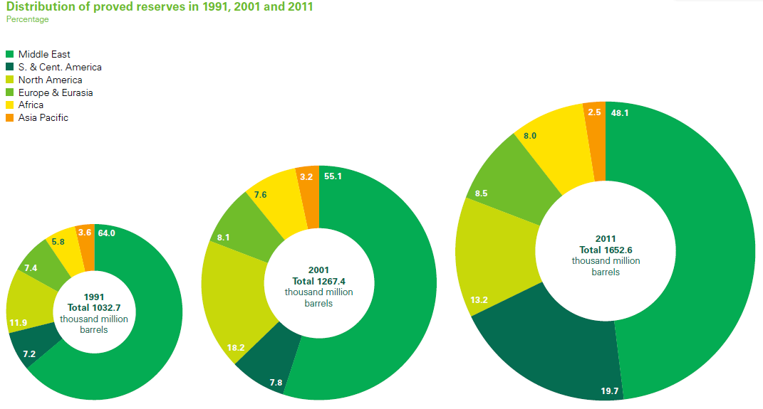
Proven Oil Reserves
13
Adapted from the BP Statistical Review of World Energy, June 2012. See http://www.bp.com/assets/bp_internet/globalbp/globalbp_uk_english/reports_and _publications/statistical_energy_review_2011/STAGING/local_assets/pdf/statistical_review_of_world_energy_full_report_2012.pdf

Slide 14
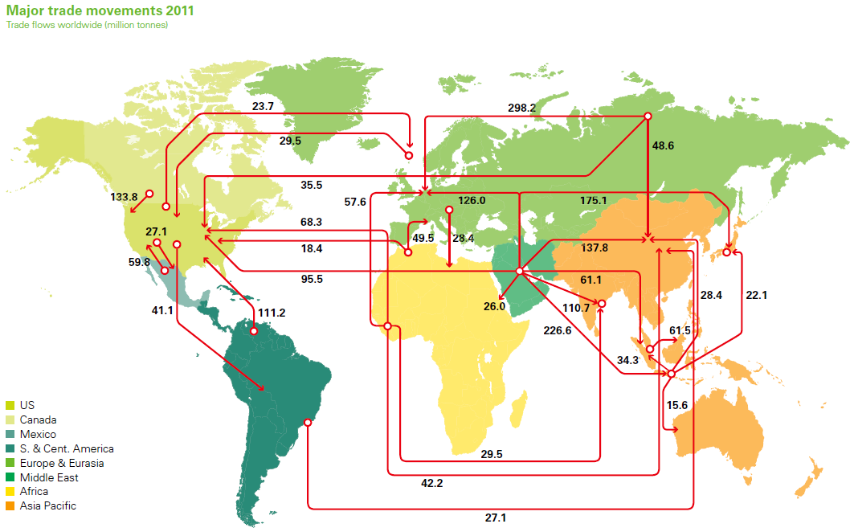
Oil Imports & Exports, 2011
14
Adapted from the BP Statistical Review of World Energy, June 2012. See http://www.bp.com/assets/bp_internet/globalbp/globalbp_uk_english/reports_and _publications/statistical_energy_review_2011/STAGING/local_assets/pdf/statistical_review_of_world_energy_full_report_2012.pdf

Slide 15
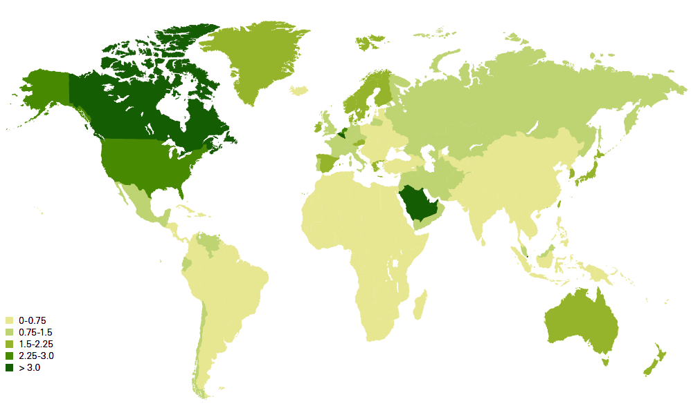
Per Capita Oil Consumption, 2011
15
In tonnes
Adapted from the BP Statistical Review of World Energy, June 2012. See http://www.bp.com/assets/bp_internet/globalbp/globalbp_uk_english/reports_and _publications/statistical_energy_review_2011/STAGING/local_assets/pdf/statistical_review_of_world_energy_full_report_2012.pdf

Slide 16
Reserves, Production (2011):
NATURAL GAS
Total proven reserves: 208 trillion cubic meters
Major proven reserves:
  Russia (21%)
  Iran (16%)
  Qatar (12%)
  Turkmenistan (12%)
Annual global production: 3,223 billion cubic meters
Major consumers:
  US (22%)
  Russia (13%)
  Iran (5%)
  China (4%)
  Japan (3%)
Adapted from the BP Statistical Review of World Energy, June 2012. See http://www.bp.com/assets/bp_internet/globalbp/globalbp_uk_english/reports_and _publications/statistical_energy_review_2011/STAGING/local_assets/pdf/statistical_review_of_world_energy_full_report_2012.pdf

Slide 17
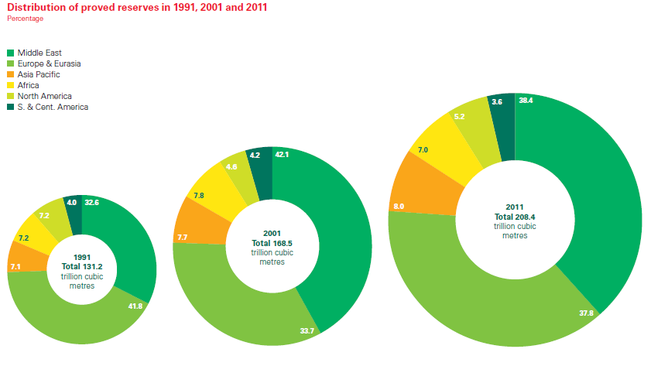
Natural Gas: Proven Reserves
Adapted from the BP Statistical Review of World Energy, June 2012. See http://www.bp.com/assets/bp_internet/globalbp/globalbp_uk_english/reports_and _publications/statistical_energy_review_2011/STAGING/local_assets/pdf/statistical_review_of_world_energy_full_report_2012.pdf

Slide 18
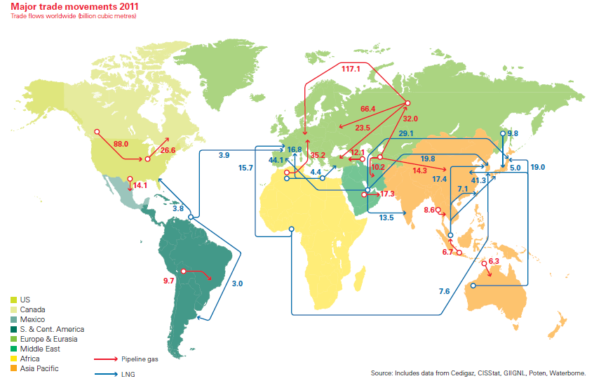
Natural Gas Imports & Exports, 2011
Adapted from the BP Statistical Review of World Energy, June 2012. See http://www.bp.com/assets/bp_internet/globalbp/globalbp_uk_english/reports_and _publications/statistical_energy_review_2011/STAGING/local_assets/pdf/statistical_review_of_world_energy_full_report_2012.pdf

Slide 19
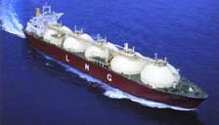
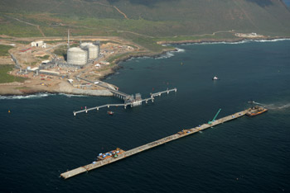
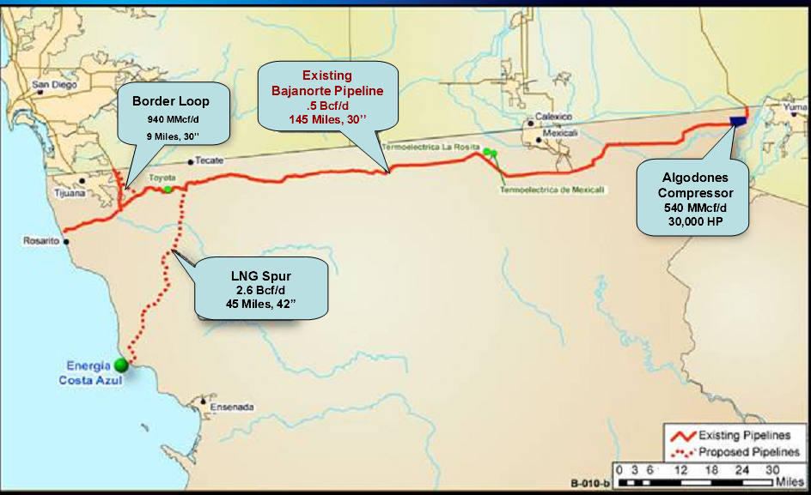
LNG
The easiest way to transport natural gas is by pipeline – but when that’s not possible, it can be sent by tanker.
Natural gas is liquefied by cooling it to -259˚F (-161˚C); it condenses to form a liquid with just ¹/₆₀₀th its original volume. When it reaches its destination the LNG is warmed and “regassified.”
Unfortunately, these procedures take a lot of energy – making LNG less efficient and environmentally friendly than conventionally processes natural gas.
There has never been a serious LNG tanker accident; however, there have been some accidents in the processing phases.
This is Sempra Energy’s new Energía Costa Azul facility near Ensenada, Mexico.
It began operation in 2008, and can process one billion cubic feet/day.
Source: http://www.energy.ca.gov/lng/faq.html; http://www.energiacostaazul.com.mx/English/constructionupdate.htm;
http://www.energy.ca.gov/lng/documents/costa_azul/2007-01-18_GOVERNORS_LNG_TASK_FORCE_BRIEFING.PDF

Slide 20
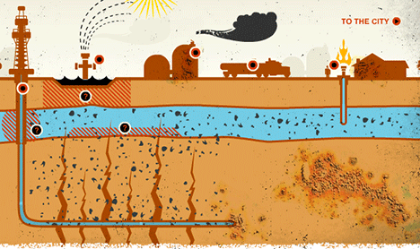
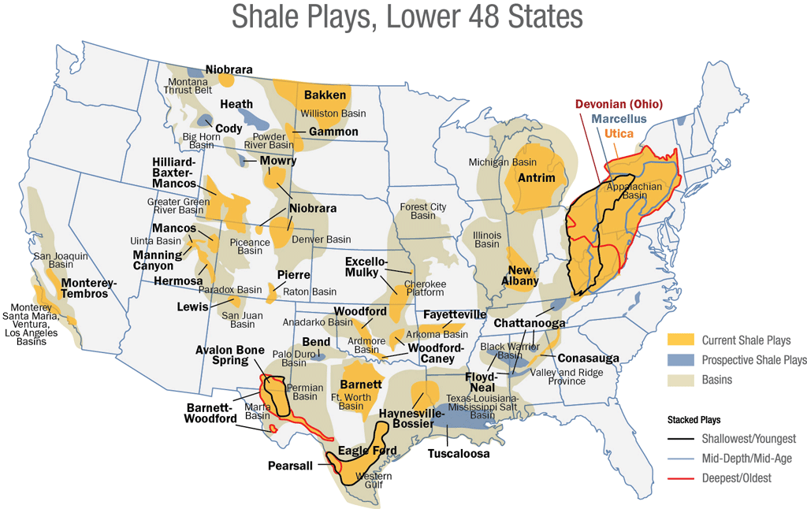
Fracking
Fracking (“induced hydraulic fracturing”) is a kind of drilling in which a fluid is used to create breaks (fractures) in rock at great depth.
Fracking is used to extract both oil and natural gas from sources that cannot otherwise be productive.
Fracking has enormously increased proven reserves in the US. However, there are real concerns about air and water pollution, as well as global warming (there are also some who dispute how much of the reserves are really "proven").
Sources: http://earthjustice.org/features/campaigns/fracking-across-the-united-states;
http://bigthink.com/think-tank/what-you-need-to-know-about-fracking; http://northcarolinaflowers.blogspot.com/2012/12/hello-everyone-i-was-searching-for.html

Slide 21
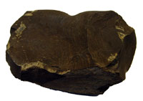
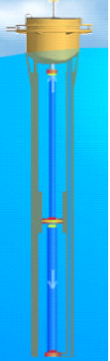
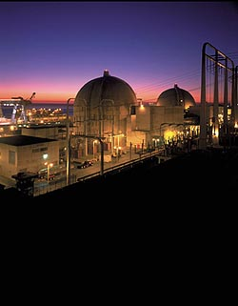
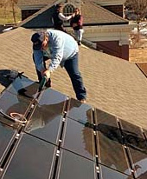
Alternative Sources of Energy
Non-Renewable
  Alternative fossil fuels (oil shale, frozen methane)
  Nuclear power (fission-based)
Renewable (or inexhaustible)
  Solar
    Passive
    Active
      Heat conversion
      Indirect electric
      Photovoltaic
Other Renewable Energy Sources
  Wind
  Waves
  Hydroelectric
  Biomass
  Nuclear Fusion
  Others?
Sources: http://www.eere.energy.gov/kids/roofus/solar_panels.html; http://ostseis.anl.gov/guide/oilshale/index.cfm;
http://www.anl.gov/Media_Center/logos22-1/hydrogen.htm; http://www.epa.gov/cleanenergy/pdf/smith_may10.pdf

Slide 22
Problems With Other Fossil Fuels
Alternative fossil fuels have all the inherent problems of more conventional fossil fuels.
They also have major problems:
  They are usually not economical to extract at current prices; or
  We aren’t sure how to extract or process them yet.

Slide 23
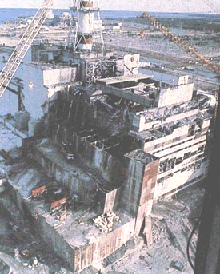
Problems with Nuclear Power
Nuclear power produces about 6% of the world’s electricity (the amount varies – 75% of the electricity in Lithuania and France comes from nuclear power).
Nuclear power also varies in the US – 18 states have no nuclear power, but it supplies more than half the electricity in New Hampshire and Vermont.
Problems with nuclear power:
  Accidents
  Waste and waste storage
  Bomb material (nuclear and “dirty” bombs)
  Non-renewable – limited fuel supply
  High cost
Chernobyl, Ukraine
Source: http://www.hf.faa.gov/webtraining/Controls/ControlsFinal022.htm

Slide 24
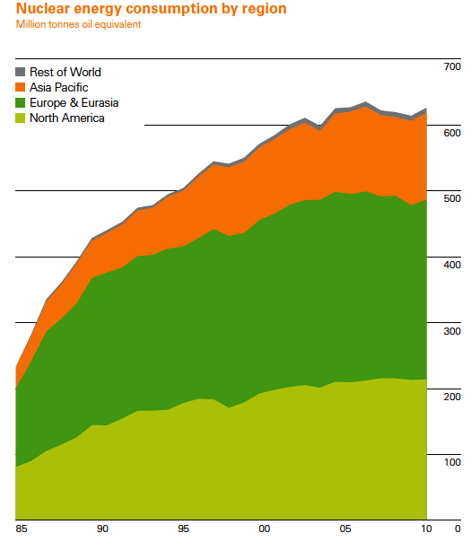
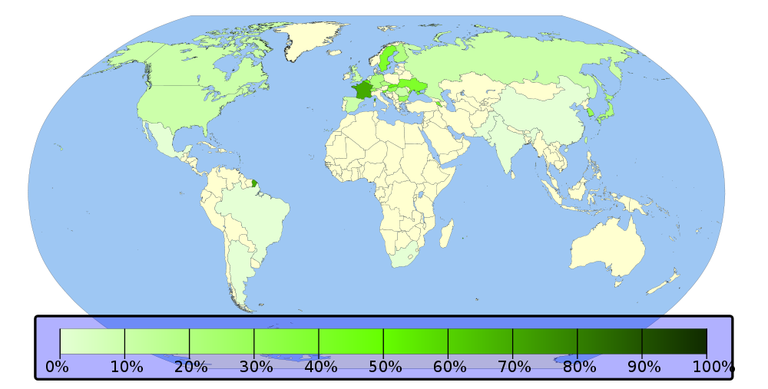
Nuclear Power Production
http://upload.wikimedia.org/wikipedia/commons/thumb/9/9b/Nuclear_power_percentage.svg/1000px-Nuclear_power_percentage.svg.png; Adapted from the BP Statistical
Review of World Energy, June 2011. See http://www.bp.com/assets/bp_internet/globalbp/globalbp_uk_english/reports_and
_publications/statistical_energy_review_2011/STAGING/local_assets/pdf/statistical_review_of_world_energy_full_report_2011.pdf

Slide 25
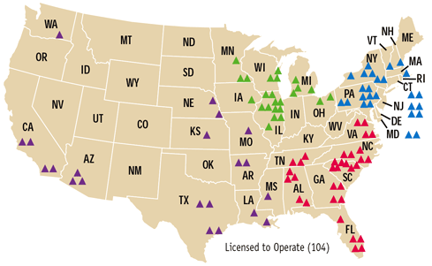
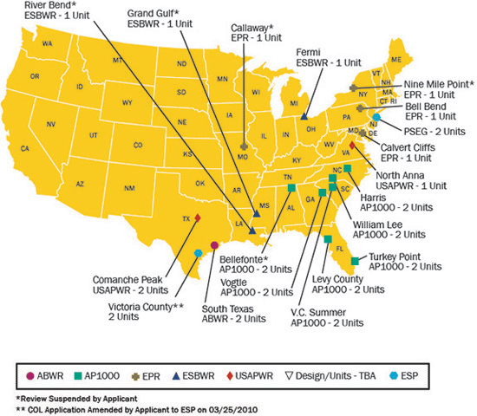
Nuclear Power in the U.S.
Current nuclear power plants
Proposed nuclear power plants
Sources: http://www.nrc.gov/reading-rm/doc-collections/nuregs/staff/sr1415/v18n2/; http://www.nrc.gov/reactors/new-reactors/col/new-reactor-map.html

Slide 26
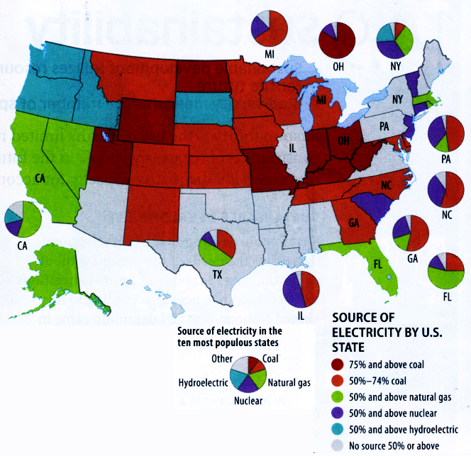
Electricity Source, by State

Slide 27
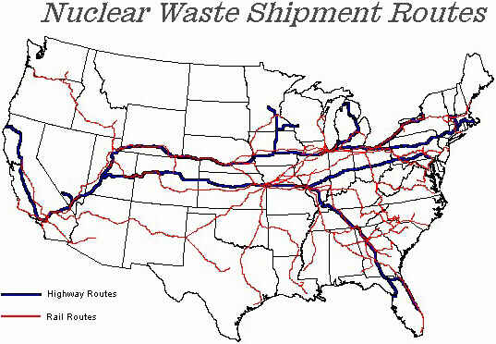
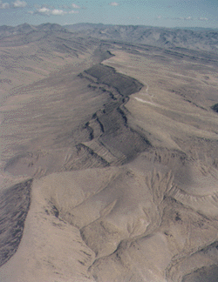
Radioactive Waste
Radioactive waste may be either
  Low-level (650,000 yd³/year)
  High-level (more than 30,000 tons)
Radioactive waste may be dangerous for literally thousands of years.
Low-level waste in the US can be disposed of at the Waste Isolation Pilot Project (WIPP) in New Mexico.
Yucca Mountain, NV
The Yucca Mountain high-level waste repository project was canceled in 2010.
http://www.ymp.gov/reference/photos/geology/page1.htm;
http://www.state.nv.us/nucwaste/states/us.htm

Slide 28
Problems with Renewable
Energy Sources
Solar, wind and wave power are dispersed – you need large areas and lots of machines to harness them – which raises costs.
Hydroelectric and geothermal power can only be done in a limited number of places – and have serious environmental impacts.
Biomass energy can cause pollution, and may cause a loss of food producing lands.
Nuclear fusion sounds great – but it doesn’t work yet.

Slide 29
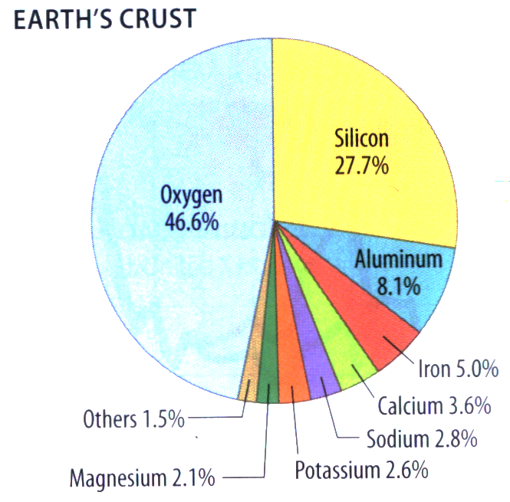
Mineral Resources
Minerals are essential for an industrial society.
Unfortunately, the earth’s crust is fairly miserly when it comes to the metals and other minerals – metallic and non-metallic – that we need.
Remember that minerals are non-renewable – once they’re mined, they’re gone.

Slide 30
Commercial Cut-Off Grades for Ore Deposits
Metal | Avg. Crust Abundance (%) | Minimum Commercial Grade (%) | Concentration Factor
Aluminum | 8.13% | 30% | 3.7
Iron | 5.00% | 25% | 5.0
Manganese | 0.10% | 35% | 350
Chromium | 0.02% | 30% | 1500
Nickel | 0.008% | 1.5% | 188
Zinc | 0.008% | 4% | 500
Copper | 0.007% | 1% | 140
Silver | 0.00001% | 500 g/t | 5000
Gold | 0.0000005% | 5 g/t | 1000

Slide 31
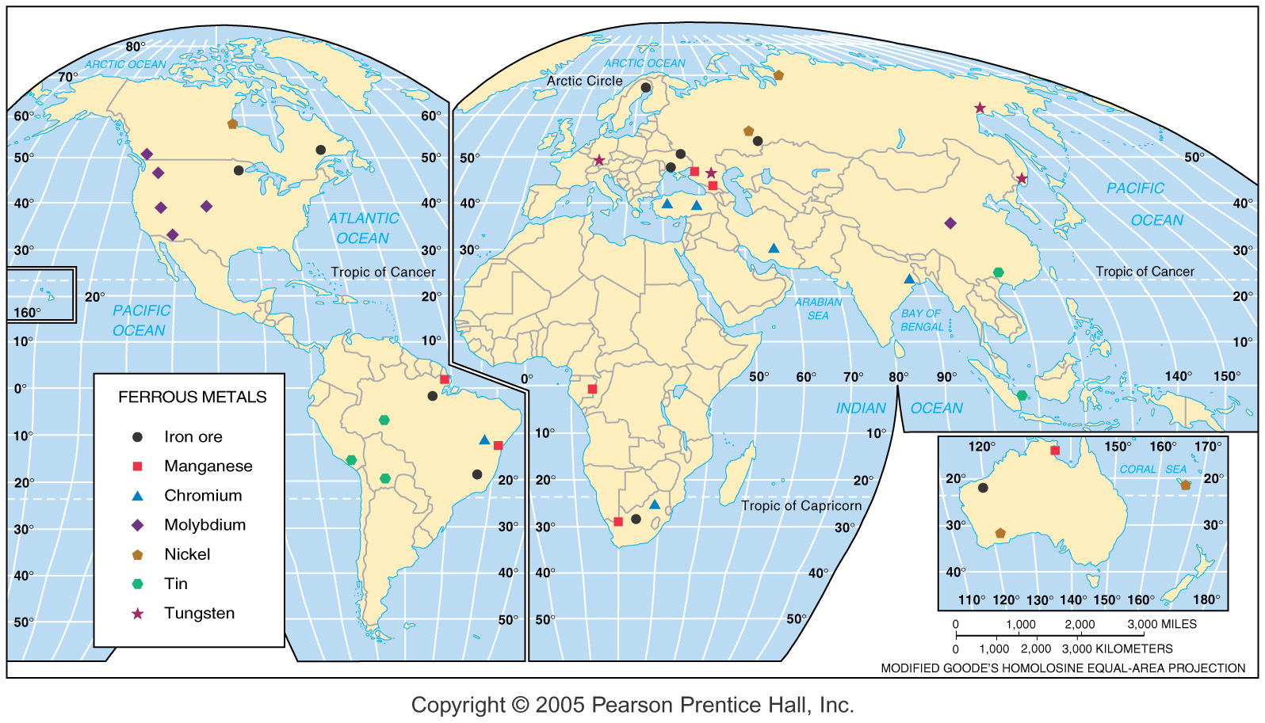
Ferrous Minerals
“Ferrous” minerals include iron and all the various alloy metals (chromium, manganese, etc.) that are used in steel making.

Slide 32
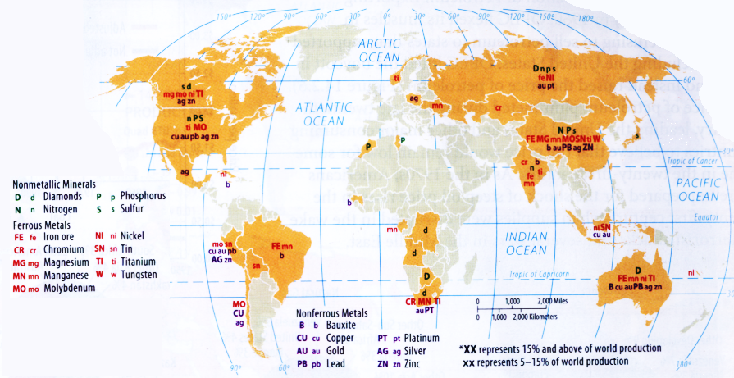
Nonferrous Metal Production
Nonferrous metals are basically all metals that aren’t involved in iron and steel production (including precious metals like gold and silver).
Nonmetallic mineral resources include everything from sand and gravel to precious gems.

Slide 33
Pollution
When more waste is added than a resource can accommodate, we have pollution.
Not all pollution is caused by people; however, until we can control volcanoes, we are going to worry about the things we are responsible for:
  Air pollution
  Water pollution
  Land pollution (waste disposal)
When it comes to managing pollution there are two types of sources: point and non-point. Point are much easier to control.

Slide 34
Air Pollution
We can talk about air pollution in terms of three scales: global, regional and local.
Global air pollution problems:
  Global climate change
  Ozone damage
Regional air pollution problems:
  Acid deposition
Local air pollution problems:
  Smog

Slide 35
GLOBAL: People and Climate Change
There is no question that earth’s climate has changed over time
There is also no question that people have been adding large quantities of certain gases and particles to atmosphere for the past 250 years.
The question is: Does what we do seriously affect the earth’s climate?

Slide 36
Global Warming?
Instead of “warming” it would be better to say “climate change.”
We know that global climate has changed – that’s not the issue.
What we are focusing on here is human caused (or anthropogenic) climate change.
The factors that cause climate change are complex.
The effects of climate change are likely to be complex, too.

Slide 37
Factors Affecting Climate Change
Greenhouse Gasses (CO₂, CH₄, CFCs, etc.)
Atmospheric aerosols (soot, etc.)
Cloud changes
Land cover changes
Variations in the sun’s output
Volcanic aerosols
Hotter Cooler

Slide 38
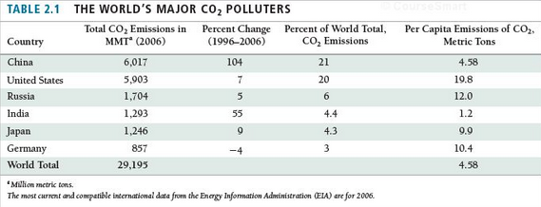
The World’s Major CO₂ Producers
These six countries produce nearly 60% of the world’s CO₂.

Slide 39
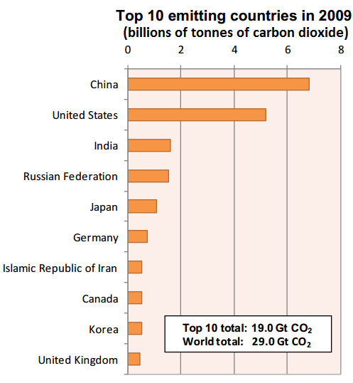
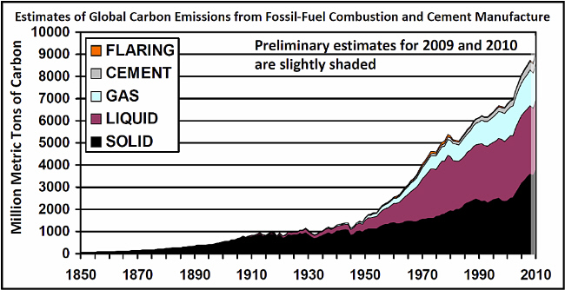
CO₂ Production
2010
Just 10 countries account for about ²/₃ of all CO₂ emissions.
There was a slight decline in the US and Europe due to global financial problems, but Asia and South America have been increasing.
Sources: http://cdiac.ornl.gov/trends/emis/perlim_2009_2010_estimates.html; http://www.iea.org/co2highlights/CO2highlights.pdf

Slide 40
But Isn’t There Controversy?
Not all the evidence clearly points to global climate change.
It seems like there are contradictory news story almost every day.
All we can do is take the best evidence we can get, listen to the most reliable sources, and try to make the most prudent decisions.

Slide 41
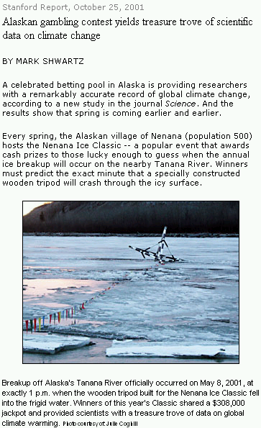
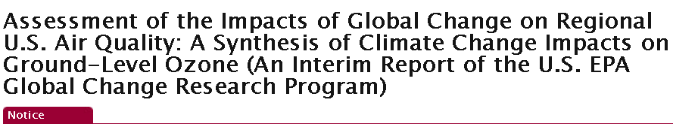
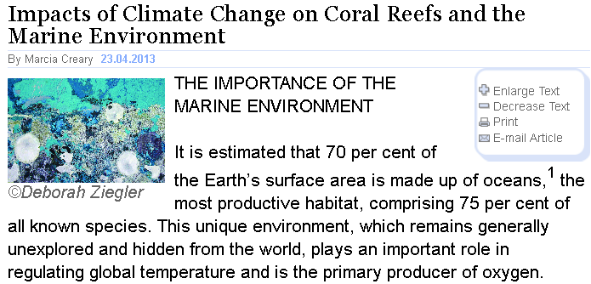
Sometimes the research is serious, sometimes it seems silly.
In the Nenana Ice Classic for 2012, the ice breakup date was April 23rd.
The prize was $350,000.
See: http://www.nenanaakiceclassic.com/
http://cfpub.epa.gov/ncea/global/recordisplay.cfm?deid=203459; http://www.un.org/wcm/content/site/chronicle/home/archive/issues2013/water/impactsofclimatechangeoncoralreefsandthemarineenvironment

Slide 42
Nenana Ice Classic Data
Note that the dates are in Julian format, so lower numbers mean earlier in the year (e.g. January 1st = “Day 1,” and “Day 110” = April 20^{th)}.
So – is there a pattern?
Data source: ftp://sidads.colorado.edu/pub/DATASETS/NENANA/;
http://www.nenanaakiceclassic.com/Both.htm; http://nsidc.org/index.html

Slide 43
Nenana Ice Classic Trend
The red line indicates a trend (a simple regression line) in the data
It seems to say that the ice is tending to break up earlier.
Data source: ftp://sidads.colorado.edu/pub/DATASETS/NENANA/;
http://www.nenanaakiceclassic.com/Both.htm; http://nsidc.org/index.html

Slide 44
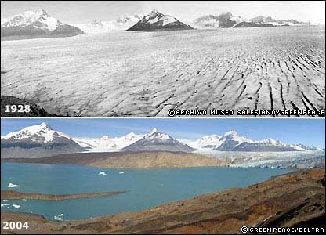
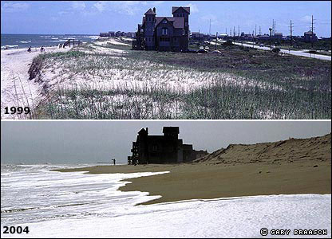
Before & After (or maybe “During”)
Cape Hatteras, North Carolina
Upsala Glacier, Argentina
Source: http://news.bbc.co.uk/1/shared/spl/hi/picture_gallery/05/sci_nat_how_the_world_is_changing/html/1.stm

Slide 45
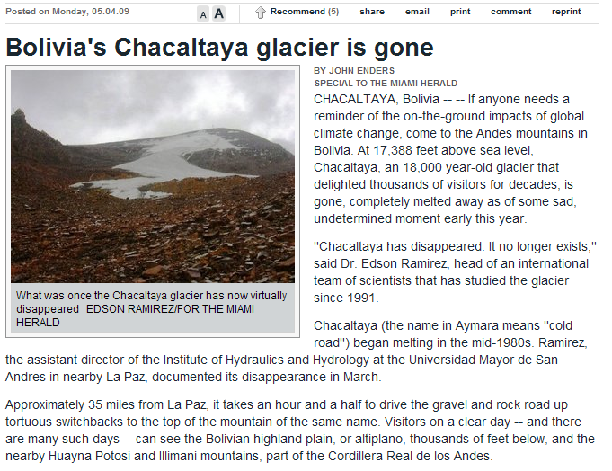
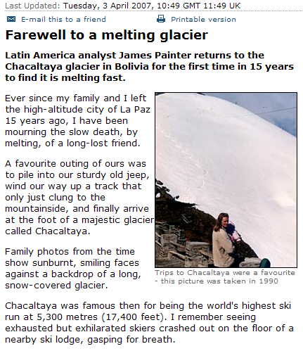
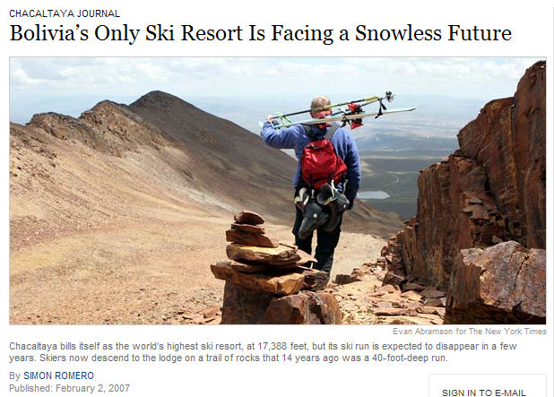
Chacaltaya: End of a Glacier
Source: http://news.bbc.co.uk/2/hi/americas/6496429.stm; http://www.miamiherald.com/news/americas/story/1030126.html;
http://www.nytimes.com/2007/02/02/world/americas/02bolivia.html?_r=1

Slide 46
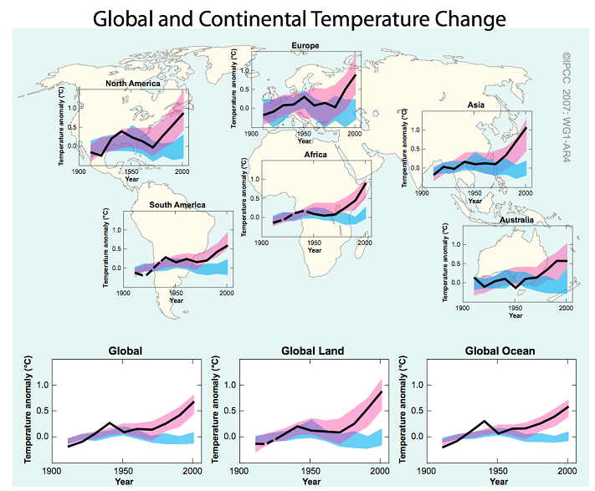
Highlights from the IPCC 2007 Summary for Policymakers
Warming of the climate system is “unequivocal.”
For the next two decades temperatures will rise by 0.2˚C, with continued rising through the end of the century. A total rise in global average temperatures of about 2.0˚C-4.5˚C (3.6 - 8.1°F) is likely.
Predicted sea level rise is now in the range of 0.3-0.8m (11.8-31.5 in), although a larger rise is possible.
Snow cover at the global scale is predicted to contract, with widespread thawing of permafrost.
Extra-tropical (midlatitude) and tropical storm tracks are predicted to move poleward.
Precipitation may increase at higher latitudes and decrease in the subtropics.
Climate changes will persist for centuries.
Source: http://www.ipcc.ch/

Slide 47
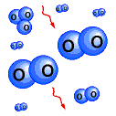

Ozone is just Oxygen!
Oxygen makes up about 21% of the atmosphere. Most of the time, atmospheric oxygen atoms travel in pairs — as O₂ molecules
However, oxygen in the atmosphere can exist in another form — as O₃ or ozone.
Source: http://uarsfot08.gsfc.nasa.gov/HP_THEME/Ozone_Topic/Stat_Ozone_Loss(nat)

Slide 48
Ozone Is Not “Just Oxygen!”
Ozone is more chemically active than oxygen.
Ozone is a pale blue gas.
Ozone has a distinctive smell.
Ozone has the ability to absorb/block ultraviolet light.
Ozone is an extremely poisonous, corrosive gas (and has been used as a disinfectant, in water purification, and as a bleach) that damages and kills vegetation.
In the stratosphere, ozone is vital to our planet’s survival.

Slide 49
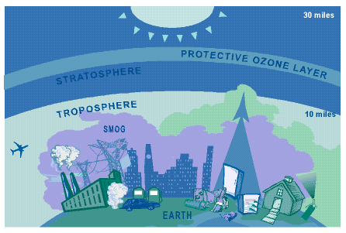
In the upper atmosphere, ozone is produced by a natural process and forms a layer that protects us from ultraviolet radiation.
At ground level, ozone is a dangerous pollutant (part of smog).
Source: http://www.epa.gov/oar/oaqps/gooduphigh/

Slide 50
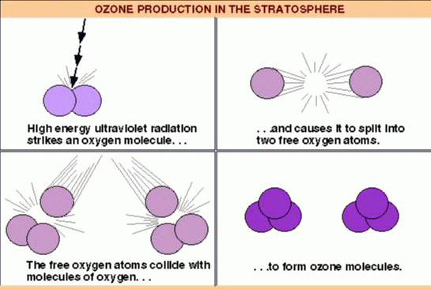
Making Good Ozone…
Source: http://www.meto.umd.edu/~bruce/m1239702.html

Slide 51

…And Making It Better
Source: http://www.meto.umd.edu/~bruce/m1239702.html

Slide 52

The Problem: CFCs and Friends
A variety of human-created chemicals, including solvents, packaging materials, industrial cleaners, and fire extinguishers, contain chlorofluoro-carbons (CFCs) or related chemicals (HCFCs, carbon tetrachloride, methyl chloroform, etc.).
When CFCs interact with ozone in the stratosphere, the results aren’t pretty
Source: http://www.epa.gov/oar/oaqps/gooduphigh/

Slide 53




Breaking Up Is Hard ...
1
2
3
4
Source: http://www.meto.umd.edu/~bruce/m1239702.html

Slide 54


… And It Keeps Getting Worse
5
6
Source: http://www.meto.umd.edu/~bruce/m1239702.html

Slide 55


Cold Clouds
During winter stratospheric winds form a vortex around the South Pole. Within the vortex the atmosphere over the pole is effectively isolated, temperatures are extremely cold (-80ºC), and unusual polar stratospheric clouds form.
Chlorine from CFCs is “stored” on the clouds during the long polar night, and then released to attack ozone when the sun returns in spring.
Sources: http://svs.gsfc.nasa.gov/imagewall/solve.html; http://zebu.uoregon.edu/1997/ph161/l15.html ;
http://science.org.au/nova/004/004glo.htm

Slide 56

The Results for the Planet
Total Ozone Mapping Spectrometer (TOMS) on the Earth Probe satellite shows the growth of the ozone hole over 20 years. Image © 2004, NASA
Source: http://www.floridatoday.com

Slide 57

Ozone hole, September 22, 2012
http://blogs.nasa.gov/cm/blog/whatonearth/posts/post_1351111005279.html/

Slide 58
Acid Precipitation
Because all organic compounds contain nitrogen and sulfur, oxides of nitrogen and oxides of sulfur are released into the atmosphere whenever we burn anything organic (wood, oil, etc.).
These combine with atmospheric moisture to produce sulfuric and nitric acids — and can precipitate as acid rain or snow.

Slide 59


Acid Precipitation Damage
Acid precipitation affects some areas of the world far more than others — an effect of wind currents.
The kinds of damage that can be done by acid rain vary from minor to disastrous.
Marble building ornaments,
Philadelphia, showing effects
of acid rain
http://pubs.usgs.gov/gip/acidrain/2.html;
http://pubs.usgs.gov/gip/acidrain/5.html

Slide 60

http://nadp.sws.uiuc.edu/isopleths/maps2000/

Slide 61

http://nadp.sws.uiuc.edu/isopleths/maps2000/

Slide 62

http://nadp.sws.uiuc.edu/isopleths/maps2000/

Slide 63

Controlling Acid Rain
Under the Acid Rain Program of the 1990 Clean Air Act, a program of emission trading (a "cap and trade" system) was set up to control SO₂.
By 2007 SO₂ emissions had been cut by 50% from 1980 levels, and costs of controlling acid precipitation had been reduced by as much as 80%.
Today a similar program, The Cross-State Air Pollution Rule (CSAPR). Under the 2011 CSAPR there are now four national SO₂ and NO_{x} trading groups.

Slide 64

Smog
There are really two kinds of smog:
  Sulfurous
  Photochemical
Photochemical smog is produced by the action of sunlight on atmospheric chemicals — mostly oxides of nitrogen and hydrocarbons (volatile organic compounds).
One of the most dangerous compounds in photochemical smog is ozone.
Smog layer, upstate NY
http://visibleearth.nasa.gov/cgi-bin/viewrecord?6626

Slide 65


Temperature Inversion
Normally, air temperature declines with altitude.
In a temperature inversion, cold air at the surface is trapped beneath a layer of warm air.
Since cold air doesn’t rise, the air at the surface becomes stagnant.
Any pollutants released into the surface air are trapped.
http://www.airparif.asso.fr/english/prevision/inversionpollution.htm

Slide 66

Temperature Inversion:
The Donora Valley
In October 1948, a temperature inversion in the town of Donora, PA trapped pollutants from nearby steel and zinc smelters.
After 5 days, almost 6,000 people were severely ill. Twenty died.
In 1950 President Harry Truman convened the first national air pollution conference, citing Donora as an example of the need.
The kind of smog that caused the Donora Valley disaster is sometimes called a “sulfurous” smog (even though other chemicals, including fluorine, were involved).
http://www.epa.gov/region02/epa30/air.htm; http://www.smithsonianmag.si.edu/smithsonian/issues99/nov99/

Slide 67
Water Pollution
There are three main sources of water pollution
  Water-using industries (mostly point source)
  Municipal/sewage (point and non-point)
  Agriculture (mostly non-point)
About half the water used daily in the US is used by industry.
Industrial activities routinely discharge a variety of chemicals (and heat) into our waters.
Industrial pollutants include
  PCBs (polychlorinated biphenyls)
  Radioactive waste
  Petrochemicals
  Thermal pollution

Slide 68


Mining
Rainwater reacts with mine waste to produce a variety of toxic pollutants
Mine waste is a significant problem in many parts of the country:
  Kentucky, Tennessee and West Virginia (strip mining for coal)
  Utah, Nevada, New Mexico (gold, silver, lead, copper, uranium mining)
Cyanide heap-leach mining presents special problems in California and other western States.
Acid mine drainage, Pennsylvania
Cyanide sump pond, California
http://www.dep.state.pa.us/dep/deputate/minres/bamr/amd/science_of_amd.htm; http://www.epa.gov/region08/superfund/sites/co/svlpondpic.html

Slide 69

Municipal Water Pollution
Cities produce an enormous variety of water pollutants
  Street runoff
  Salts, fertilizers, heavy metals, biocides
  Sewage
    Three kinds of sewage treatment
      Primary (settling & skimming)
      Secondary (aerobic decomposition)
      Tertiary (chemical & biological purification)
    About 72% of the US population is served by some kind of wastewater treatment facility
Sources: Statistical Abstract of the US, 2000; http://www.csc.noaa.gov/rvat/environ.html

Slide 70

Agricultural Water Pollution
Agriculture is the leading source of non-point pollution in the US
There are 3 main types of agricultural pollution
  FERTILIZERS
  BIOCIDES
    Herbicides
    Pesticides
  ANIMAL WASTE
Feedlot, Roman L. Hruska U.S. Meat
Animal Research Center,
Clay Center, Nebraska
http://www.ars.usda.gov/is/AR/archive/oct98/odor1098.htm

Slide 71

Biological Oxygen Demand
When too great a quantity of plant nutrients get into the water, they can set off a series of steps that result in the biological death of a water body.
Steps to oxygen depletion
  Excess nutrients
  Algal bloom and death
  Bacterial decomposition
  Oxygen depletion
http://www.agnr.umd.edu/users/agron/nutrient/Factshee/Phosphorus/Eutrop.html

Slide 72


The Aral Sea: 1960s
1964
http://edcwww.cr.usgs.gov/earthshots/slow/Aral/Aral

Slide 73

The Aral Sea: 1970s
1973
http://edcwww.cr.usgs.gov/earthshots/slow/Aral/Aral

Slide 74

The Aral Sea: 1980s
1987
http://edcwww.cr.usgs.gov/earthshots/slow/Aral/Aral

Slide 75

The Aral Sea: 1990s
1999
http://edcwww.cr.usgs.gov/earthshots/slow/Aral/Aral

Slide 76

The Aral Sea: 2003
Satellite image of the Aral Sea in 2003
http://news.bbc.co.uk/1/hi/sci/tech/3846843.stm

Slide 77
The Aral Sea Today
In the 1980s 60,000 people were employed in the Aral Sea fishing industry. Today there is no commercial fishing in the area.
Surface area is less than 50% what it was in 1950; volume is less than 25%.
Climate in the area has become more extreme; dust, contaminated with pesticides and heavy metals, is blown as far as Pakistan, China, and the Arctic.
Kazakhstan and Uzbekistan signed treaties to try to save the Aral Sea in 1992 and 1994. The crisis continued.
In 2003 the Kazakh government announced a plan to build a dam to raise the water level of the North Aral Sea and reduce its salinity; the South Aral Sea would be abandoned.

Slide 78

Saving the North
Killing the South
In the summer of 2005 the Kok Aral dam, funded by the World Bank to save the northern part of the Aral Sea, was completed.
Since then the northern region has started to fill up – and even more quickly than expected.
The southern Aral Sea, however, has largely been abandoned. Uzbekistan has begun drilling for oil in the exposed seabed.
http://earthobservatory.nasa.gov/Newsroom/NewImages/images.php3?img_id=17241

Slide 79

The Aral Sea, 2011
http://earthobservatory.nasa.gov/IOTD/view.php?id=52002

Slide 80


Aral Sea: 19th Century & Now
http://earthobservatory.nasa.gov/IOTD/view.php?id=52002 ; http://www.lib.utexas.edu/maps/historical/aral_1853.jpg

Slide 81
Land “Pollution”
We could talk about a number of “land pollution” problems – loss of farmland; soil erosion; salinization, etc.
Instead we are going to focus on one aspect of land pollution: solid waste disposal.
  “Solid Waste” refers to trash and garbage — not sewage!
Americans throw away more trash per person than any other people on earth — about 1,600 pounds per person, per year.

Slide 82

Municipal Solid Waste
http://www.epa.gov/osw/nonhaz/municipal/index.htm

Slide 83

What’s in the trash?
http://www.epa.gov/osw/nonhaz/municipal/index.htm

Slide 84

Methods of Waste Disposal
There are four methods of solid waste disposal that are used today:
  DUMP (“landfill” – obsolete in MDCs)
  SANITARY LANDFILL
  INCINERATION
  RECYCLING
US Census Bureau, Statistical Abstract of the United States, 2000

Slide 85

Dumps (not sanitary landfills!)
Dumps are pretty much self-explanatory – solid waste (trash) is just dumped.
In most of the United States, dumps are now illegal.
Dumps are notorious for their stench, disease, and for attracting vermin.
A village dump in rural Alaska. Because the land here is frozen (permafrost), it is impossible to construct a landfill here.
http://www.denali.gov/content/challenges/solid.htm

Slide 86

Sanitary Landfill
The most common way to dispose of solid waste in the developed world today is in a sanitary landfill.
Although a definite improvement on the old-fashioned dump, landfills have some serious problems.
http://school.discovery.com/homeworkhelp/worldbook/atozpictures/lr000599.html

Slide 87
Problems with Sanitary Landfills
Leachate — liquid (from rain or other sources) reacts with solid waste to produce a toxic brew that can easily contaminate groundwater.
Capacity — since the 1970s the number of landfills in the US has declined by 80%.
NIMBY — “not-in-my-back-yard”

Slide 88

Sanitary Landfills: Declining Capacity
http://www.epa.gov/epawaste/nonhaz/municipal/pubs/msw07-fs.pdf

Slide 89

Incineration
Incinerators are designed to burn solid waste.
In theory this turns a problem into an opportunity:
  Waste can be burned to generate electricity.
  The volume of waste can be reduced (by about 75%).
  There were 89 waste-to-energy facilities in the US as of 2007.
http://sofia.usgs.gov/publications/posters/merc_program/;
http://news.cnet.com/Powering-cities-on-landfill-waste/2100-11392_3-6188867.html

Slide 90
Problems With Incineration
Air Pollution — the fumes produced by burning solid waste are highly toxic.
Ash — although the volume of trash is reduced by 75%, the remaining ash is extremely toxic and highly concentrated, and must be disposed of — probably in a landfill.

Slide 91


Hazardous Waste
Hazardous waste is any waste that poses a serious threat to public health or safety.
Hazardous waste includes heavy metals (lead, cobalt, etc.), radioactive materials, and toxic chemicals (acids, cyanides, etc.)
Most hazardous waste is disposed of in specially designed landfills.
http://www.maine.gov/dep/waste/hazardouswaste/index.html; http://www.csb.gov/investigations/detail.aspx?SID=15

Slide 92

Recycling Resources
Recycling is the separation, collection, processing, marketing and reuse of unwanted materials.
Today more than ¹/₃ of solid waste in the US is recycled.
There are four methods of recycling:
  Deposit programs
  Drop-off centers
  Curbside pick-up
  Buy-back centers

Slide 93

Curbside Recycling Programs
As of 2006, there were almost 9,000 curbside recycling programs in the US, serving about 51% of the population.
The greatest number were in the Northeast, where more than 80% of the population have access to a curbside recycling program.
US Census Bureau, Statistical Abstract of the United States, 2000; http://www.epa.gov/garbage/recycle.htm

Slide 94


US Recycling Rates, 1960-2010

Slide 95

Recycling Rates by Material
http://www.epa.gov/osw/nonhaz/municipal/index.htm

Slide 96
Re-Manufacturing
Products can be “recycled” in two ways:
  Recycling in the same production system
    When an aluminum can is recycled to make another aluminum can, not only is pollution reduced, but the need for mining aluminum is reduced as well.
  Recycling in a different production process
    Not everything can be recycled – plastic soda bottles can’t usually be made into more soda bottles.
    Instead, the bottles are used to make other plastic items – brooms, pails, etc.
    This also reduces waste, and reduces the need for making plastics directly from petroleum.

Slide 97

Sustainability & Conservation
Sustainability means that resources are used in such a way that they are conserved – kept, as far as possible, for future use.
Conservation is not the same as preservation – conservation uses resources; preservation tries to leave resources untouched.

Slide 98

Biodiversity
“Biodiversity” refers to the variety of species in an area – either at the global or local scale.
New species are constantly being identified, and we estimate that there are millions of undiscovered species still out there.
Source: http://www.globalchange.umich.edu/globalchange2/current/lectures/biodiversity/biodiversity.html

Slide 99



Loss of Biodiversity
Costa Rican rain forest
South African grassland
Iowa cornfield
http://www.npr.org/blogs/krulwich/2012/11/29/166156242/cornstalks-everywhere-but-nothing-else-not-even-a-bee

Slide 100

Threats to Biodiversity
Species die – that is natural and inevitable. But in the last few centuries the rate of species extinction has increased enormously.
Habitat destruction, especially in the tropics, is a very great concern.
Tropical forests cover only 7% of the earth’s land, but are home to more than 50% of all species of plants and animals!
Source: http://www.globalchange.umich.edu/globalchange2/current/lectures/biodiversity/biodiversity.html

