Slide 1
Ethnic Groups in Southwest Asia
Fig. 8-14: Ethnic boundaries do not match country boundaries, especially in Iraq, Iran, Afghanistan, and Pakistan.
Notes:
Nation-States are difficult to create in Southwest Asia
Many of the boundaries were created by the Imperial Powers such as Britain, France or Russia.

Slide 2
Division of Cyprus
Fig. 8-10: Cyprus has been divided into Green and Turkish portions since 1974.

Slide 3
The Fertile Crescent
Fig. 8-3: The Fertile Crescent was the site of early city-states and a succession of ancient empires.

Slide 4
Political Organization of States or Countries

Slide 5
Forms of Government
Unitary – highly centralized government where the capital city serves as a focus of power.
Federal – a government where the state is organized into territories, which have control over government policies and funds.

Slide 6
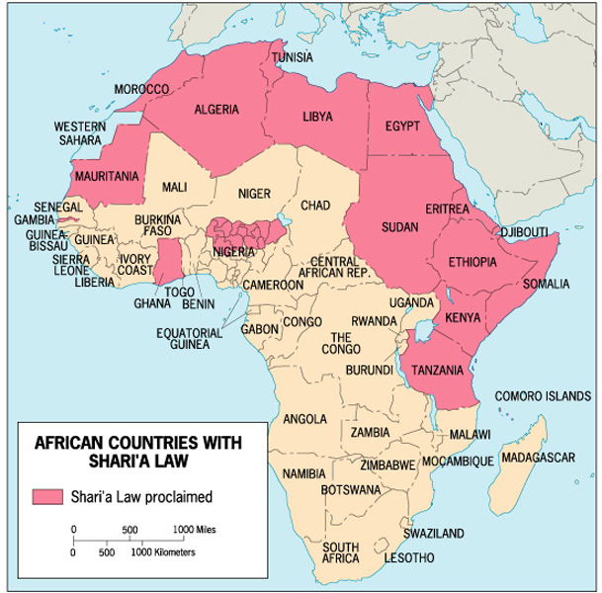
Nigeria’s Federal Government –
Allows states within the state to determine
whether to have Shari’a Laws
Shari’a Laws
Legal systems based on traditional Islamic laws

Slide 7
The U.S. Federal Government –
Allows states within the state to determine “moral” laws such as death penalty, access to alcohol, and concealed weapons.
Minnesota’s concealed
weapons law
requires the posting of signs such as this on buildings that do not allow concealed weapons.

Slide 8
Electoral Geography
A state’s electoral system is part of its spatial organization of government.
In the United States:
- territorial representation
- reapportionment
- voting rights for minority populations

Slide 9
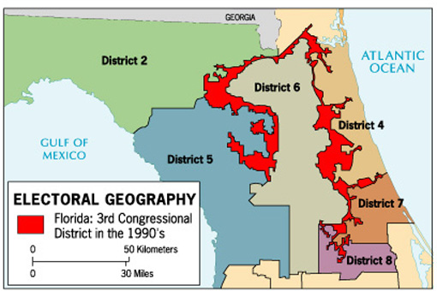
Gerrymandering – drawing voting districts to benefit one group over another.
Majority-Minority-districts drawn so that the majority of the population in the district is from the minority.

Slide 10
Centripetal and Centrifugal Forces
Richard Hartshorne, a leading political geographer described Centripetal forces as things that bind or hold a nation together & promote national unity:
Strong leadership-charismatic leader
External threat
Education
Ideology-Fascism, Communism or Democracy
Movement or circulation
Notes:
“Charisma” Greek for divine gift
Peron of Argentina
DeGaulle in France
Tito in Yugoslavia

Slide 11
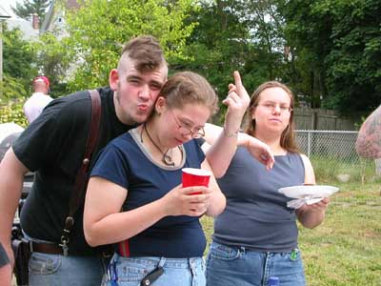
Centripetal and Centrifugal Forces
Centrifugal forces are things that that divide or tear a state apart: (also called Devolutionary forces)
Ethnic or cultural differences
Religious differences
Linguistic diversity
Economic disparity
Movement or circulation
Physical geographical differences

Slide 12
Devolution –
Movement of power from the central government to regional governments within the state.
What causes devolutionary movements?
Ethnocultural forces
Economic forces
Spatial forces

Slide 13
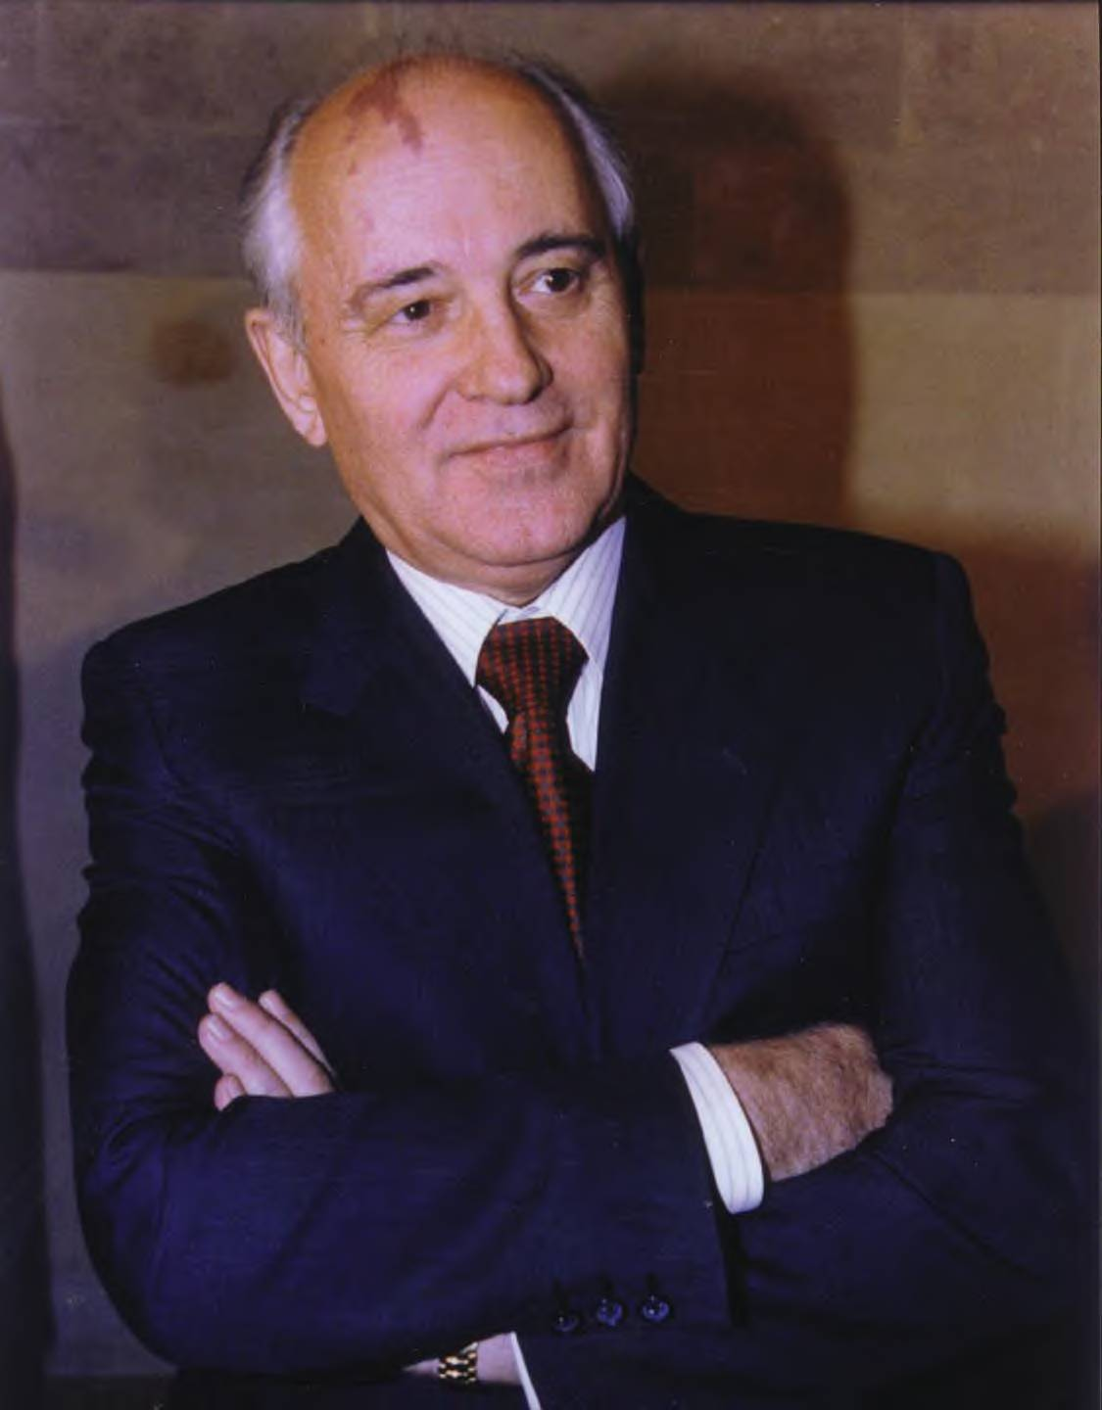
The Forces of Devolution
After USSR collapse in 1991, optimism-a New World Order?
Supranationalism, no more costly arms race & negotiation replacing confrontation??
Yet despite optimism-powerful self-interests contribute to centrifugal (divisive) forces.
Geopolitics-the study of political science within a geographic framework
Notes:
Mikhail Gorbachev-the last leader of the Soviet Union 1985-1991

Slide 14
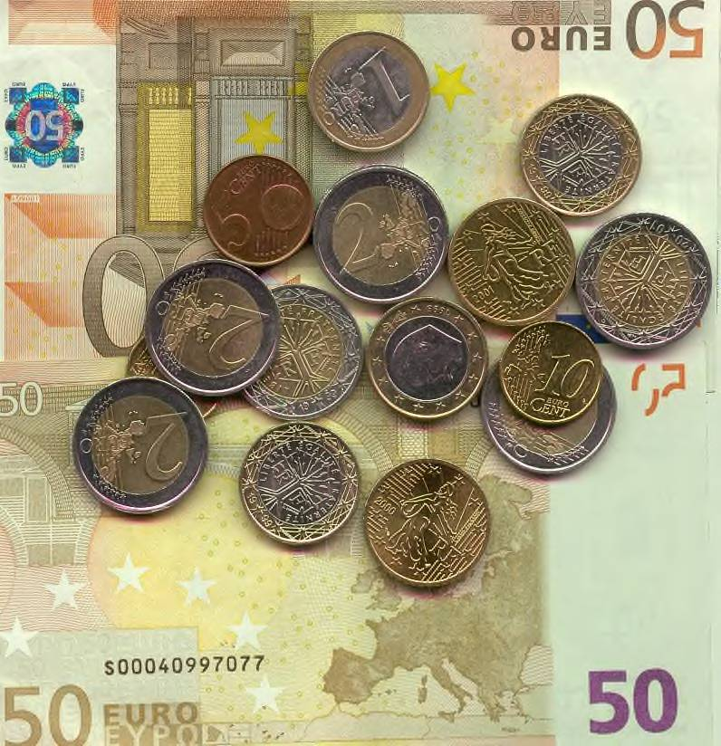
The Forces of Devolution
Since 1990 about 26 new states created.
Ironically with EU & adoption of euro greater centrifugal forces in Europe.
London’s decision to join EU encouraged Scottish nationalism.
1990s Scottish National Party encouraged devolution.
1997 Labour Party gave Scots & Welsh chance to vote-both voted to have their own parliaments
Notes:
Scotland felt as a part of EU would be less powerful than just a part of UK.
Reasoned that if Denmark-about same size as Scotland, could be a member of EU, why couldn’t they.

Slide 15
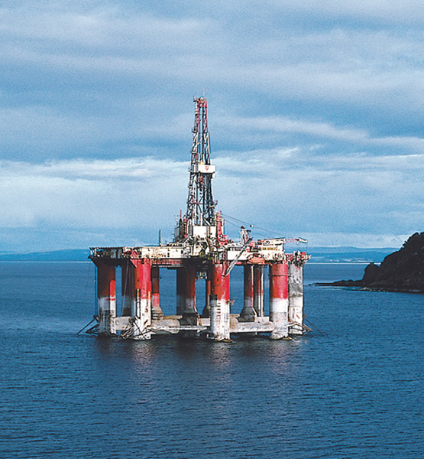
Ethnocultural Devolutionary Movements
Scotland
rise in independence movement is coupled with:
- European Union
- Scotland’s oil resources

Slide 16
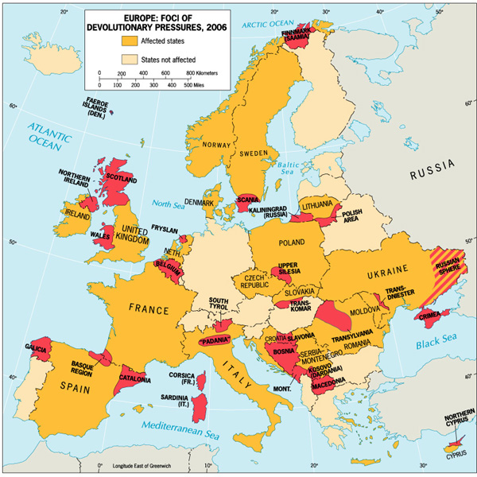

Slide 17
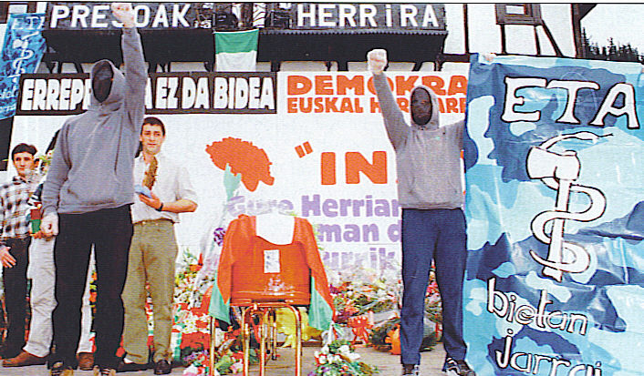
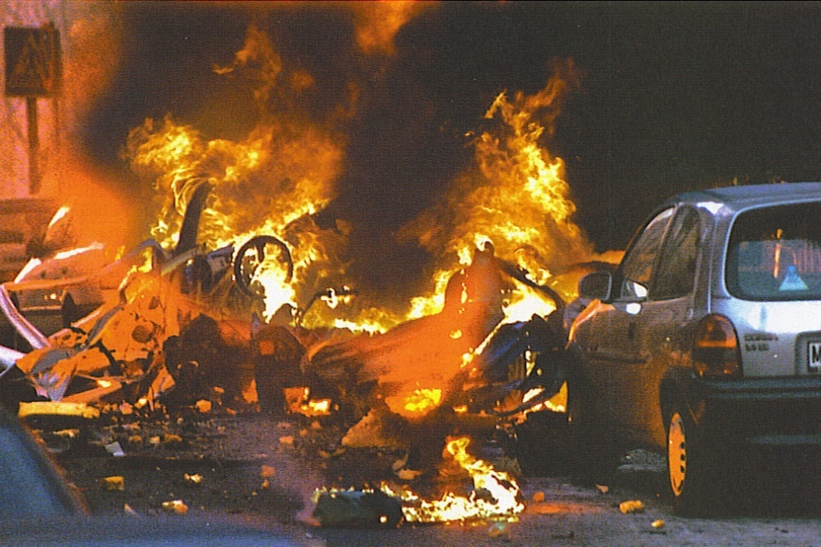
The Forces of Devolution-Cultural Forces
Most of the world’s 200 states have multicultural populations.
Spain-Basque & Catalonia in 1979 signed autonomy agreements
Have their own parliaments
Languages have official status
Control over education
Power of taxation
But Basque separatist were not satisfied-continued bombing & terror attacks
Notes:
Top Basque ETA Protest
Bottom Basque ETA bombing in Madrid Jan. 2000-Spanish Army officer was killed

Slide 18
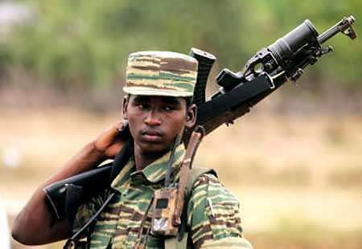
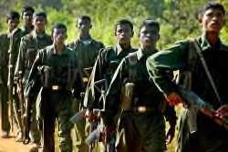
The Forces of Devolution-Cultural Forces
Quebec and Parti Quebecois in Canada
Belgium-Flemish (Dutch) in north, Walloons (French) in south
Czechoslovakia split in Jan. 1993 in the “Velvet Divorce”
Sudan-Muslim north & Christian south
Sri Lanka-Tamils, a Hindu minority fight for independence from the Sinhalese a Buddhist majority
Notes:
Tamil Tigers –photo top & bottom

Slide 19
The Forces of Devolution-Cultural Forces
Greatest tragedy was Yugoslavia which erupted in Civil War in the 1990s
Thrown together after WW I with Serbia as the core of “The Land of the South Slavs”
7 major, 17 minor ethnic groups, 3 religions & 2 alphabets
North-Croats & Slovenes-Catholic
South-Serbs are Orthodox, Muslim enclaves
Rule by royal house of Serbia, during WWII German occupation the Croats supported the Nazis, Serbs fought as anti-Nazi partisans.
Josip Broz Tito emerged as a communist leader after WWII-nationalism suppressed under his iron fist.
Notes:
Scotland felt as a part of EU would be less powerful than just a part of UK.
Reasoned that if Denmark-about same size as Scotland, could be a member of EU, why couldn’t they.

Slide 20
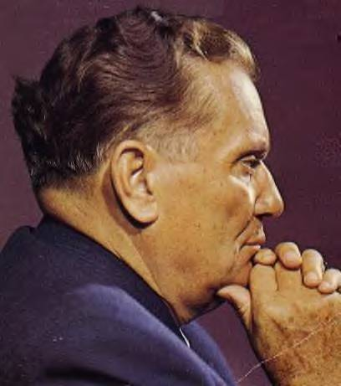
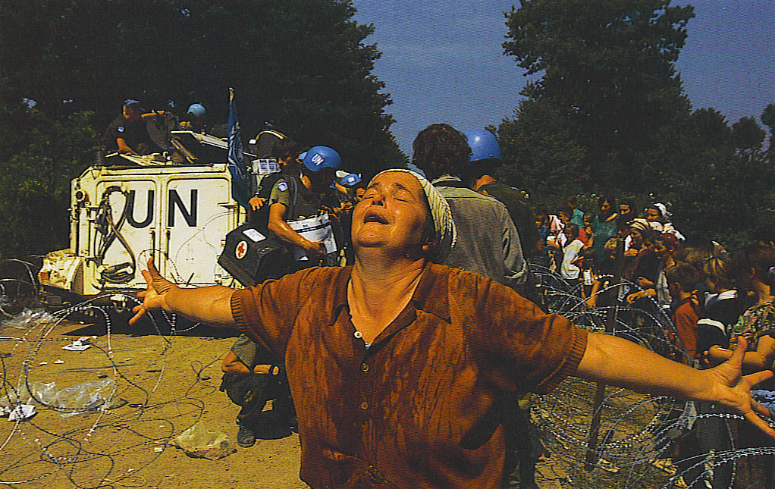
The Forces of Devolution-Cultural Forces
After the death of Tito & later the collapse of communism-ethnic conflict of Croat versus Serb and everyone versus Muslims emerged again.
Slovenia, Croatia, Bosnia, Serbia-Montenegro & Macedonia became independent.
Bosnia-no clear majority, Dayton Accords partitioned Bosnia & ended the civil war-Muslims 44%, Serbs 32% & Croatians 17%
Notes:
Josip Broz Tito
Bottom Muslim woman reaches a refugee camp after escaping from Serbian massacre at Srebenica.

Slide 21
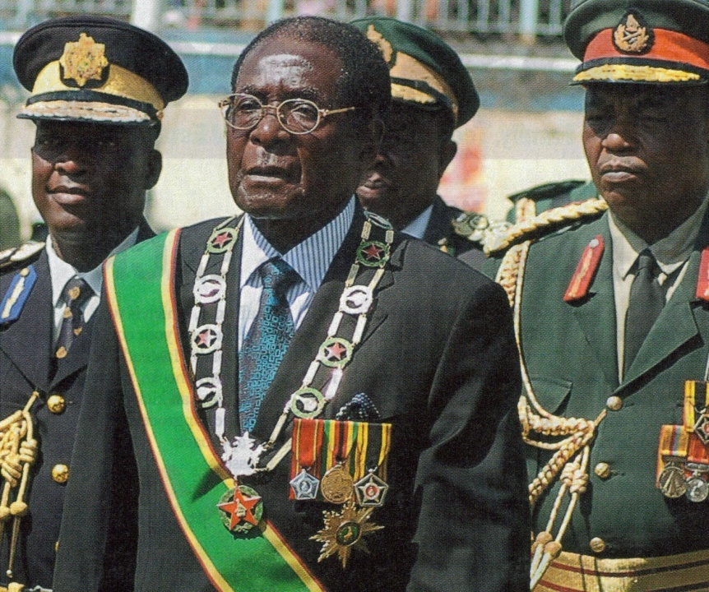
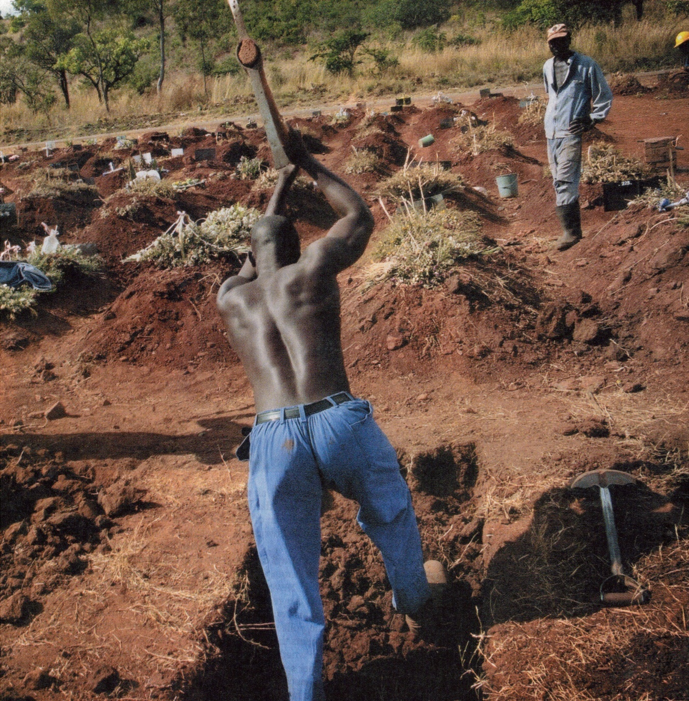
Zimbabwe
Robert Mugabe’s dictatorship forced thousands of white farmers to flee Zimbabwe.
Notes:
Mugabe (now 87)came to power in 1980 after a bloody war against the racist white-rule of Ian Smith. Hailed at first as a reformer-he is now viewed as a ruthless dictator who is ruining his country-a kleptocracy
Inflation has risen to 19,000 percent (summer of 2007) mortality rates are up, one of the lowest life expectancy rates in Africa.
UN estimates that 4 million (1/3) of population could go hungry. 3 million live abroad and 2,000 flee each week.

Slide 22
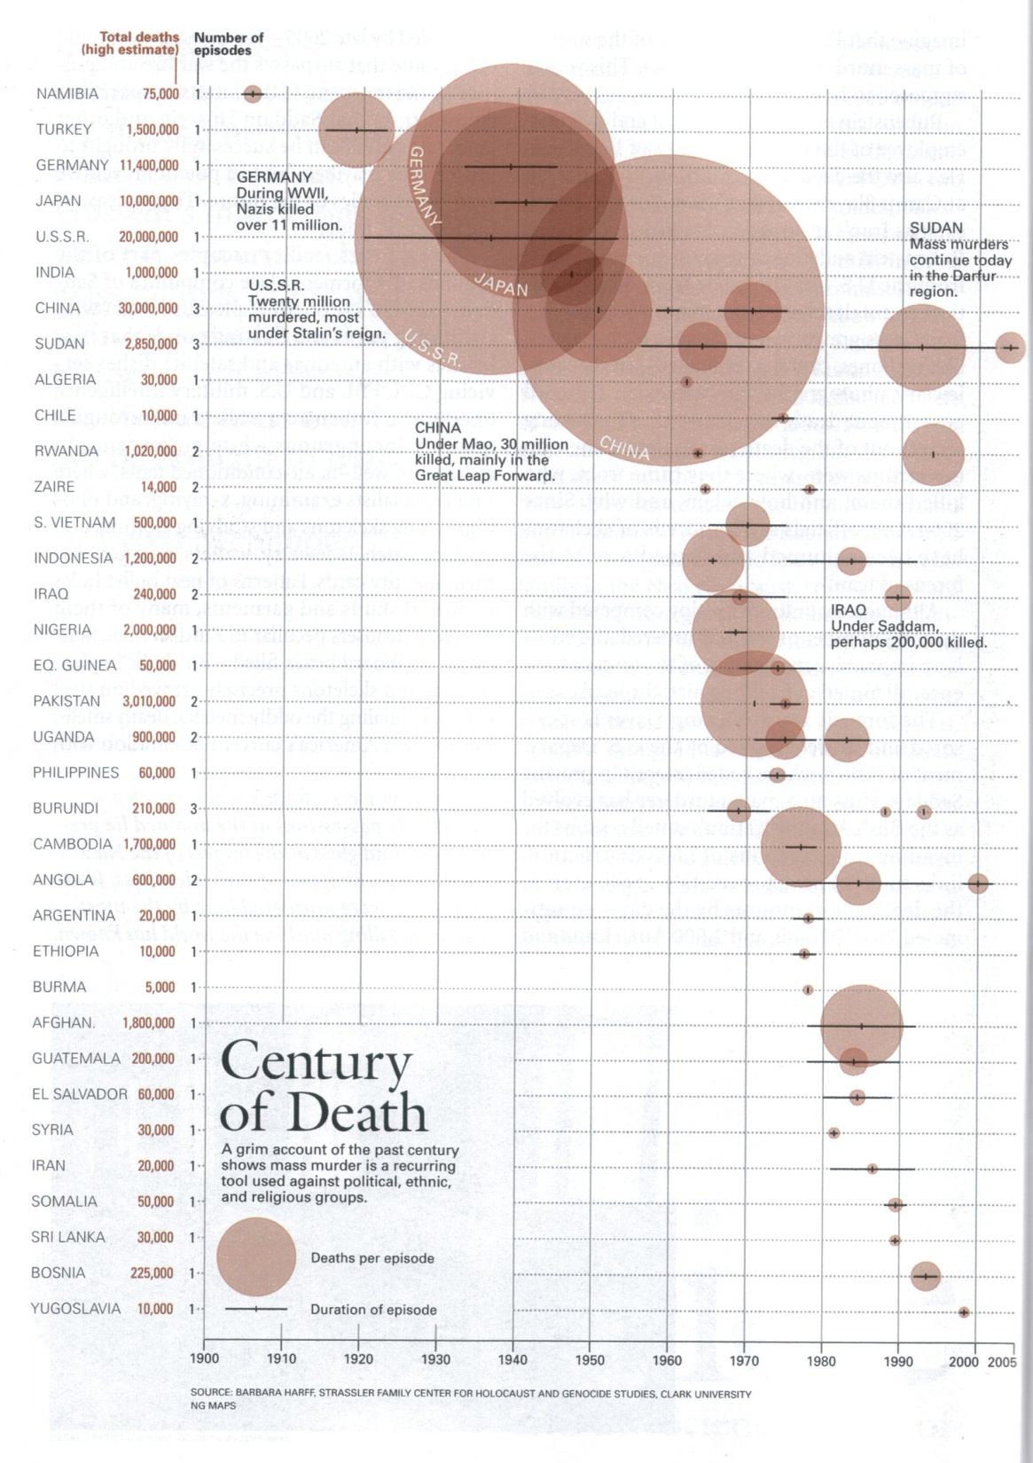
Genocide
Genos, greek for tribe or family, -cide from Latin to kill.
Last 100 years over 50 million people were murdered due to race, ethnicity, religion or political persuasion.
Mao Zedong-30 m. Chinese
Stalin-20 m. Soviets
Nazis-11.4 m. Jews, Slavs, etc.
Japan 10 m. Chinese, etc.

Slide 23
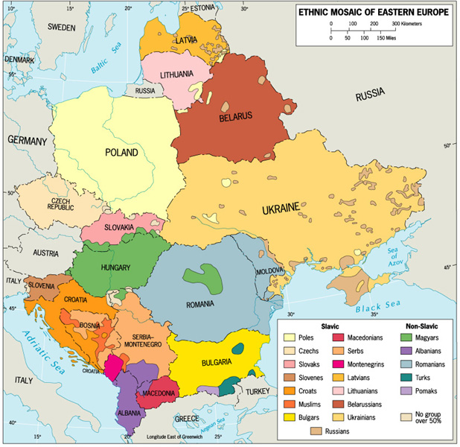
Ethnocultural Devolutionary Movements
Eastern Europe
devolutionary forces since the fall of communism

Slide 24
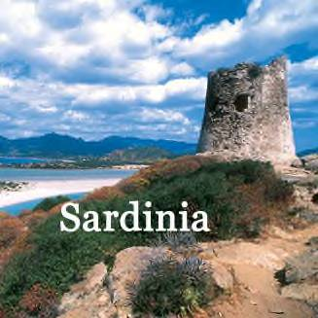
The Forces of Devolution-Economic Forces
Catalonians in Spain site reasons for economic independence-6% of territory, yet have 25% of exports & 40% of industrial exports.
Italy-Mezzorgiono (region of the south is poor & agrarian) Sardinia feels neglected and there is a growing disparity between the industrial North & agricultural South
Italy has moved to a federal system due to pressure by the north.

Slide 25
Economic Devolutionary Movements
Catalonia, Spain
Barcelona is the center of banking and commerce in Spain and the region is much wealthier than the rest of Spain.

Slide 26
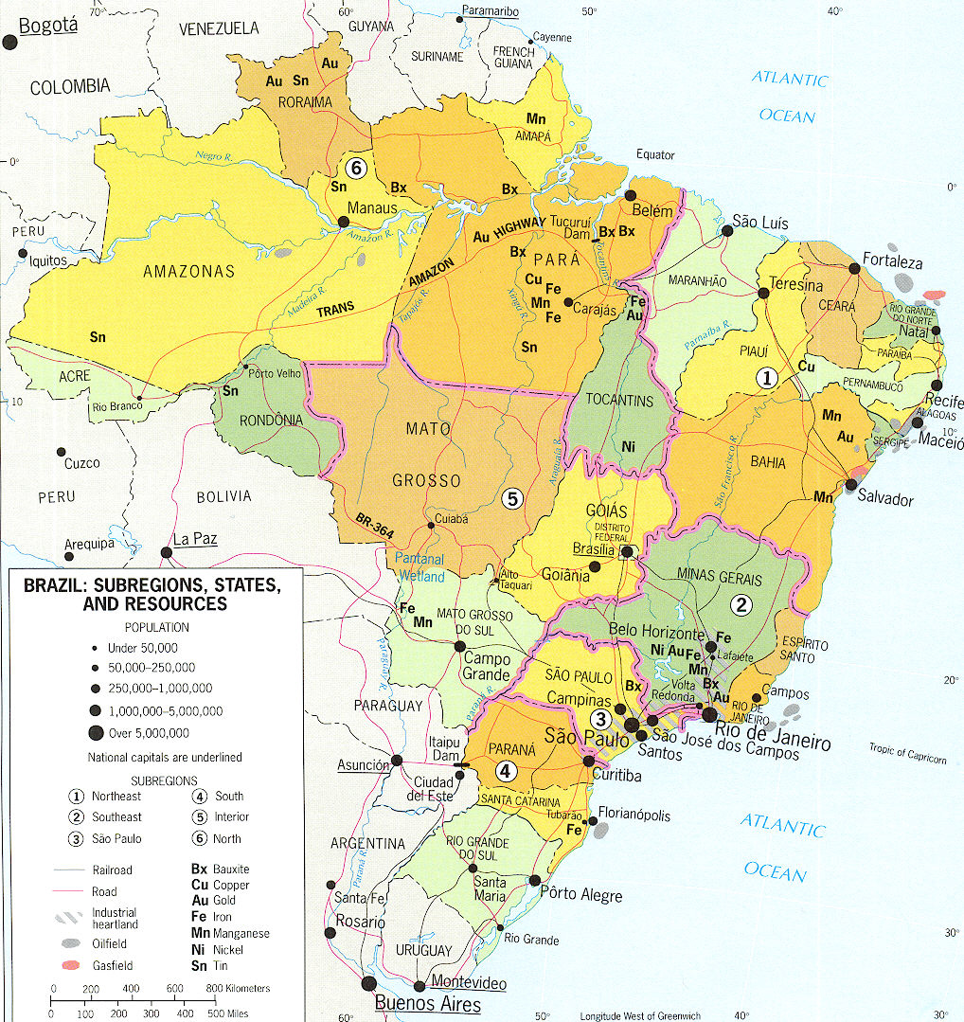
The Forces of Devolution-Economic Forces
France-Corsica, a small minority of the islands 25,000 demand autonomy. It was taken from Genoese, Italy in 1768. Bomb attacks (600) in 1996 caused tourism to drop.
Brazil-1990s the 3 southern states: Rio Grande do Sul, Santa Catarina, Parana claimed the govt. misspent money in Amazon-had a leader, created flag, and demanded independence for the Republic of the Pampas.

Slide 27
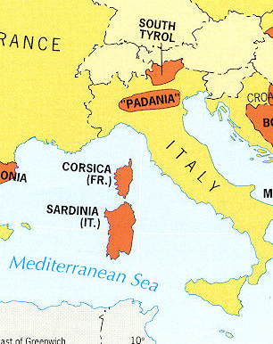
The Forces of Devolution-Spatial Forces
Spatial factors-remote frontiers, isolated villages, rugged topography or repeated historic invasions contribute to devolution
Many islands such as Corsica, Sardinia, Taiwan, Singapore, Zanzibar, Jolo (Philippines) and Puerto Rico have demanded independence.
Hawaii-indigenous population demand autonomy; Puerto Rico small, but vocal independence movement; Cascadia-Washington, Oregon & British Columbia.

Slide 28
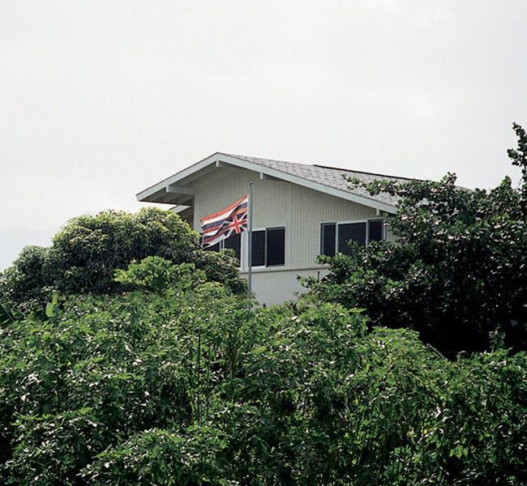
Spatial Devolutionary Movements
Honolulu, Hawai’i
A history apart from the United States, and a desire to live apart in order to keep traditions alive.

Slide 29
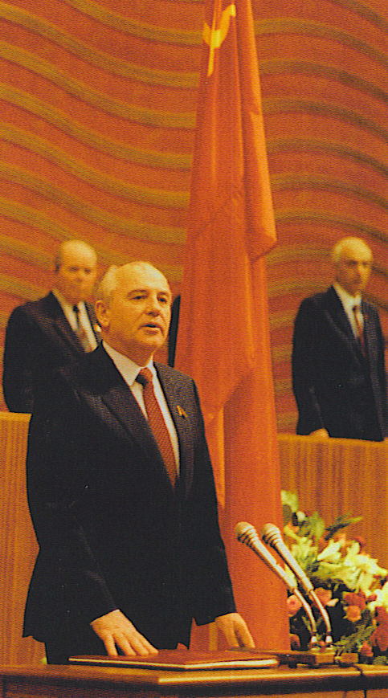
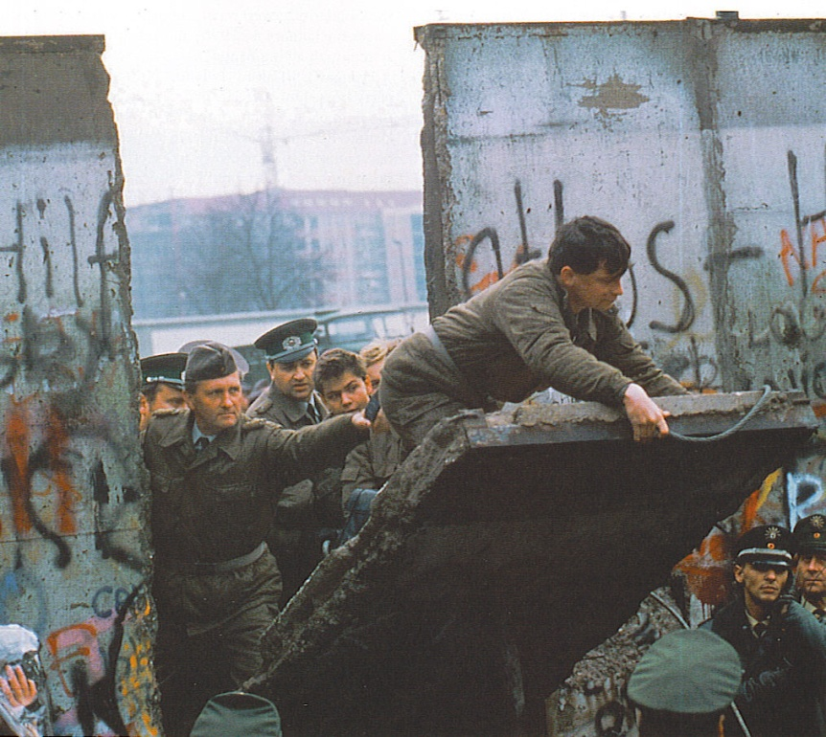
Devolution of the Soviet Union
50 years a Bi-Polar World of Cold War arms race & danger of nuclear war.
In 1980s centrifugal forces increased-multiculturalism, multi-nationalism, economic troubles
Gorbachev loosened the Soviet grip on Eastern Europe & at home introduced perestroika (restructuring) & glasnost (openness)
Fall of 1989 the Iron Curtain collapsed, the Berlin Wall was opened.
Notes:
Top-Gorbachev’s acceptance speech before the Supreme Soviet after being chosen as leader of the USSR
Bottom-the fall of the Berlin Wall in November 1989

Slide 30
The Devolution of the Soviet Union
Failed coup attempt in August 1991 led to the collapse of communism & dissolution of the USSR on Dec. 25, 1991.
Commonwealth of Independent States created, Baltic States & Georgia stayed out & became completely independent.
Muslim Azerbaijan & Christian Armenia had armed conflict.
Georgia had a civil war, Abkhazia in Northwest declared independence
Near Abroad-what the Russians called the 25 million Russians who live in the former Soviet Republics.

Slide 31
Irredentism
Type of expansionism and is often the consequences of superimposed boundaries.
Territorial disputes over the ownership of a region often arise when a boundary that has been superimposed on the landscape divides an ethnically homogeneous population.
Each of the two states then has some justification for claiming the territory inhabited by the ethnic group in question.

Slide 32
Geopolitics

Slide 33
Geopolitics
Geopolitics – the interplay among geography, power, politics, and international relations.
German School-eg. German Geographer Friedrich Ratzel’s (1844-1940) organic state theory
British / American School- eg. British Geographer - Sir Halford Mackinder’s (1861-1947) Heartland Theory
Nicholas Spykman, a critic of Mackinder, in a 1944 book coined the term “Rimland” and stated that the rimland of Eurasia, not the heartland held the key to global power.

Slide 34
Seapower Doctrine
Alfred Mahan-U.S. Navy flag officier, geostrategist, and historian(1840 –1914)
National greatness is associated with the sea. Who ever has control of choke points (strategic transit points throughout the world), canals, and coaling stations can control commerce in times of peace and enemy fleets during war time.
The concept had an enormous influence in shaping the strategic thought of navies across the world, especially in the United States, Germany, Japan and Britain, ultimately causing the World War I naval arms race. His ideas still permeate the U.S. Navy Doctrine.

Slide 35
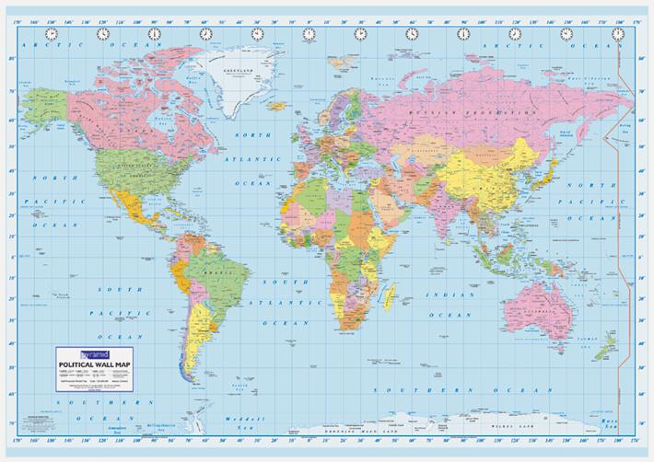
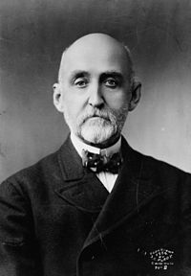

Slide 36
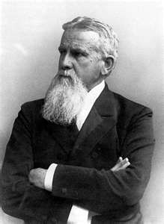
Organic Theory
Friedrich Ratzel- (1844–1904) German Geographer
Influenced by thinkers like Darwin
His theory came about in a time of Industrial growth and supported the concept of territorial expansion
Ratzel's concept was not overtly aggressive, but theorized simply as the natural expansion of strong states into areas controlled by weaker states.
This concept was later used by Hitler in World War II to support his expansion into most of Europe.

Slide 37
Heartland Theory - Halford Mackinder (1861-1947)
Eurasia (Europe and Asia) is considered the World Island - it is the largest in area and in population (in the world). Its interior is called the Heartland - it is the most inaccessible area in the world - by water. It’s coastlines are vulnerable - but not the interior which is dominated by Eastern Europe.
Who rules Eastern Europe commands the Heartland. The Heartland would be the base for world conquest.
Who rules the Heartland commands the entire World Island.
Who rules the World Island rules the rest of the World.

Slide 38
The Heartland Theory is based on Sea Power!
Not valid today since we can attack with Air Power and ICBM’s (Intercontinental Ballistic Missiles)
But think of History - Think of Napoleon Bonaparte and Adolf Hitler. They both went after Eastern Europe first.
Think of the U.S.S.R. and their attempt to expand by taking over Eastern Europe (Poland, Hungary, Czechoslovakia etc. Think of Vietnam, think of North Korea.
The USSR tried to set up an Iron Curtain. The USA used a plan called Containment. When the Soviets moved to North Korea the US contained them by moving into South Korea. The Soviets mover to North Vietnam and the US moved into South Vietnam

Slide 39
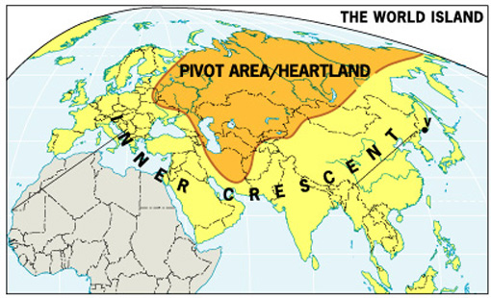
Mackinder’s Heartland Theory: “Who rules East Europe commands the Heartland Who rules the Heartland commands the World Island Who rules the World Island commands the world”

Slide 40
Rimland Theory - Nicholas Spykman (1894-1943)
Eurasia was the key to world domination, but the coastal regions were more important than the interior (heartland)
The Coastal regions had a large population, resources, ports and access and control over the seas.
Control the coast and your control the interior - this was the Rimland Theory.
Again the Soviet Union has always been desperate to have control over land that has access to water, especially a warm water port. That is why they tried Korea, Vietnam, Cuba and Afghanistan. They want Eastern Europe to get access to the Black Sea.

Slide 41
Geopolitical World Order
Temporary periods of stability in how politics are conducted at the global scale.
bi-polar-after WW II the U.S. & U.S.S.R.
multi-polar-many major powers
unilateralism-one state (U.S.) acting alone-which creates resentment and hostility.
Will individual states remain the dominant actors in a future geopolitical world order?
Notes:
Bush Doctrine of sowing democracy in the Middle East is in serious trouble
The king of Saudi Arabia has been arresting government critics and refuses to hold elections for a “toothless” council (the country has no parliament).
Egypt which is propped up by $2 billion in US aid each year is run by Hosni Mubarak who won in a landslide election 2 years ago after jailing his main political challenger.

Slide 42
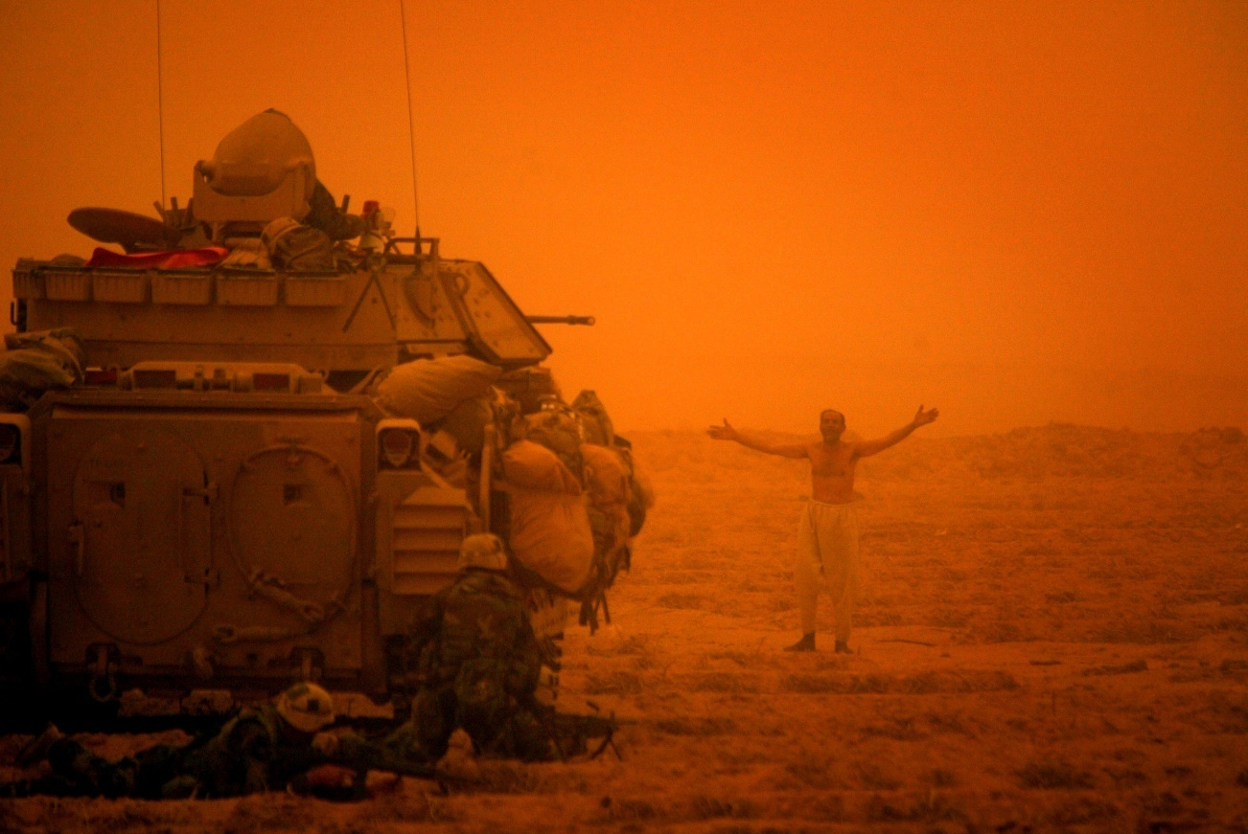
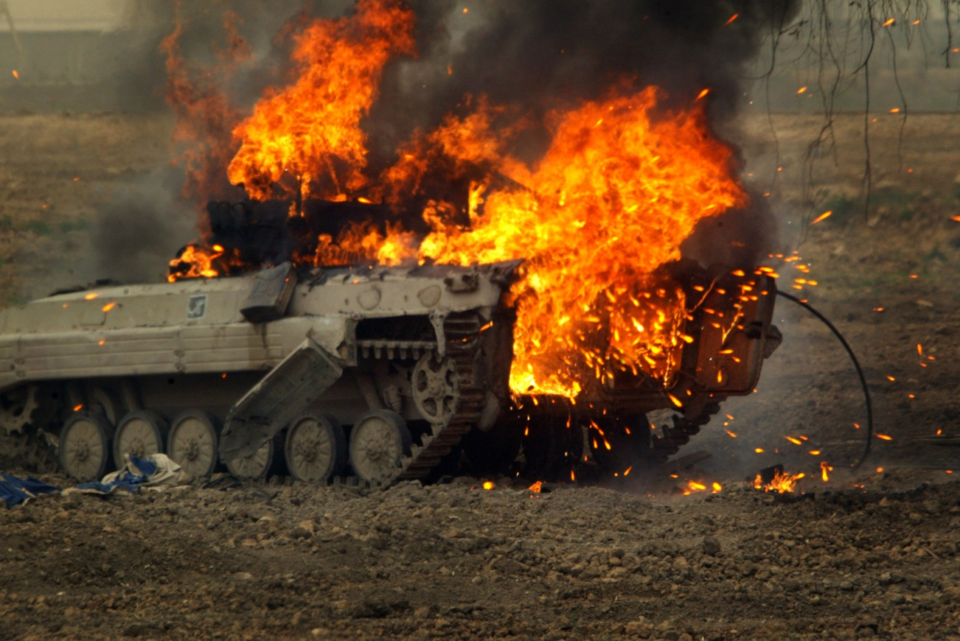
The War in Iraq
The 2003 invasion of Iraq was a unilateral decision by the US
No weapons of mass destruction were found, Iraq posed no threat to the US or its neighbors-it was being contained by the UN imposed sanctions.
Current unemployment of 50% contributes to the sectarian violence
Notes:
Over 655,000 Iraqis have been killed during the 3 year occupation-that was far more that Saddam Hussein was responsible for murdering.

Slide 43
Antiwar Protest on 42nd street in New York City-March 18th, 2006 – the 3rd anniversary of the start of the war-similar protests took place around the world
Notes:
1999 Survey by the State Department of US favorable rating by citizens of
France 62%, German 78%, Indonesia 78%, Turkey 52% and after 9/11 an outpouring of international sympathy.
Now after 6 years of war support for US leadership has evaporated-US is seen as a major violator of human rights
Jan 2007 BBC survey of favorable ratings: 52% in 18 countries had a negative view of US only 29% had a mainly positive view.
Germany 37%, Indonesia 30%.
Negative view: Egypt 70%, Pakistan 73% Jordan 85%, Turkey 88%
These trends reduce the US capacity to protect national security-US power and prestige have been eroded by the pre-emptive war policy of the Bush adminstration.
Source American Prospect Jan/Feb. 2008 John Shattuck “Healing Our Self –Inflicted Wounds”

Slide 44
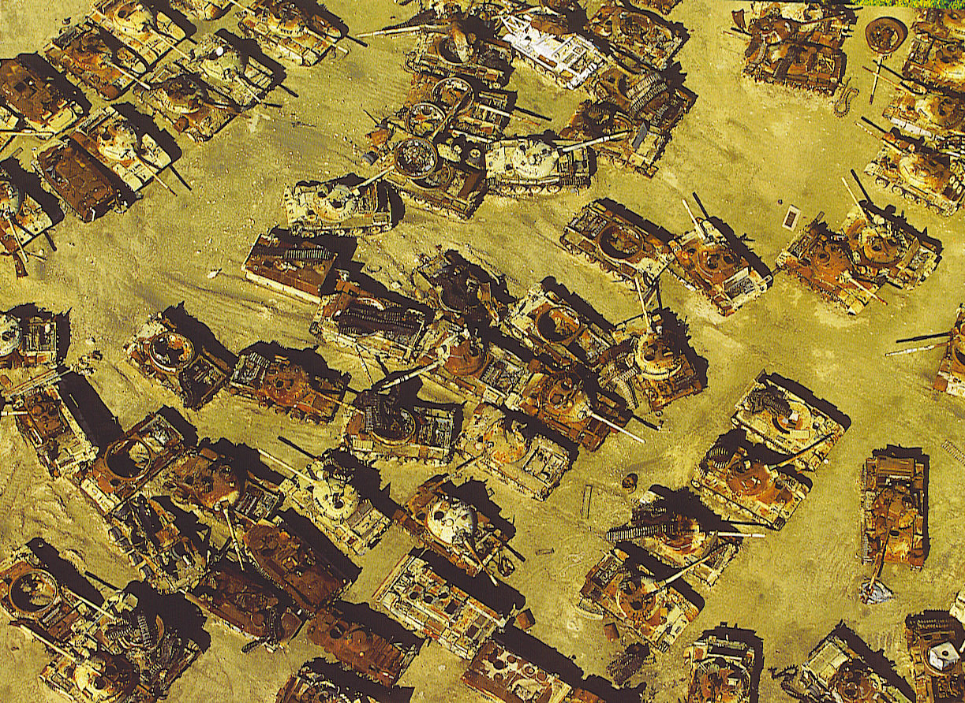
Notes:
Iraqi tanks (purchased from the Soviet Union) in the desert after the first Gulf War of 1991

Slide 45
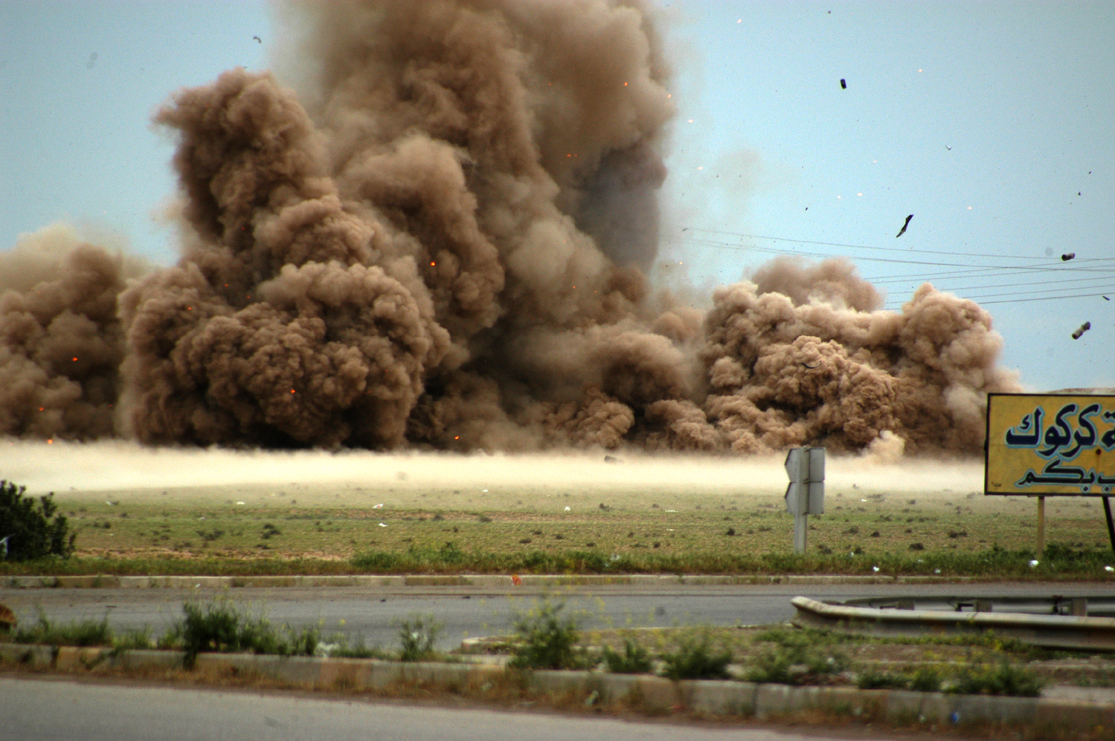
Notes:
Blowing up 6 Iraqi guns near Kirkuk

Slide 46
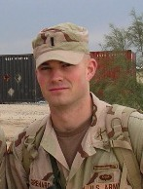
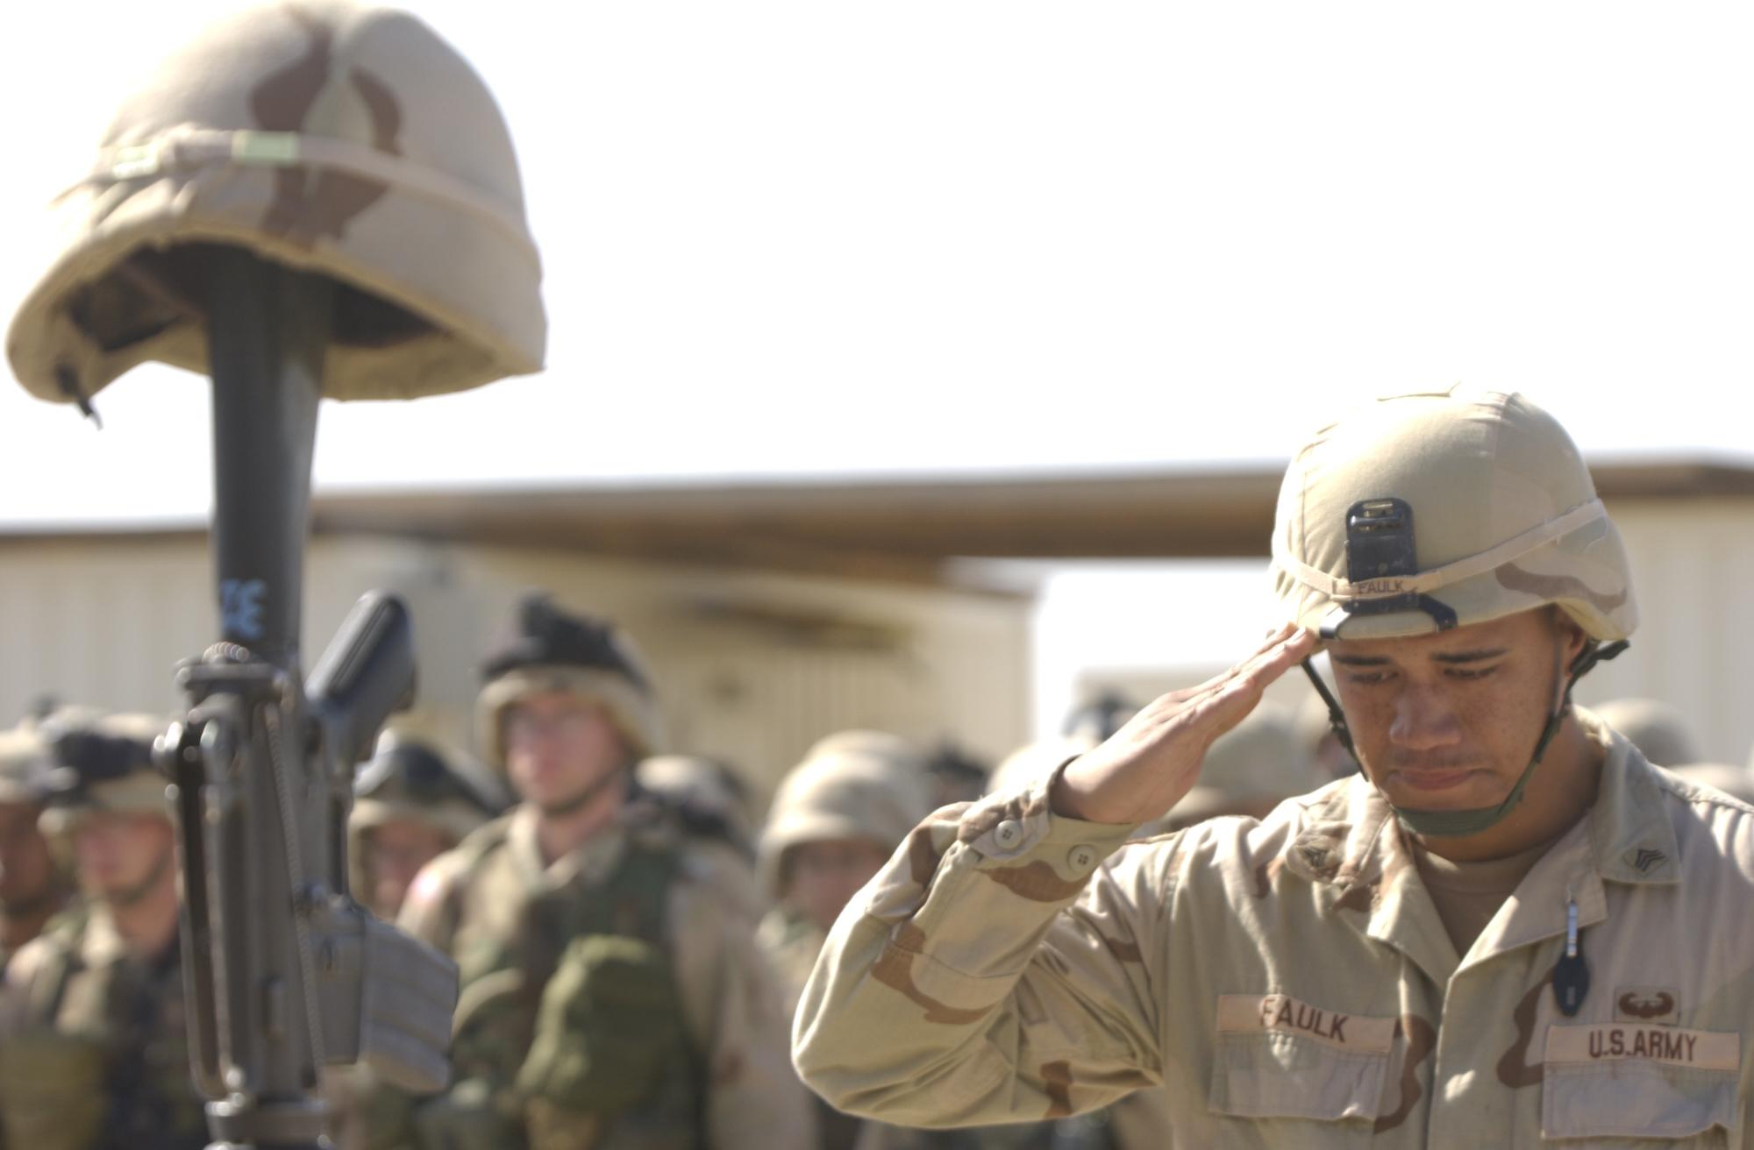
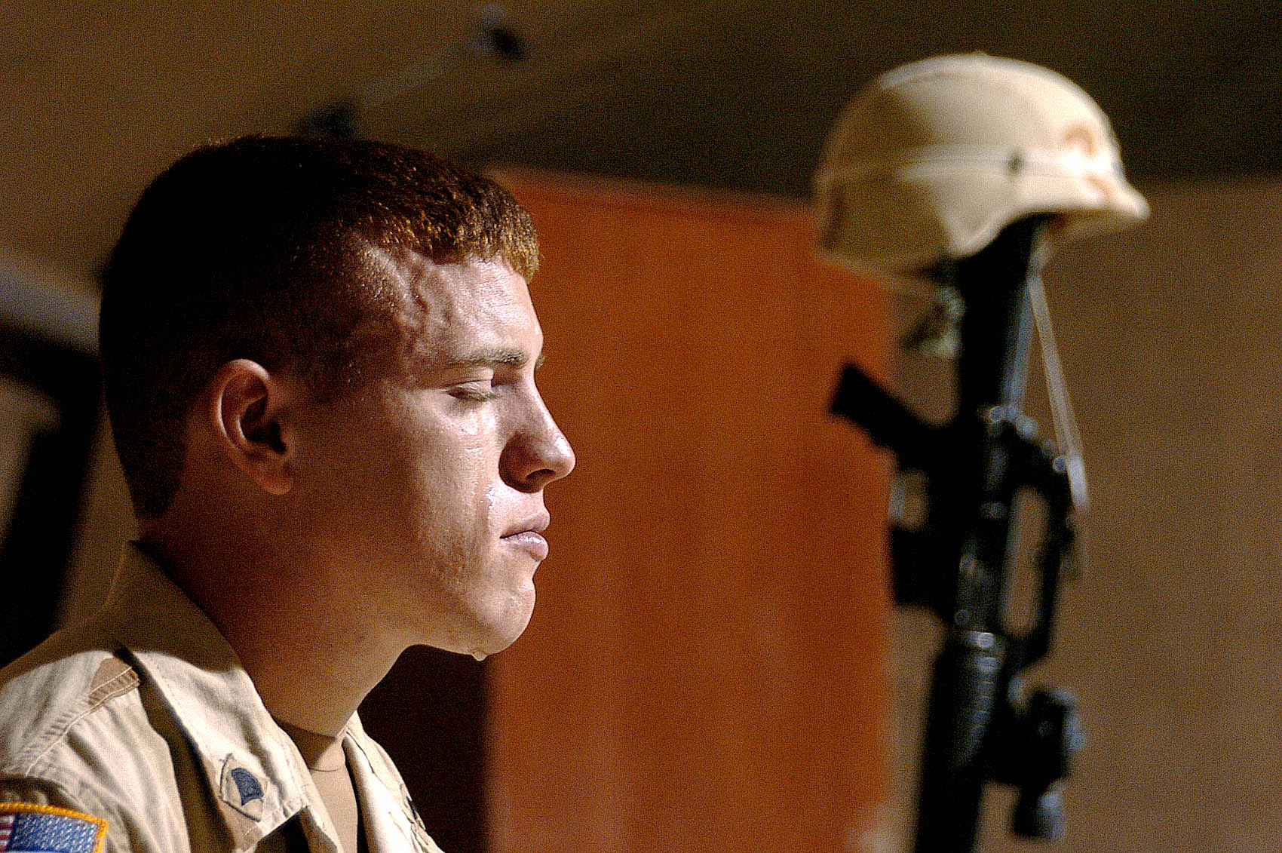
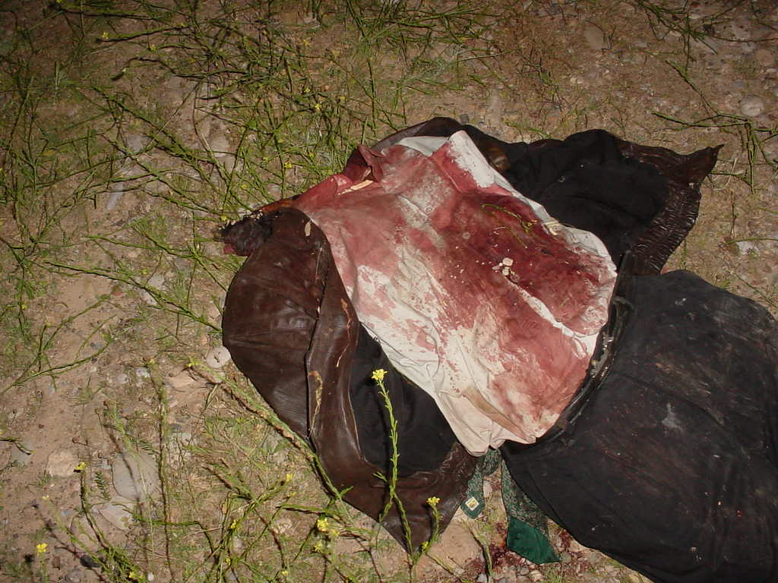
Notes:
April 9th 2004-Funeral for fallen comrade-
Josh Grenard upper left
Headless Iraqi-killed by ???

Slide 47
The Capitalist World-Economy
The World-Economy is more than the sum of its parts. It is composed of “dots” but we must also understand the “whole.”
Sunday on La Grande Jatte by Georges Pierre Seurat

Slide 48
Immanuel Wallerstein’s World-Systems Theory:
The world economy has one market and a global division of labor.
Although the world has multiple states, almost everything takes place within the context of the world economy.
The world economy has a three-tier structure.
European nations and those settled by European migrants established colonies throughout the world to extract wealth.
This period of colonialism established the current imbalance in world economic and political power
Notes:
Wallerstein was a sociologist who wrote
The World-Systems Theory.

Slide 49
Construction of the World Economy
Capitalism – people, corporations, and states produce goods and services and exchange them in the world market, with the goal of achieving profit.
Commodification – the process of placing a price on a good and then buying, selling, and trading the good.
Colonialism – brought the world into the world economy, setting up an interdependent global economy.
Notes:
Commodification-creating a product, marketing and creating a demand for the product (bottled water example) and selling the product.
Political independence did not create economic independence-no nation can be entirely self-sufficient.

Slide 50
Three Tier Structure
Core
Processes that incorporate higher levels of education, higher salaries, and more technology
* Generate more wealth in the world economy
Periphery
Processes that incorporate lower levels of education, lower salaries, and less technology
* Generate less wealth in the world economy
Semi-periphery
Places where core and periphery processes are both occurring. Places that are exploited by the core but then exploit the periphery.
* Serves as a buffer between core and periphery
Notes:
Core=US, Canada, Western Europe, Australia and Japan
Semi-Periphery-Mexico, Venezuela, Argentina, Uruguay, Brazil, South Africa, Russia and Eastern Europe, Turkey, Saudi Arabia, India and China-exploited by Core and in turn exploit the Periphery
Periphery=rest of Africa, rest of South American and Central America, Central and Asia and most of Middle East-exploited by everyone

Slide 51
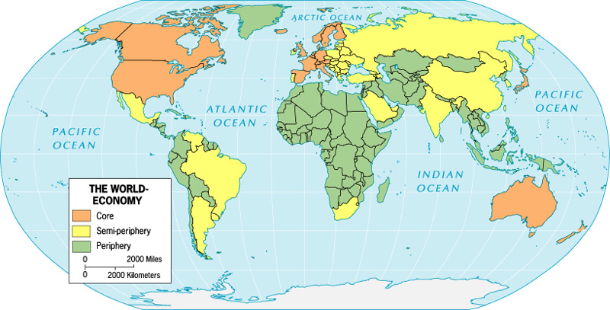

Slide 52
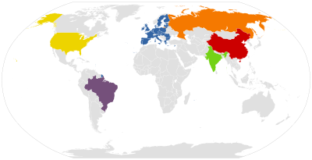
Super Powers of the 21st Century
United States of America
Federative Republic of Brazil
People’s Republic of China
European Union
Republic of India
Russian Federation
Notes:
A superpower is a state with a dominant position in the international system which has the ability to influence events and its own interests and project power on a worldwide scale to protect those interests. The basic components of superpower stature may be measured along four axes of power: military, economic, political, and cultural. Presently, it is widely considered that only the United States currently fulfills the criteria to be considered a superpower

Slide 53
Containment Theory
Containment was a United States policy using numerous strategies to prevent the spread of communism abroad. A component of the Cold War, this policy was a response to a series of moves by the Soviet Union to enlarge communist influence in Eastern Europe, China, Korea, and Vietnam.

Slide 54
The Domino Theory
The domino theory holds that destabilization from any cause in one country can result in the collapse of order in a neighboring country-a chain of events that can affect a whole region.
Indochina War (1964-1975) US backed South Vietnam in a struggle against communist North Vietnam-war expanded into Laos & Cambodia-US feared it would lead to communist expansion in Thailand, Malaysia, Burma & so on-didn’t happen.
Yet domino theory has validity-in 1989 the fall of communism followed the domino effect, instability in Yugoslavia followed the same pattern-other examples religious extremism, economic and environmental causes can cause spreading havoc.

Slide 55
Global Organizations and Multinationalism

Slide 56
Supranational Organizations
A separate entity composed of three or more states that forge an association and form an administrative structure for mutual benefit in pursuit of shared goals.
Many supranational organizations
exist in the world today:
U.N.
N.A.T.O.
European Union
S.E.A.T.O.
COMECON
Warsaw Pact
Notes:
UN
NATO
Warsaw Pact
SEATO
COMECON
Etc.

Slide 57
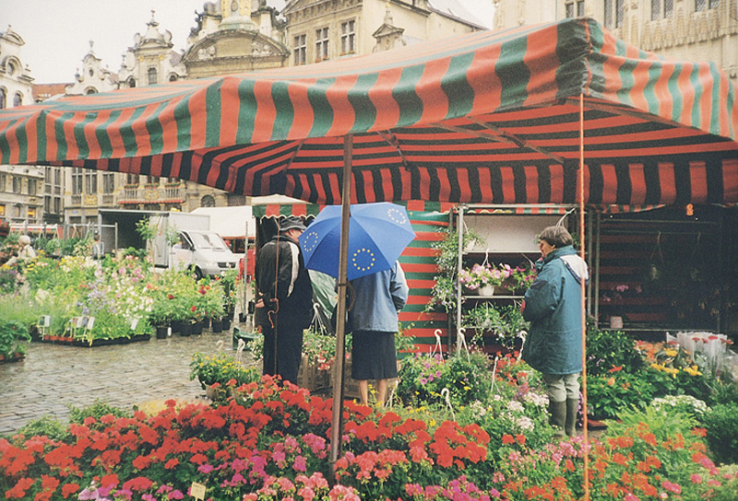
How does Supranationalism affect the State?
identities
economics
Notes:
NAFTA-North American Free Trade Association
ACS-Association of Caribbean States
Central American Common Market, the Andean Group,
MERCOSUR-the Southern Cone Community Market
ECOWAS-Economic Community of West African States
APEC-Asia-Pacific Economic Council
CIS Commonwealth Independent States-former Soviet Union

Slide 58
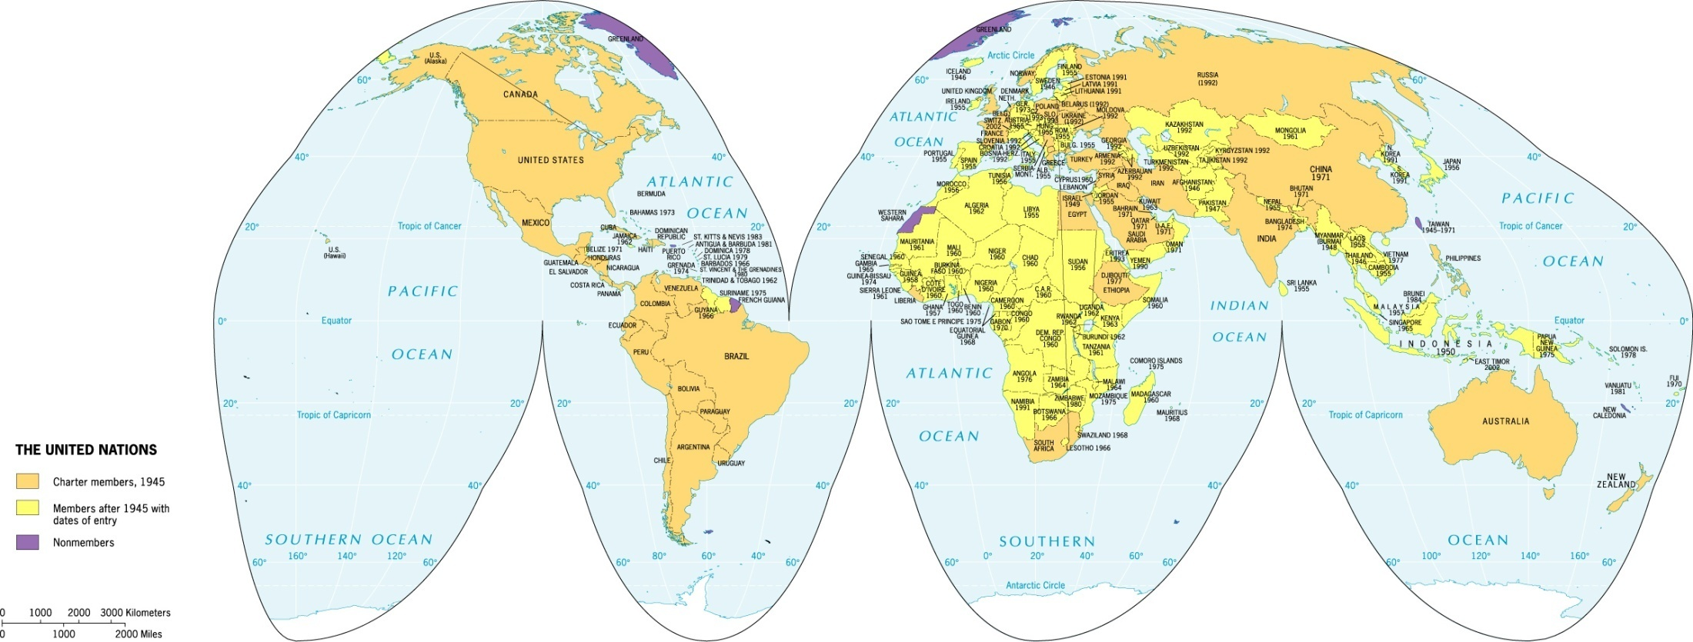
Global Scale – The United Nations

Slide 59
The United Nations
Peacekeeping Operations
International Sanctions
Unrepresented Peoples
Laws of the Sea

Slide 60
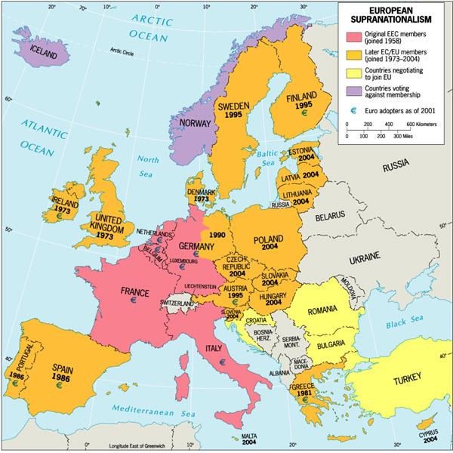
Regional Scale – The European Union

Slide 61
Economic Supranational-Examples: Benelux, Common Market, European Community, European Union, NAFTA (North Atlantic Free Trade Agreement), Association of Caribbean States, APEC (Asian-Pacific Economic Cooperation), Economic Community of African States, OPEC(Organization of the Petroleum Exporting Countries)
Military Alliances- NATO (North Atlantic Treaty Organization), SEATO (Southeast Asia Treaty Organization), ANZUS (Australia, New Zealand, and United States Treaty)
Cultural Organization and Political Unions-The Arab League, Organization of African Unity, The French Community, African States, OPEC(Organization of the Petroleum Exporting Countries)

Slide 62
The End

