Slide 1
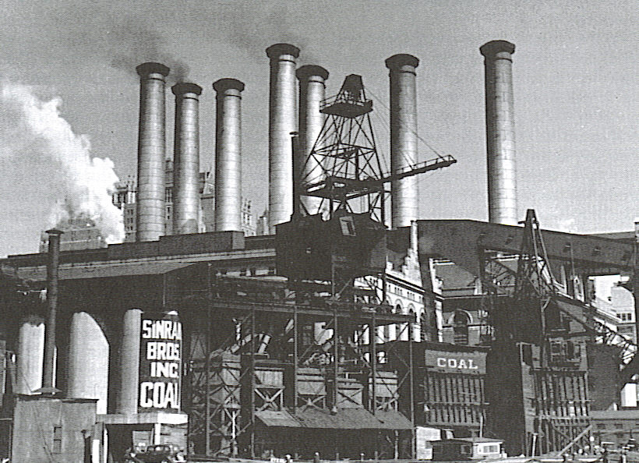
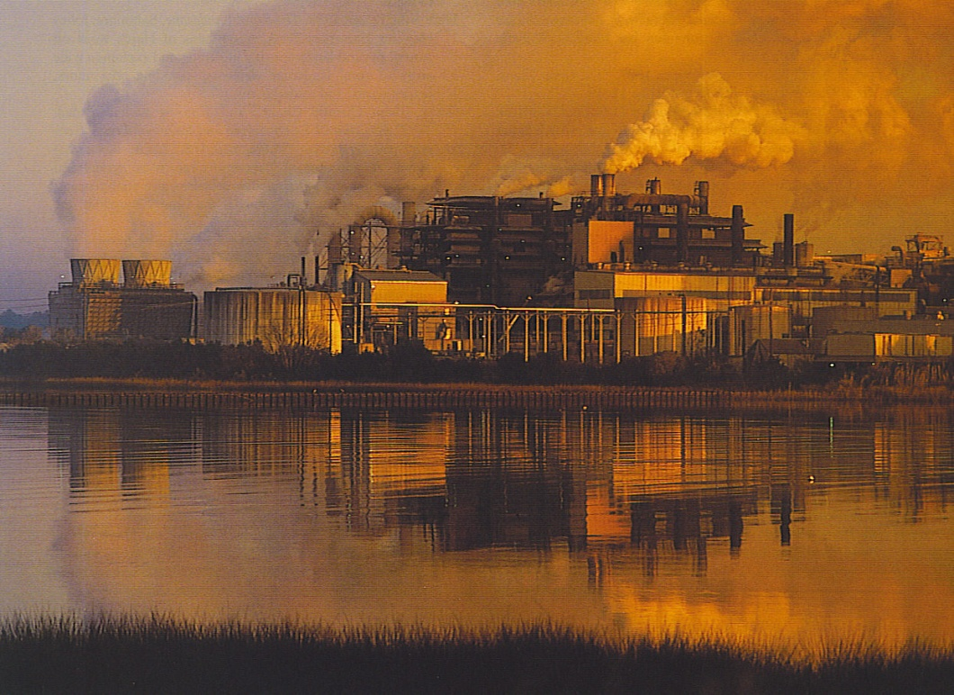
Understanding Environmental Change
Factors Erode the Environment:
  Expanding Human Population
  Increased consumption
  Technological advances
CFSs /Chlorofluorocarbons contribute to the depletion of the ozone layer
Deforestation locally impacts the whole planet
  Decreased diversity of life
  Increased sediment runoff
  Release of CO2 into the air
Notes:
Power Plant-1940s US
Industrial Scene-smokestacks

Slide 2
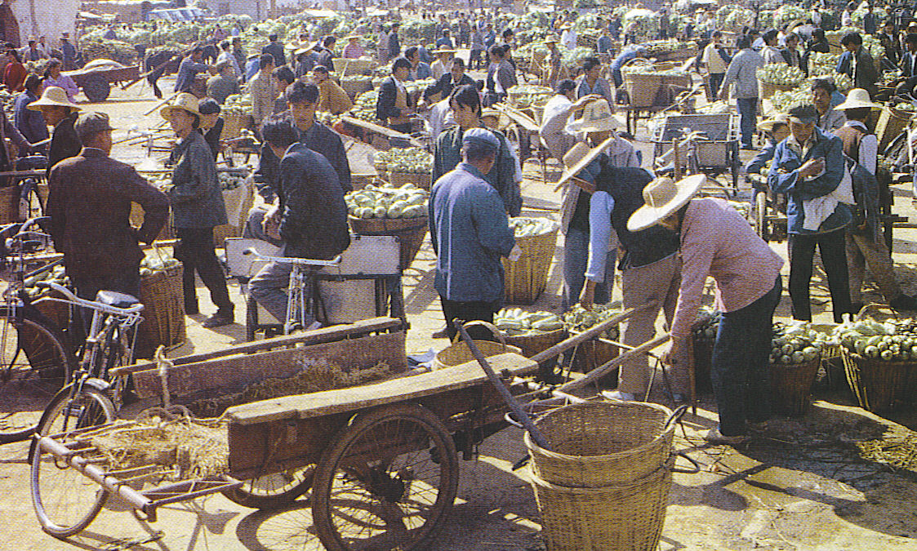
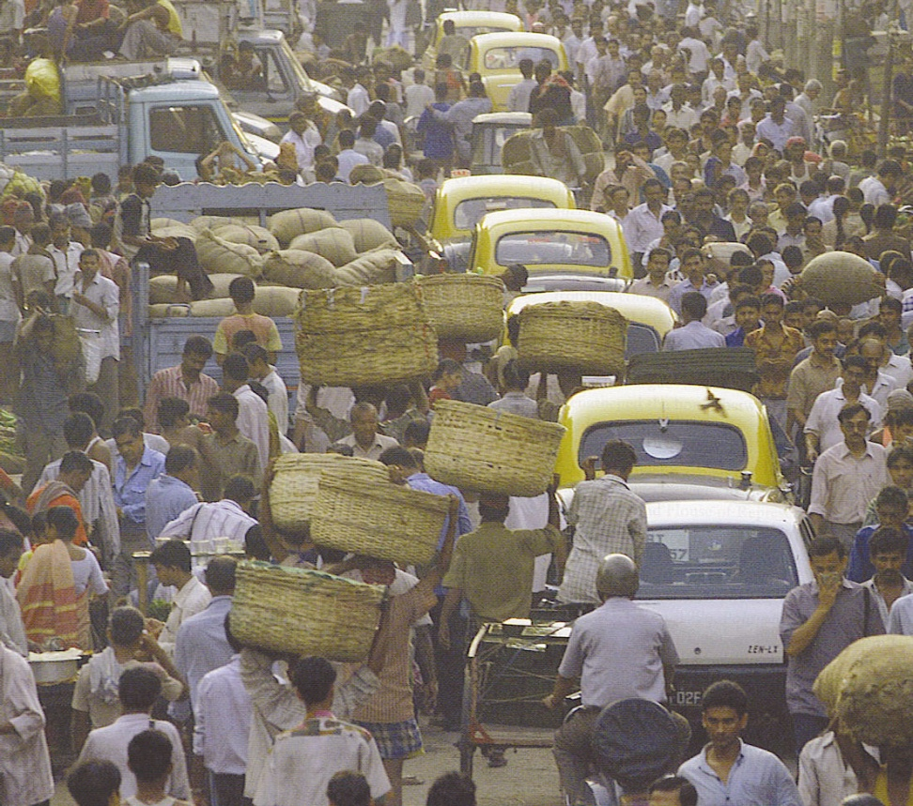
Population
U.S. as the population expands-urban sprawl that gobbles up more farmland
China-1.3 billion that are gaining in affluence & consumption.
India with over 1 billion is also gaining in affluence & consumption
As the earth’s population approaches 9 billion in this century-greater pressure on the environment.
Notes:
Chinese farmers market
Calcutta Street Scene
Each Indian is supported on 1 acre
Each American is supported by 25 acres
A child born in the US in the 1990s will use 250X the energy consumed by a child born in Bangladesh
Use the BB demonstration
6 BBs = impact of child in periphery
Rest of 1500 BBs =impact of a child in the Core

Slide 3
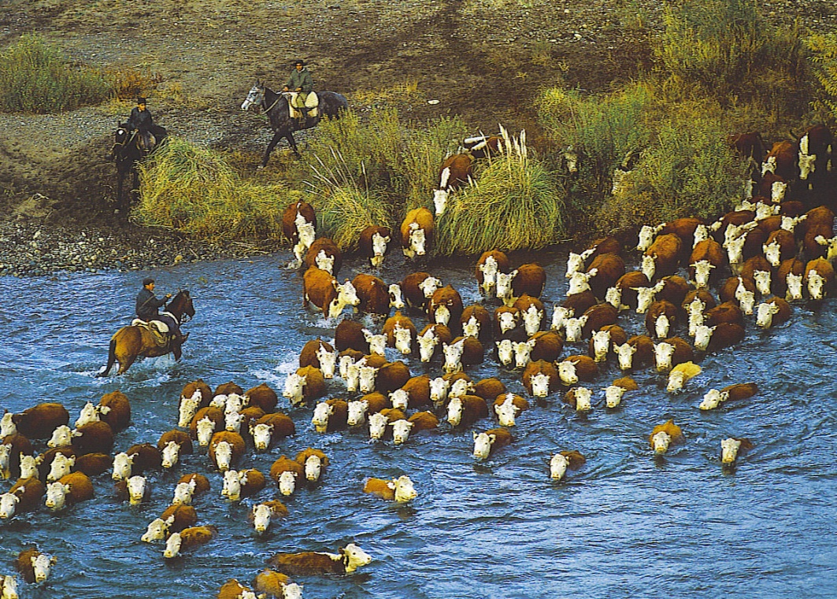

Patterns of Consumption
Periphery countries impact the immediate environment-deforestation, air pollution from wood fires, water and soil degradation
Core /affluent nations have a much wider & greater impact and use resources at a greater rate per person.
For example the demand for beef in the U.S. causes clear cutting of trees in Latin America to raise cattle
Notes:
Beef cattle in Argentina
Kid eating a cheeseburger from Whataburger

Slide 4
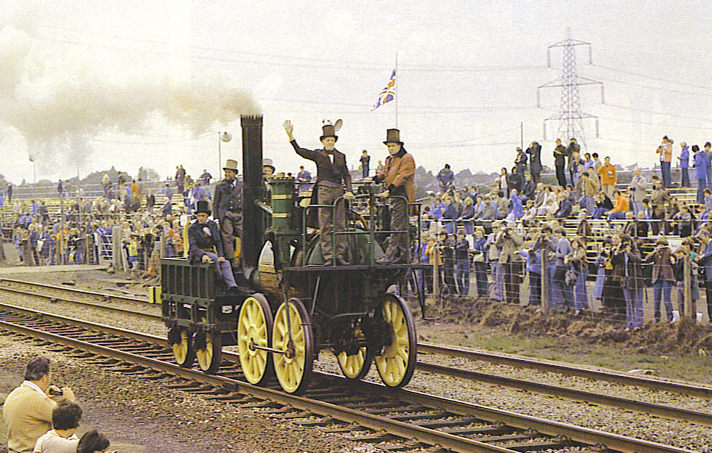
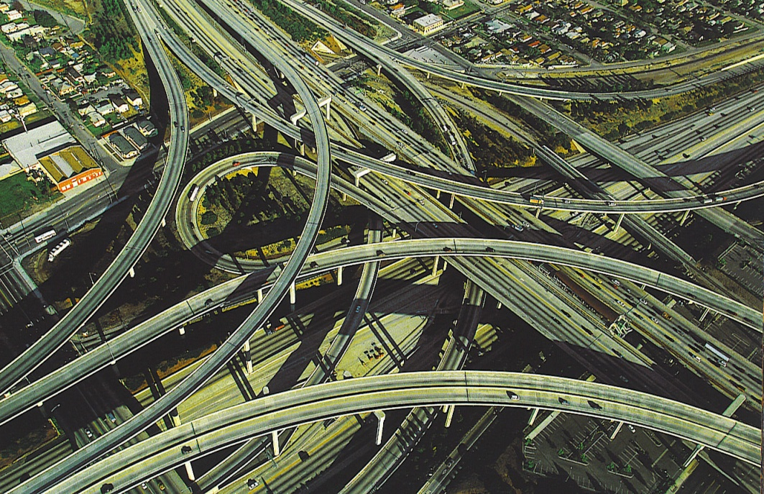
Technology & Transportation
Increased technology allows humans to alter the environment faster & over greater areas-e.g. chainsaws, trucks & even helicopters are used to log Pacific Northwest forests.
Faster transport-steam locomotives, diesel, high speed electric, autos, aircraft
Infrastructure-roads, rail lines, airports, parking lots & so on take up a great deal of space. (O’Hare = 28 sq. miles
Notes:
1830s model steam locomotive –speed 30 mph
LA freeway interchange.

Slide 5
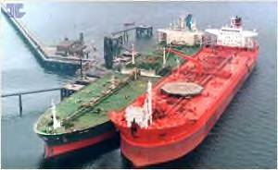
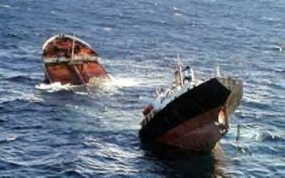
Technology & Transportation
Faster transportation is responsible for making global environmental changes-mosquitoes transported in tires, Asian Long Horn Beetle in wood crates from China.
Oil spills in shipping lanes
Pelagic (open ocean) marine species are transported to the other side of the globe by ship ballast.
Diseases are spread faster by aircraft-AIDS, SARS, Avian flu, etc.
Notes:
Top oil tankers off-loading
Bottom the Prestige which broke in half off the coast of Spain in Nov. 2002

Slide 6
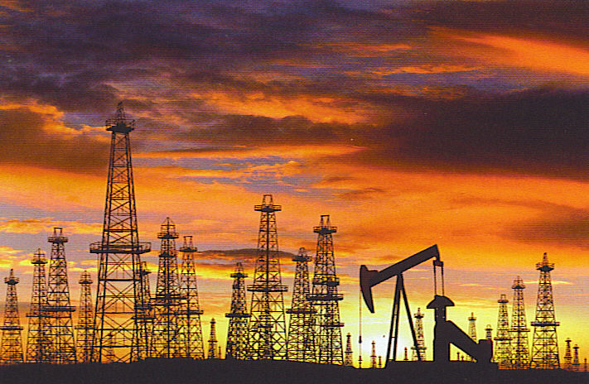
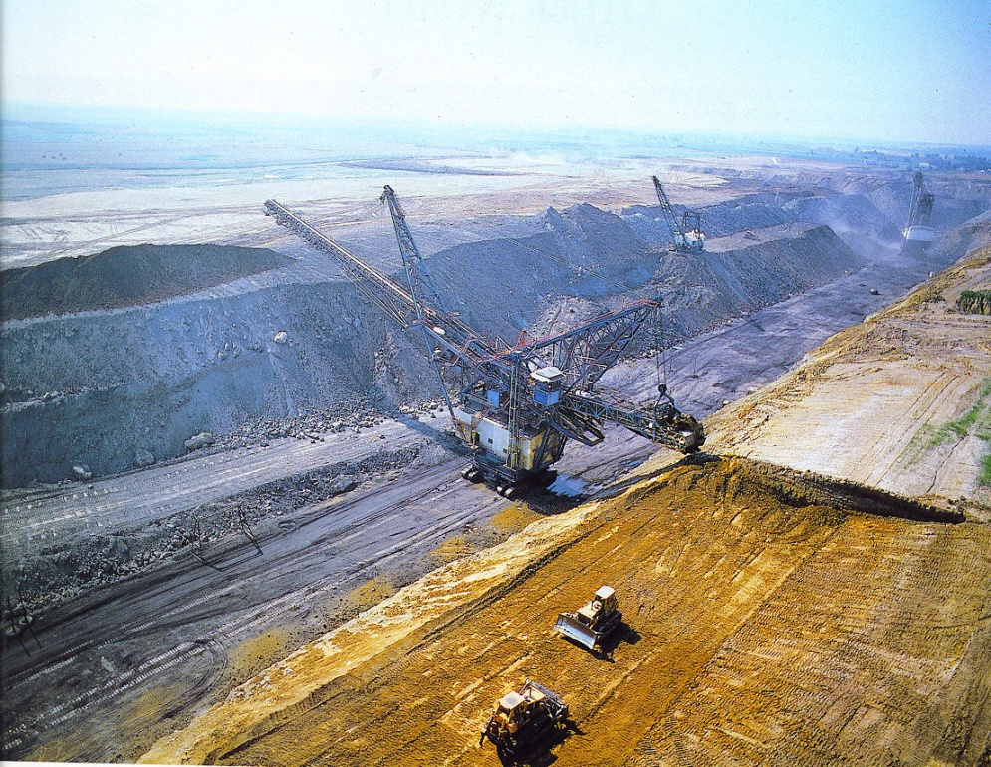
Energy
Historically-biomass was the most important fuel-wood, plant material or animal waste.
With Industrial Revolution-the burning of fossil fuels-coal & later oil & natural gas became common.
As population rises & periphery nations improve the demand for fossil fuels will increase
Notes:
Texas Oil field at sunset
Open pit coal mine in Illinois

Slide 7
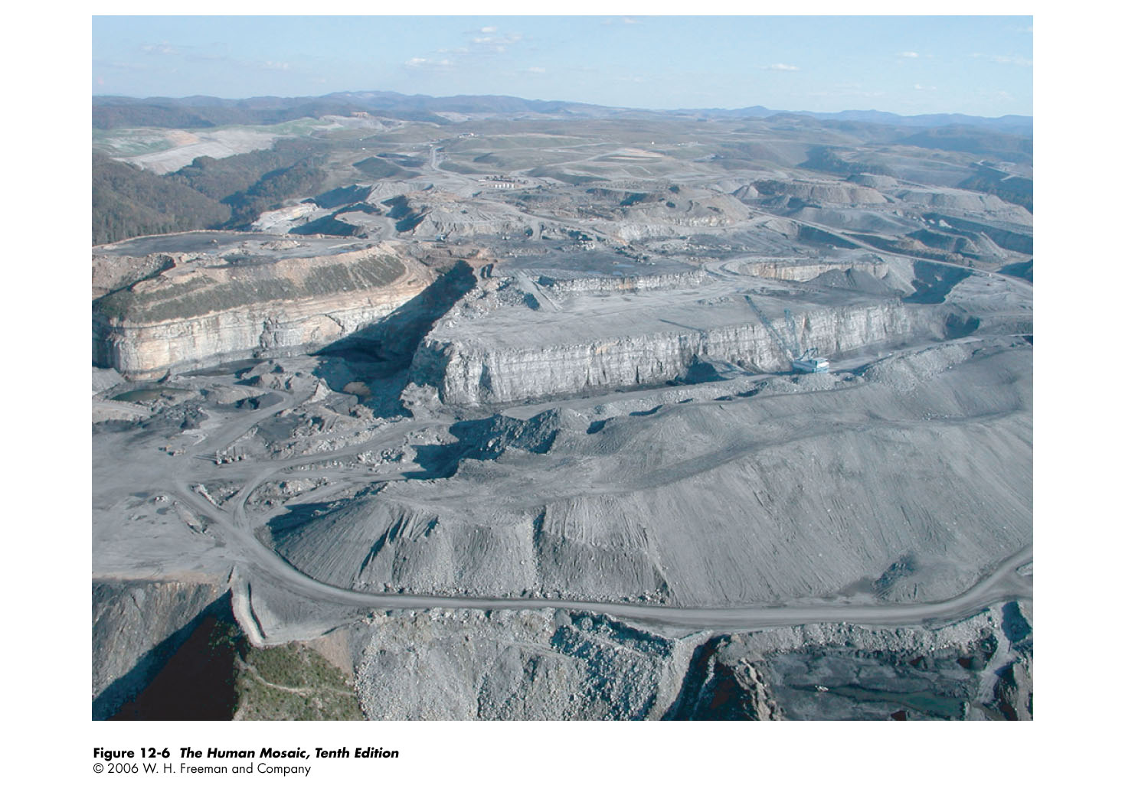
Notes:
Mountain top mining in West Virginia-Landscapes and ecosystems are permanently altered to meet the increasing industrial demand for fossil fuels. A popular technique in “sustainable” coal mining involves the removal of entire mountain tops to access the deposit

Slide 8
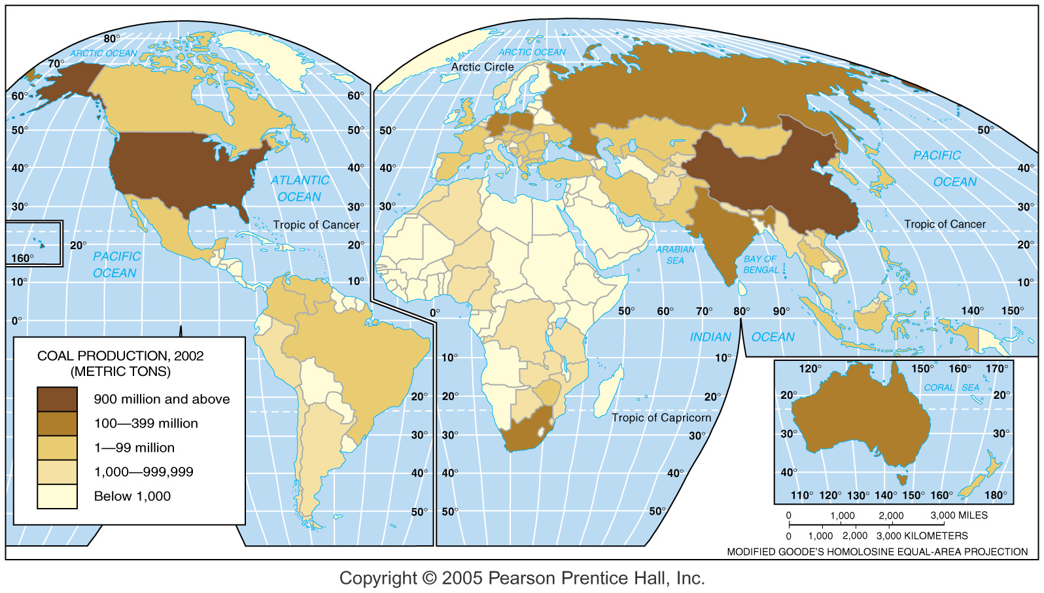
Coal Production
Fig. 14-2a: China and the U.S. are the world’s largest coal producers. Little coal is produced in most of Africa and some of Latin America.

Slide 9
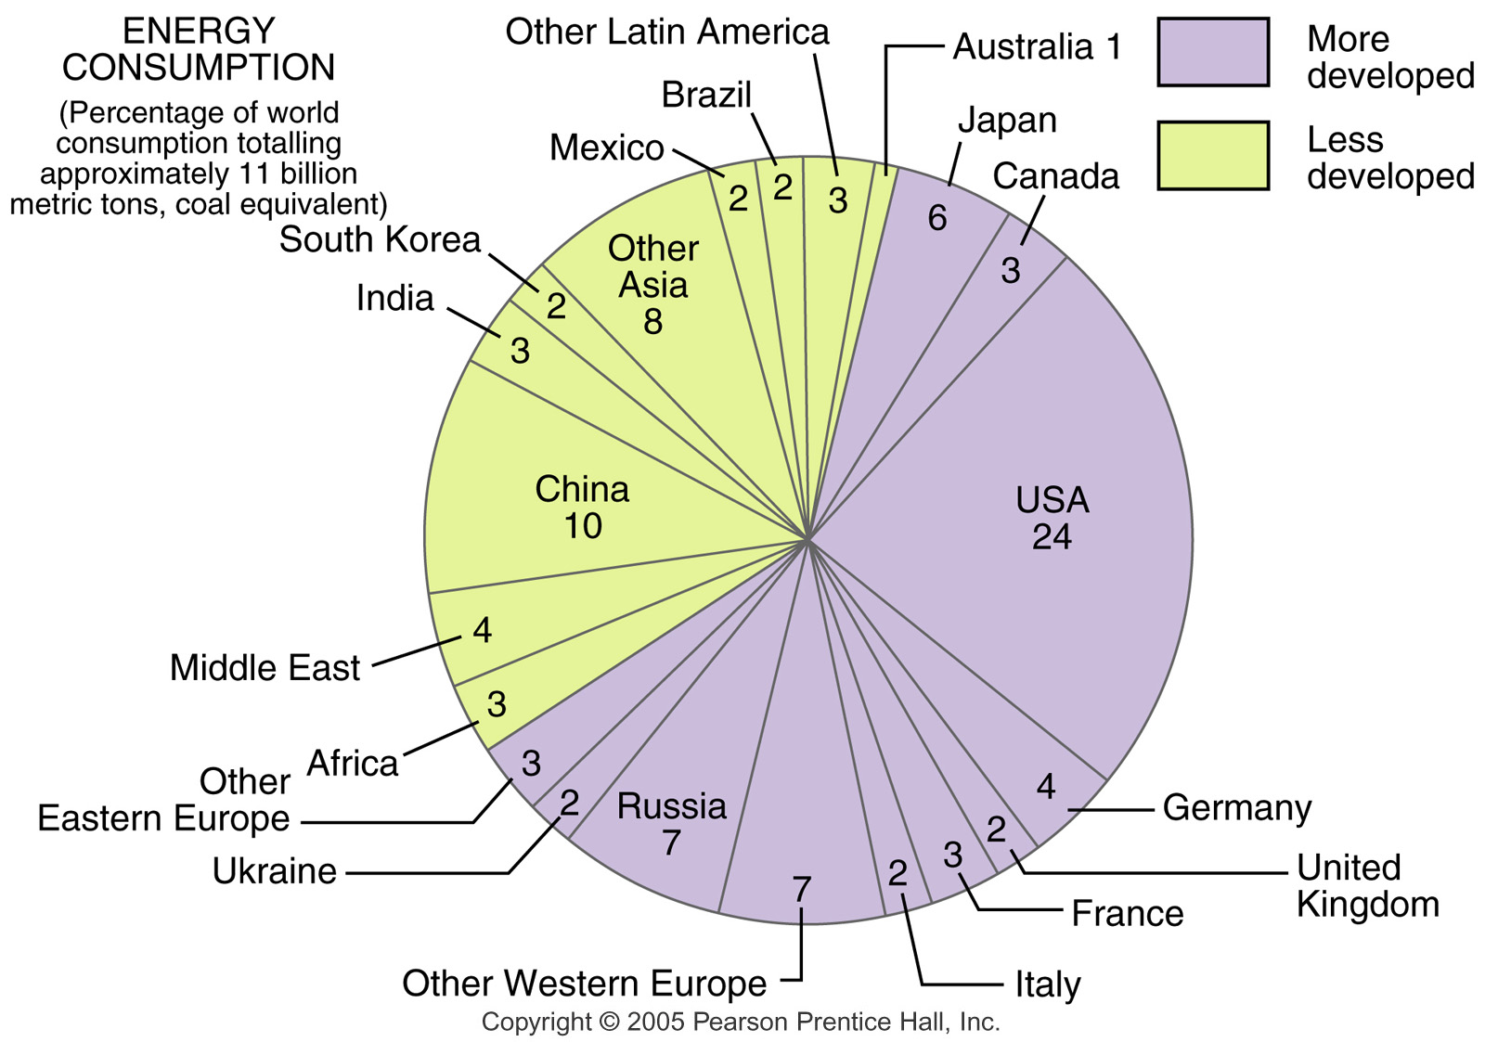
World Energy Consumption
Fig. 14-5b: The U.S., with about 5% of world population, consumes about 25% of world energy.

Slide 10
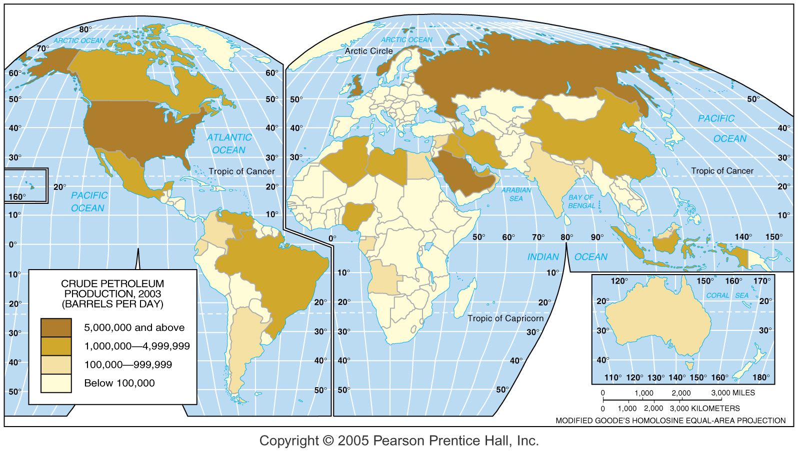
Petroleum Production
Fig. 14-3a: Saudi Arabia, Russia, and the U.S. are the world’s largest petroleum producers.

Slide 11
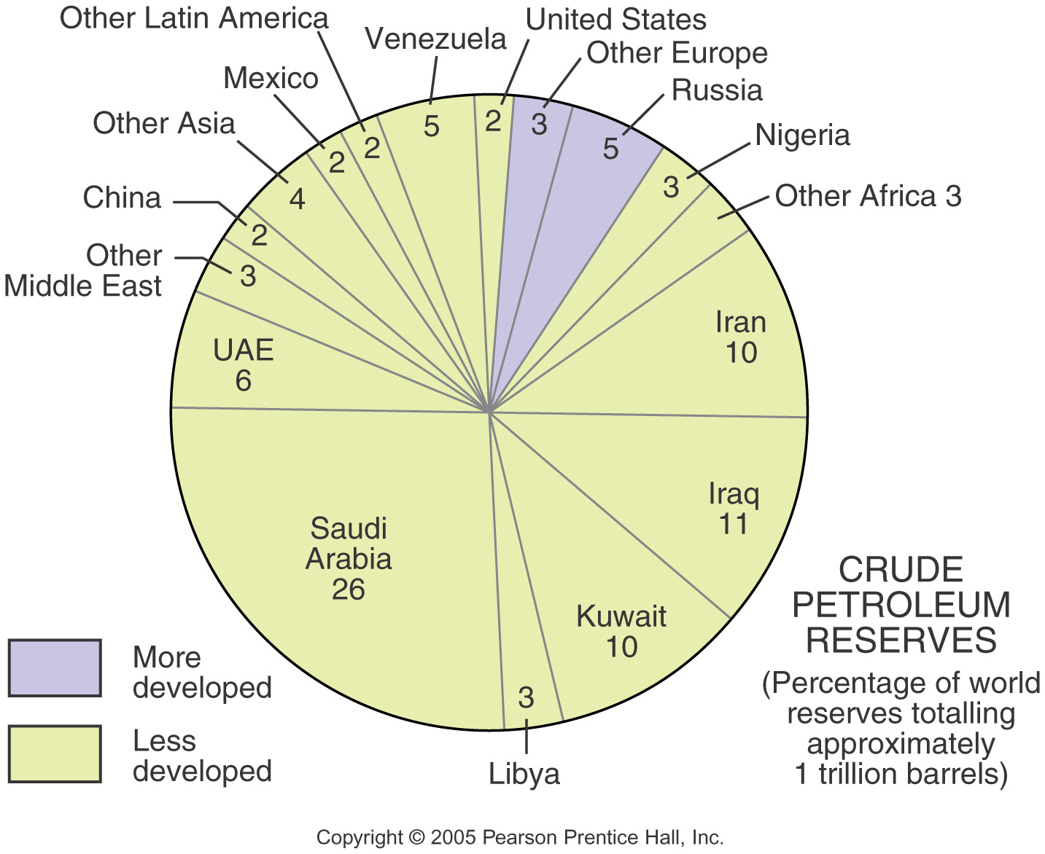
Petroleum Reserves
Fig. 14-3b: Two-thirds of the world’s known petroleum reserves are in the Middle East. Saudi Arabia alone has over one-quarter of world reserves.

Slide 12
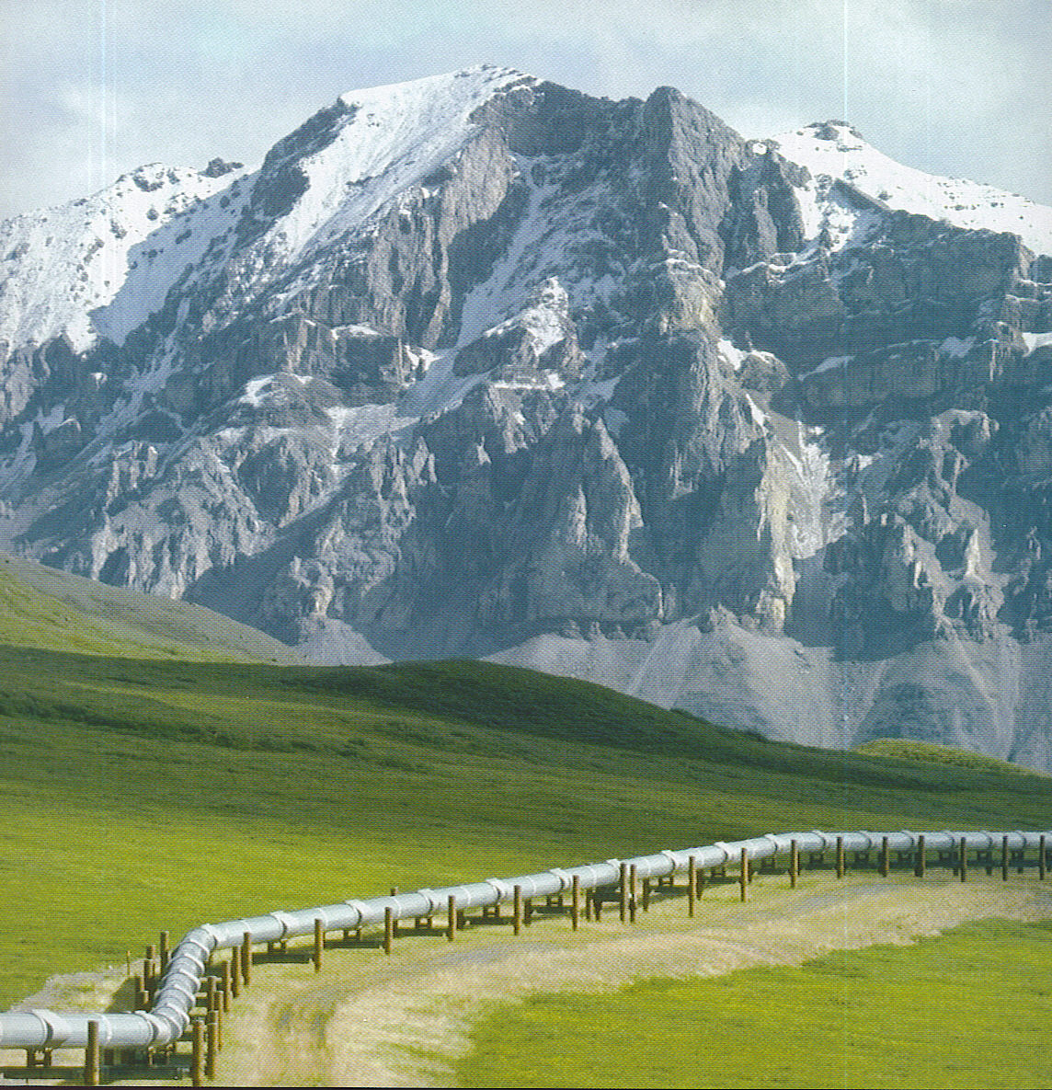

Slide 13
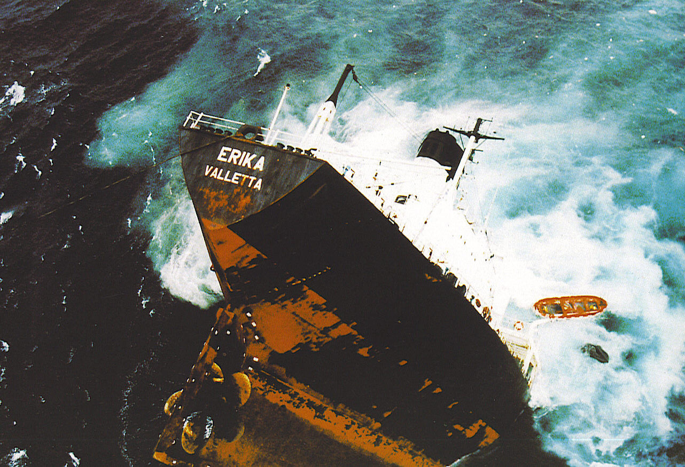
Notes:
Oil Tanker Erika sinking off the coast of France in Dec. 1999 spilling 11,000 tons of crude oil that impacted 500 miles of the French coast.

Slide 14
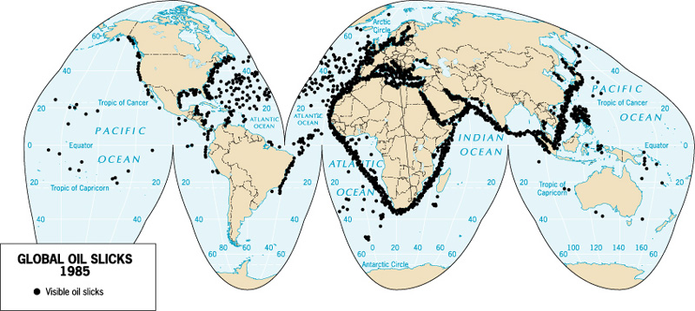
Locations of Visible Oil Slicks
Oil dependency and transportation creates more opportunities for oil slicks.

Slide 15
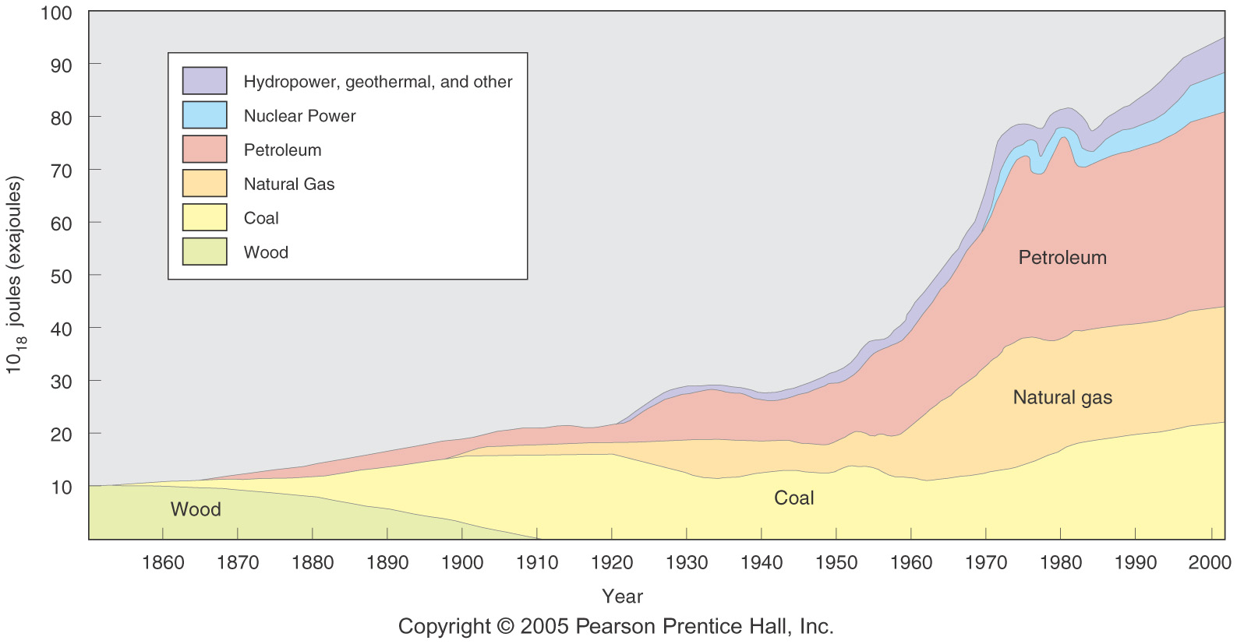
U.S. Energy Consumption 1850–2000
Fig. 14-1: The main energy sources in the U.S. have changed over time as total energy use has increased. Growth was particularly rapid in the 1950s and 1960s.

Slide 16
The Human Impact
Ecosystems-the ecological units of self-regulating living & nonliving natural elements.
Even primitive civilizations inflicted great damage on the environment.
Environmental stress includes:
  Cutting forests-deforestation
  Polluting the air with factory waste, cars & farming
  Polluting water with chemicals and waste products
  Excessive use of the limited supply of fresh water
  Burying toxic and non-toxic wastes
  Oil spills
  Over fishing
  Dumping garbage into the ocean

Slide 17
Humans impact Environment by:
Water
  Humans are causing the death of aquatic life and the spread of waterborne diseases
  What is breaking down the atmosphere?
  Water using industries
  Municipal sewage
  Agriculture
  Impacts
  Disease and death

Slide 18
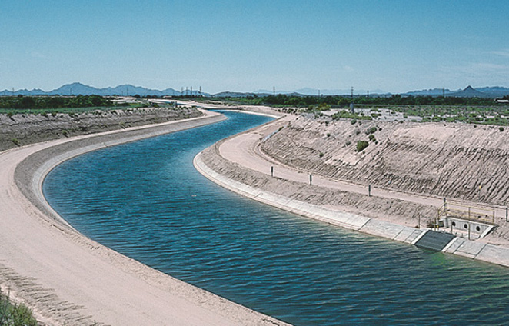
In arid landscapes, such as the American Southwest, dams and narrow ribbons of water bring water to the people.
Tucson, Arizona
Notes:
1 billion people lack access to clean drinking water
80 countries (40%) of world population experience serious water shortages
75% of earth’s surface is water, but only 1% is usable by humans
Average water used by an American brushing their teeth with tap on is more than that used in one day by a person in Ethiopia, Somalia, Mali, Mozambique, Tanzania or Uganda

Slide 19
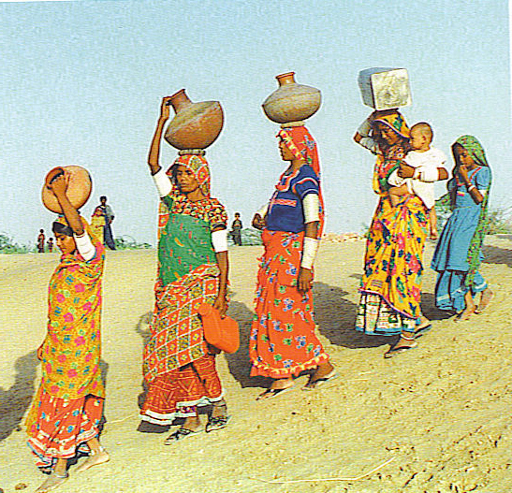
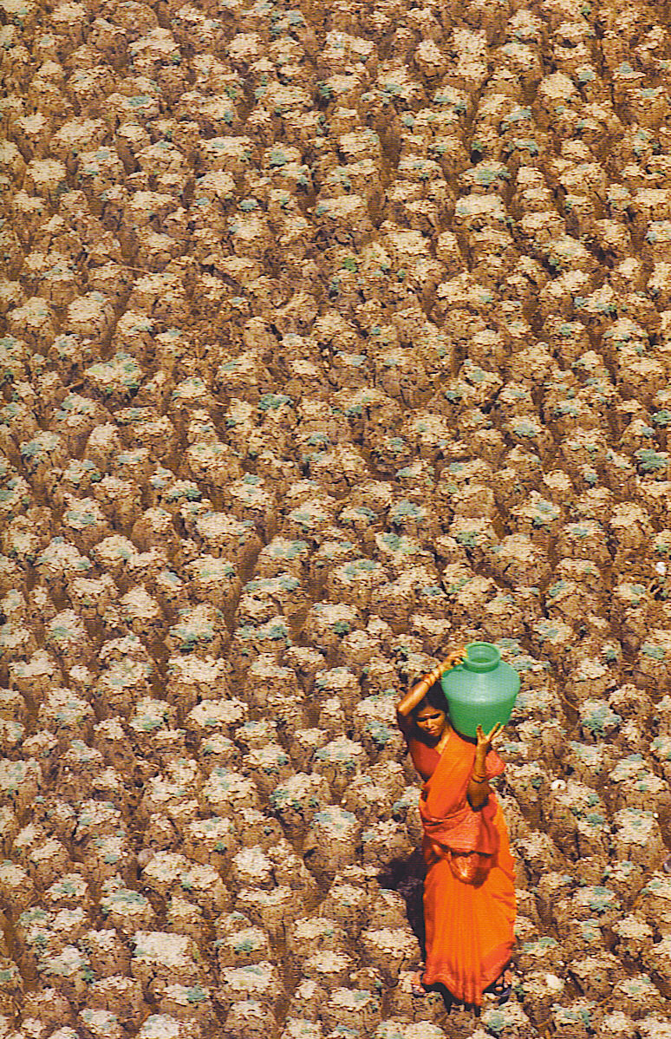
Water
Water is a renewable resource, but the amount of fresh water is limited in many areas of the world.
World wide about 75% of fresh water is used for farming-in California it is 80%
Industries use 20% of the world’s water supply and contribute heavily to water pollution.
Notes:
US-573 Liters per day-average use
China-87 Liters
Mozambique 10 Liters
Top-women in Pakistan carry water during a drought
Bottom-woman in Oman carrying water during a drought
1.8 billion children die each year from diarrheal diseases (including cholera) caused by unclean water-41% are in Sub Saharan Africa.

Slide 20
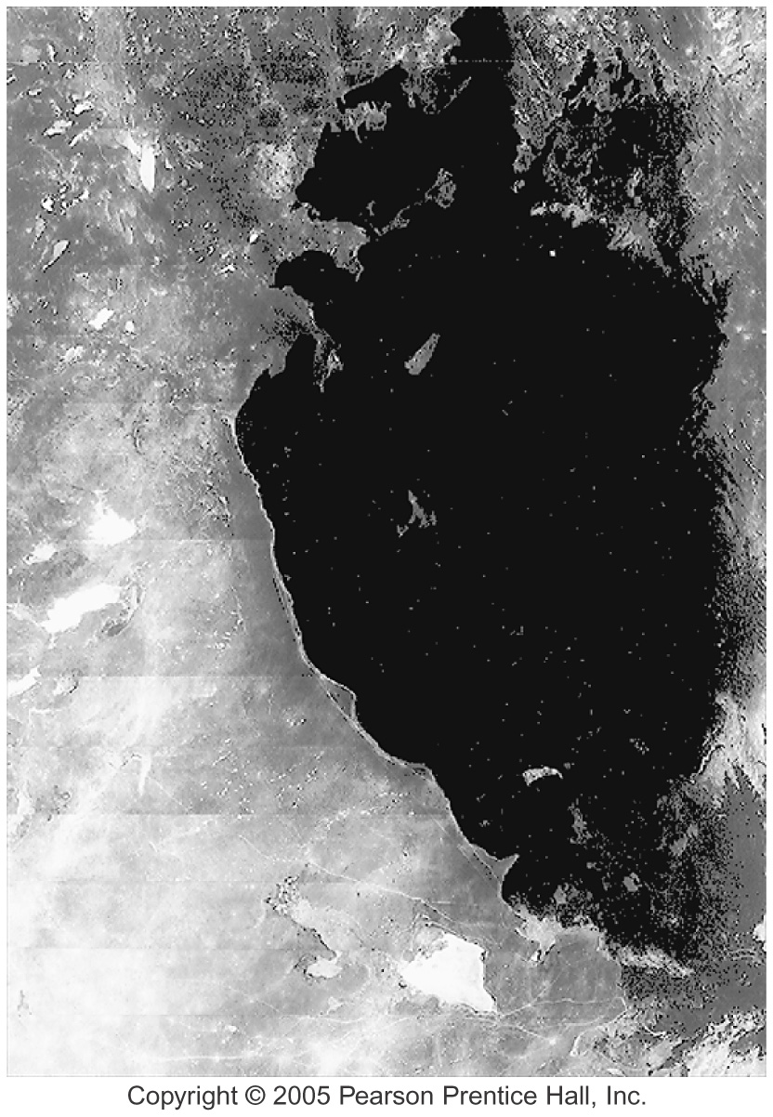
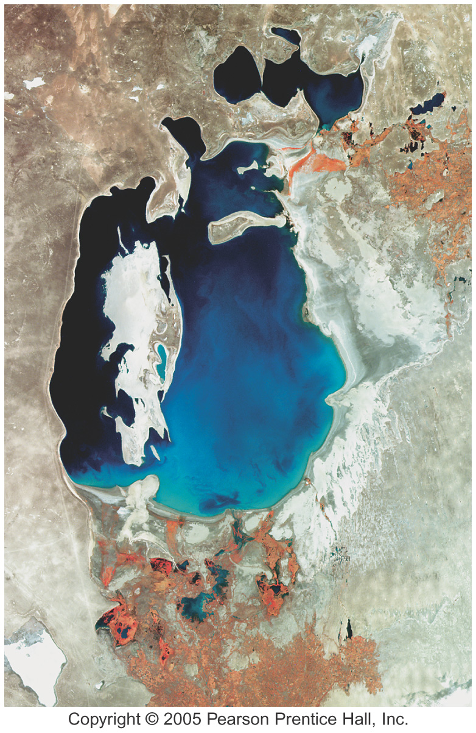
Aral Sea, 1975 and 1996
Figs. 14-1-1 and 14-1-2: The Aral Sea in the former Soviet Union has shrunk dramatically in area and volume due to extensive diversion of water for irrigation.
Notes:
Aral Sea bordering Kazakhstan and Uzbekistan
Streams and rivers were diverted for cotton farming irrigation beginning in the 1960s.
Also the heavy use of pesticides and herbicides which ran into the sea caused accumulated.
The Aral sea dying a quick death

Slide 21
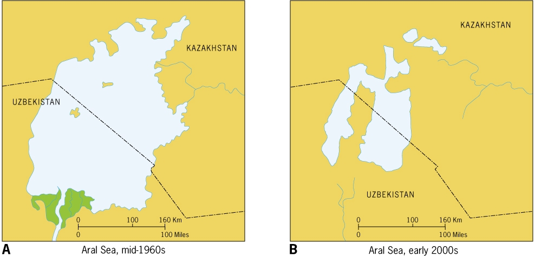
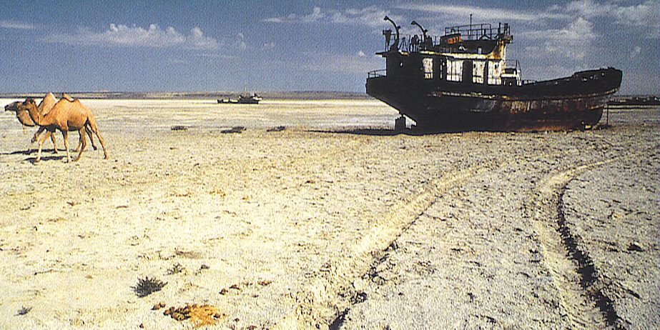
Notes:
The Aral Sea has lost ¾ of its surface area in 25 years
Many areas of the world also will suffer from a shortage of water
The Southwest US is increasing in population with insufficient water supplies

Slide 22
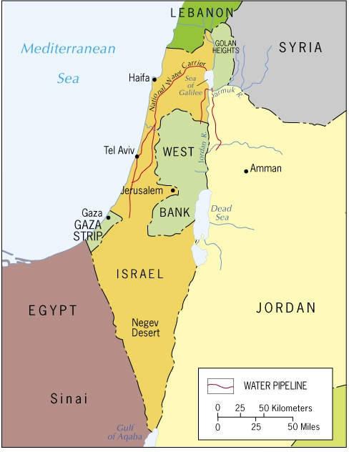
Focus on Water & Politics in the Middle East
Turkey’s dam building projects will impact Syria & Iraq.
Israel’s 6 million use 3X as much water as Jordan, West Bank Palestinians and Gaza with 7 million.
Jordan River & an aquifer under the West Bank are major water sources for Israel.
Water is an important issue between Israel & the Palestinians.
Notes:
Jordan River
Aquifer under West Bank
Who should control/who will control the water resources?

Slide 23
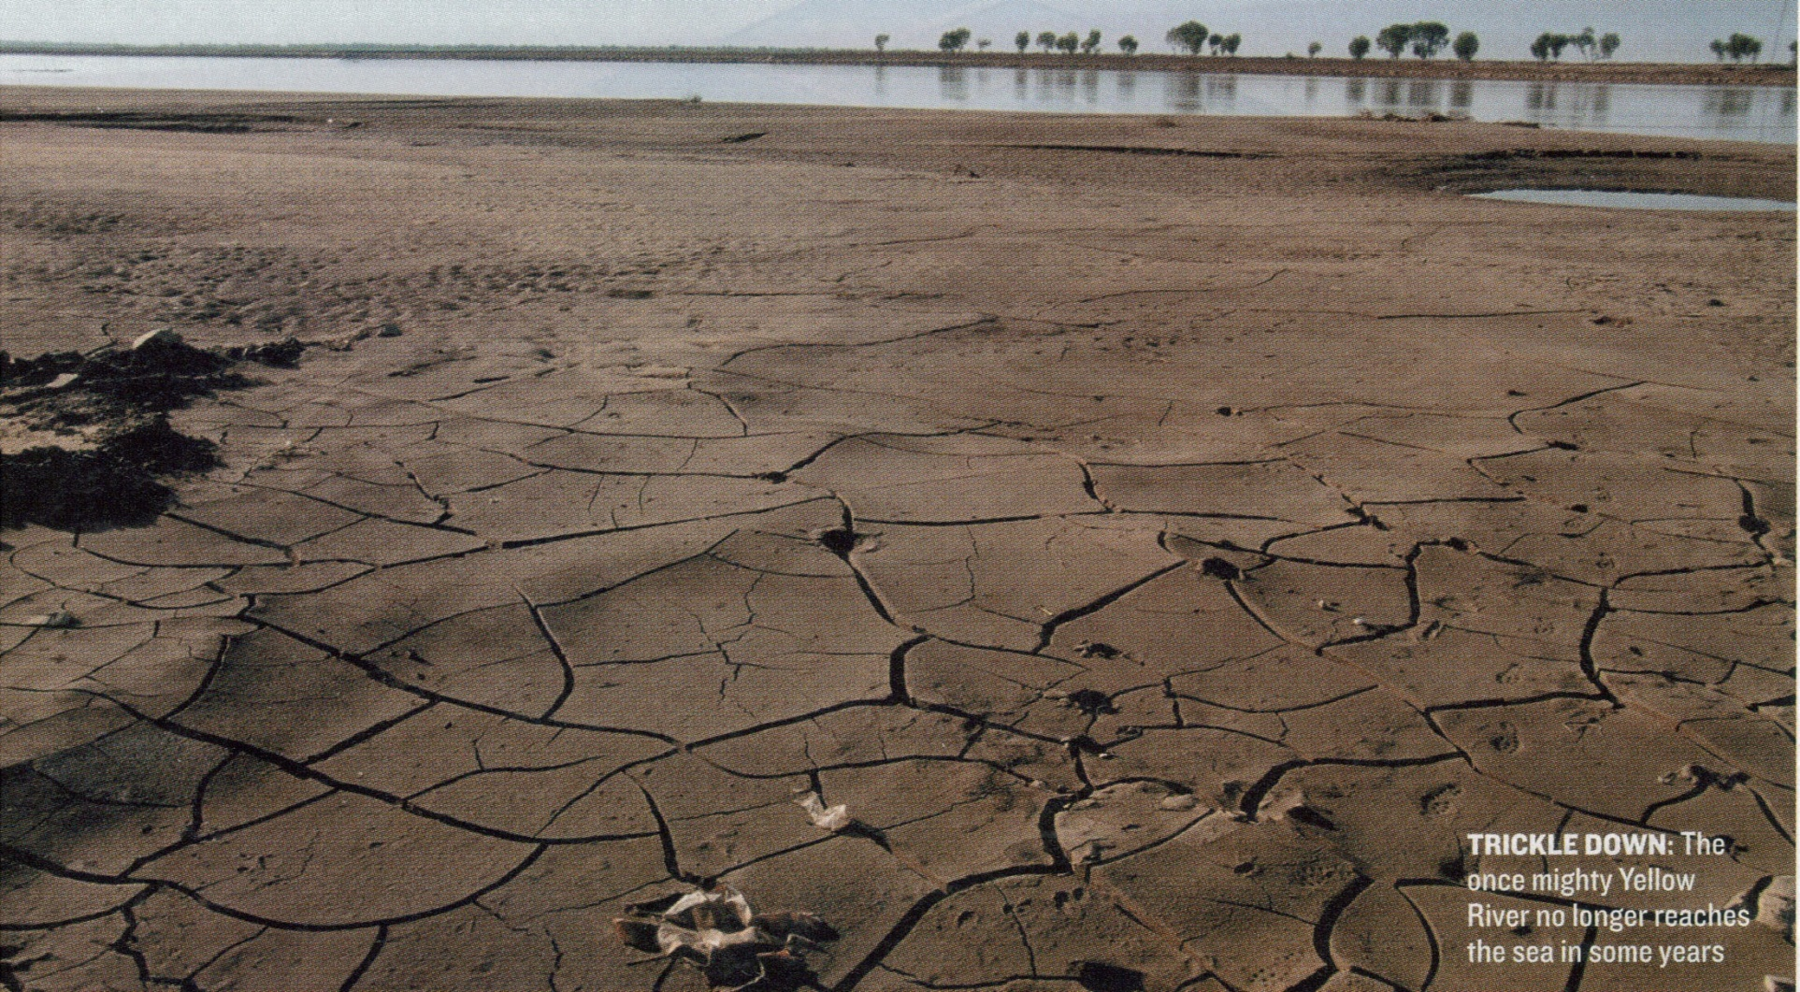
North China Plain-one of the most densely populated regions of the world-65% of China’s agriculture and 24% of its water. Only 278/661 major cities in China have sewage treatment plants-70% of the country’s rivers are polluted.
Notes:
The Yellow River (Hwang He) once known as “China’s Sorrow” for its tendency to flood is now so dry that sometimes it does not even make it to the sea. The river has been damned, diverted and pumped dry for farming and industrial uses.
250 million Chinese live on the North China Plain-per capita water use is only 1/8th of the typical American

Slide 24
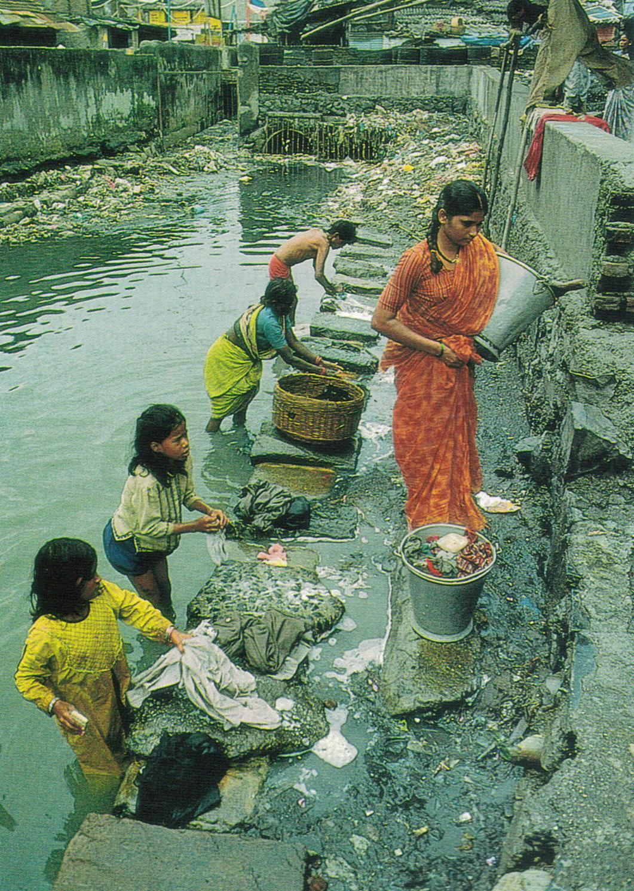
Dharavi, a slum of Mumbai is the largest in the world.
Women wash clothes in a water way that is polluted by garbage and raw sewage on a daily basis
Notes:
Dharavi, a section in Mumbai, is Asia’s largest slum.
Women who was clothes in the watercourse flowing through Dharavi have a difficult time because of garbage and raw sewage pollute the water on a daily basis.

Slide 25
Humans impact Environment by:
The Land
  Humans causing deforestation, soil erosion, and desertification.
  What are the impacts?
  Deforestation: affect oxygen cycle
  Soil Erosion: soil not having enough time to rebound
  Waste Disposal: solid waste is filling landfills
  and toxic and radioactive wastes are difficult to dispose of and keep confined.

Slide 26
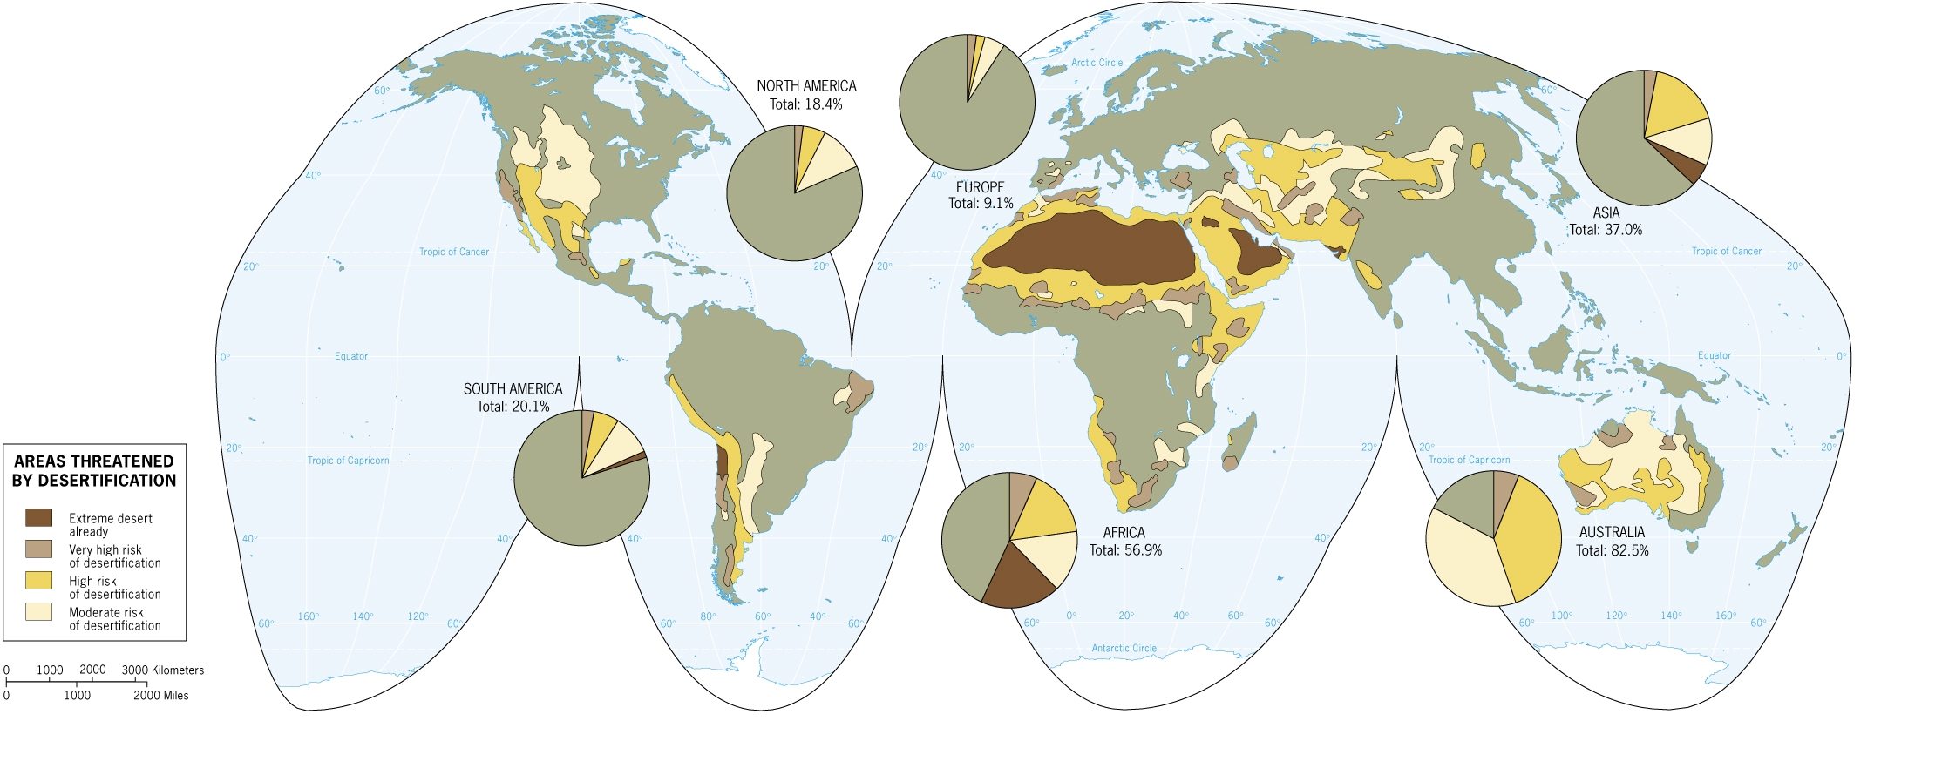
Desertification-the world’s deserts are expanding, especially in populated areas.
It is a natural, cyclical process, but one that is made worse by man’s overuse of the land-overgrazing and deforestation contribute.
Africa is most at risk with the Sahel expanding in the 1970s causing problems of drought and famine

Slide 27
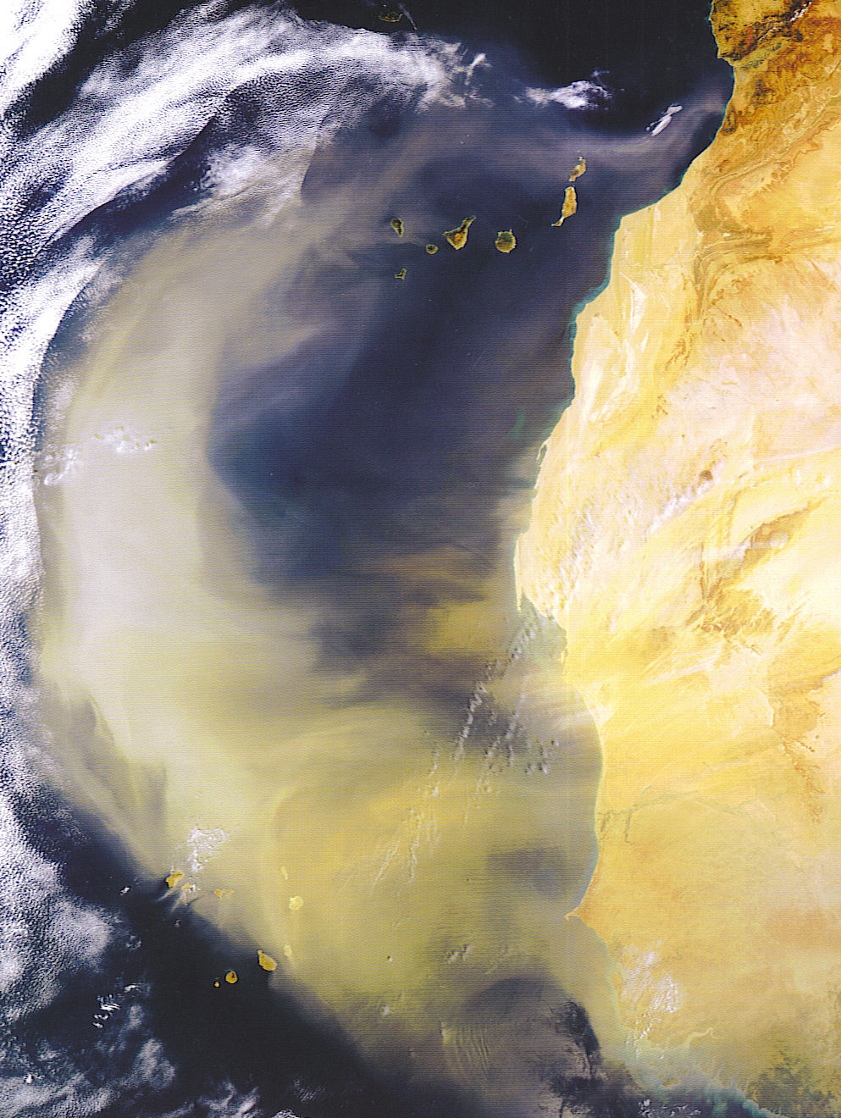
Heavy winds blow sand and dust off the west coast of Africa’s Sahara desert.
As the population of Africa increases, greater pressure on the land leads to more overgrazing and desertification.
In the last 50 years world wide over 270,000 miles of farm & grazing land has been lost
Notes:
A dust storm off the Sahara over the Atlantic

Slide 28
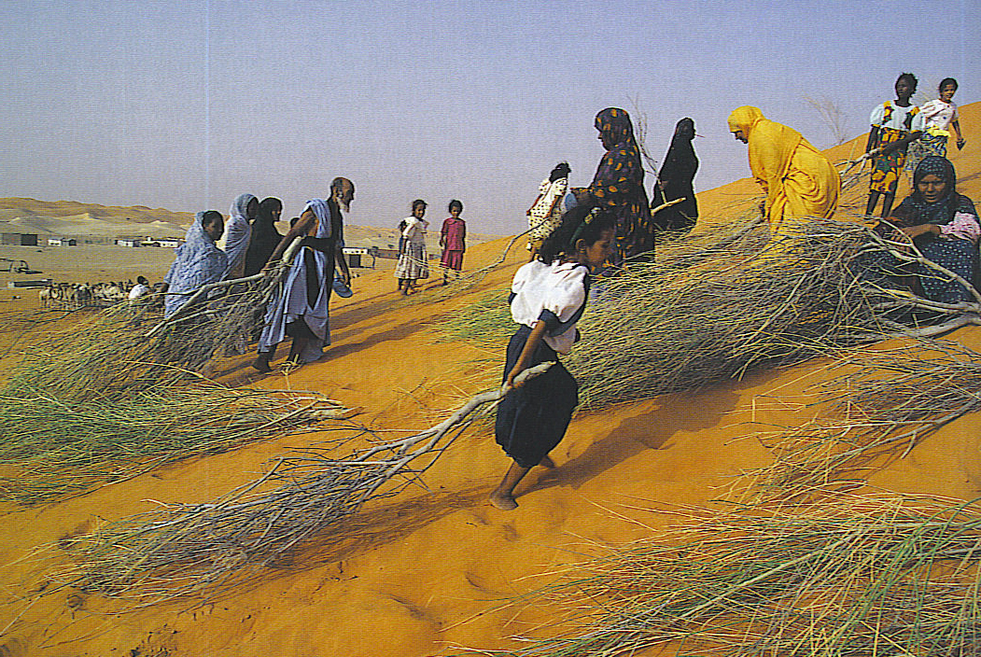
People of Mauritania try to stabilize a sand dune as it advance on their village.

Slide 29
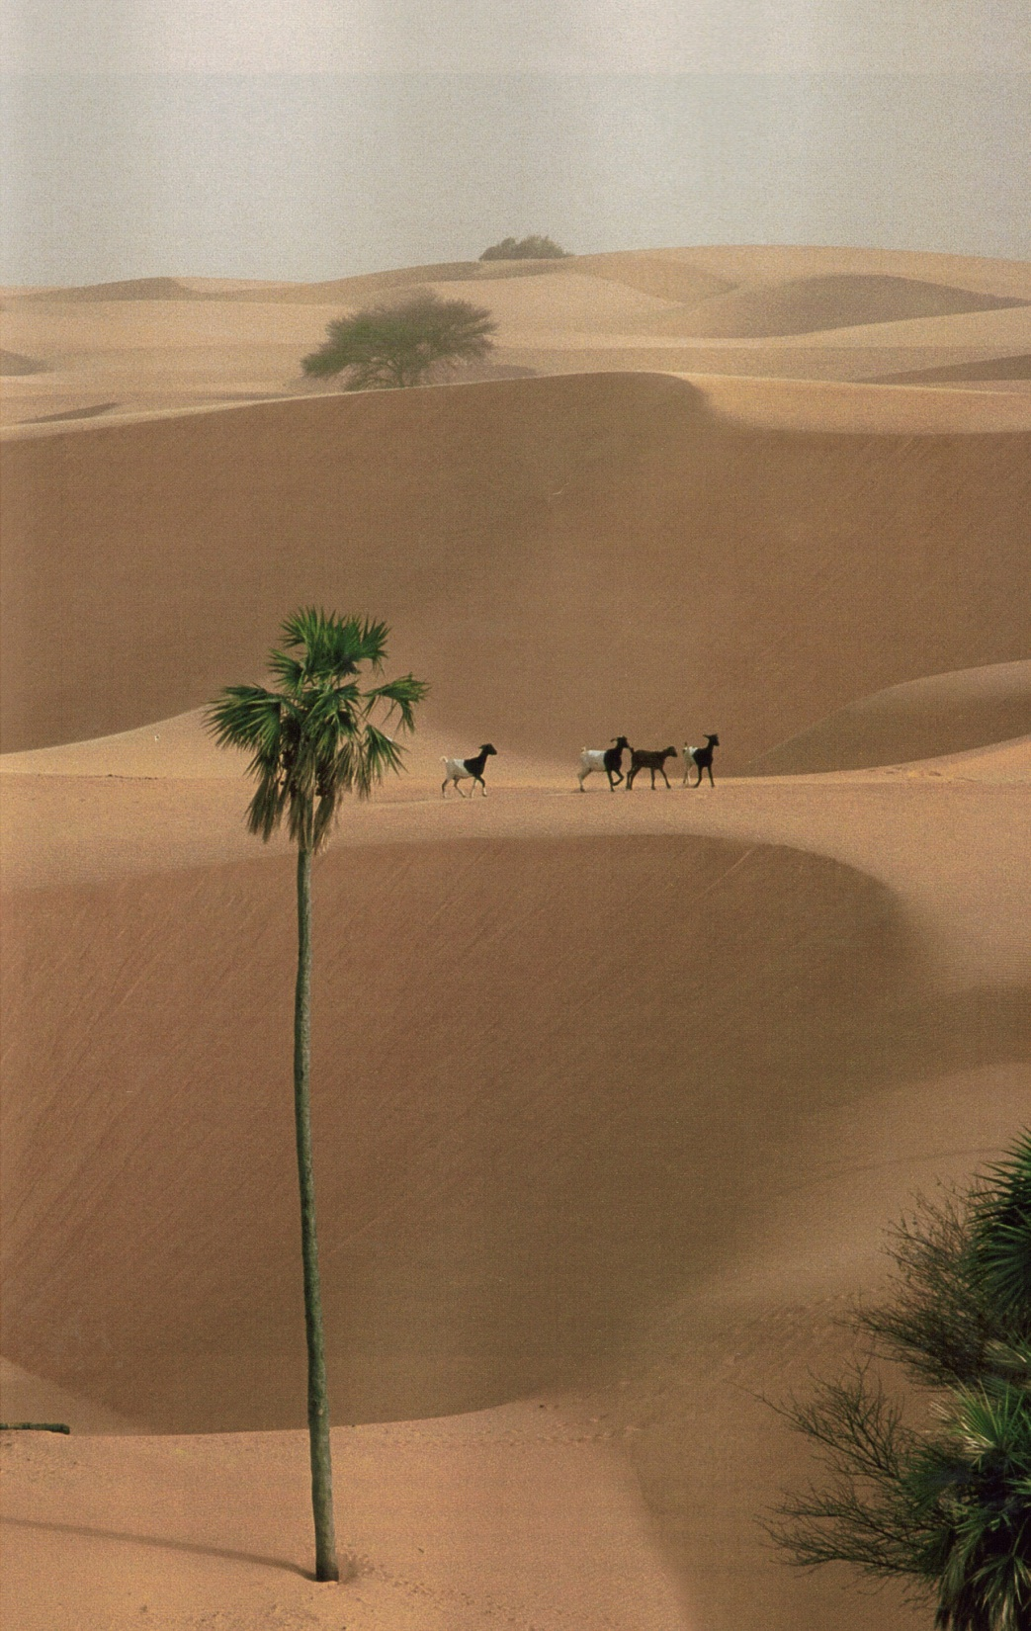
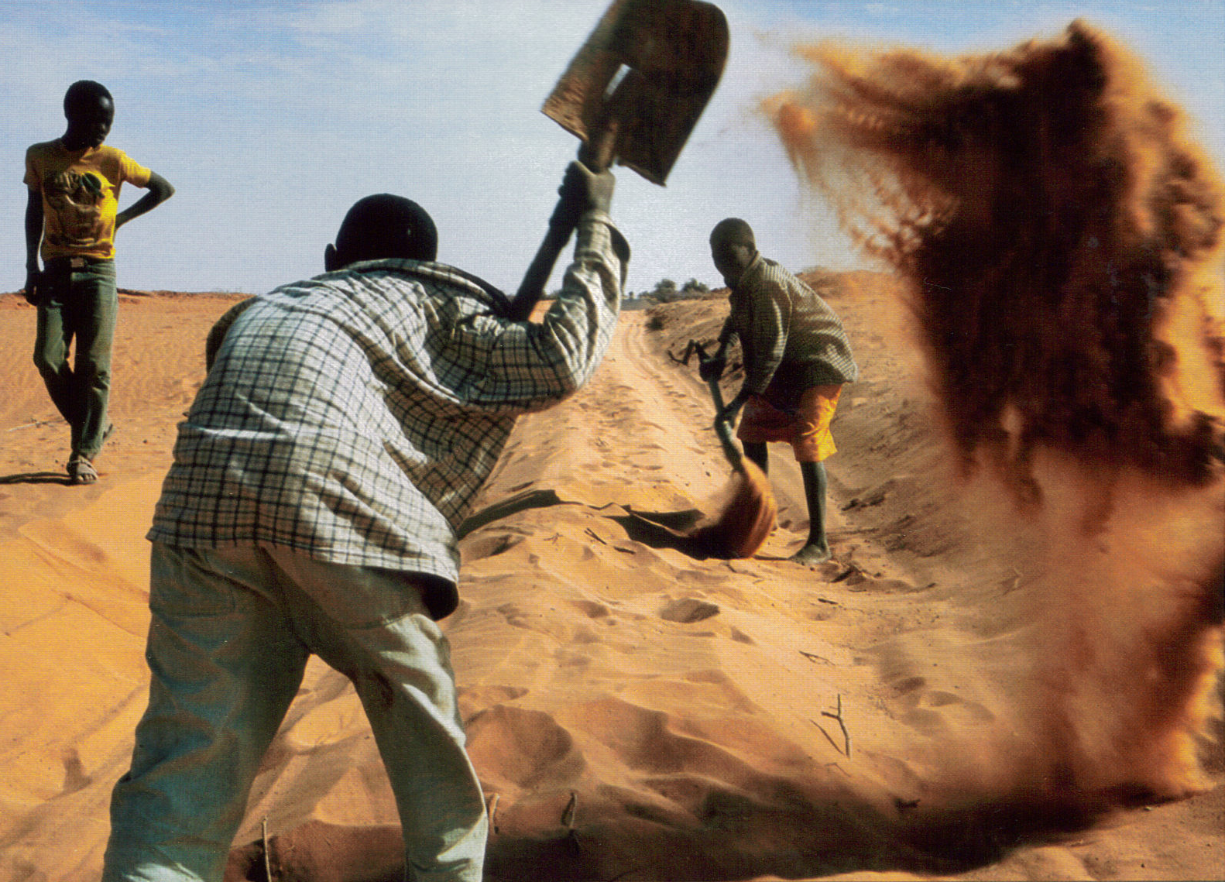
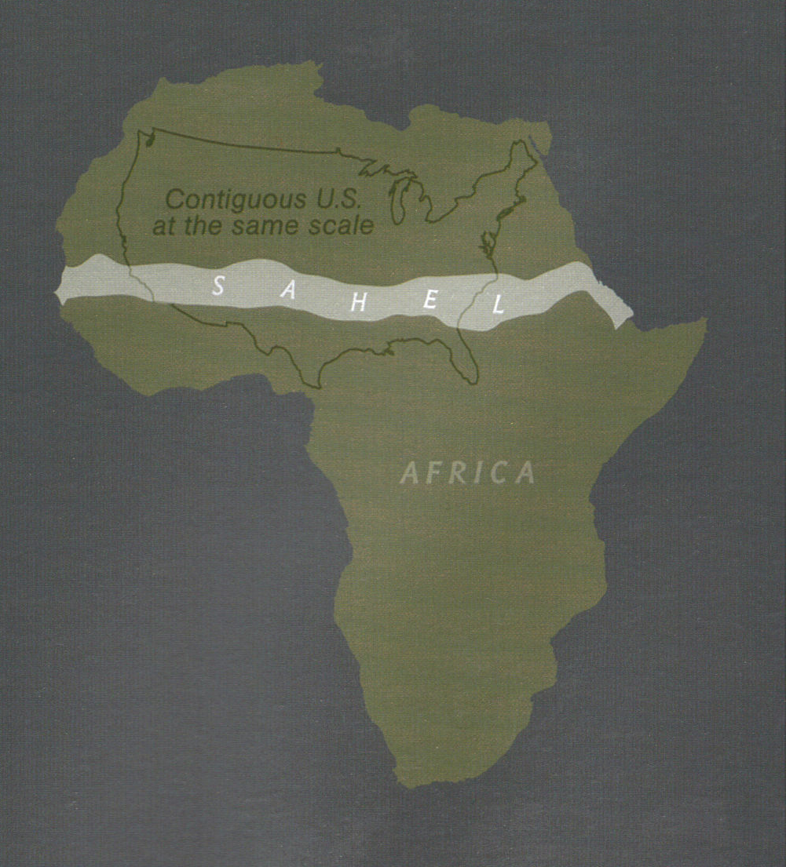
Notes:
Top-Sahel rainfall varies from 6” per year in the dry north near the Sahara to 24” per year in the south.
During the 20th century the rainfall patterns shifted and the Sahel moved south and became drier.
Green lands became barren, nomads lost herds, and in the northern Sahel sand dunes no longer anchored by vegetation, invaded some villages. Global warmer will make rains spotty and less predictable
Photo bottom left-Niger-shoveling out a road near village of Tali-young boys earn tips from drivers for their work clearing the road
Photo far right-Niger-swallowing all but the tallest trees, dunes buried cropland near the city of Goudoumaria. A goat herd in search of forage-Sahel had droughts in 1970s and 80s-rainfall has increased a bit in the 1990s but a decades long dry spell continues
Nat. Geog. April 2008

Slide 30
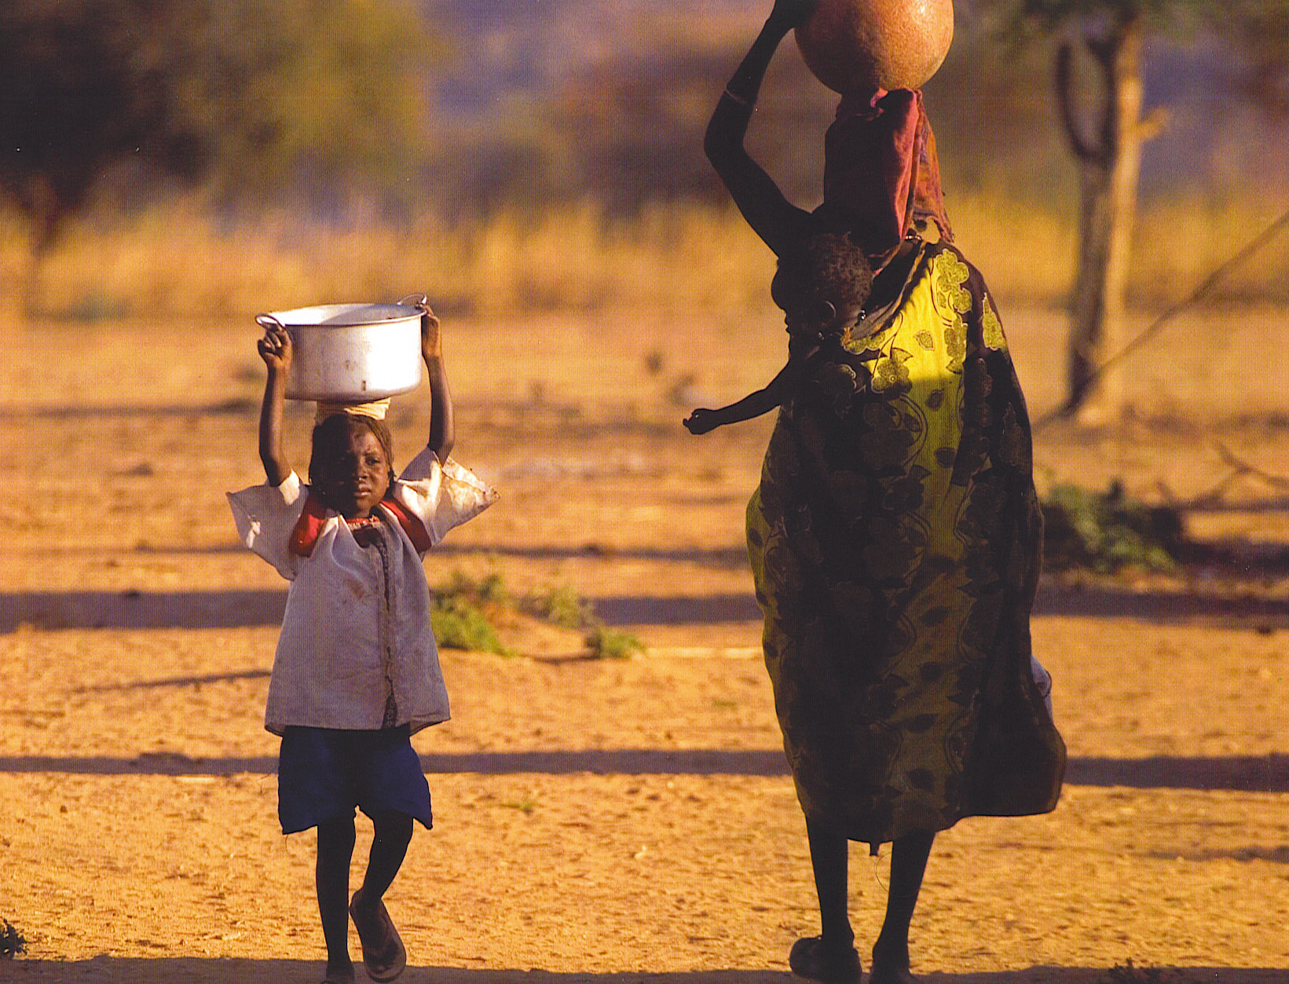
Notes:
Darfur refugees carry water

Slide 31
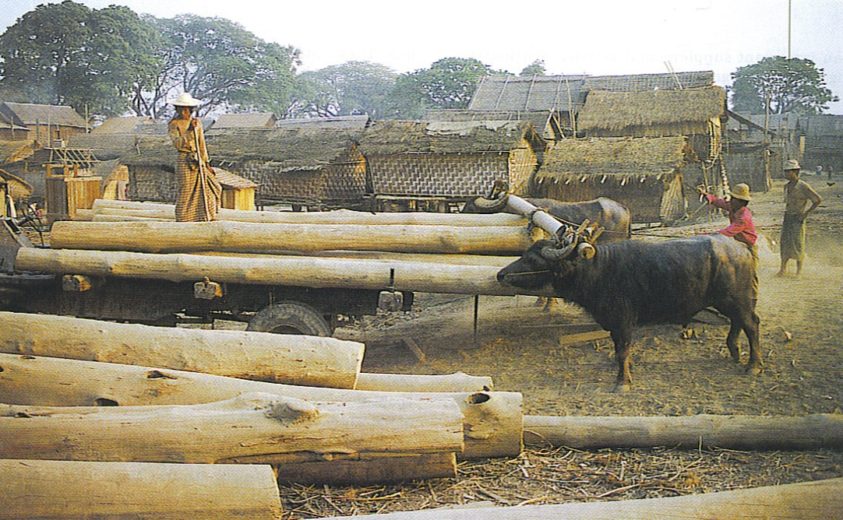
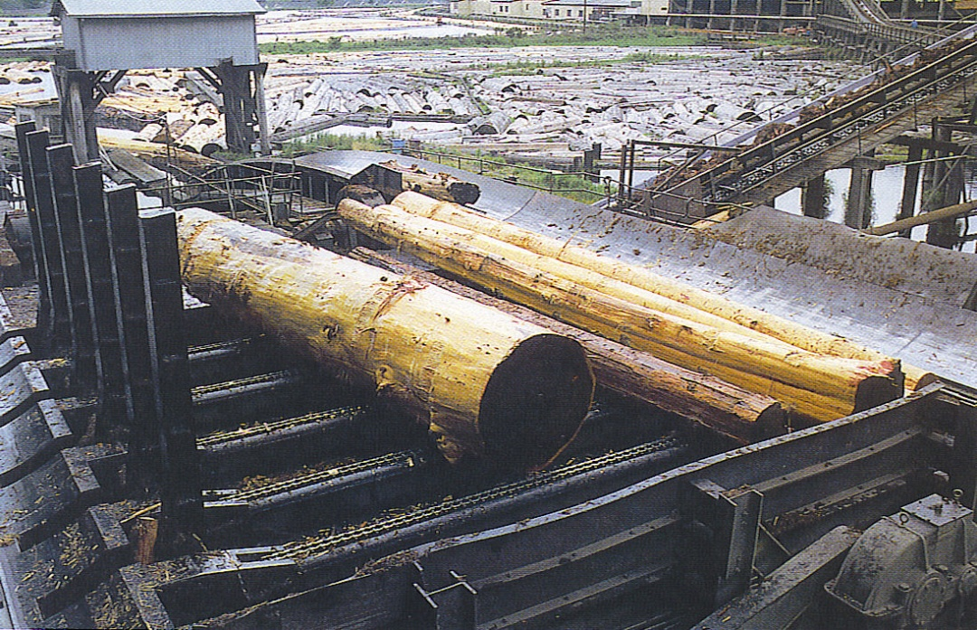
Deforestation
Clear cutting of trees has occurred in tropical Amazon, Eurasia & North America.
Forests are a key the oxygen cycle.
At the current rate of cutting all tropical forests would be gone in 90 years-some estimate only 45 yrs.
Most US forests are second growth-were logged once.
Impact-adds to soil erosion-change in climate patterns
Notes:
Teak logging near Mandalay Myanmar
Lumber mill

Slide 32
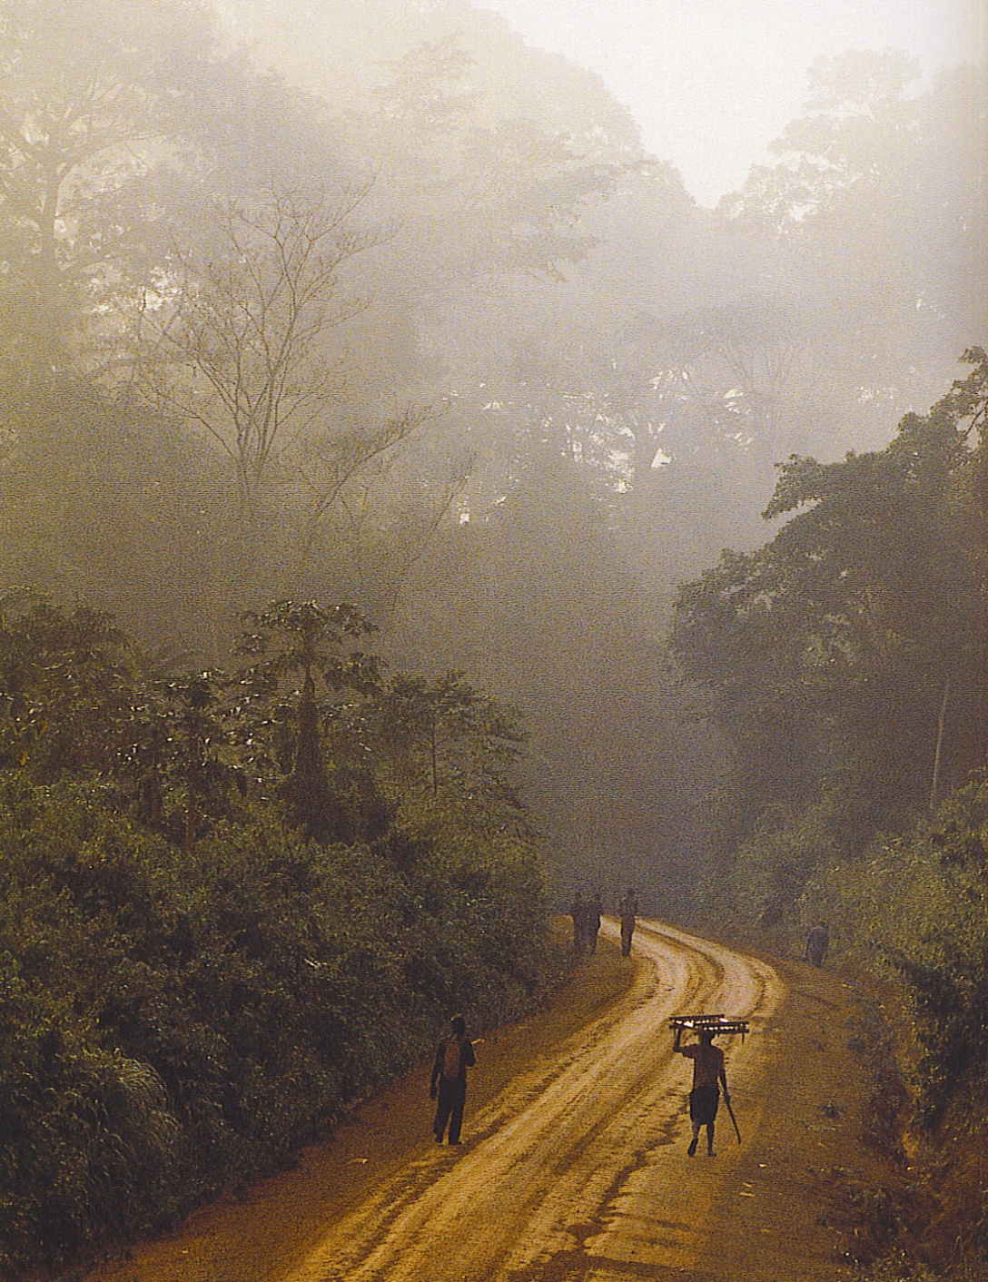
Deforestation
Causes of deforestation;
Expansion of farmland as food demands grow
Logging & timber industry
Road building
Mining operations
Human settlement & expanding population.
Notes:
logging road cut in the tropical rainforest of Cameroon

Slide 33
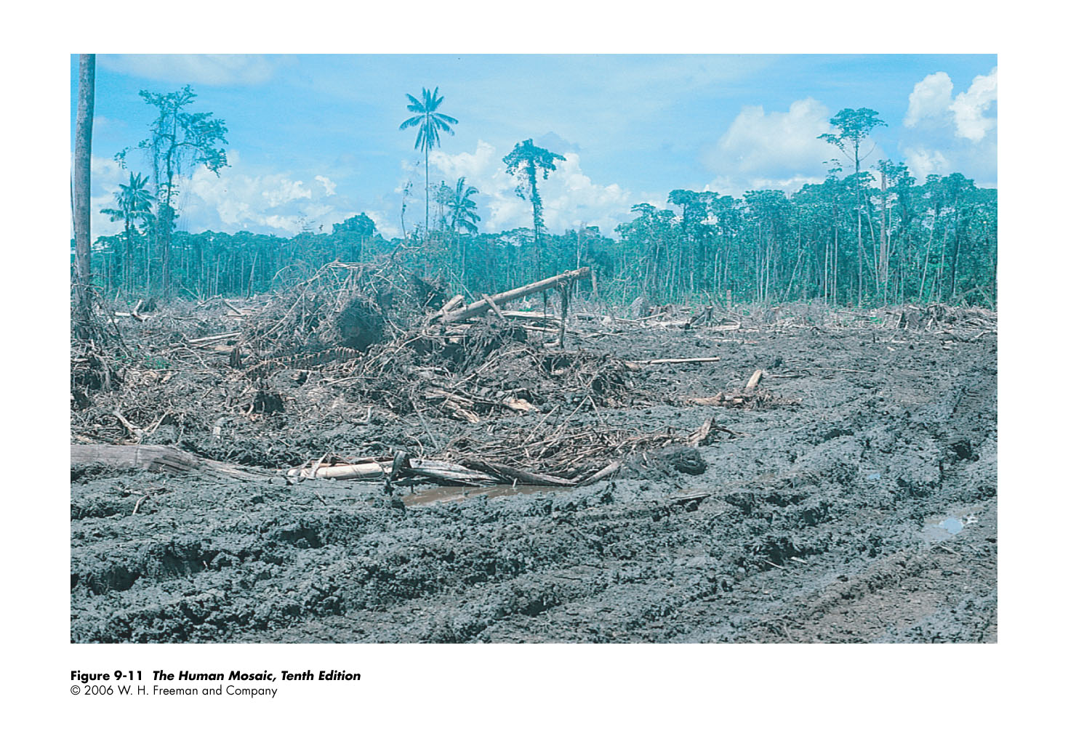
Deforestation - Tropical Rainforest of Papua, New Guinea
Notes:
Deforestation of tropical rain forest near Madang in Papua New Guinea by Japanese lumbering company.

Slide 34
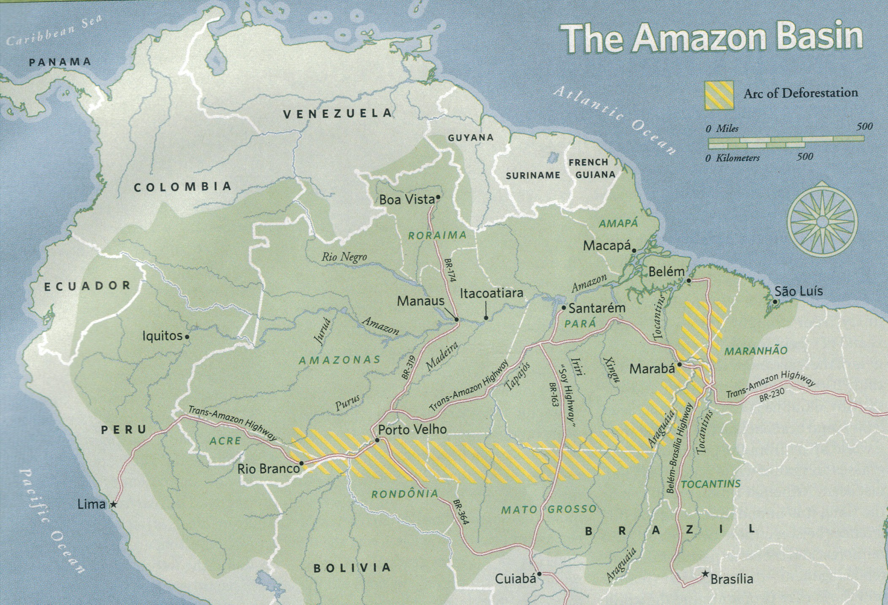
Notes:
20 % of the world’s fresh water
¼ of the world’s animal species
Ranching, farming and logging are shrinking the globe’s great rainforest at an alarming rate.
Trans-Amazon highway has made exploitation of the interior occur even more rapidly

Slide 35
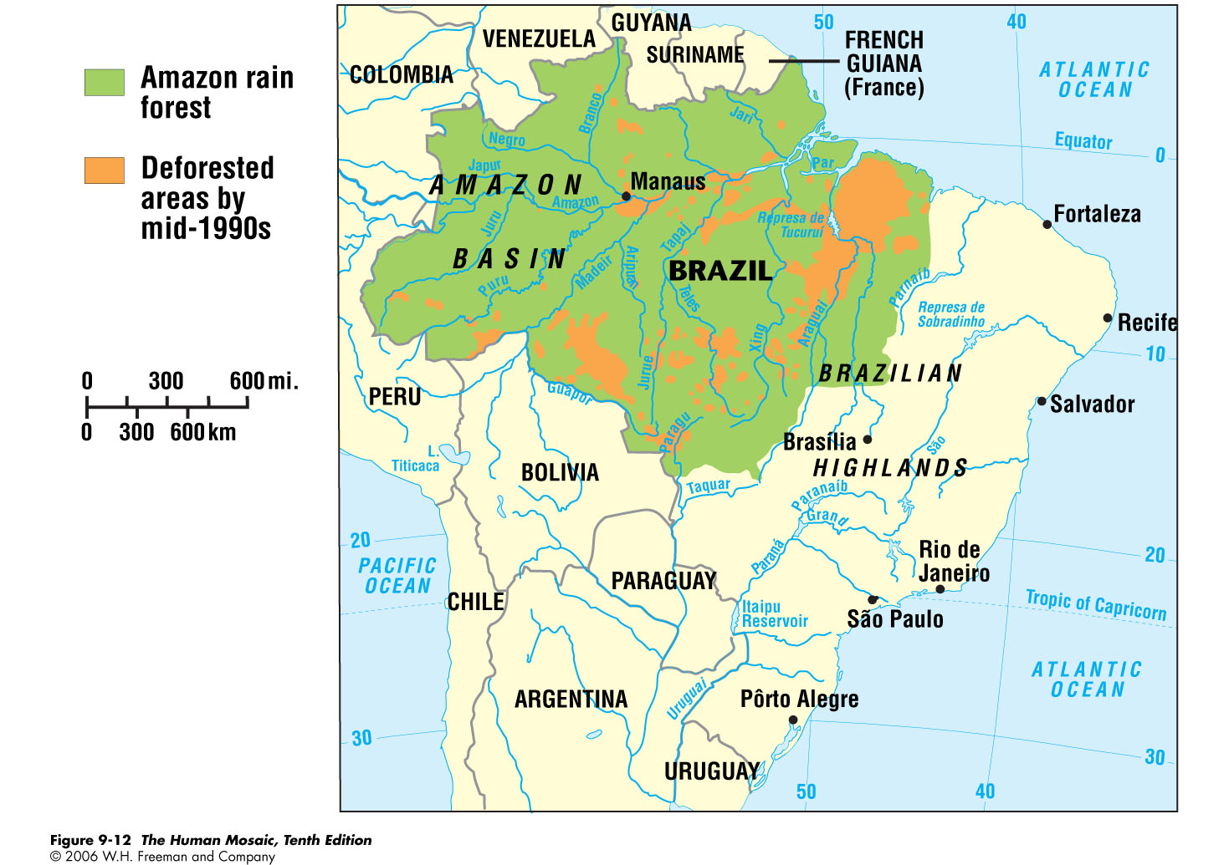
Notes:
Demand for low-cost meat for hamburgers in the US led to cutting trees in Central and South America for pasture for beef cattle herds

Slide 36
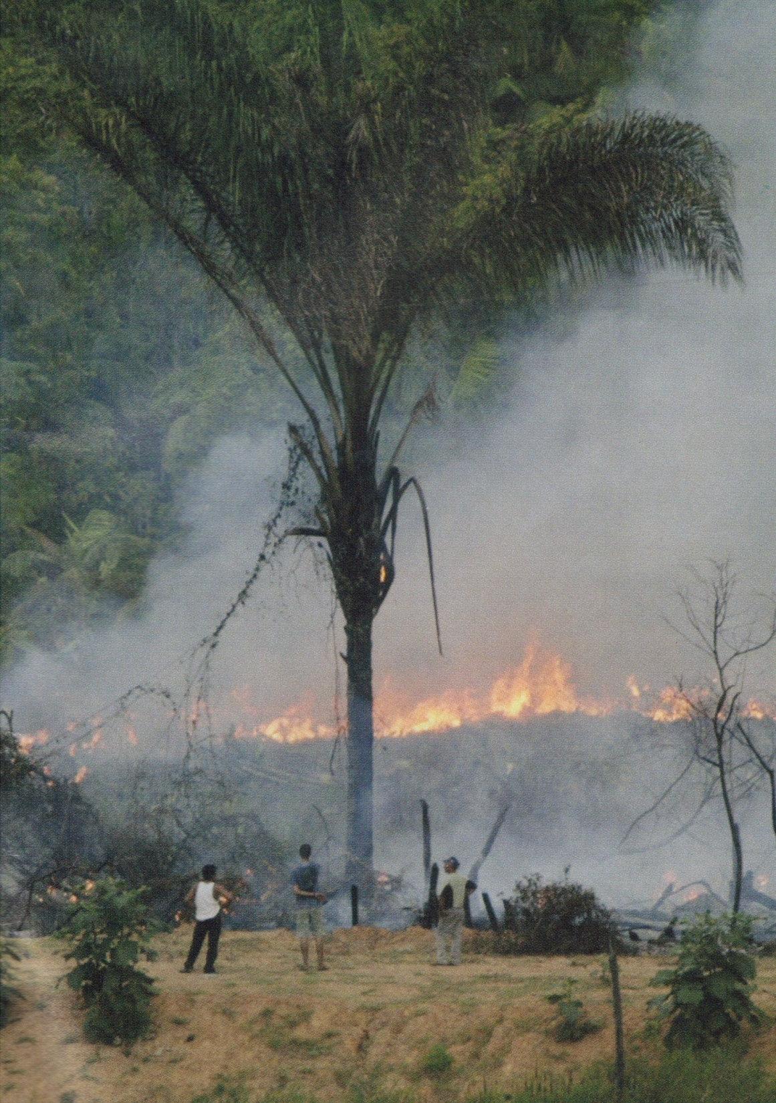
A Vicious Cycle- Warming breeds drought, drought breeds fires, fires release carbon and carbon breeds warming.

Slide 37
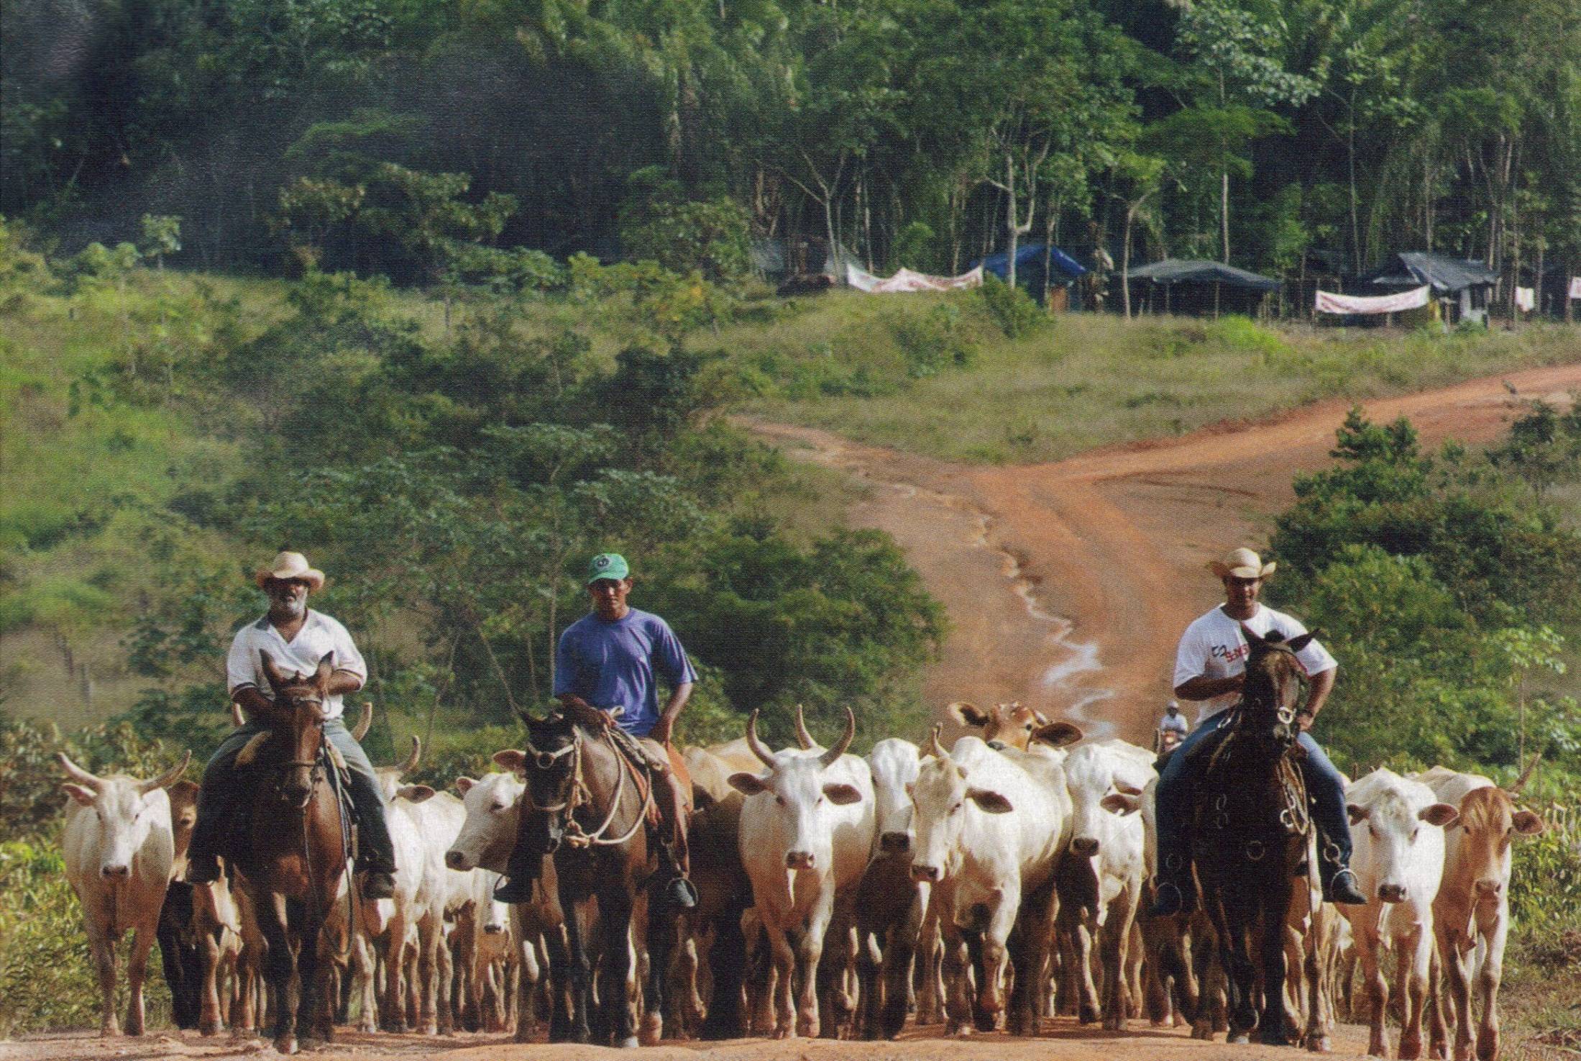
Amazon ranching=bigger profits, but smaller forests

Slide 38
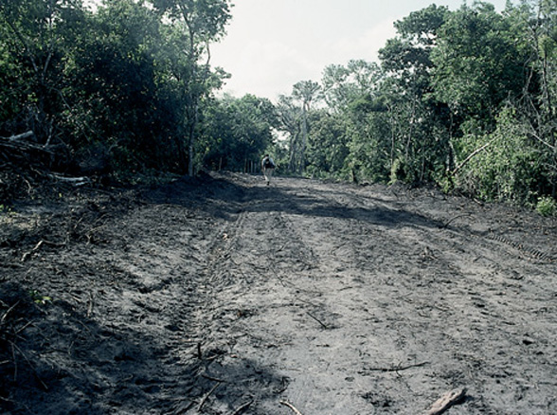
Deforestation –
In the rainforest of South America, new roads, such as this one in Para, Brazil, push deforestation farther into the forest.
Para, Brazil-newly cleared road in the Amazon Rainforest

Slide 39
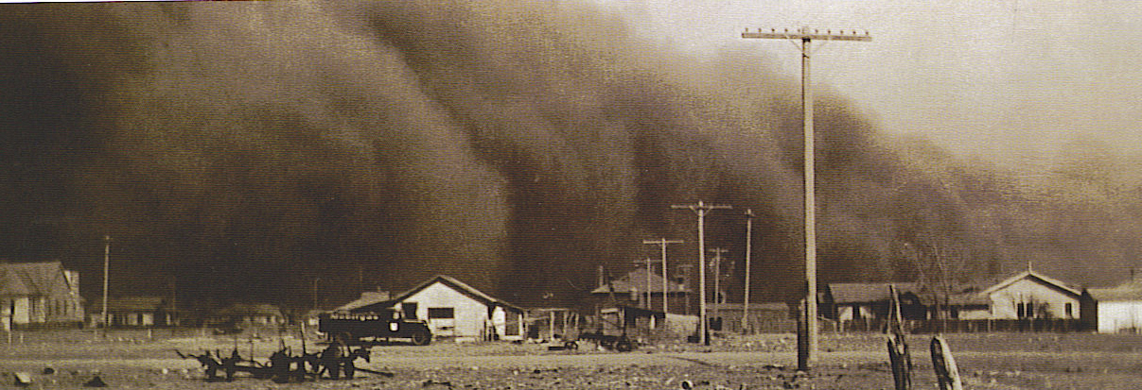
Soil Erosion
Soil is a renewable resource, but it takes a great deal of time. About 7% of the soil is lost each decade or about 25 billion tons a year.Why has soil erosion increased drastically?
  Population pressure
  Cultivation of steeper slopes with poor terraces
  Intensity of land use has increased-shorter rotation of shifting agriculture
  Overgrazing by larger herds of livestock
Notes:
Photo at bottom-Dust Bowl-Springfield, Colorado. 1935

Slide 40
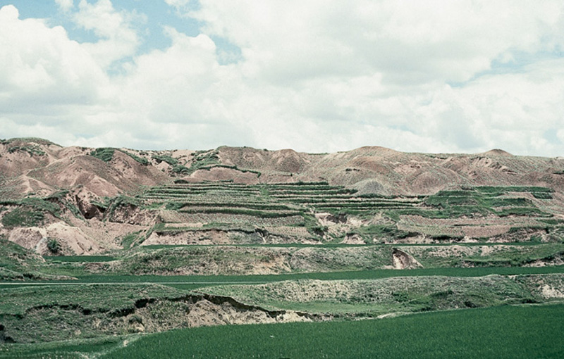
Soil Erosion -
Overuse of land in Guangxi-Zhuang, China has led to the collapse of formerly-sound terracing systems.
Notes:
Land degradation caused by centuries of overuse-over grazing, over farming in an attempt to feed 20% of the world’s population has led to desertification of almost 1 million acres of grassland a year (equal to Rhode Island)
Since 1949 the 425 million farmers have lost 1/5 of their arable land-dust storms buffet Beijing annually (see next slide).
Ironically urban migration may help as number of farmers decrease. (Nat. Geog. May 2008)

Slide 41
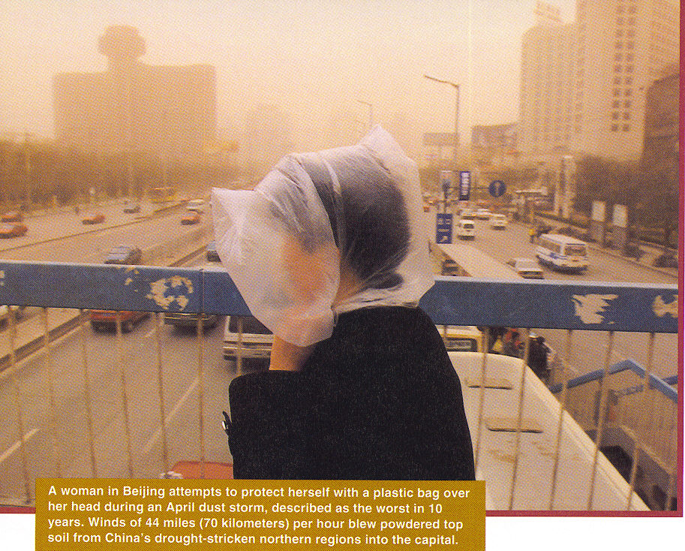

Slide 42
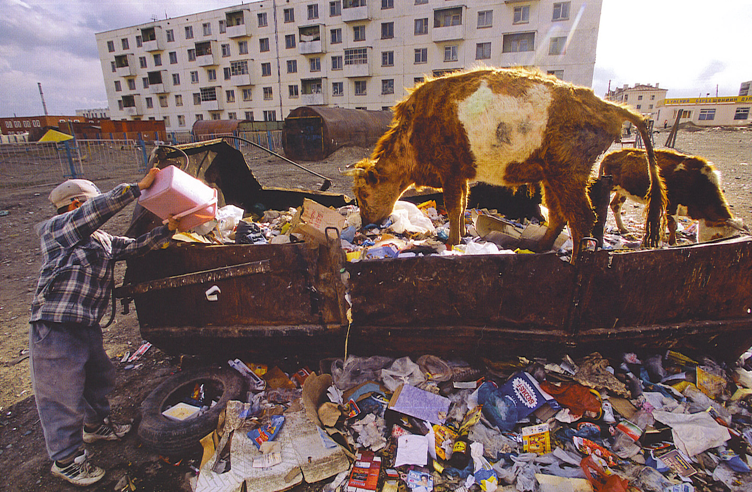
Waste Disposal
Poor countries have open dumps with vermin, methane gas, fires, air pollution & contamination of ground water.
Notes:
A dumpster diving cow in a parking lot dump in Ulaanbaatar, Mongolia

Slide 43

Waste Disposal
US the largest consumer of resources & the largest producer of solid waste. (3.7 lbs per person per day)
Industrialized nations use sanitary landfills that are lined holes that have been compacted and capped.
US, EU & Japan export solid waste (sometimes hazardous) to Africa, Middle East & South America
Notes:
Each day’s deposit is compacted and isolated in a separate cell by a covering of soil or clay. Better than open dumps-but a problem-potential groundwater contamination, seepage of methane and hydrogen sulfide gases. By federal law, landfills must be lined with clay and equipped with leachate or chemically contaminated drainage from the landfill to protect groundwater.
Toxic waste can be chemical or medical. Radioactive wastes from hospitals, industrial research and nuclear power plants will be dangerous for thousands of years.

Slide 44

Oil barrels rust in the rugged landscape of Alaska
Notes:
Oil barrels rust in the rugged landscape of Alaska

Slide 45

Some of the 240 million tires replaced each year in the US
Notes:
Some of the 240 million tires replaced each year. Most used tires are dumped-legally or illegally, some are retreaded, some are exported, some are burned to make electricity. Most wind up in dumps to remain as fire hazards or breeding grounds for insects like mosquitoes.

Slide 46
Humans impact Environment by:
Atmosphere
  A thin layer of air lying directly above the lands and oceans.
  What is breaking down the atmosphere?
  Human pollution
  Volcanic action (dust into atmosphere)
  Impacts
  Global Warming
  Acid Rain

Slide 47


Acid Rain
Sulfur dioxide & nitrogen oxide are produced by the burning of fossil fuels.
When these react with water vapor a weak sulfuric or nitric acid is formed
The acid rain fall kills wildlife, plants and eat away at stone structures.
It can impact food supplies & water supplies many miles from the source

Slide 48

The Sources of Acid Rain
Notes:
The highest density of coal & oil burning and heavy manufacturing in Western Europe, Eastern Europe, Russia and the United States-severe pollution problems.
Clear Air Standards were first introduced into the US in the 1970s
1990 Clean Air Act Amendment required that sulfur dioxide and nitrogen oxide emissions from smokestacks be cut in half.

Slide 49

Acid Deposition
Fig. 14-13: Due to prevailing winds, the highest sulfate deposit levels in North America lie east of the emission sources. Deposit levels in Germany are higher than in the U.S.
Notes:
84% of world energy produced by burning fossil fuels
Acid rain can poison fish, damage plants and diminish soil fertility.
Germany, one of the most industrialized nations has witnessed rapid damage. In 1982 only 8% of forests showed damage from acid rain, by 1990 the number jumped to over 50%.

Slide 50

World Distribution of Fossil Fuels
Sources of Carbon Dioxide
Places where most carbon dioxide is emitted on earth.

Slide 51

Global Warming
Amounts of CO2, methane, and nitrous oxide are increasing 2% per decade mainly from steel mills, refineries, chemical plants and power plants.
It is expected that the temp. will rise by 3.5 to 5.5 degrees F over the next 50 years.
Sea levels will rise & the hydrologic cycle and precipitation patterns will change.
The coast of the Netherlands
is threatened by the predicted
rise of the sea level

Slide 52


Once the world’s highest ski area at 17,250 feet-now the glacier is almost gone
Notes:
This glacier once offered a half-mile swoop down a steep mountain side.

Slide 53

100 years ago Glacier National Park in Montana contained 150 glaciers.
Today only 27 are left and 90% of the ice volume is gone.
In another 25 years these 7,000 year old glaciers will be completely gone.
World wide-mountain glaciers play a major role in the supply of fresh water from yearly melt water.
Notes:
Greenland alone could push up sea level by 3 feet or so over the next century at the present rate of melting

Slide 54

Glacier National Park, Montana

Slide 55


Glacier National Park, Montana
1938
1981

Slide 56


Glacier National Park, Montana
1998
2006

Slide 57
Humans impact Environment by:
Biodiversity
  Loss of biodiversity because species are threatened or quite concentrated.
  What species are most affected?
  The species with a small range
  Why?
  Destruction of a relatively small habitat area can cause extinction of a species with a small range.

Slide 58


Biodiversity
There is a great diversity of life on earth-1.7 m. identified species.
Yet rapid extinction of many species may take place in the near future-some is natural, but we have accelerated the rate of extinction.
In last 400 years 650 species of plants & 480 species of animals became extinct.
Notes:
Pictures-above Elephants of Kenya, bottom elephants in the Serengeti of Tanzania
Currently 8% of plants
5% fish
11% birds
18% mammals are threatened with extinction
Current rate of extinction is 1,000 to 10,000 times normal rate-by 2100 about ½ of all plant and animal species will be extinct
Currently ¼ mammals 1/8 birds and 1/3 amphibians are on the brink of extinction.

Slide 59

Biological Diversity
In 1995 about 118 nations of the UN called for the establishment of protected areas.
UN provides funding to developing nations to preserve plant & animal species.
The problems-how to balance economic development & preservation of the environment & who pays for the conservation projects?
Notes:
Fishing harder, faster & more ruthlessly than ever before, we are driving some fish toward global extinction, even though fish is the primary source of protein for 1/6 humans.
2000 marked a turning point in the global fish harvest-which grew 500% between 1950-1997. Despite better technology-the world-wide fish harvest has fallen by 3% per year since 2000
Aquaculture-may not be the answer either
Every yr. 10 tons of mercury comes down the Mississippi with another ton added by off-shore drilling.
The Gulf has a dead zone that is the size of New Jersey-there are nearly 150 dead zones around the world and they all lie at the mouths of rivers. Nitrogen from fertilizers feeds a plankton explosion and algae explosion that kill fish, dolphins and manatees. When the plankton get too dense and die in mass they since to the bottom, decompose and the bacteria consume all the oxygen in the water 50 hypoxic zones lie off the US coast-the worse is in Europe with 14 dead zones that do not go away.

Slide 60


Notes:
Pike National Forest, Colorado-a constellation of blazes dot the Grouse Mountains. The fire scorched over 2,300 acres in one week in April 2002-worst fire season for Colorado ever.
100 million tons of fertilizer enters the ocean each year. In some towns in the US sewage is being released untreated into rivers & the ocean. Tuna are so contaminated by mercury spewed from smokestacks that the government warns pregnant women and children to limit consumption
The oceans have absorbed 118 billion metric tons of CO2 since the beginning of the Ind. Rev. this has helped the atmosphere, but made the ocean ph zone to slightly acidic.
Top half of the ocean has warmed dramatically in the last 40 yrs due to greenhouse gases.
Compact sea ice with high albedo or whiteness reflects 80% of the sun’s heat, but seawater absorbs 80%-thus a decrease in sea-ice promotes further warming.
If West Antarctic Ice Sheet ever surges, it would raise sea levels by as much as 23 feet worldwide.

Slide 61



Notes:
Top Right-Mother & Cub-March on Hudson Bay
Bottom Right-450 lb polar bear & her cub walk on ice in a frozen fjord in Norway-670 miles from the North Pole.
World population of 22,000 to 25,000 polar bears could become extinct by the end of this century at the present rate of polar ice melting. Arctic Seas have become so polluted that as north bound winds carry industrial pollutants from North America and Europe. Predators like the polar bear are highly contaminated since the chemicals are concentrated as you go up the food chain. Polar bears retain the chemicals in their fat and then pass it on to their young in their milk.
.

Slide 62
Renewing Resources
Leading Renewable Energy Sources

Slide 63


Biomass energy
Wood can be used to generate electricity and heat.
Crops such as sugarcane, corn, and soybeans can be processed into motor-vehicle fuels.
Limits
  The energy to produce the crops may be as much as the energy supplied by the crops
  Fertility of the forest is depleted
  serves other purposes: food, clothing, and shelter

Slide 64


Slide 65

Yunnan, China-Blooming rapeseed plants weave around the hills near Luoping. China grows more of the crop-some 14 million tons in 2006-than any other country, officials hope a biodiesel boom will increase the demand. Nat. Geographic May 2008

Slide 66

Hydroelectric power
World’s 2nd most popular source of electricity, after coal.
Many LDCs depend on, Brazil being the most populous country.
Limits
  Dams may flood usable land, cause erosion, and upset ecosystems.

Slide 67


Slide 68

Sense of Scale: Wind Energy Parks in European Union
UN Framework Convention on Climate Change in 1992-154 nations met to discuss lowering CO2 emissions,
European Union demanded that a % of development funds go to renewable energy projects
EU provided 43 m. euros for 3 wind parks in Spain-will provide 50% of Navarra’s energy needs.
Notes:
Wind turbines in Flanders, Belgium

Slide 69

Alternative
Energy Sources
Wind energy parks, such as this one in Lake Benton, Minnesota, are filled with hundreds of enormous turbines to generate energy.
Wind is a clean, renewable energy.

Slide 70

Notes:
Germany leads in wind power-totally renewable and nonpolluting, wind power harnessed using the most modern methods developed by the aeronautics industry.
Wind Turbines in Banning Pass near Palm Springs, California

Slide 71


Geothermal Energy
Energy from heated water or steam under the ground
Only accessible at rifts along Earth’s surface where crustal plates meet.
California, Italy, New Zealand, Japan, Iceland, and Indonesia use it

Slide 72


Slide 73


Nuclear Fusion
Result of the fusing of hydrogen atoms to form helium
Releases a large amount of energy, equivalent to a ton of coal
Limit: only occurs at high temperatures and has only been achieved during bomb tests

Slide 74

Solar Energy
Two ways to harness the energy
  Passive: use south-facing windows and dark surfaces
  Active: collect and convert to heat or electricity

Slide 75


Slide 76


Slide 77
THE END

