Slide 1
Agricultural Origins & Regions
Origins of agriculture
  Hunters and gatherers
  Invention of agriculture
Location of agricultural hearths
  Carl O Sauer – Two types of cultivation
    Vegetative planting
    Seed agriculture
Classifying agricultural regions
  Subsistence vs. commercial agriculture
  Mapping agricultural regions

Slide 2
Question:
If we lived in this area during the hunting and gathering period what types of plants and animals might we have eaten? Use whatever knowledge of the area you might have or guess if you have to.

Slide 3
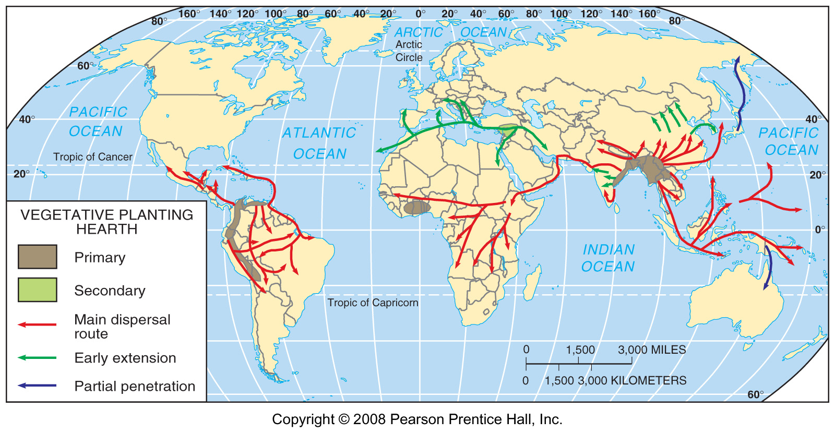
Vegetative Planting Hearths
Fig. 10-1: There were several main heaths, or centers of origin, for vegetative crops (roots & tubers, etc.), from which the crops diffused to other areas. Carl Sauer suggested that Southeast Asia was a primary hearth.

Slide 4
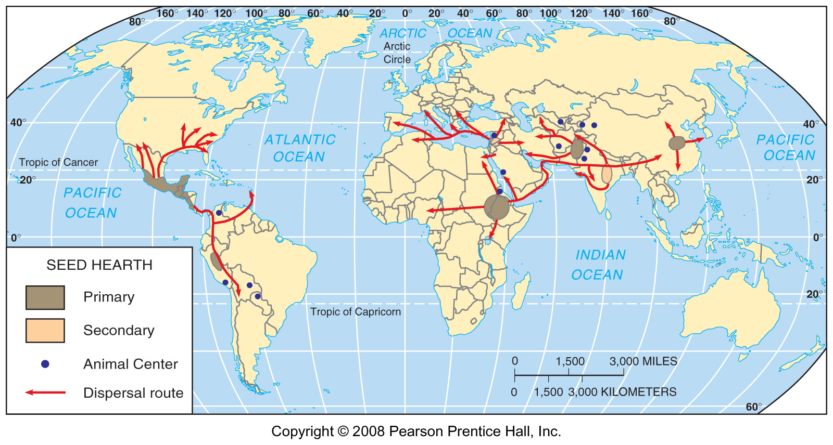
Seed Agriculture Hearths
Fig. 10-2: Seed agriculture also originated in several hearths and diffused from those elsewhere.

Slide 5
Difference between Subsistence and Commercial Agriculture
Purpose of farming
Percentage of farmers in the labor force
Use of machinery
Farm Size
Relationship of farming to other businesses – Agribusiness

Slide 6
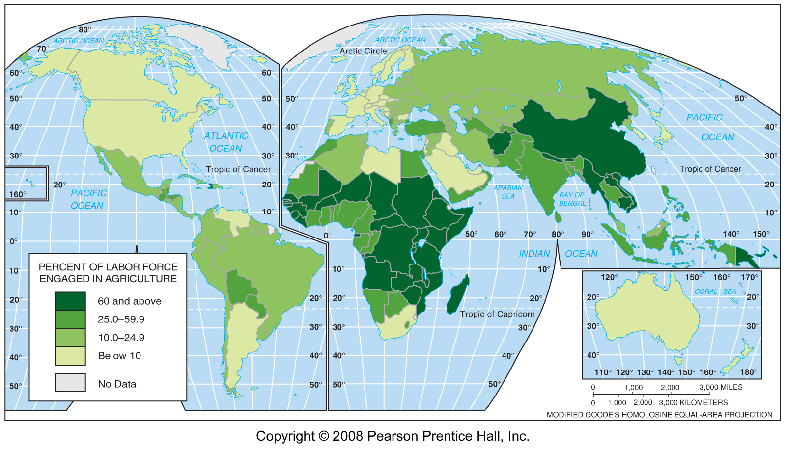
Labor Force in Agriculture, 2005
Fig. 10-3: A large proportion of workers in most LDCs are in agriculture, while only a small percentage of workers in MDCs are engaged in agriculture.

Slide 7
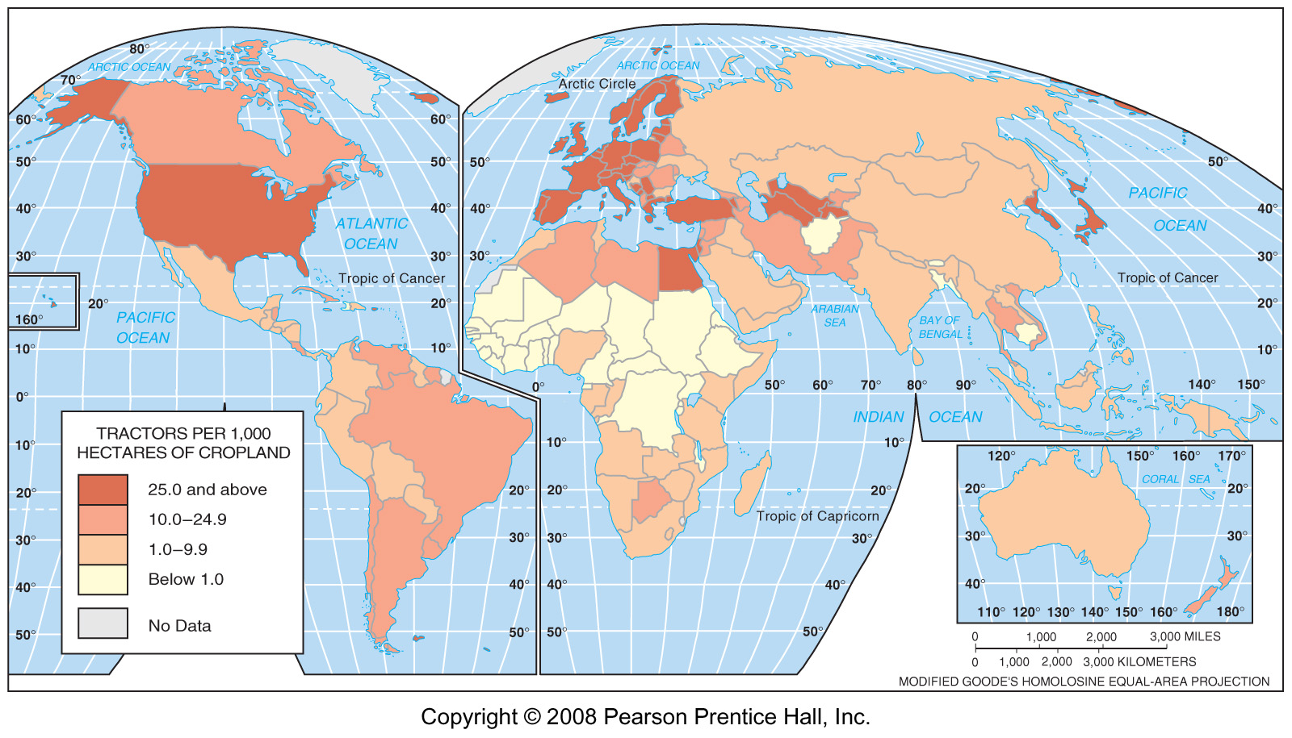
Tractors, per cropland
Fig. 10-4: Tractors per 1000 hectares of cropland. Use of machinery is extensive in most MDC agriculture, but it is much less common in LDCs.

Slide 8
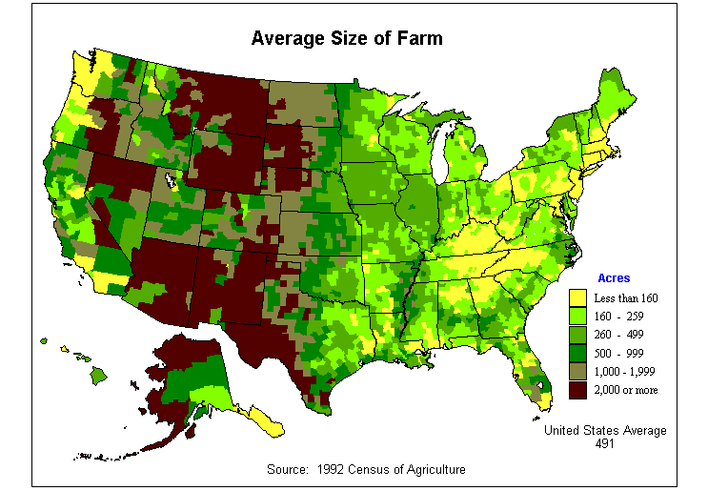
Farm Sizes

Slide 9
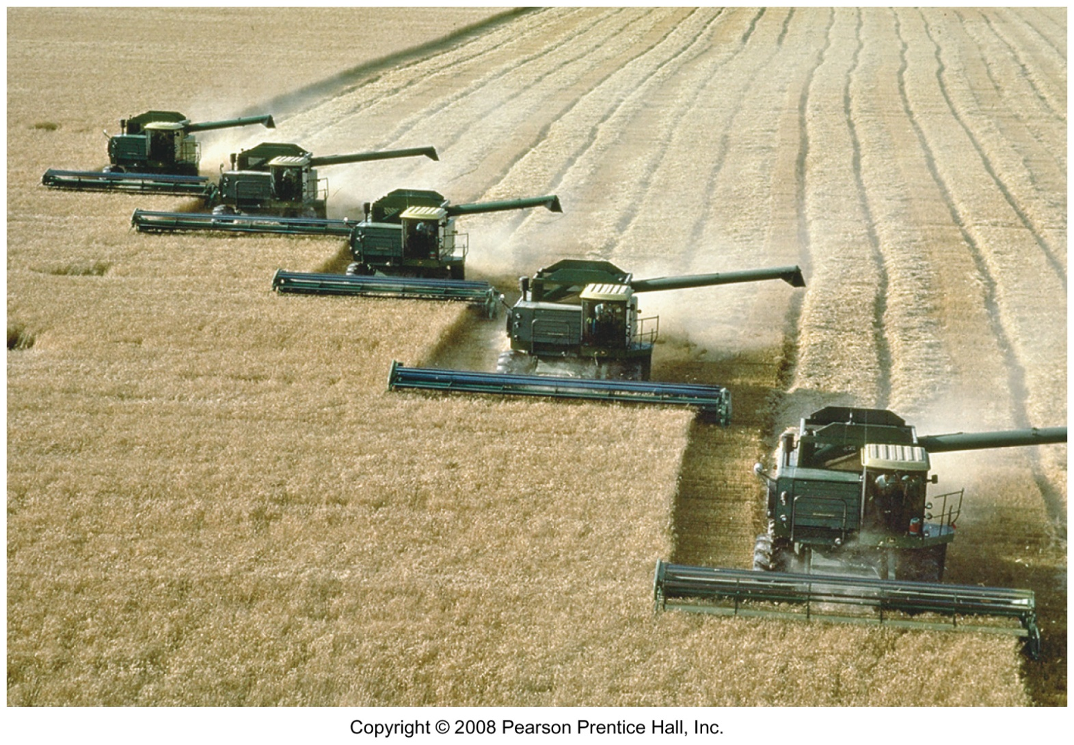
Combines on Wheat in Kansas
Combines can reap, thresh, and clean crops like wheat in a single operation.

Slide 10
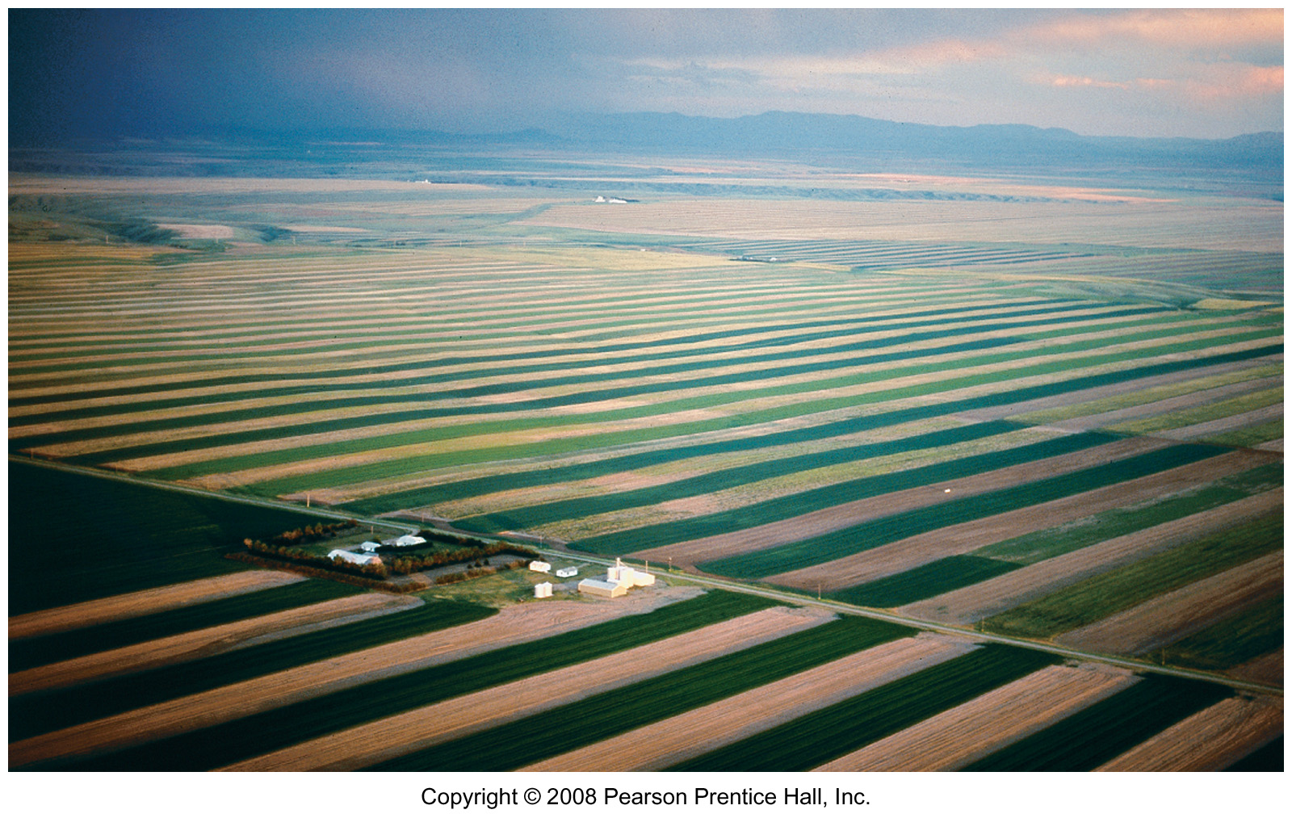
Wheat Farm in Montana
American grain farms can cover enormous amounts of land.

Slide 11
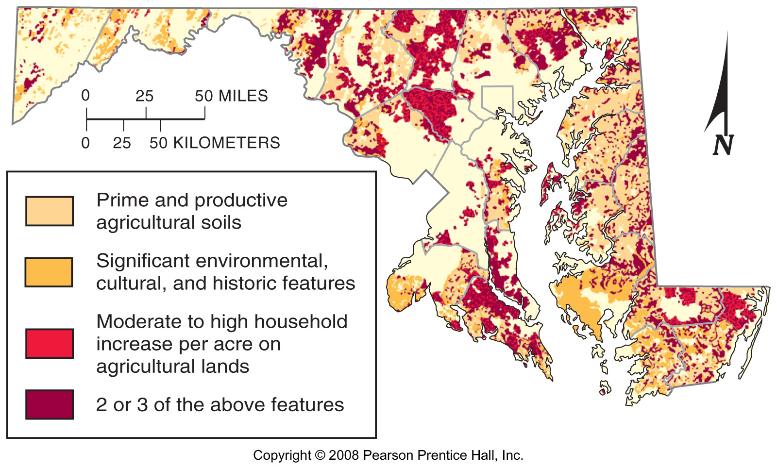
Farmland Loss in Maryland
Fig. 10-1.1: Overlaps of soil quality, environmental & cultural features, and population growth may show areas of greatest threat of farmland loss in Maryland.

Slide 12
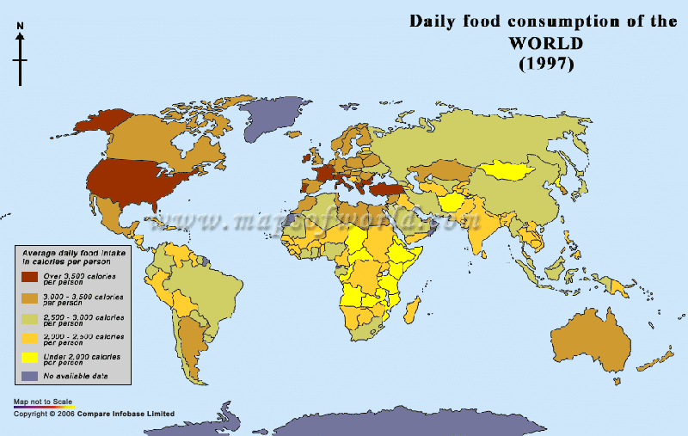
Calorie Consumption

