Slide 1
Migration
Migration: Terms & “Laws”
Migration Distance
Reasons to Migrate
Migrant Characteristics

Slide 2
Migration: Terms
Mobility: “all types of movement”
Circulation: “short term, repetitive, or cyclical movements”
Migration: “a permanent move to a new location”
  Emigration: “migration from”
  Immigration: “migration to”
    Net Migration: “the difference between the number of immigrants and the number of emigrants”
    Immigrants > Emigrants: “net in-migration”
    Immigrants < Emigrants: “net out-migration”

Slide 3
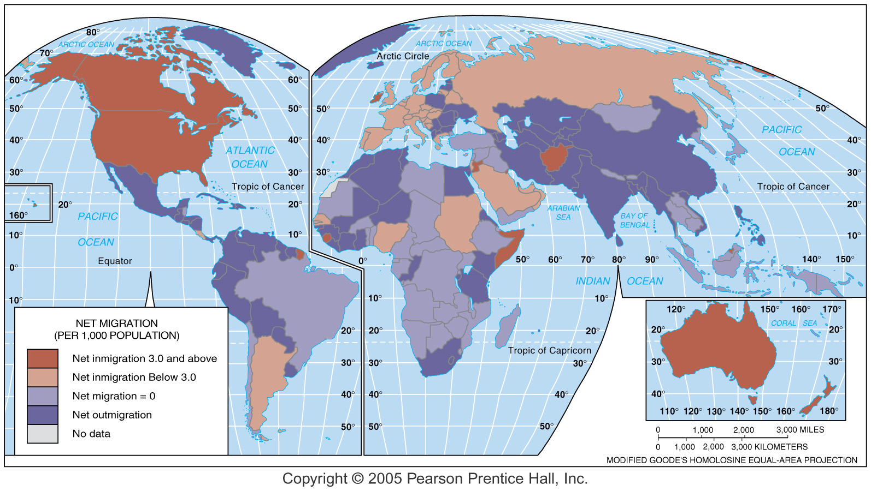
Net Migration (per 1,000)

Slide 4
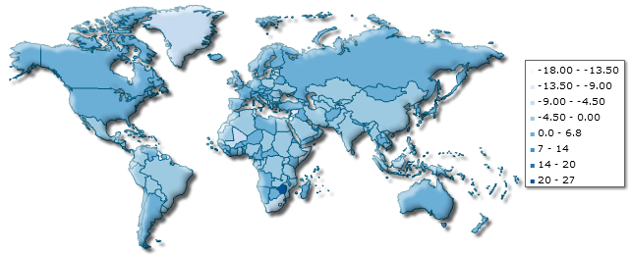
Net Migration, 2011
Sources: http://www.indexmundi.com/map/?v=27

Slide 5
Ravenstein’s 19th Century
“Laws” of Migration
Not really laws – more like observations.
Three categories: Distance, Reasons, Characteristics
Distance of migration
  Most migrants move a short distance, within a single country.
  Long-distance migrants usually go to major centers of economic activity.
Reasons for migration
  Most people migrate for economic reasons.
  Cultural & environmental factors may also be important, but usually not as important as economics
Characteristics of migrants
  Most long-distance migrants are males.
  Most long-distance migrants are adults, not families with their children.

Slide 6
Migration Distance
International migration (usually) involves:
  Greater distances
  Greater cultural differences to deal with
  Greater separation from friends and family
Internal migration (usually) involves:
  Shorter distances
  Fewer cultural differences to deal with
  Less separation from friends and family
Because of these differences most migrants historically have been internal, not international.

Slide 7
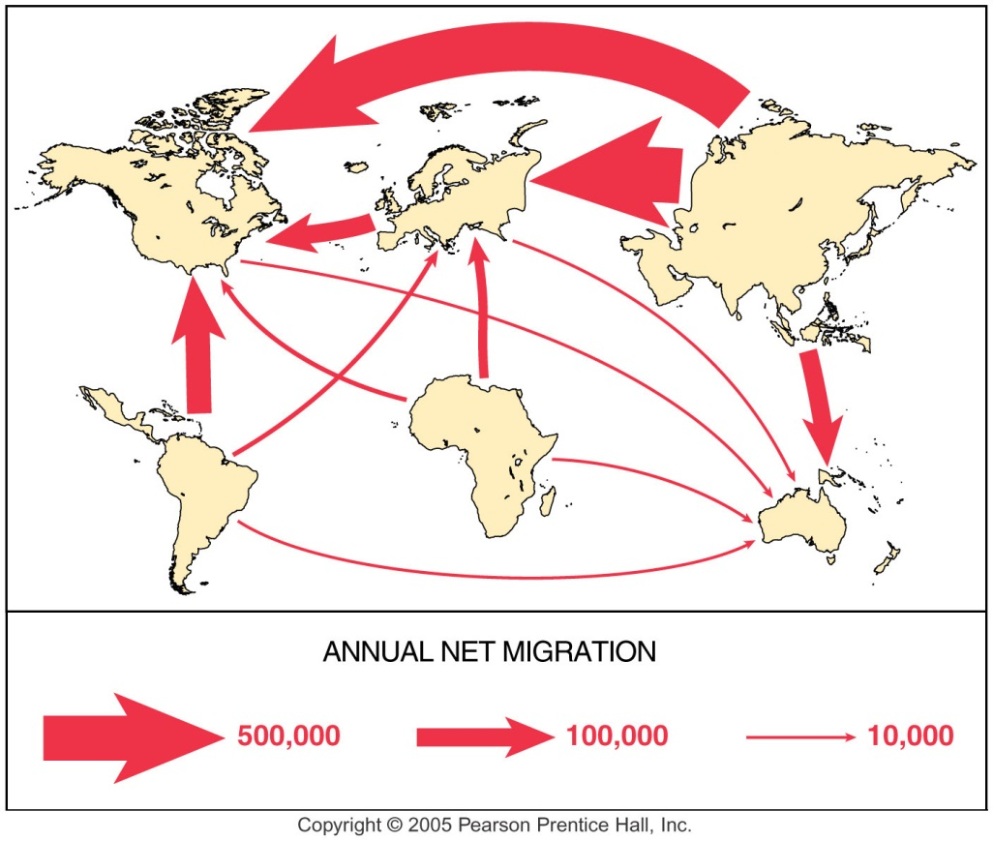
Global Migration Patterns
Only 3% of the world’s population are international migrants – but that’s still more than 200 million people.
At the global scale, some regions tend to accept migrants, and some tend to be sources of migrants.
  Net out-migration: Asia, Latin America and Africa
  Net in-migration: North America, Europe, Oceania
Most migration today is from less developed to more developed nations.
The US has a very high proportion of international migrants – about 25-30 million people (around 10%).
Data Sources: http://www.iom.int/jahia/Jahia/about-migration/facts-and-figures/lang/en

Slide 8
International Migration:
Voluntary vs. Forced
Voluntary: the migrant chooses to move.
Forced: the migrant has no choice.
  Traditionally, people who move for economic or environmental reasons are automatically considered to be voluntary migrants.
  The category of forced migrants is usually limited to just two groups: slaves and refugees.
  Since most people move for economic reasons – most migrants are considered to be voluntary.

Slide 9
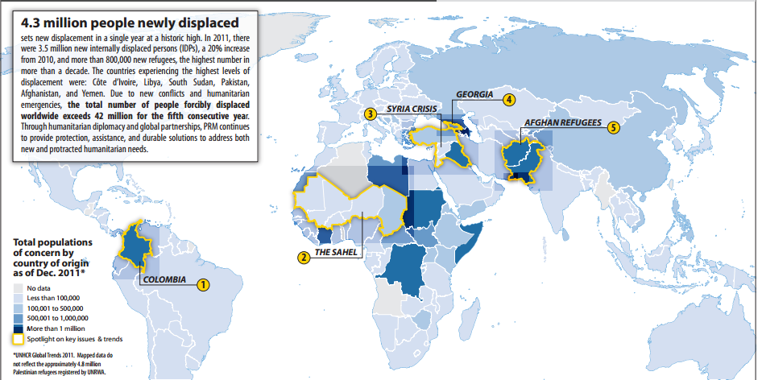
Refugees Today
According to the US Department of State and the UN High Commissioner for Refugees, as of 2011 there were more than 42 million “persons of concern”:
  15.2 million refugees
  26.4 million internally displaced persons
Sourcess https://hiu.state.gov/Products/Worldwide_GlobalDisplacement_2012Aug17_HIU_U622.pdf; http://www.unhcr.org/4fd6f87f9.html

Slide 10
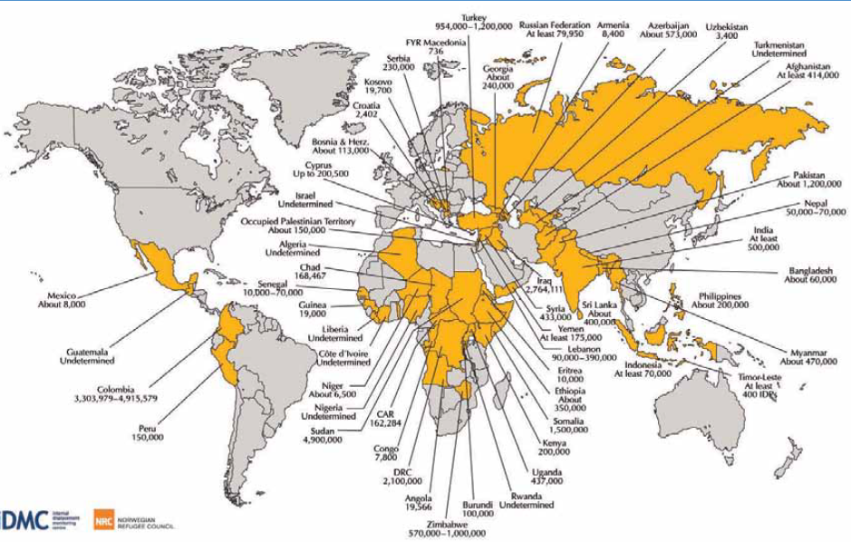
Internally Displaced Persons
Technically, if someone is still in their own country, they aren’t a refugee – they are “internally displaced.”
In 2010 Sudan had the largest number of IDPs, with 4.9 million, followed by Colombia (3.3 million) and Iraq (2,764,111).
Sources: http://www.iom.int/jahia/webdav/shared/shared/mainsite/published_docs/wmr-2010/Maps.pdf

Slide 11
Refugees in the US
In the US [under the Immigration and Nationality Act, Section 101(a)(42)]:
    The term 'refugee' means:
      (A) any person who is outside any country of such person's nationality … who is unable or unwilling to return to, and is unable or unwilling to avail himself or herself of the protection of, that country because of persecution or a well-founded fear of persecution on account of race, religion, nationality, membership in a particular social group, or political opinion, or
      (B) in such circumstances as the President … may specify, any person … who is persecuted or who has a well-founded fear of persecution on account of race, religion, nationality, membership in a particular social group, or political opinion.
Sources: http://www.refugees.org/world/countryrpt/amer_carib/us.htm; http://usinfo.state.gov/topical/global/refugees/2001work.pdf

Slide 12
US Refugees Can Also Include…
In 2006, the Secretary of State added an additional statement:
  Consistent with section 101(a)(42) of the Act (8 U.S.C. 1101(a)(42)), and after appropriate consultation with the Congress, I also specify that, for FY 2006, the following persons may, if otherwise qualified, be considered refugees for the purpose of admission to the United States within their countries of nationality or habitual residence:
    Persons in Vietnam
    Persons in Cuba
    Persons in the former Soviet Union
    In exceptional circumstances, persons identified by a U.S. Embassy in any location.
Sources: http://travel.state.gov/visa/laws/telegrams/telegrams_2778.html

Slide 13
Who Is Not a Refugee?
The US will not admit people as refugees, if they:
  Have a communicable disease of public health significance.
  Have certain serious physical or mental disorders
  Are a drug addict, or have violated controlled substances laws.
  Renounced US citizenship for tax purposes.
  Have committed a crime of moral turpitude, or been convicted of two or more criminal offenses, or been a prostitute within the past ten years.
  Have been granted immunity from prosecution.
  Intend to practice polygamy in the United States.
  Enter the US in violation of immigration laws, or assist others to do so.
  Have been involved in international child abduction.
  Intend to enter the US to conduct illegal activities.
  Would have serious adverse foreign policy consequences to the US.
  Have been a member of the communist or any other totalitarian party.
  Have engaged in the persecution of others on the basis of race, nationality, religion, political opinion, or membership in a particular social group.
Sources:http://uscis.gov/graphics/services/refugees/qa.htm ; http://travel.state.gov/visa/frvi/ineligibilities/ineligibilities_1364.html

Slide 14
US Refugees, 2005-2011
 | 2005 | 2006 | 2007 | 2008 | 2009 | 2010 | 2011
Africa | 20,000 | 20,000 | 22,000 | 26,000 | 12,000 | 15,500 | 15,000
East Asia | 13,000 | 15,000 | 16,000 | 20,000 | 20,500 | 17,000 | 19,000
Europe & Central Asia | 9,500 | 15,000 | 6,500 | 3,000 | 2,500 | 2,500 | 2,000
Latin America & Caribbean | 5,000 | 5,000 | 5,000 | 3,000 | 5,500 | 5,000 | 5,500
Near East & South Asia | 2,500 | 5,000 | 9,000 | 28,000 | 39,500 | 35,000 | 35,500
Unallocated Reserve | 20,000 | 10,000 | 11,500 | 10,000 | 0 | 5,000 | 3,000
Sources: http://uscis.gov/graphics/services/refugees/; http://travel.state.gov/visa/laws/telegrams/telegrams_2778.html;
http://www.state.gov/g/prm/refadm/rls/rpts/2007/92585.htm; http://www.dhs.gov/xlibrary/assets/statistics/publications/ois_rfa_fr_2009.pdf;
http://www.uscis.gov/USCIS/Resources/Resources%20for%20Congress/Congressional%20Reports/2011%20National%20Immigration%
20&%20Consular%20Conference%20Presentations/Refugee_Admissions_Program.pdf

Slide 15
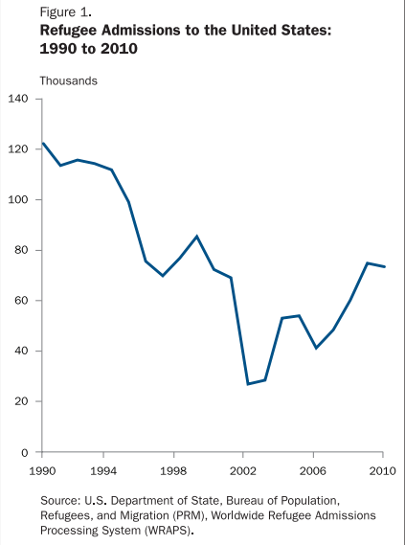
US Refugees,
1990-2010
A total of 73,293 people were admitted to the US as refugees during 2010.
The leading countries of nationality for refugees admitted to the US were Iraq, Burma, and Bhutan.
21,113 individuals were granted asylum. The leading countries of nationality for persons granted asylum were China, Ethiopia, and Haiti.
Sources: http://www.dhs.gov/xlibrary/assets/statistics/publications/ois_rfa_fr_2010.pdf

Slide 16
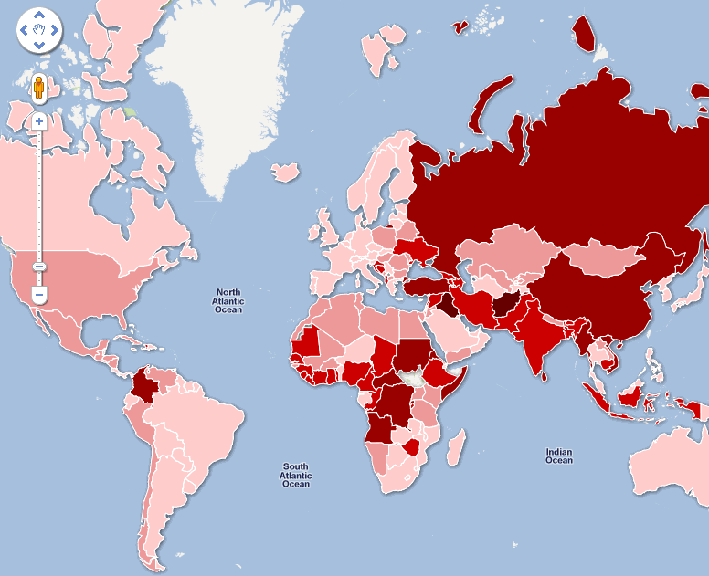
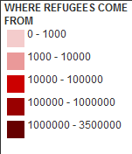
Global Refugees
The top 5 sources of refugees and asylum seekers in 2011 were:
  Afghanistan 3,054,709
  Iraq 1,683,579
  Somalia 770,154
  DR Congo 476,693
  Myanmar 415,670
  The UNHCR also is responsible for 94,000 Palestinian refugees, and the UN Relief and Works Agency is responsible for about 5 million additional Palestinian refugees.
Sources: http://www.guardian.co.uk/news/datablog/2011/jun/20/refugee-statistics-unhcr-data; http://www.unhcr.org/pages/4a0174156.html;
http://www.unhcr.org/statistics/Ref_1960_2010.zip; http://www.unrwa.org/etemplate.php?id=47;
http://www.unhcr.org/cgi-bin/texis/vtx/page?page=49e486826

Slide 17
Internal Migration
People migrate within a particular country for pretty much the same reasons they migrate from one country to another – mostly for economic reasons.
Internal migration is usually easier than international migration.
There are two main types of internal migration
  Interregional (between regions)
  Intraregional (within a region)

Slide 18
Interregional Migration: Examples
China: Interior rural to urban coastal cities (mostly for work).
Brazil: Encouraging migration from the urban coast to the interior.
Russia: Migration to resource-rich areas (some forced migration during Soviet period)
Indonesia: Encouraging migration from Java to less populated islands.
India: Limited migration into some States.

Slide 19
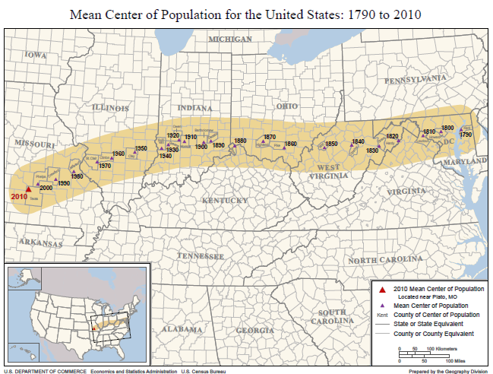
Interregional Migration: The US
Plato, Missouri
The population of the US has been spreading westward since Colonial times.
Expansion beyond the Appalachians in late 18th and early 19th centuries, into the Plains in the 19th century, and expanding settlement in the South have all shifted the “mean center of population.”
Just what is a
“mean center?”

Slide 20
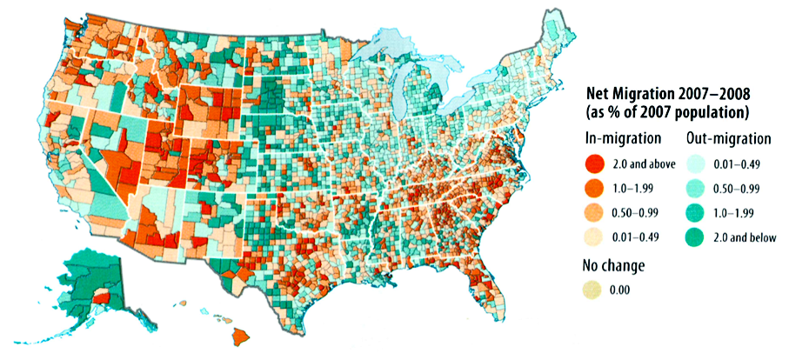
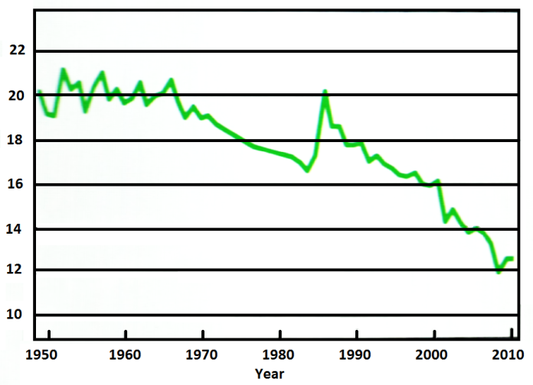
US Migration by County, 2007-2008
Percent of Americans
Moving each year

Slide 21
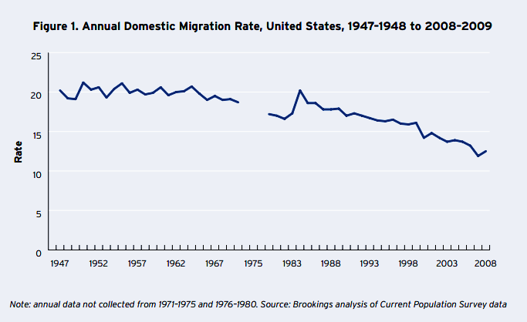
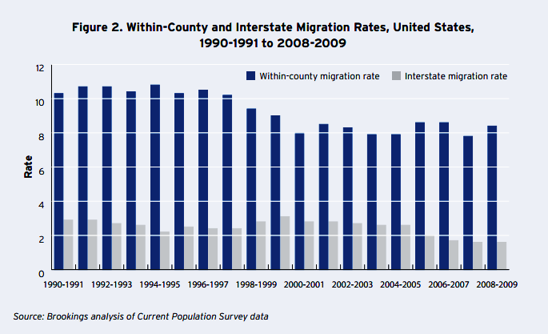
US Internal Migration: Recent Changes
Note that most of this migration is intraregional (within a single county).
Source: http://www.brookings.edu/~/media/research/files/opinions/2011/1/12%20migration%20frey/1209_migration_frey

Slide 22
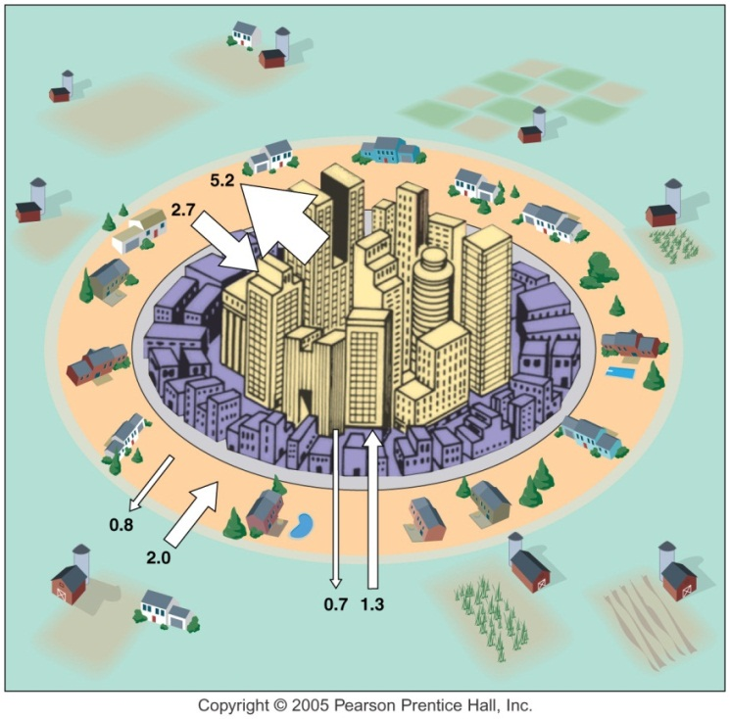
Intraregional Migration in the US
Intraregional migration – migration within a single region – is one of the most important kinds of migration (but tends to get ignored).
  Rural to urban
    1800 – 5% urban
    2010 – 90% urban
  Cities to suburbs
    Today more than 50% of the US population lives in suburbs.
    However, since 2010 cities have grown faster than suburbs.
Counterurbanization
  Movement from urban to rural areas – “back to the land.”
  Small numbers, but possibly a significant trend in some areas (Colorado, etc.)
Data Source: http://articles.nydailynews.com/2012-04-05/news/31296431_1_housing-index-housing-bubble-exurbs

Slide 23
Reasons People Migrate
People migrate because of push & pull factors
  PUSH FACTORS push people to leave their current location
  PULL FACTORS pull people to a new location (usually a particular place)
There are 3 basic kinds of push & pull factors
  ECONOMIC
  CULTURAL
  ENVIRONMENTAL

Slide 24
Economic Push-Pull Factors
Resources
  Land (for agriculture)
  Natural resources (minerals, forests, fish)
Jobs
  Availability
  Advancement
Government Policies

Slide 25
Cultural Push-Pull factors
Political Instability
  War and civil war
  Prejudice and persecution
  Refugees
Political Stability (a pull – not usually a push!)
Slavery
  Please note that slavery is not just of historical interest. It is estimated that there are more than 20 million people today living in some form of slavery (bonded labor, forced labor, chattel slavery, etc.).
  The International Labor Organization (ILO) of the UN estimates more than 126 million children are employed in dangerous or unhealthy work.
  (Source: http://www.antislavery.org/)

Slide 26
Environmental Push-Pull Factors
Health and Disease
Water
  Flood
  Droughts
  Reliability
Amenities
  Attractive scenery, beaches, warm winters, etc.

Slide 27
Temporary Migration for Work
In Western Europe there are millions of “guest workers” – people mostly from the Middle East, Asia and North Africa, who have migrated for work, but who are not considered permanent migrants.
Today guest workers make up a significant percentage of the population of many European countries.
Despite your book’s assurances, the legal and social status of guest workers until recently was fairly marginal – and their status (and the status of their children) in some countries remains controversial.

Slide 28
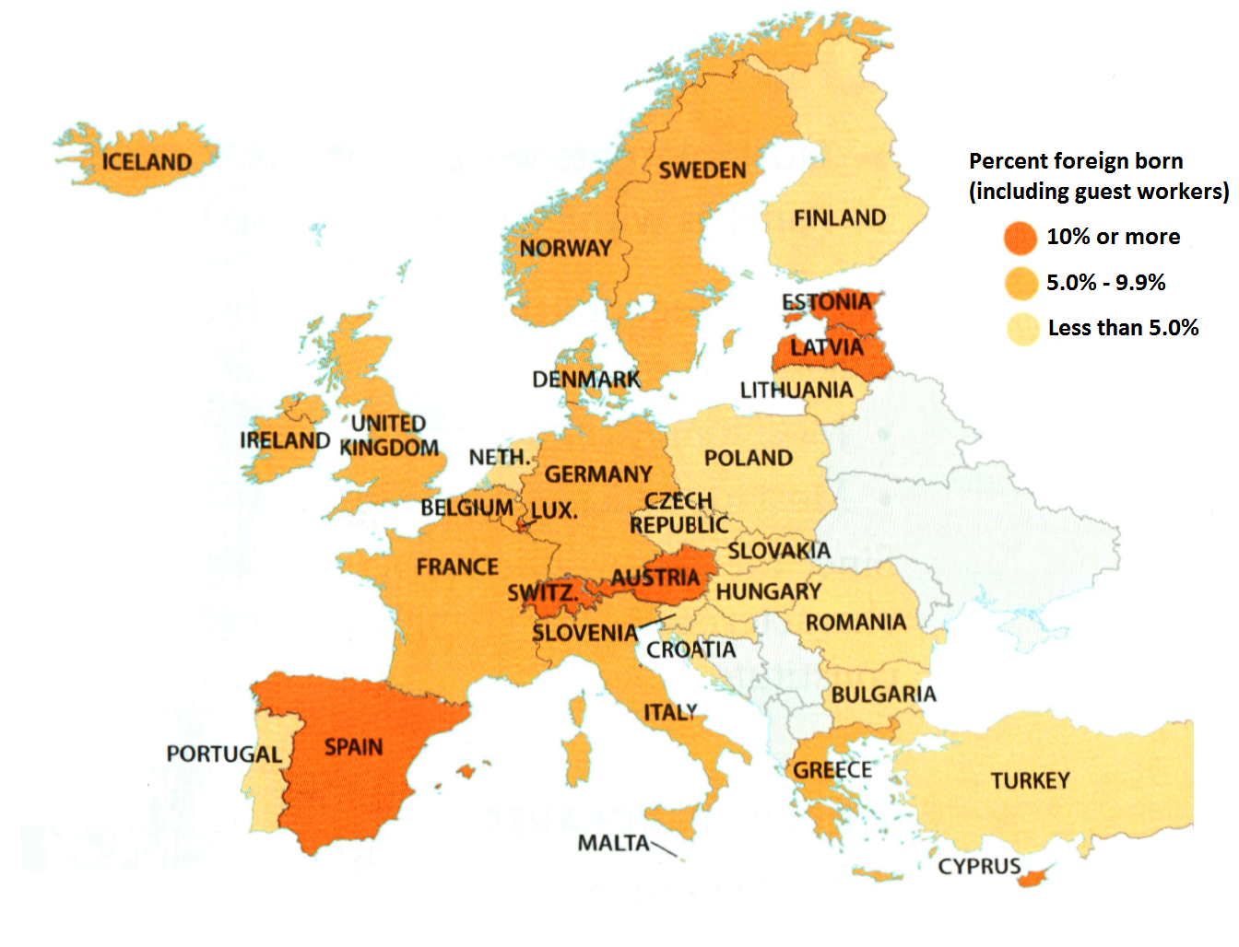
Guest Workers in Europe
Guest workers (and other resident foreigners) are a significant fraction of the population in many European countries:
For example, in 2011 the non-EU foreign resident populations in these countries were:
  Spain 7.2%
  Germany 5.6%
  Italy 5.3%
  UK 3.9%
Data Source: http://europa.eu/rapid/pressReleasesAction.do?reference=STAT/12/105

Slide 29
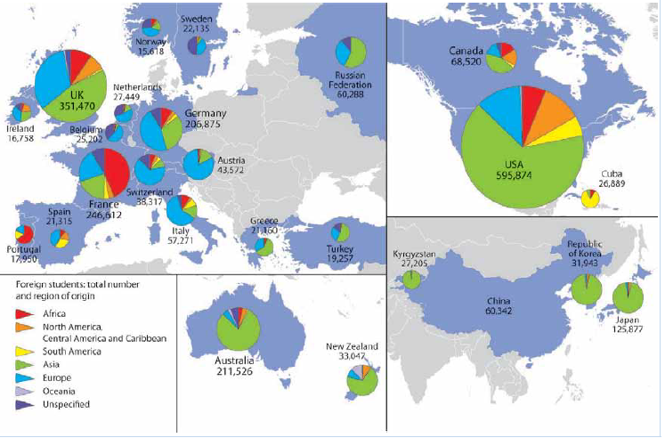
Temporary Migration for Education
In 2007 there were nearly 3 million foreign students around the world.
The primary destinations for foreign students are Australia, France, Germany, Japan, the UK and the USA.
Source: http://www.iom.int/jahia/webdav/shared/shared/mainsite/published_docs/wmr-2010/Maps.pdf

Slide 30
Economic Migrants vs. Refugees
Economic migrants are not the same as refugees – at least, not when it comes to the law.
All countries who are signatories to the 1951 Convention Relating to the Status of Refugees (including the US) have agreed to give refugees special status (they may not take them in permanently, but they won’t send them back where they came from).
No country has an obligation to take in economic migrants.
Economic Migrants or Refugees?
  Cuba: Refugees? (“wet-foot/dry-foot” policy)
  Haiti: Economic Migrants?

Slide 31
Migrant Characteristics: Changes?
In the 19th Century E.G. Ravenstein noted that:
  Most long-distance migrants were male.
  Most long-distance migrants were single adults, not families with children.
Are these characteristics still true?
  Today, in many parts of the world, the majority of international immigrants are women, not men.
  Although most immigrants to the US are still single adults, an increasing number of immigrants are children (17 years of age or less).
Why do we see changes?
  Changes in the status of women, changes in the kinds of jobs available, changes in the transportation system.

Slide 32
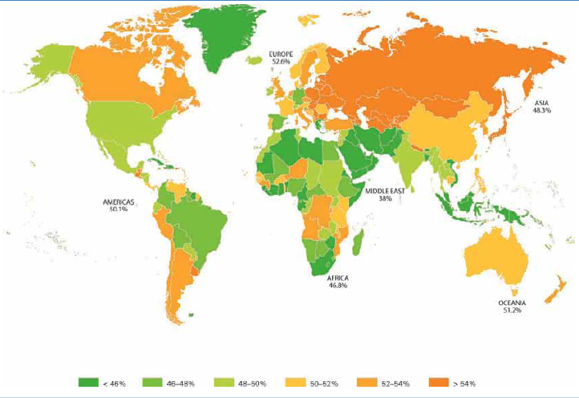
Female Migrants, by Region, 2010
Source: http://www.iom.int/jahia/webdav/shared/shared/mainsite/published_docs/wmr-2010/Maps.pdf

Slide 33
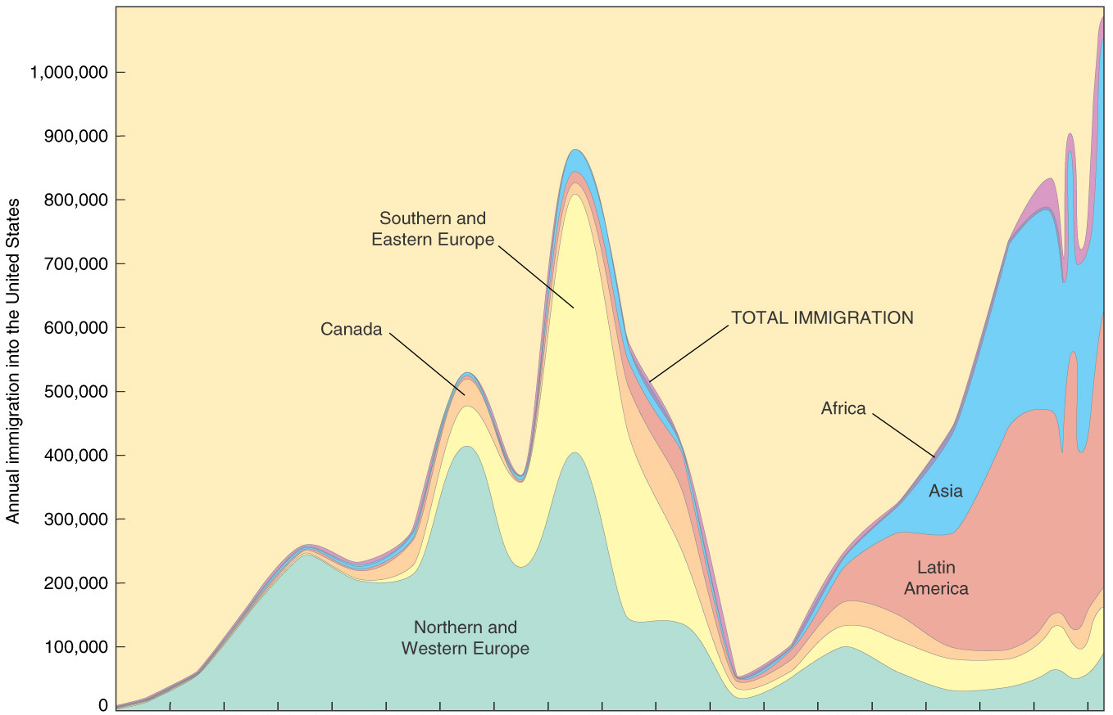
US Immigration, by Region

Slide 34
US Immigration History
About 10% of the US population today are immigrants.
Two main periods in US immigration:
  Colonial to Early 20th Century (mostly European immigrants)
    Three Waves of European Immigration
      1607-1850 (90% Great Britain)
      1870s-1880s (75% North & West Europe)
      1890s-1924 (75% South & Eastern Europe)
  1970's to Present (mostly Asian & Latin American immigrants)

Slide 35
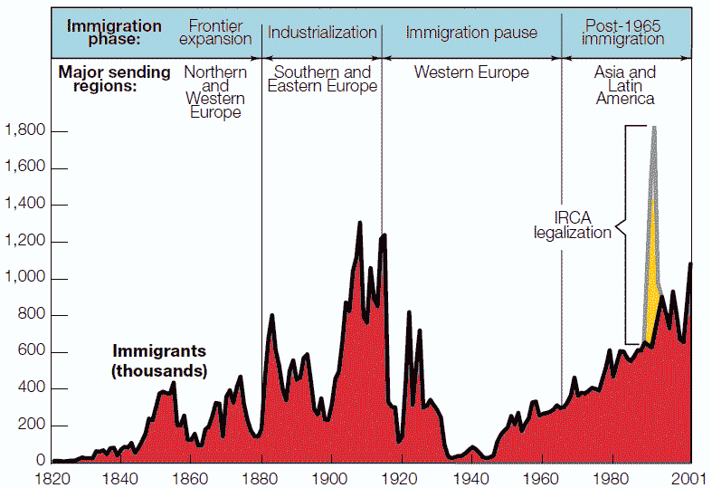
US Immigration Periods
Immigration Reform & Control Act of 1986
Source: www.prb.org/Source/58.2ImmigrShapingAmerica.pdf

Slide 36
Why Three European Waves?
Different parts of Europe passed through the demographic transition at different times, shifting from Stage 2 (massive population growth and societal changes) to Stage 3 (moderate population growth).
Wilbur Zelinsky’s migration transition model points out that massive international migration happens during Stage 2.
We can chart the social and economic changes associated with the demographic transition that affected Europe in the 19th Century by looking at the sources of US immigrants:
  1607-1850: Mostly UK (UK in stage 2)
  1870-1880: Mostly Northern Europe (UK stage 3, Northern Europe stage 2)
  1890-1920: Eastern and Southern Europe (UK and Northern Europe stage 3, Eastern Europe stage 2)

Slide 37
Immigration Today
Most immigrants to the US today come from less developed countries.
Primary sources of immigrants:
Data source: http://cis.org/2012-profile-of-americas-foreign-born-population#4

Slide 38
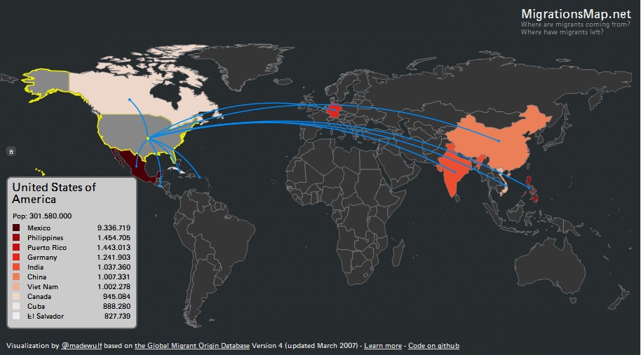
Recent US Immigration Flows
(2008)
Sources: http://www.indexmundi.com/map/?v=27

Slide 39
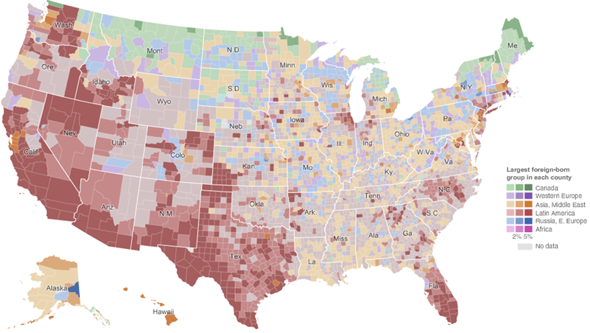
US Immigrant Destination Patterns by Region of Origin: 2000
Source: http://www.nytimes.com/interactive/2009/03/10/us/20090310-immigration-explorer.html

Slide 40
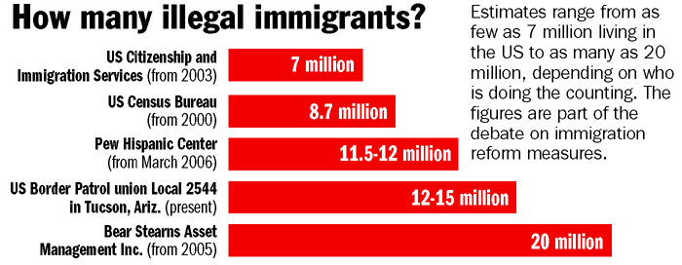
Undocumented Immigration
No one knows how many immigrants are in the US without proper permission – estimates range from three to thirty million!
  Best guess – about 11 million people?
About half of all undocumented migrants enter illegally; the other half enter legally and just “overstay” visas.
Major sources of undocumented migrants: Mexico, Central America, Asia, Europe.
States with the greatest numbers of illegal immigrants (2011 estimate): California (2,839,000); Texas (1,976,000); Florida (664,000), Illinois (556,000); New York (528,000)
Sources: http://www.csmonitor.com/2006/0516/p01s02-ussc.html#; http://cis.org/node/3877#illegal

Slide 41
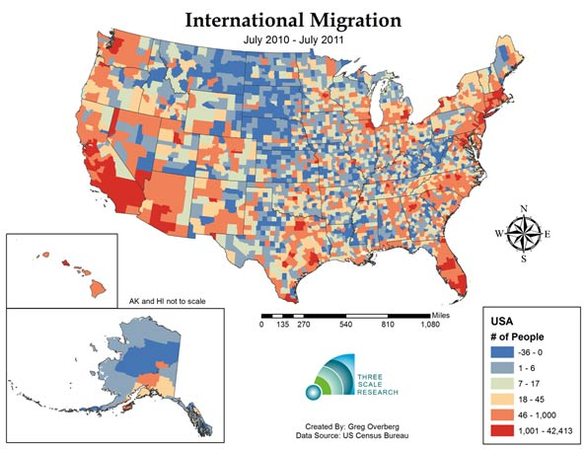
Migrant Destinations in the US
Recent migrants tend to locate in certain areas:
  ¼ in California
  ¼ in New York & New Jersey
  ¼ Florida, Texas and Illinois
Why here?
  Jobs
  Chain migration
Source: http://www.newgeography.com/content/002812-is-negative-population-growth-upon-us-deaths-exceed-births-one-third-us-counties

Slide 42
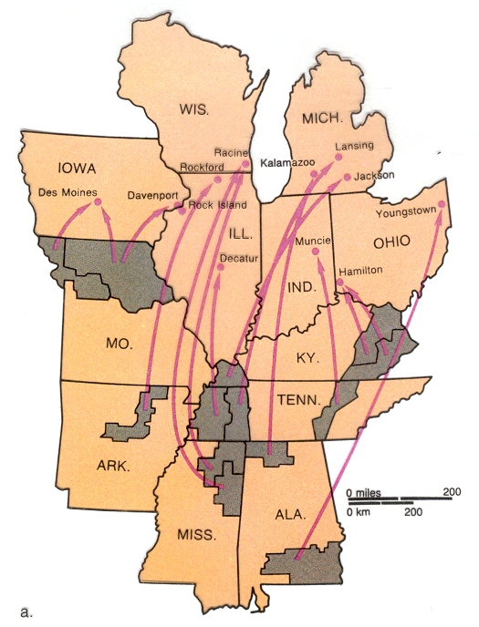
Chain Migration
“Chain migration” describes the way that many migrants choose a new place to live.
If they have connections – links – to people who have already moved to a new location, then it is much easier to relocate.
Chain migration in the “Great Migration” 1910-1930

Slide 43
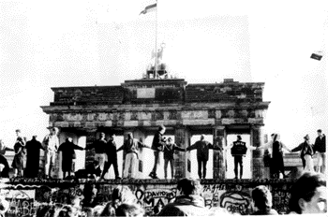
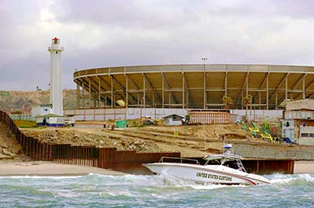
Intervening Obstacles
Migrants can’t always go to the places they want – there may be obstacles in their way.
Intervening obstacles may be either
  Environmental
  Cultural
In the past, obstacles were mostly environmental; today, they are mostly cultural.
Collapse of the Berlin Wall
Tijuana Border Fence
Sources: http://www.cbp.gov/xp/cgov/newsroom/image_library/afc/patroling_the_water/patrolling_waters_05.xml
http://www.usaid.gov/about/challenge/challenge_2.html

Slide 44
Obstacles to US Immigration
At one time the major obstacles to immigration to the US were physical – travel was difficult and dangerous, and often involved long hazardous journeys by sea.
Today, travel technology has made it much faster and easier to travel long distances, and the major barriers to migration are mostly cultural:
  Getting permission to enter the country.
  Attitudes toward migrants.
Until the late 1800s immigration to the US was almost unlimited – if you wanted to come, you could come.
Today, the US (and all other developed countries, too) put limits on the number of immigrants.

Slide 45
US Immigration Laws:
Selected Highlights, 1776-1924
1790 — Residence requirement (2 years)
1819 — Reporting to government; Sustenance rules for ship's passengers
1864 — Secretary of State given control of immigration
1875 — Entry of prostitutes & convicts prohibited [First restrictions]
1882 — Chinese Exclusion Act; Persons convicted of political offenses, lunatics, idiots, persons likely to become public charges also excluded; Head tax imposed
1888 — Expulsion provisions adopted
1891 — Bureau of Immigration established
1903 — Polygamists and radicals added to exclusion list
1906 — Knowledge of English required (for citizenship – not for entry)
1907 — Head tax increased; People with physical or mental defects excluded; "Gentlemen's Agreement" with Japan
1917 — Illiterates, "persons of psychopathic inferiority," men entering for immoral purposes, alcoholics, stowaways and vagrants added to exclusion list
1921 — Temporary annual quotas set by nationality
1924 — Permanent quotas (2% of 1910 population, by nationality); Border Patrol established
Source: see http://www.uscis.gov/portal/site/uscis , “Immigration Legal History”

Slide 46
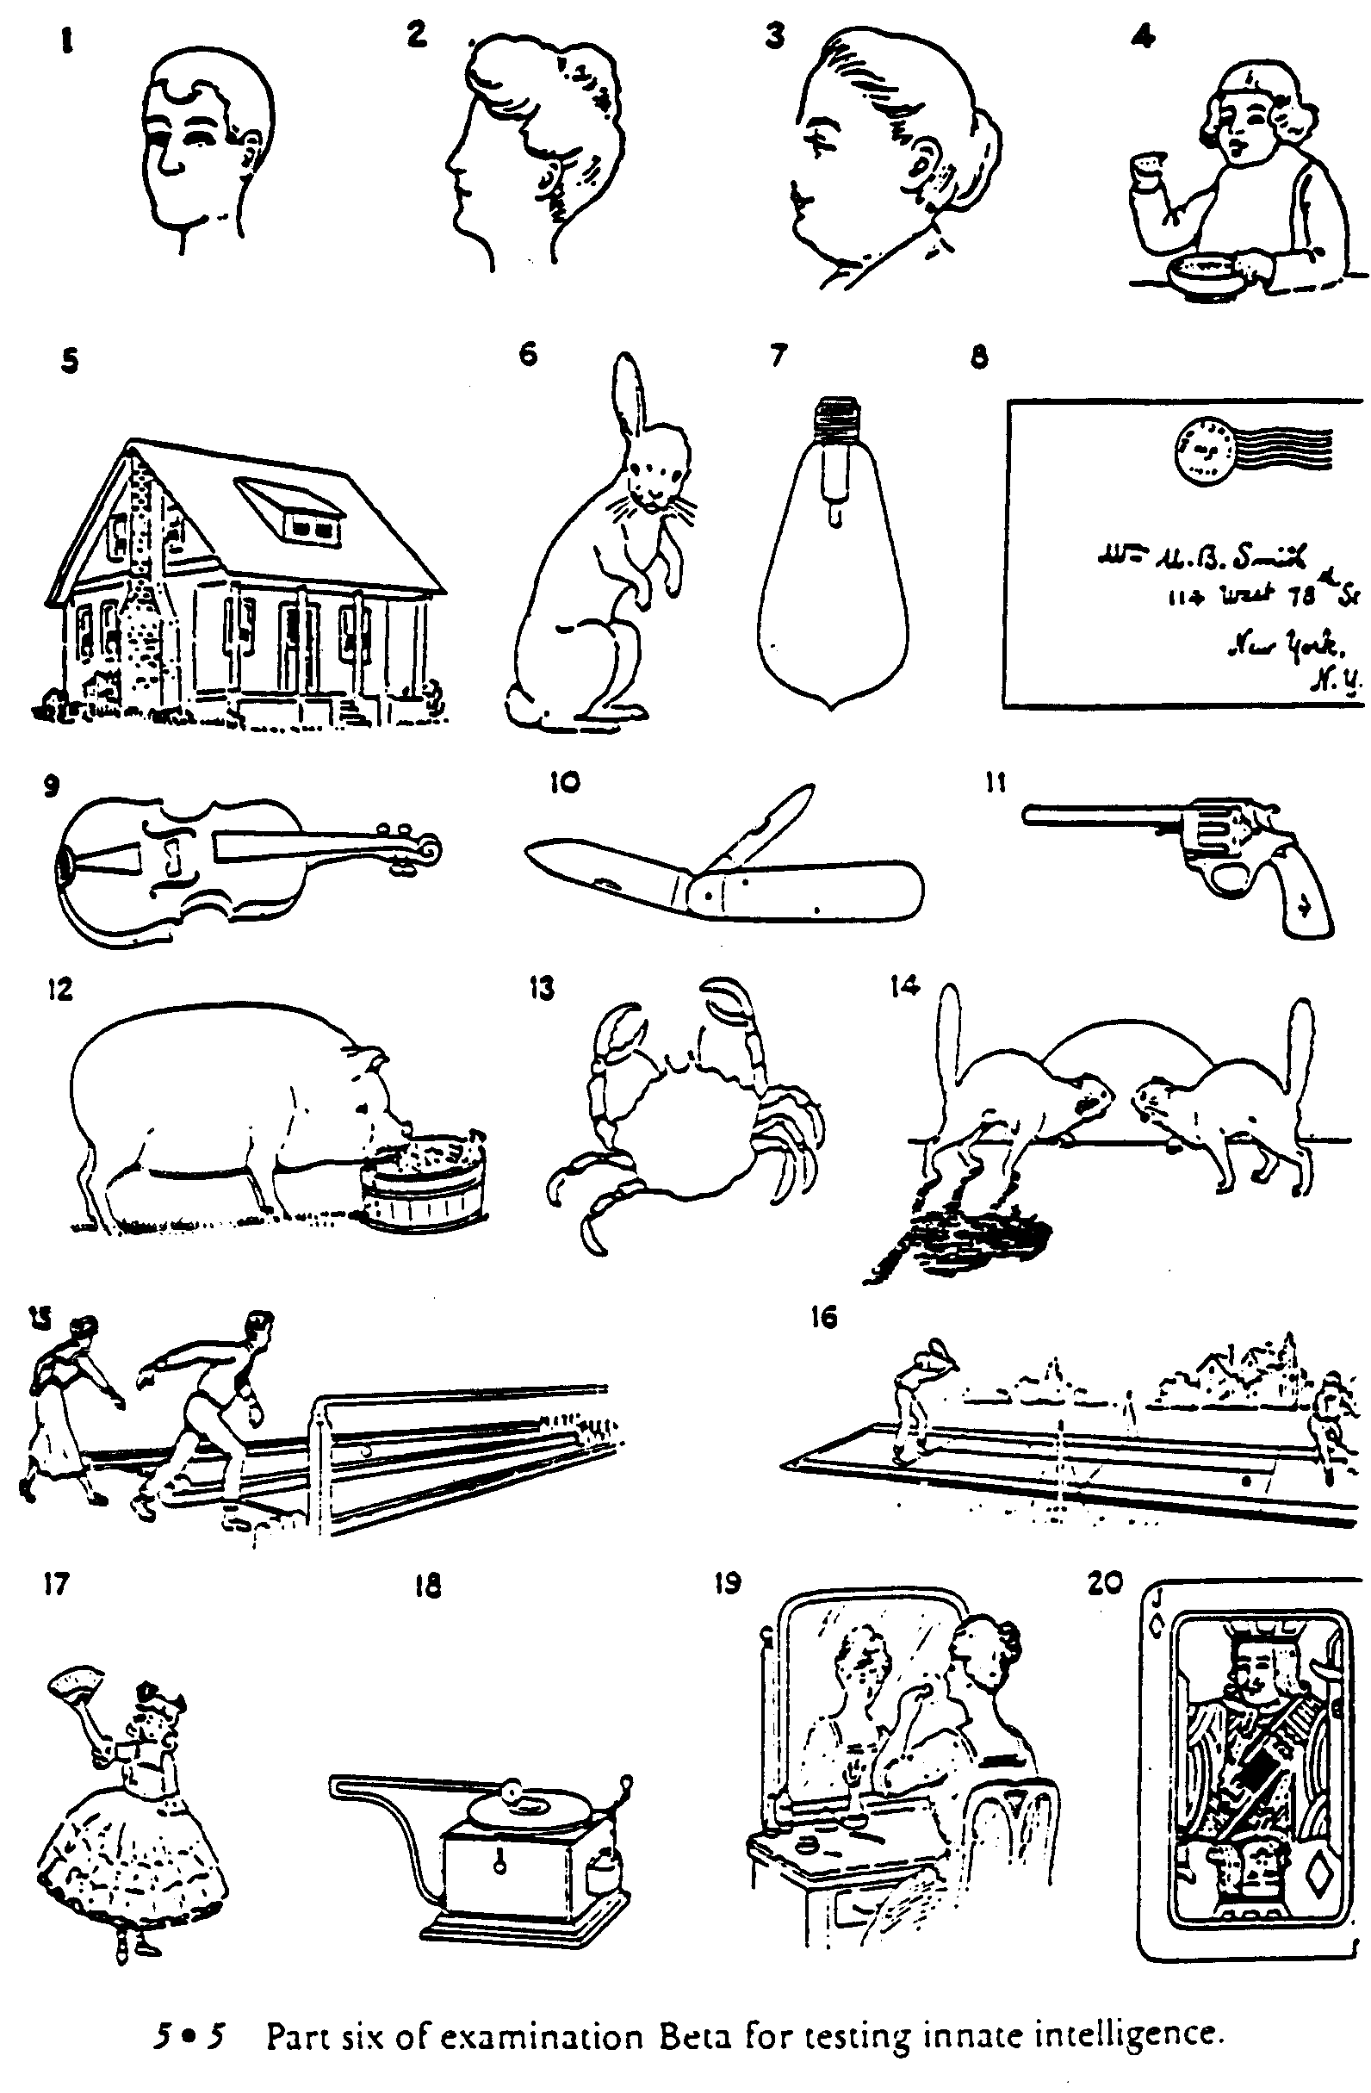
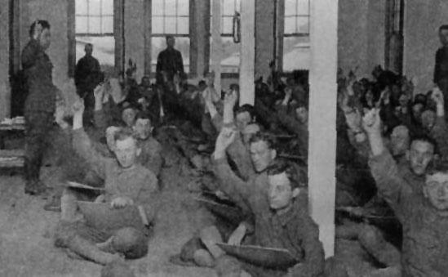
Intelligence Testing, World War I:
Justifying the Quota System
Since people from Eastern and Southern Europe were shown by “objective” testing to be “morons,” immigration quotas were established limiting migration from those regions.
Source: http://www.comnet.ca/~pballan/MAJOR.htm

Slide 47
Recent US Immigration
47
TYPE | 2002 | 2003 | 2004 | 2005 | 2006 | 2007 | 2008 | 2009 | 2010 | 2011
FAMILY | 186,880 | 158,796 | 214,355 | 212,970 | 222,229 | 194,900 | 227,761 | 211,859 | 214,589 | 234,931
EMPLOYMENT | 173,777 | 81,714 | 155,317 | 246,865 | 159,075 | 161,733 | 164,741 | 140,903 | 148,343 | 139,339
DIVERSITY | 42,820 | 46,335 | 50,084 | 46,234 | 44,471 | 42,127 | 41,761 | 47,879 | 49,763 | 50,103
REFUGEES | 115,601 | 34,362 | 61,013 | 112,676 | 99,609 | 54,942 | 90,030 | 118,836 | 92,741 | 113,045
ASYLEES | 10,197 | 10,402 | 10,217 | 30,286 | 116,845 | 81,183 | 76,362 | 58,532 | 43,550 | 55,415
TOTAL | 1,059,356 | 703,542 | 957,883 | 1,122,257 | 1,266,129 | 1,052,415 | 1,107,126 | 1,130,818 | 1,042,625 | 1,062,040
Notice that family-related migrants are usually the largest group.
Also note that no more than 7% of all visas may be issued to people from any one country (this does not affect refugees or asylum seekers).
Since the US admits large numbers of skilled workers, some countries have accused the US of encouraging “brain drain.”
Data source: http://www.dhs.gov/xlibrary/assets/statistics/yearbook/2010/ois_yb_2010.pdf;
http://www.dhs.gov/xlibrary/assets/statistics/publications/lpr_fr_2011.pdf

Slide 48
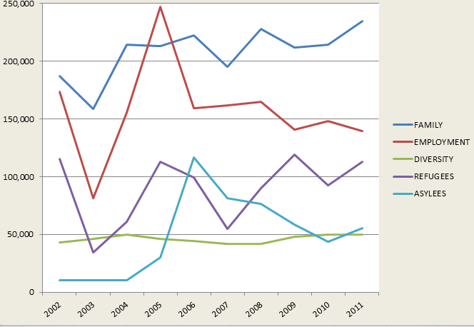
Recent US Migrants by Category
48
Data source: http://www.dhs.gov/xlibrary/assets/statistics/yearbook/2010/ois_yb_2010.pdf;
http://www.dhs.gov/xlibrary/assets/statistics/publications/lpr_fr_2011.pdf

Slide 49
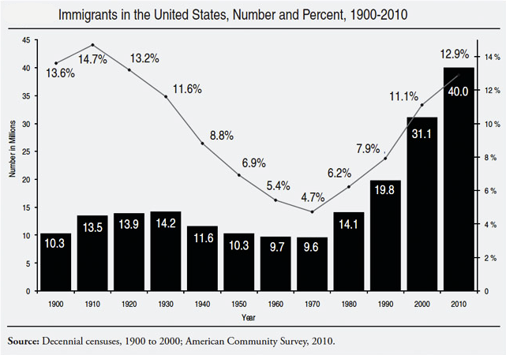
Foreign-Born Population of the US
Migrant characteristics:
  40% 23-39 years old
  Just 5% over 65 years old
  Children make up 16% of immigrants
  Recent immigrants tend to have limited education.
Source: http://cis.org/2012-profile-of-americas-foreign-born-population#f1;
see also http://www.migrationinformation.org/datahub/charts/final.fb.shtml

Slide 50
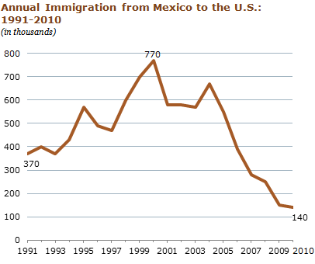
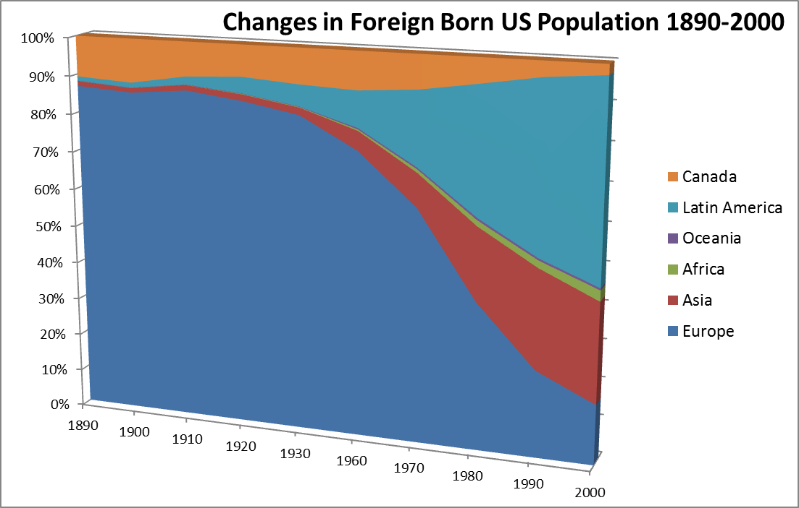
Changes in
US Migrants
Sources: http://www.pewhispanic.org/2012/04/23/net-migration-from-mexico-falls-to-zero-and-perhaps-less/;
http://www.census.gov/population/www/documentation/twps0081/twps0081.pdf

Slide 51
US Attitudes Toward Immigrants
US attitudes toward immigrants have sometimes been hostile:
  Anti-Irish, anti-Catholic
  Anti-Polish, anti-Jewish
  Anti-Chinese, anti-Japanese
  Anti-Mexican, anti-Cuban, etc.
Historically, a number of US politicians have used anti-immigrant slogans as part of their campaigns.

Slide 52
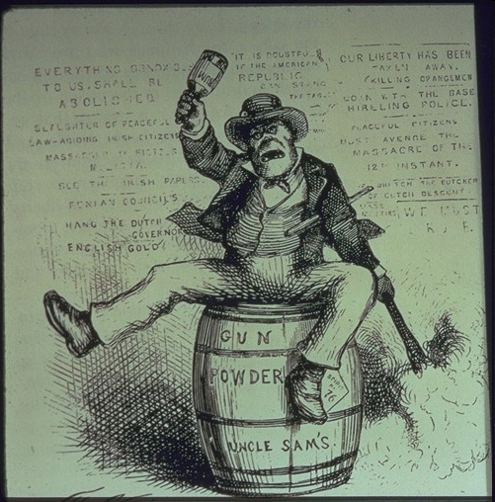
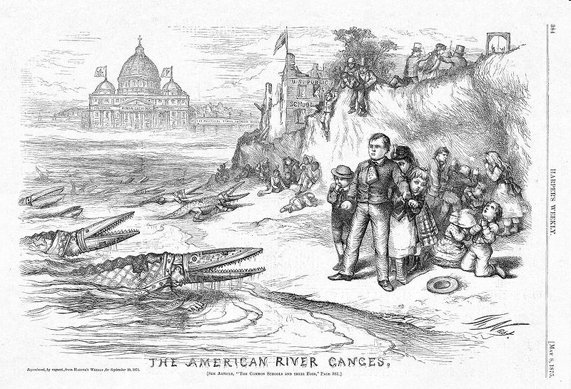

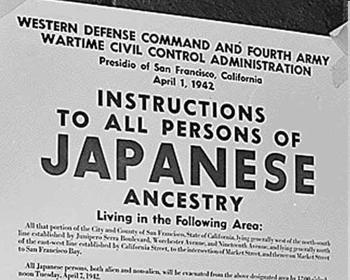
Negative US Attitudes
Anti-Irish
Anti-Catholic
Anti-Chinese
Anti-Japanese

