Slide 1
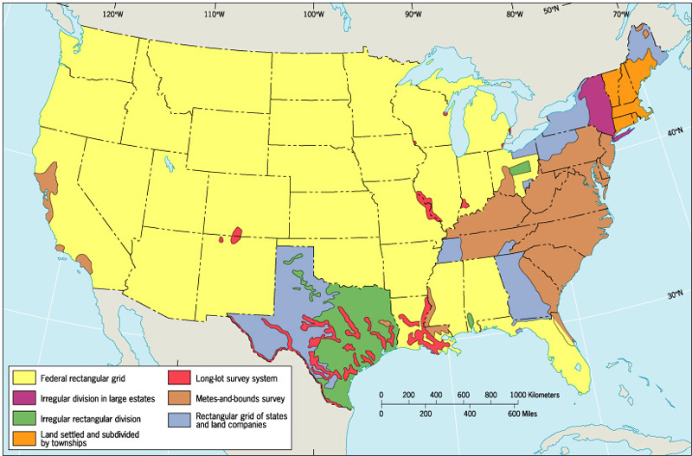
Dominant Land Survey Patterns in the US

Slide 2
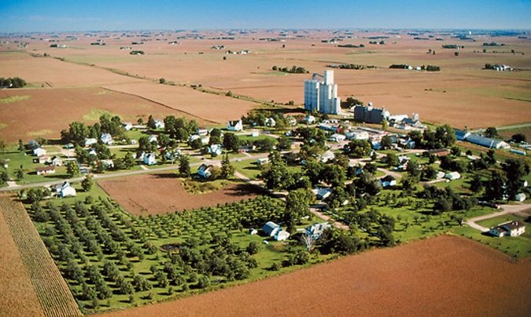
Township and Range –
The cultural landscape of Garden City, Iowa reflects the Township and Range system. Townships are 6x6 miles and section lines are every 1 mile.

Slide 3
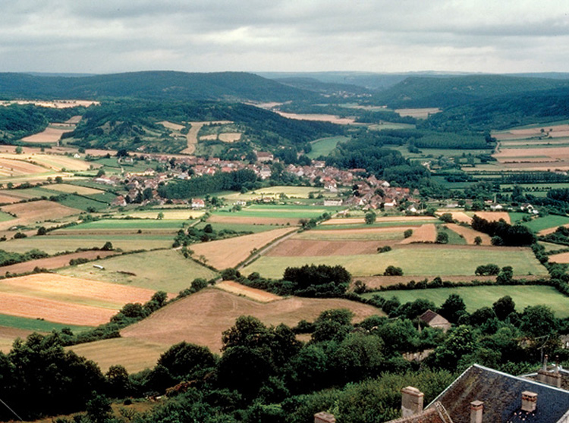
Longlot Survey System –
The cultural landscape of Burgundy, France reflects the Longlot Survey system, as land is divided into long, narrow parcels. People live in nucleated villages and land ownership is highly fragmented.

Slide 4
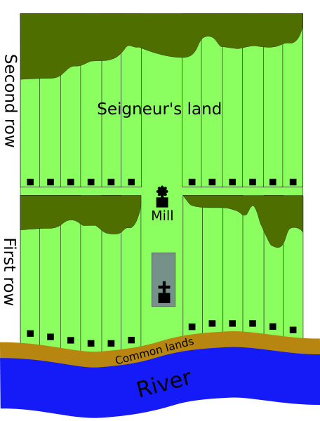
The Long Lot System of New France

Slide 5
Agricultural Villages
Nucleated settlement-intense cultivation with homes clustered in a village-most of the world’s farms are nucleated.
Dispersed settlement-individual farm house widely spaced-North America
Linear Village-follows a stream or road
Cluster Village-(nucleated) intersection of roads
Round Village-to corral livestock (rundling-Slavic farmers)
Walled Village-e.g. Medieval Europe
Grid Village-Spanish colonial villages & modern day planned-towns

Slide 6
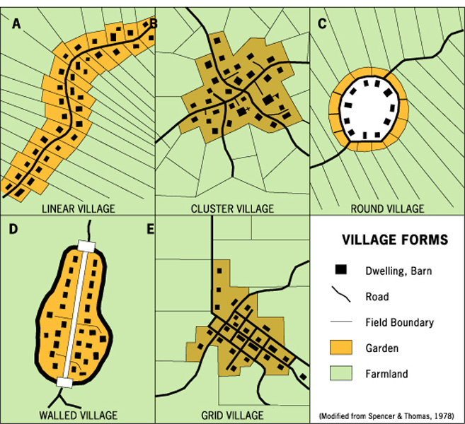
Village Forms

Slide 7
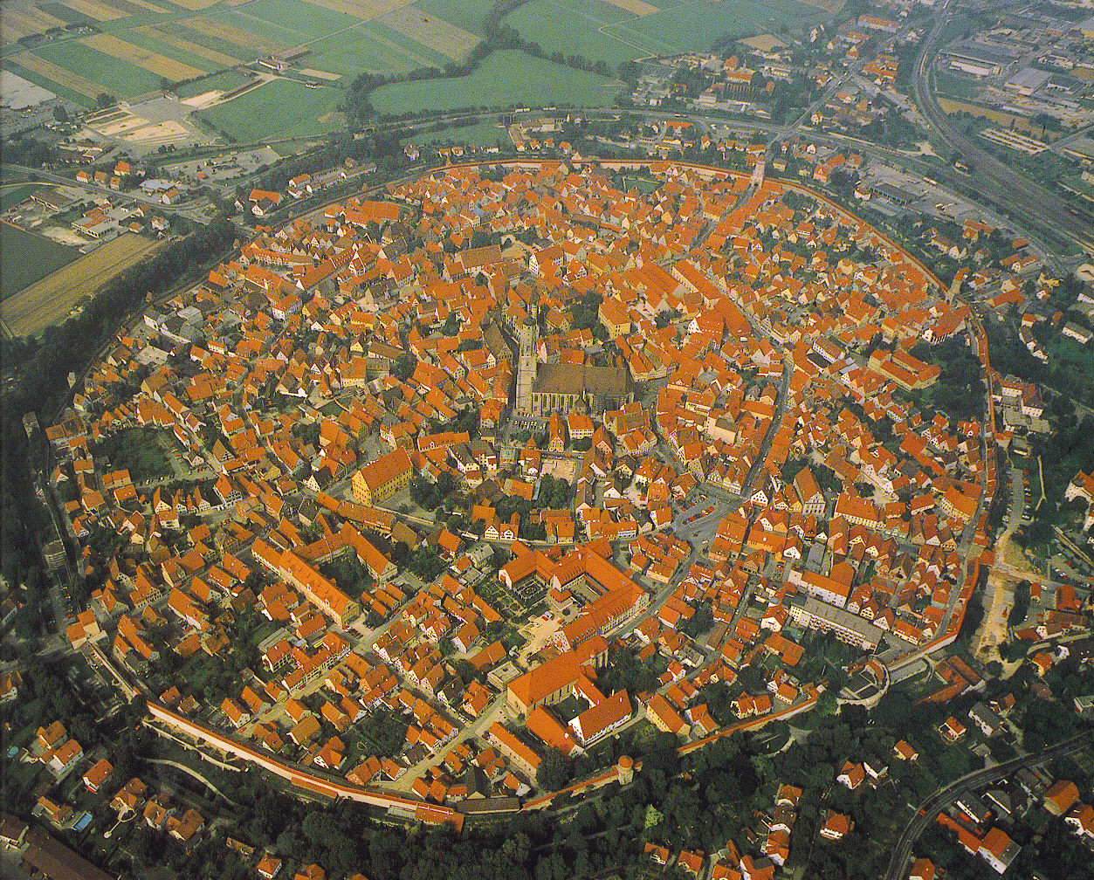
Nordlingen, Germany built in the Middle Ages circa, 14th Century

Slide 8
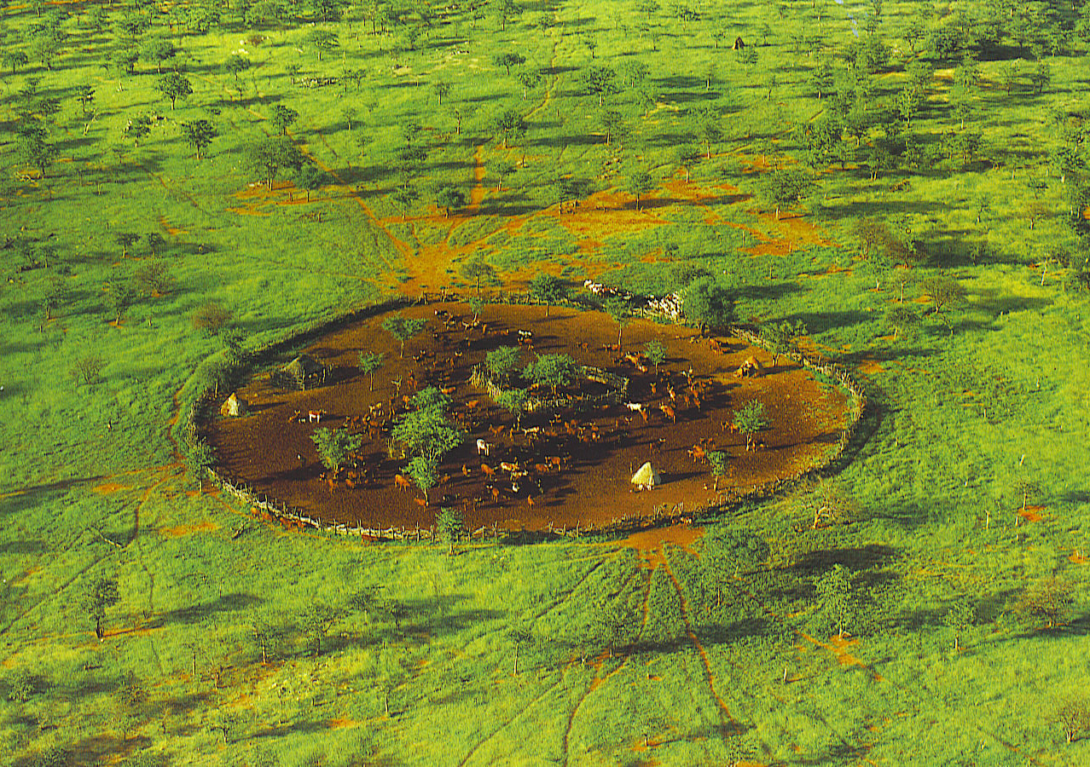
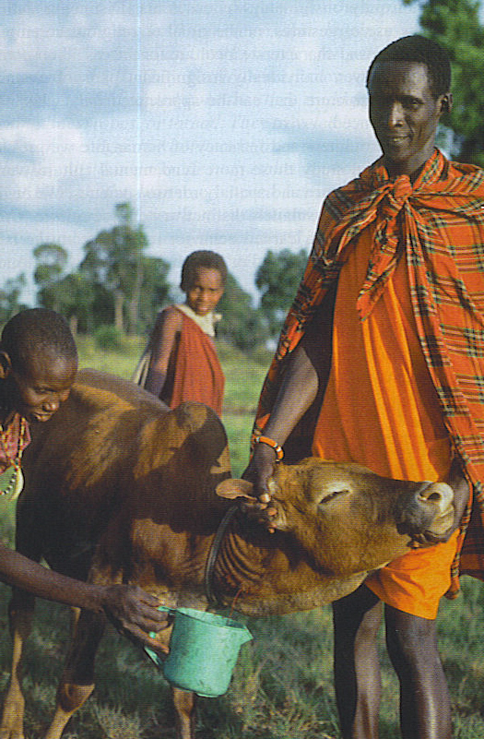
Top-a Namibian village or kraal to protect livestock
Right-Masaai use the blood of their livestock for food.
Notes:
Namibia village of the Himba people, a semi-nomadic people who live in kraals of about 50 people.
Masai-bleed their cattle for food.

Slide 9
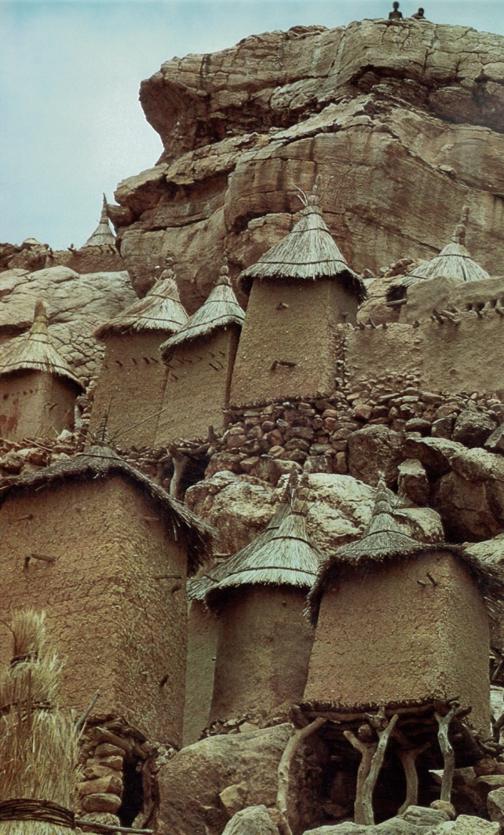
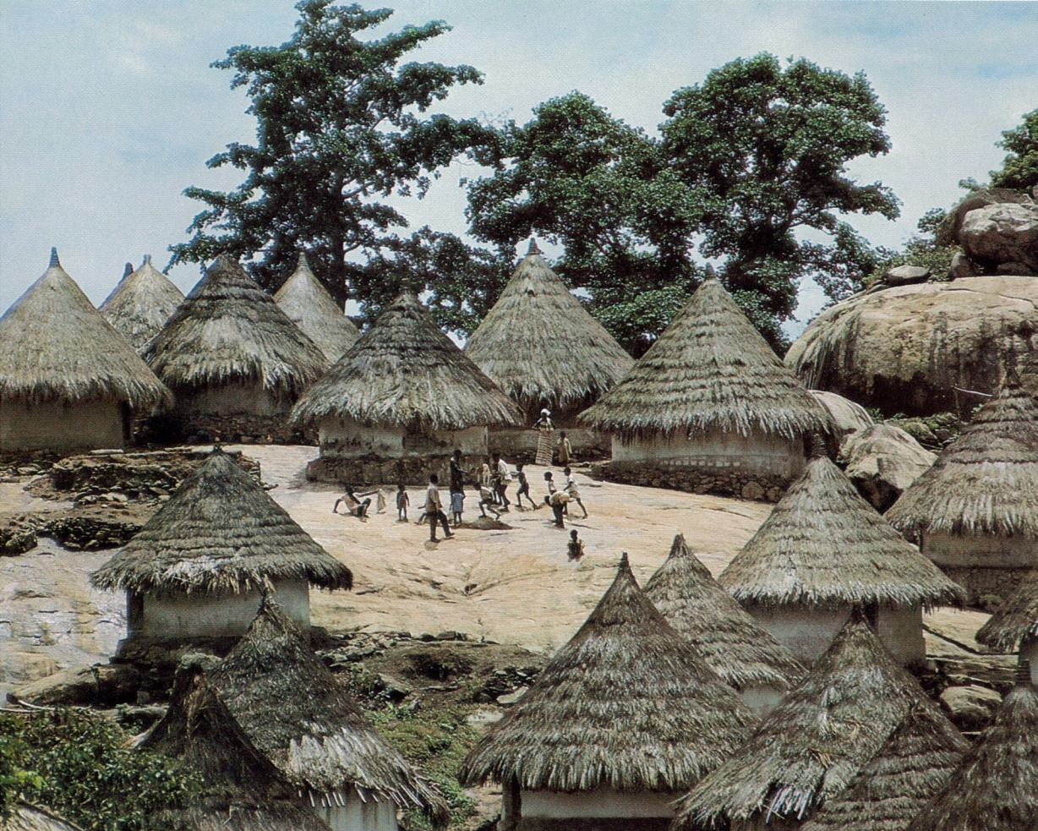
Functional Differentiation within Villages
Cultural landscape of a village reflects:
Social stratification (How is material well being reflected in the spaces of a village?)
Differentiation of buildings (What are they used for? How large are they?)
Notes:
Left-Sun-dried brick homes with thatch roof in a round African village of Mahebli south of Odienne in the Ivory Coast-The Chief’s house always held the place of prominence near the entrance of the kraal.
Right-Villagers flat roof houses cling to rocky terraces for protection. The straw-hatted granaries are built on stilts to keep the grain dry-Dogon villages seem haphazard, but conformed to a mythical human pattern with the Blacksmith’s hearth at the head, shrines at the feet and family dwellings at the chest.

Slide 10
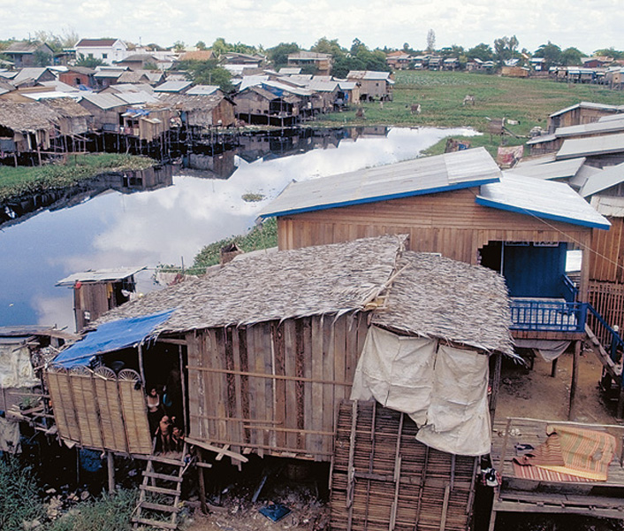
Stilt village in Cambodia- Buildings look alike, but serve different purposes.

Slide 11
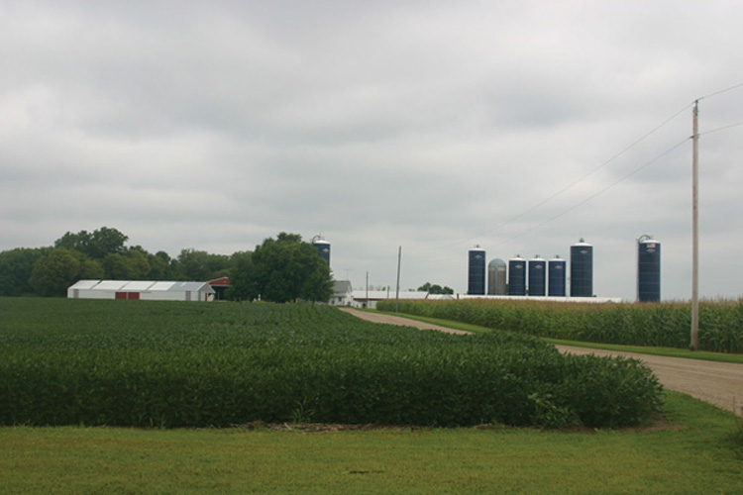
Farm in Minnesota
each building serves a different purpose
Notes:
Prosperous American farms typically have 2 story farm house, a stable, a barn, and various outbuildings including a garage for vehicles and farm machinery, a shed for tools and silos for grain storage.

Slide 12
Agriculture
Commercial Agriculture
Term used to describe large scale farming and ranching operations that employ vast land bases, large mechanized equipment, factory-type labor forces, and the latest technology.
- roots are in colonial agriculture
- today, global production made possible by advances in transportation and food storage
Notes:
NAFTA-since it started in 1994 US corn imports into Mexico have tripled and Mexican corn production has gone down. Total population is increasing, thus many small villages are losing population to the maquiladora towns or they are migrating into the US

Slide 13
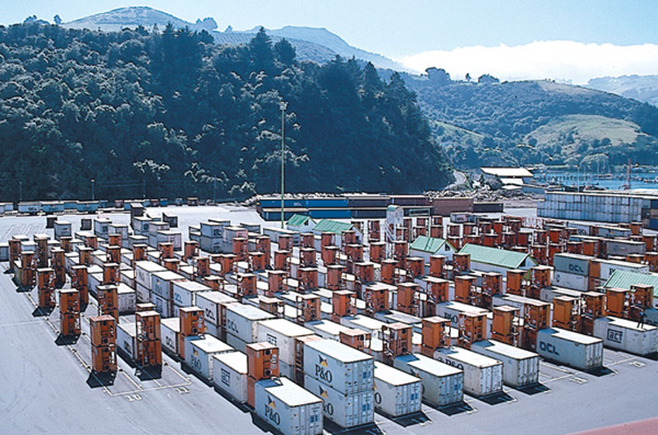
Advances in Transportation & Food Storage
- Containerization of seaborne freight traffic
- Refrigeration of containers, as they wait transport in Dunedin, New Zealand

Slide 14
Agriculture and Climate
Climate Regions (based on temperature and precipitation) help determine agriculture production.
Agriculture Regions – drier lands usually have livestock ranching and moister climates usually have grain production.

Slide 15
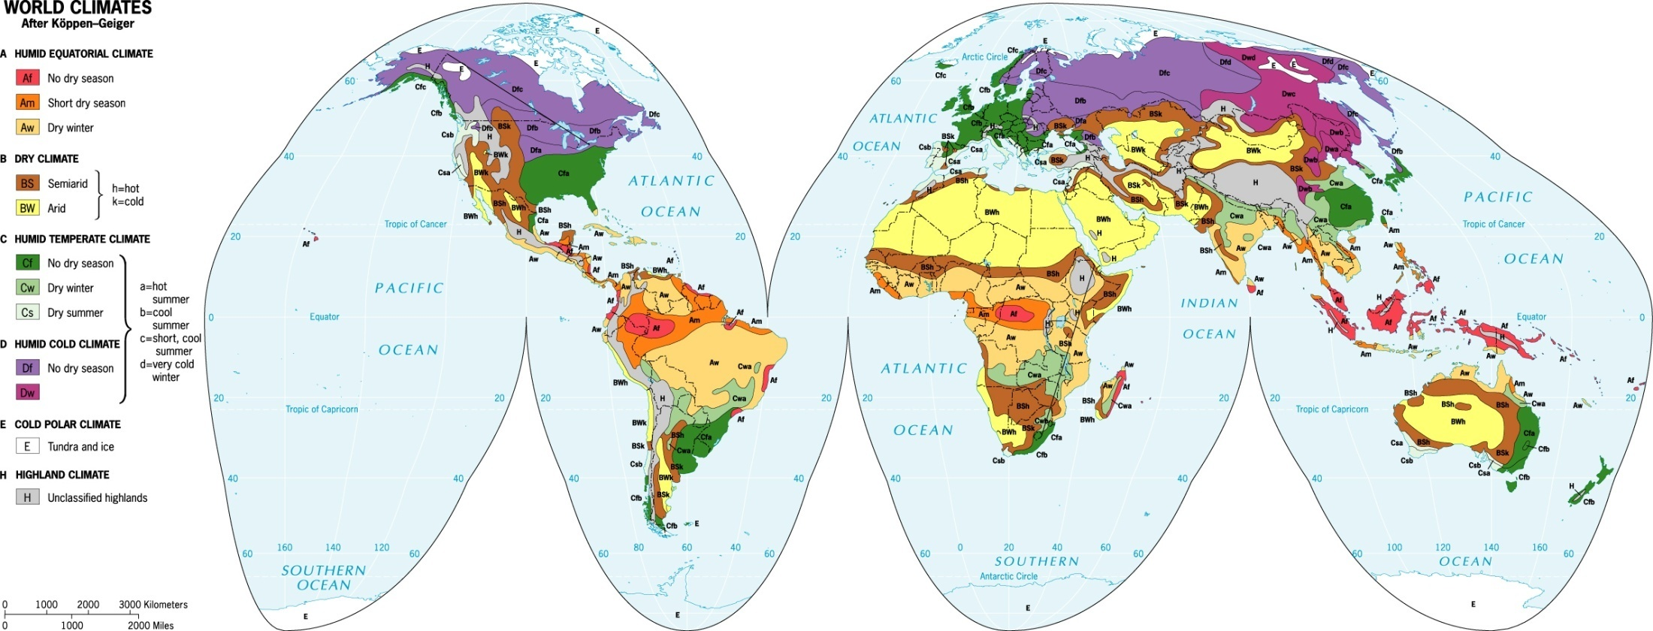
World Map of Climates
Koppen Climate Classification System
Notes:
Koppen was the first to devise a scheme for classifying the world’s climates on the basis of average temperature and precipitation.
It is important to have a sense of where the major world climate types are located. For all but B climates, the basis is the amount of precip.and when it falls-B is both temp. & precip.
A climates are hot or very warn and humid.
The Af regions are equatorial rainforests.
The Am climate is known as the Monsoon climate-farmers here are depend on monsoon rains to grow crops.
Aw are hot dry grassland or savanna
The yellow and light brown colors mean dry climates-BW are deserts and BS are steppes. (few live in A or B climates
The Koppen map explains why the world faces a long-term world wide water crisis.

Slide 16
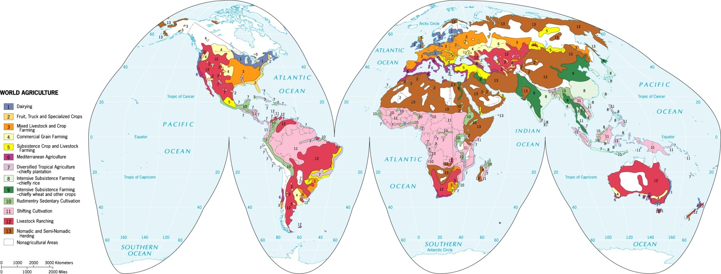
World Map of Agriculture
Cash Crop and Plantation Agriculture
Cotton and Rubber
Luxury Crops
Commercial Livestock, Fruit, and Grain Agriculture
Subsistence Agriculture
Mediterranean Agriculture
Illegal Drugs

Slide 17
Notes:
North America is remarkable in that some type of agriculture is possible throughout the lower 48 states-even in marginal areas like southern California, southern Arizona and the Utah valley-farming is possible with irrigation.

Slide 18
Agribusiness & the Changing Geography of Agriculture
Commercialization of Crop Production
With the development of new agricultural technologies, the production of agriculture has changed.
- eg. Poultry industry in the US
production is now concentrated
farming is turning into manufacturing
Notes:
Less than 1/5th of the cost of a food dollar goes to farmers
81% of the food dollar goes to corporations that transport, process and market the food.

Slide 19
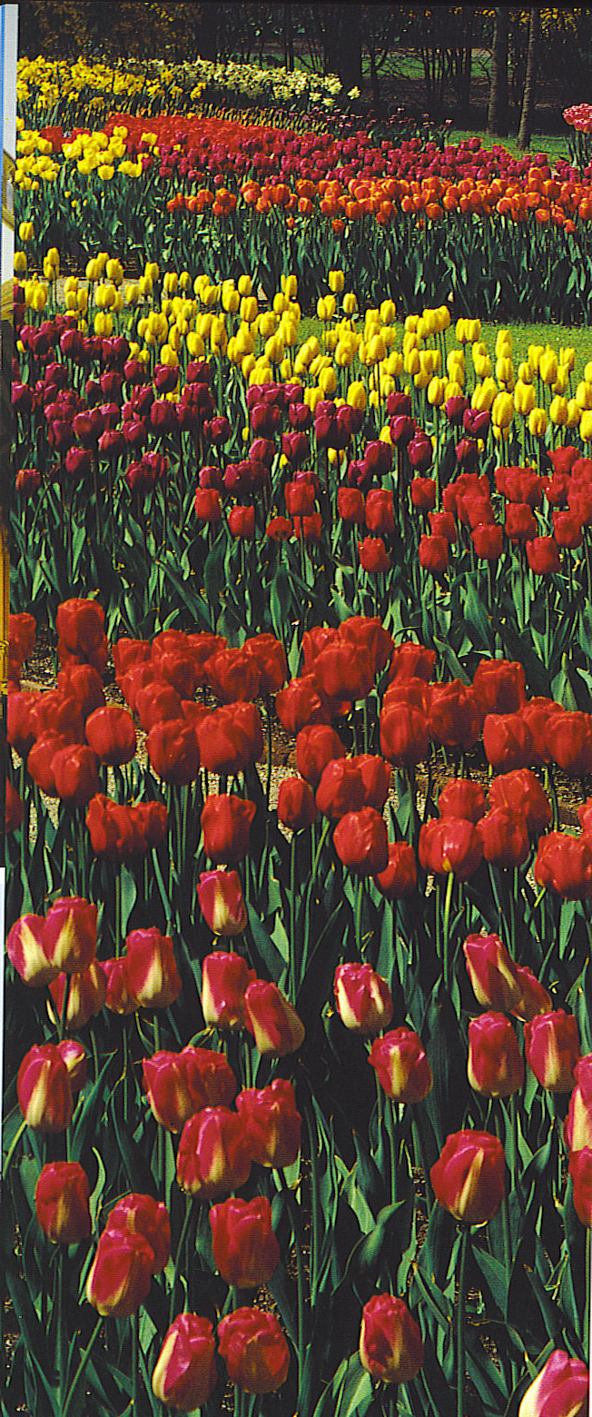
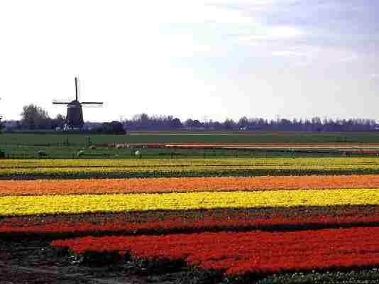
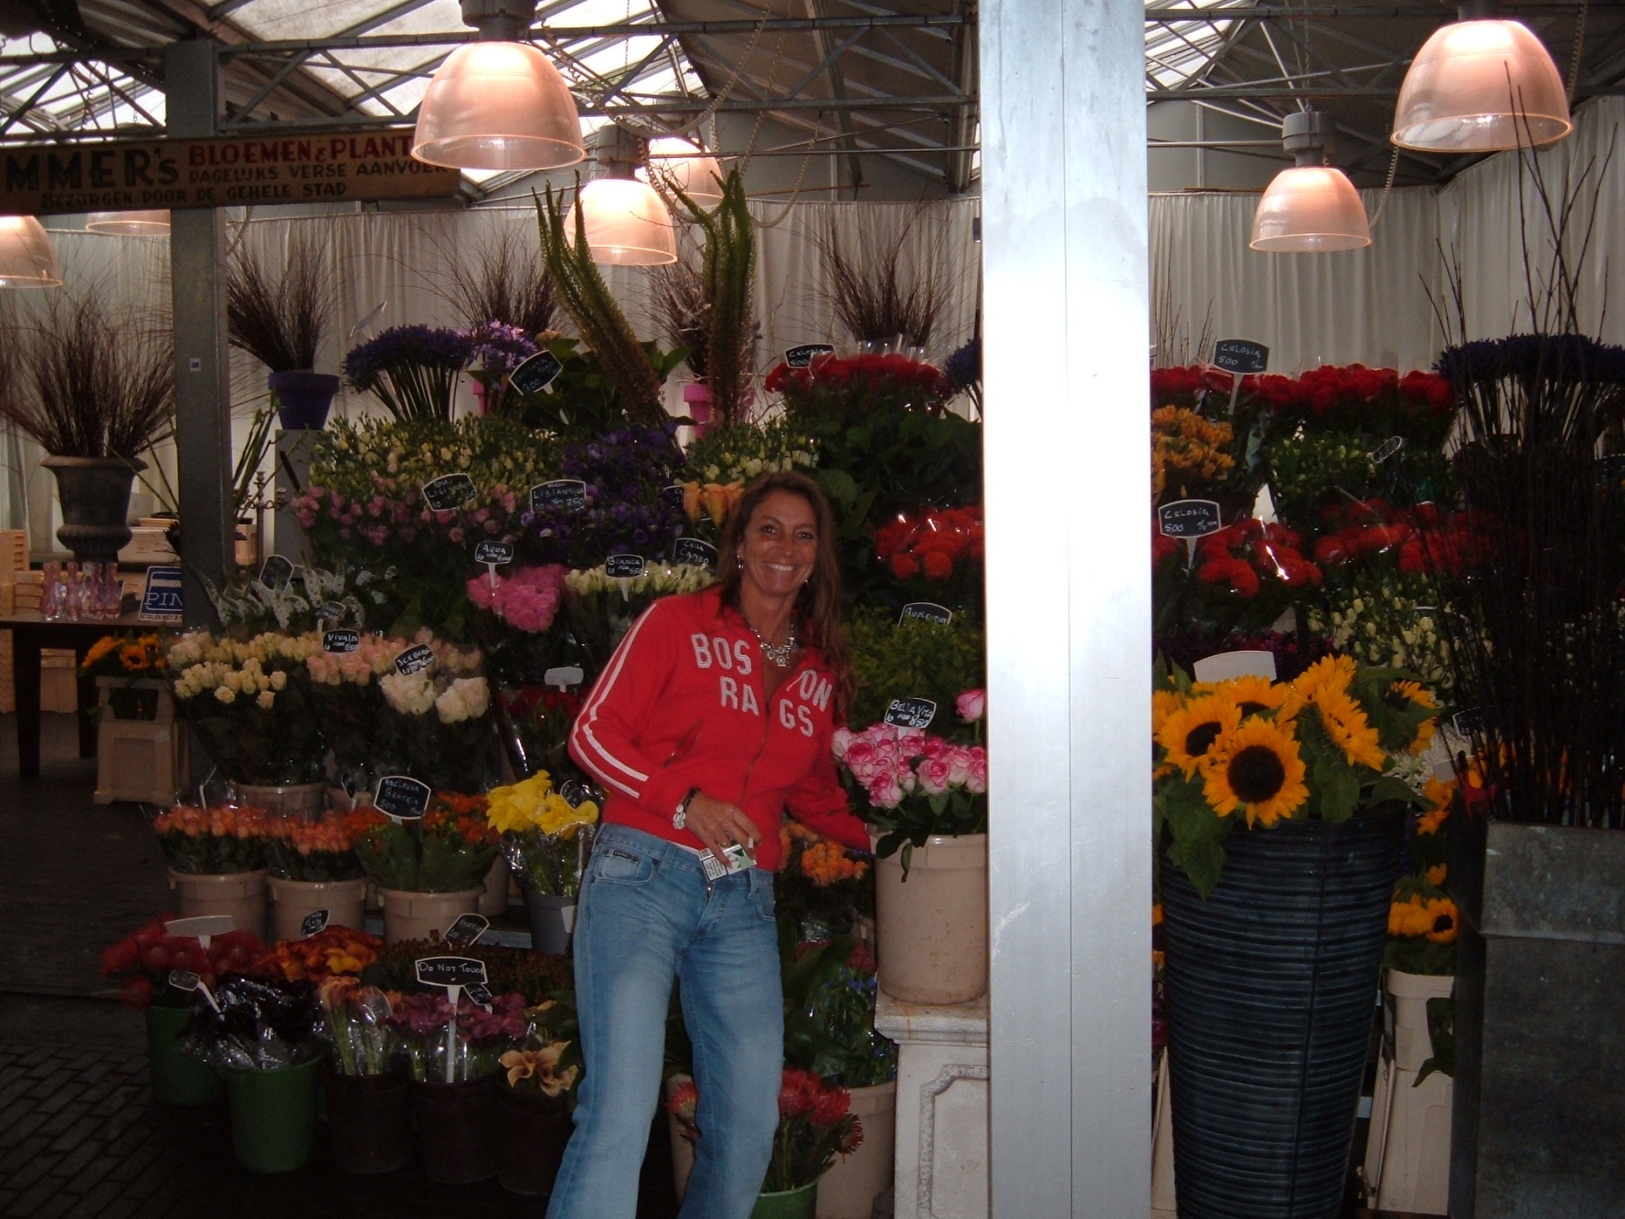
The Dutch Flower
Market
Notes:
Flowers (a luxury crop) are grown for fresh flowers and bulbs and sold all over the world.
Modern transportation systems-refrigerated containers and air freight make it possible to ship fresh flowers from Holland, Israel, Chile or Hawaii to the US or any where else in the world
Holland controls 92% of the world flower market

Slide 20
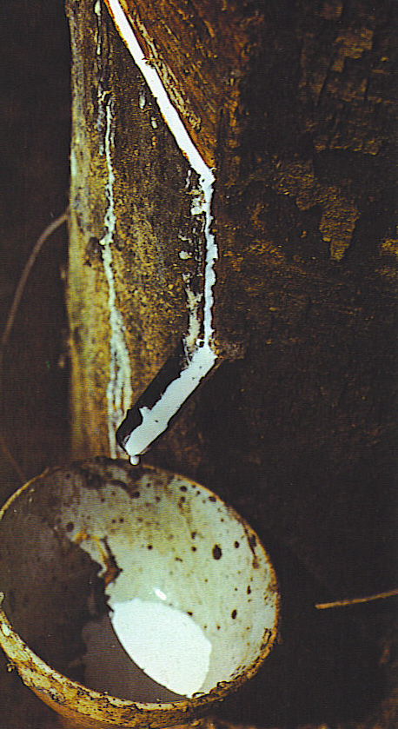
Plantation Agriculture
Governments in core countries set quotas for imports & subsidize domestic production
Large scale cash cropping is called plantation agriculture-a hold over from the colonial period
Bananas, sugar, coffee, cacao, rubber and tea are examples.
Sugar cane is a cash crop that drives the economies of many Caribbean nations
Cartels are formed to boost prices, but are seldom successful
Notes:
Multinational Corporations protect their interests-1940-50s Guatemala began agricultural reform to distribute land which threatened the monopoly of the United Fruit Company. The company used its close ties in the US Govt. Sect. Of State John F. Dulles and his brother CIA director Allen Dulles supported a coup that overthrew the govt. and est. a military dictatorship with close ties to the US.

Slide 21
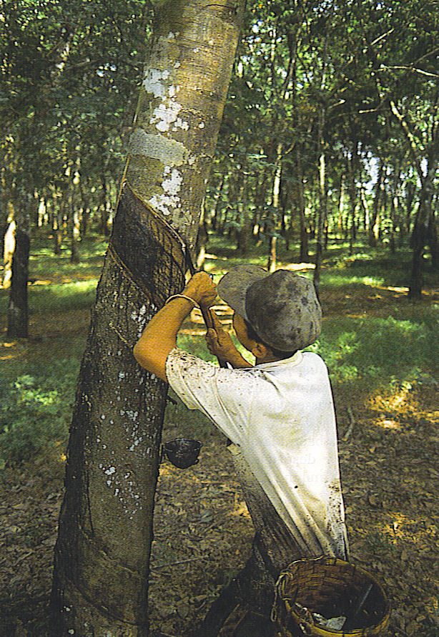
Rubber
Originally collected from a wild tree in Brazil and Africa, the seeds were planted to create plantations in Malaysia, Indonesia and other SE Asian countries.
Today 70% of world rubber production is in SE Asia.
Automobile production in the early 20th century boosted the demand for rubber. Of 17.7 tons used per year today about 10 million tons are synthetic-made from petroleum
Notes:
Indonesian rubber plantation

Slide 22
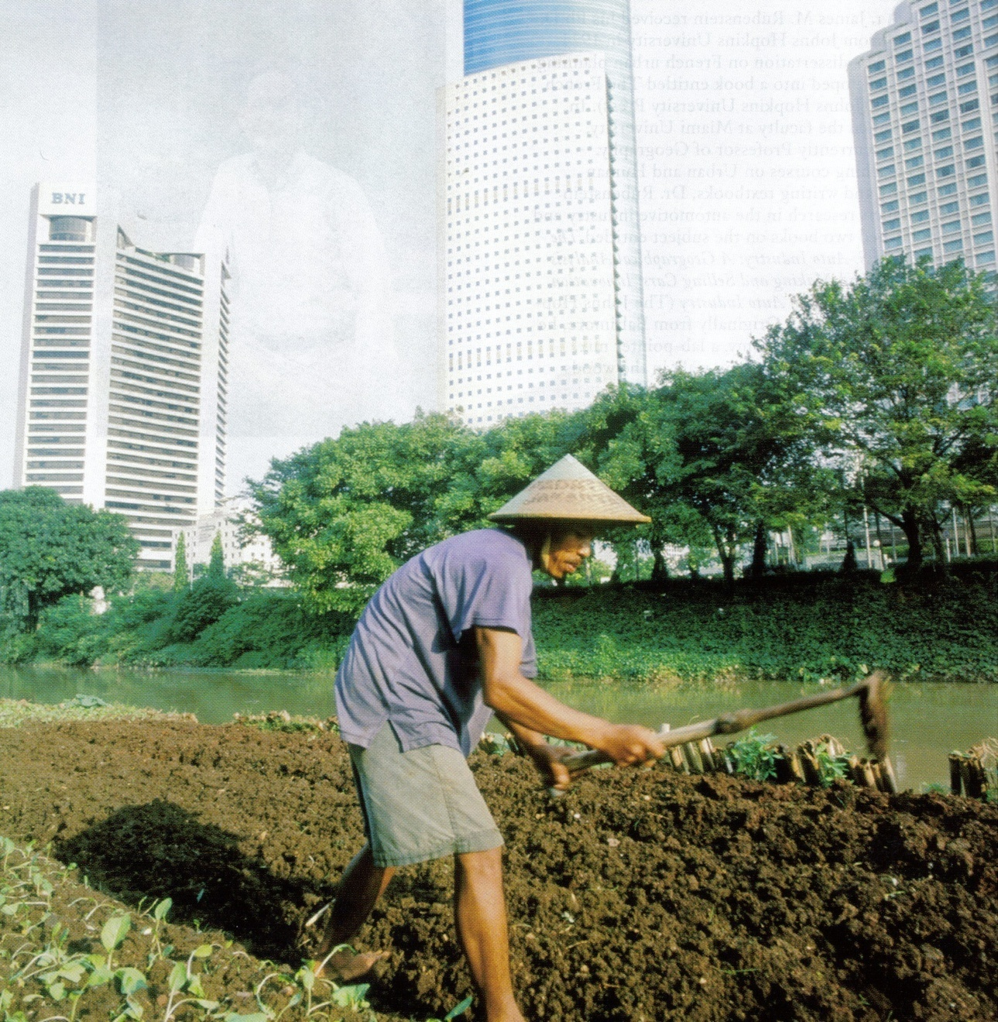
A truck (an old English word for trade or barter) farmer in the city of Jakarta, Indonesia raises vegetables within sight of great skyscrapers.
Land is valuable and a growing population requires that every square inch of fertile land is used to produce food
Notes:
Farming in Jakarta, Indonesia

Slide 23
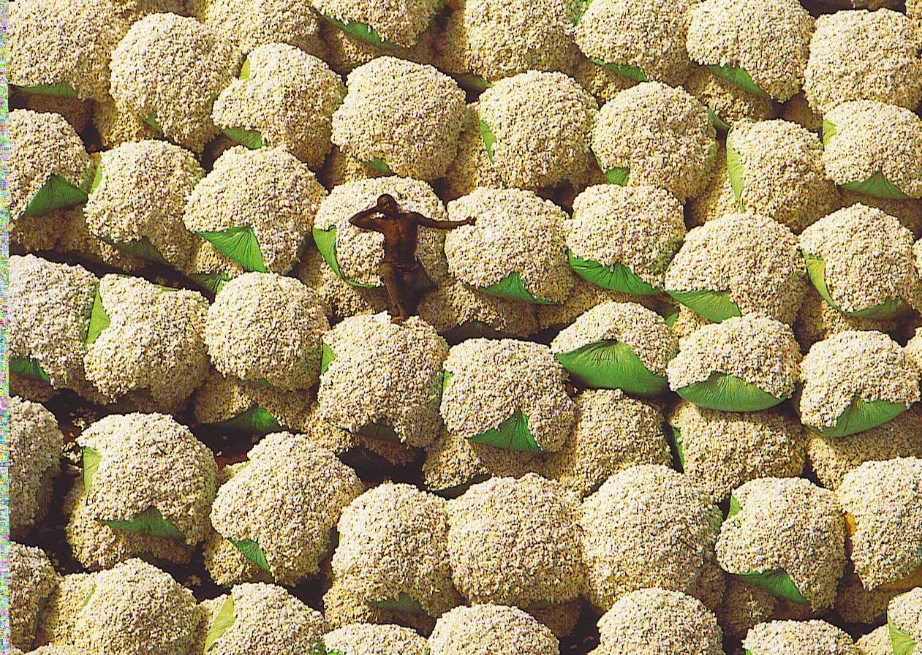
Notes:
African Cotton bales

Slide 24
Organic Agriculture
Organic Agriculture –
The production of crops without the use of synthetic or industrially produced pesticides and fertilizers or the raising of livestock without hormones, antibiotics, and synthetic feeds.
- sales of organic foods on the rise
- grown everywhere
- demand in wealthier countries

Slide 25
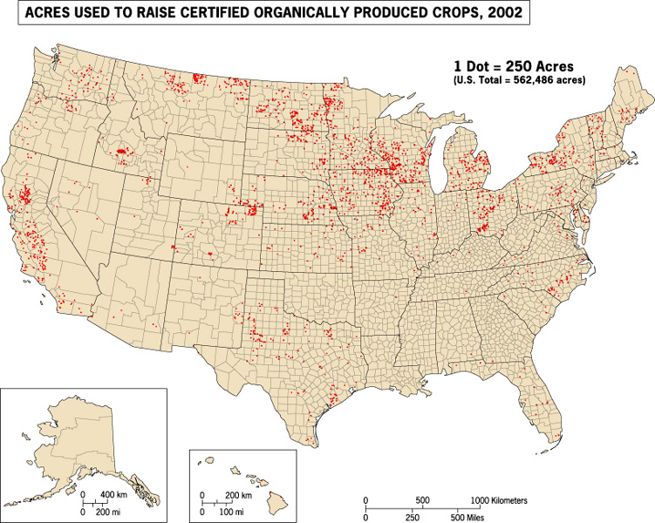
Organic Agriculture

Slide 26
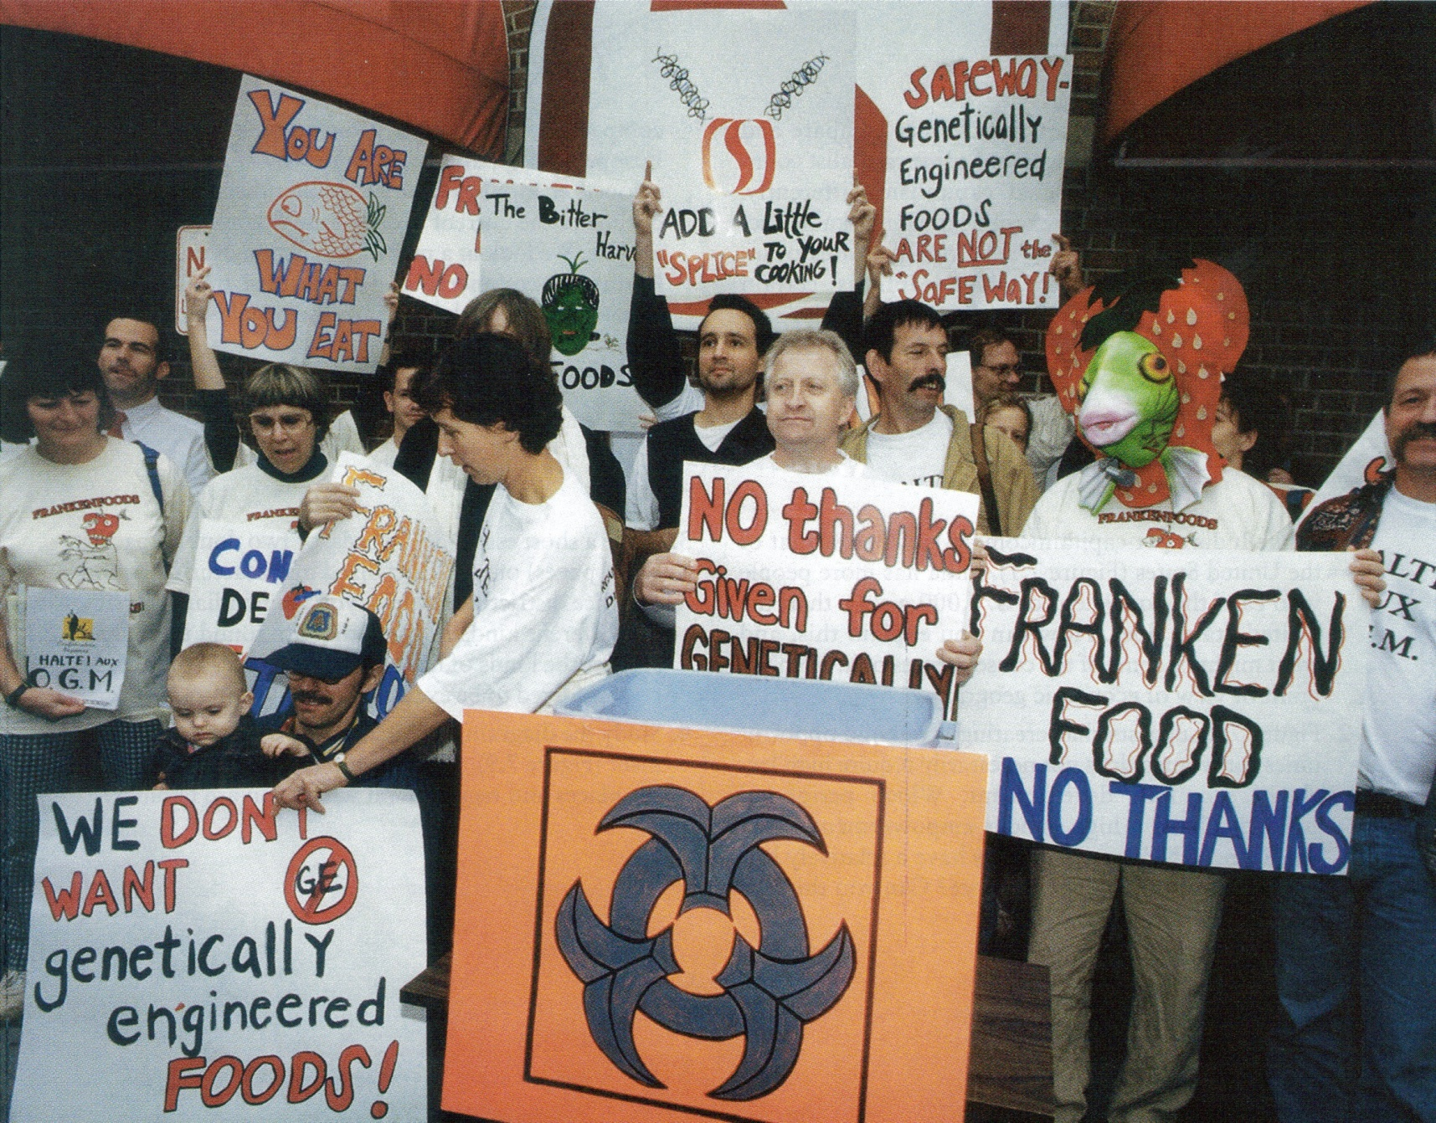
Protest of GM Foods at the World Trade Organization meeting in Seattle, 1999
Notes:
Some people fear the impact of genetically modified foods on the natural habitat and the people who consumed them. Some European countries have banned their use.

Slide 27
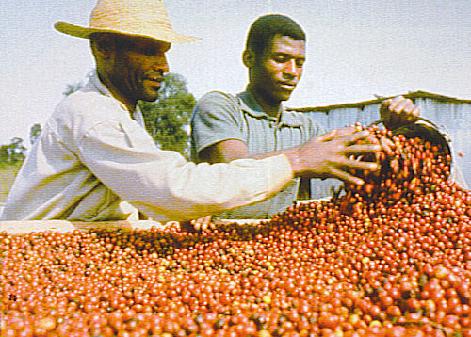
Fair Trade Agriculture
Fair Trade Coffee –
shade grown coffee produced by certified fair trade farmers, who then sell the coffee directly to coffee importers.
- guarantees a “fair trade price”
- over 500,000 farmers
- produced in more than 20 countries
- often organically produced

Slide 28
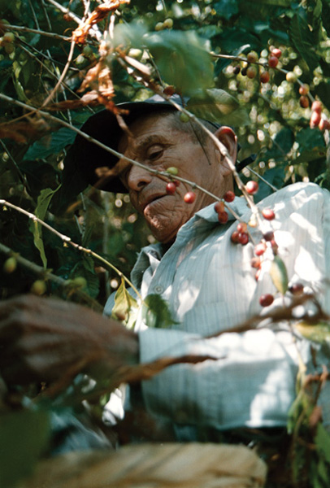
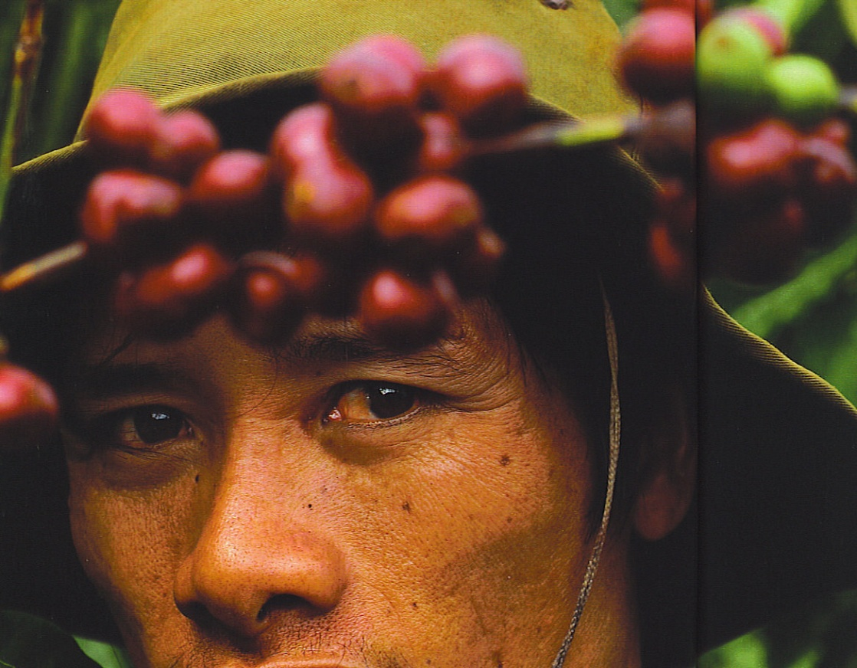
Fair trade coffee farmer in El Salvador grows his beans organically and in the shade, allowing him to get a much better price for his coffee.
Notes:
Vietnamese Coffee picker at bottom

Slide 29
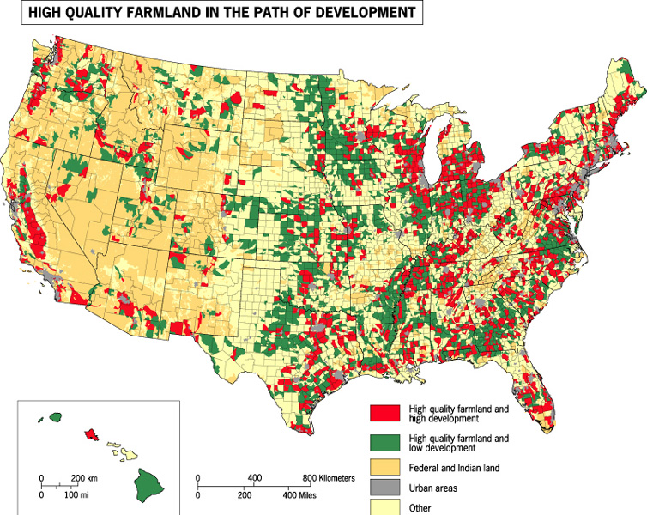
Loss of Productive Farmland
Notes:
Farmland in danger of being suburbanized as cities expand into neighboring farmlands.
Farmland in danger of being suburbanized as cities expand into neighboring farmlands.

Slide 30
Meat Production on Ranches
Cattle, sheep, and goats are the main meat animals raised on ranches.
Notes:
Live stock ranching is done on semiarid or arid land-it is practiced in MDCs where the vegetation is too sparse or soil too poor to support crops
US cattle ranching expanded in the west with the demand for beef by the growing cities of the east-Chicago became a major meat packing city
Ranching is only found in Spain & Portugal in Europe
Brazilian, Uruguan and Argentine Pampas due to proximity to sea coast ports
Australia, New Zealand, Middle East and South Africa herd sheep for wool & meat

Slide 31
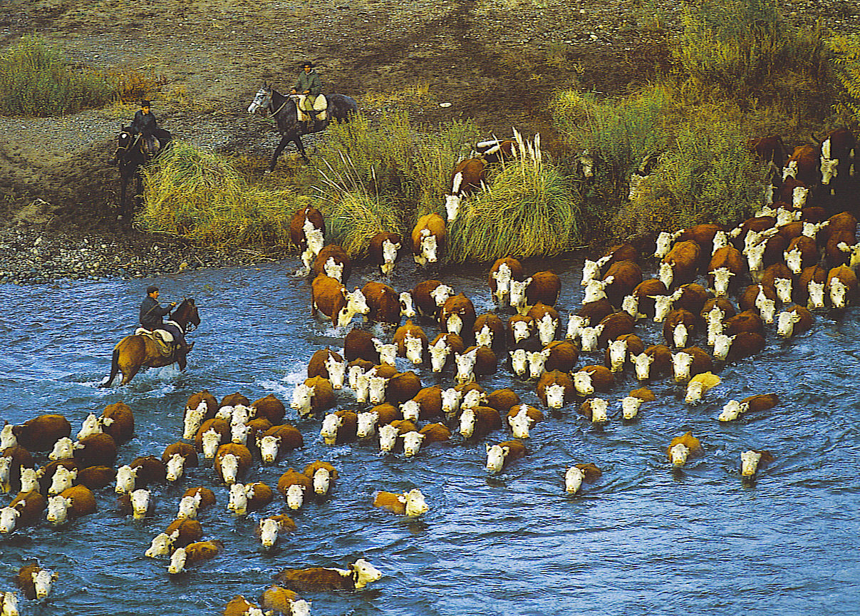
Notes:
Argentina-beef cattle-herefords

Slide 32
Grain Importers and Exporters
Most countries are net importers of grain. The U.S. is the largest net exporter.

Slide 33
World Wheat Production
Fig. 10-10: China is the world’s leading wheat producer, but the U.S. and Canada account for about half of world wheat exports.

Slide 34
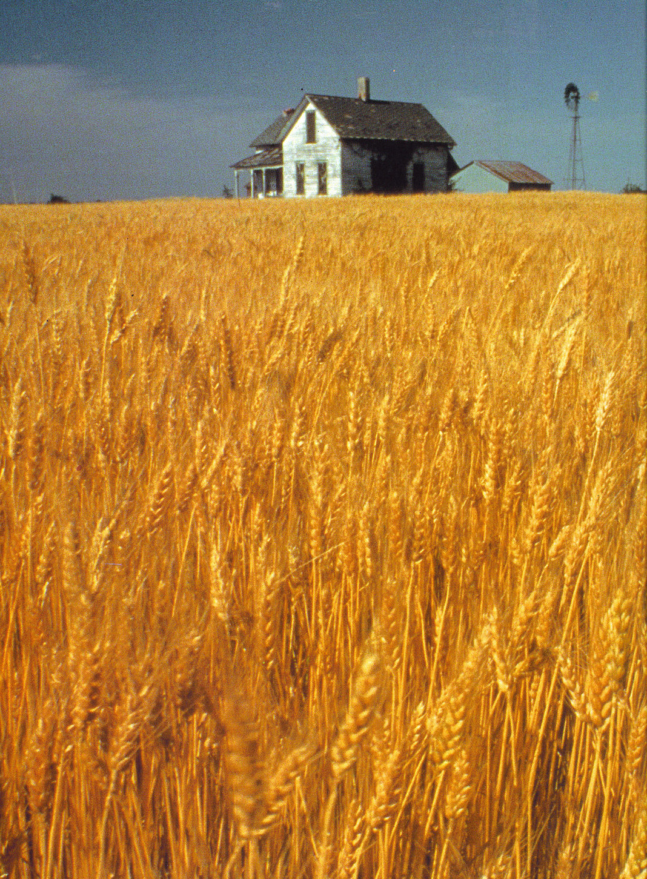
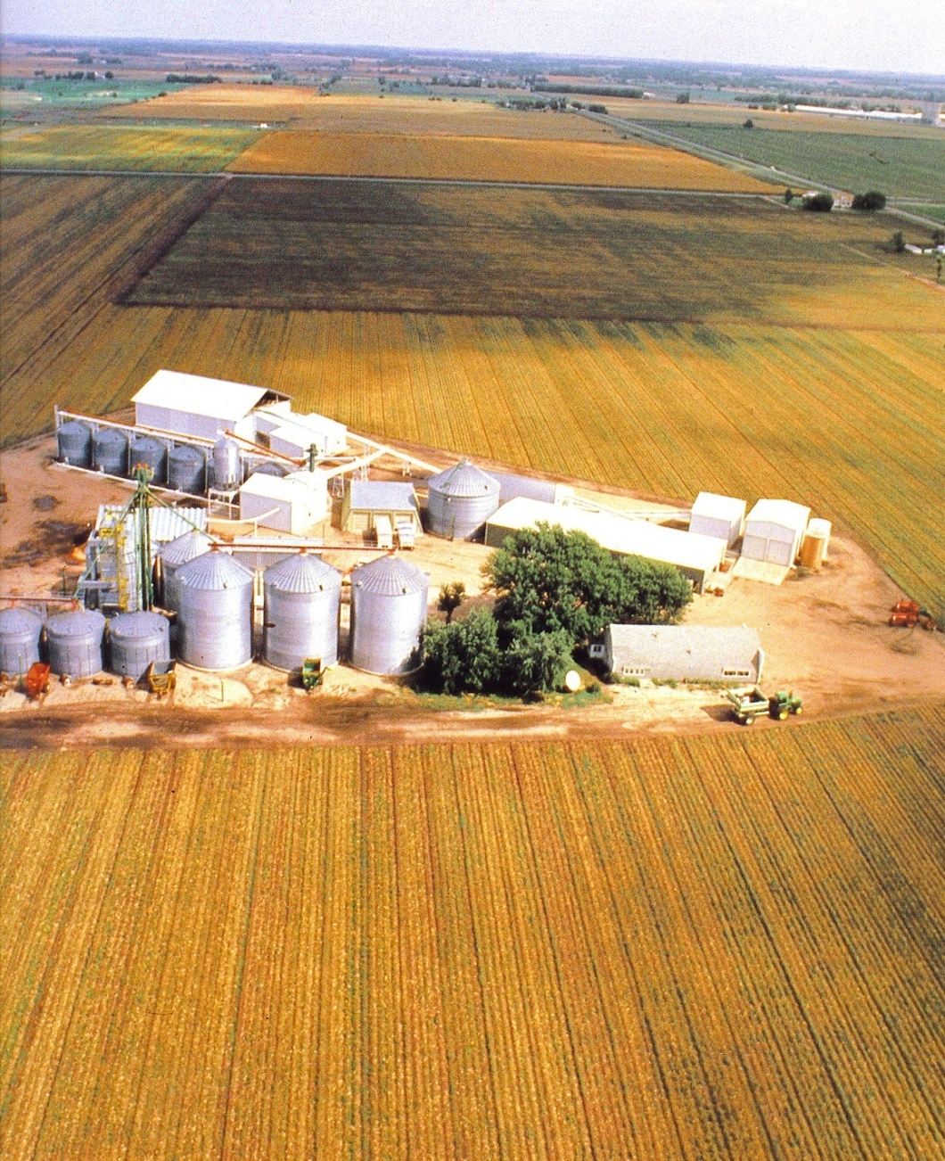
Notes:
Wheat field in Nebraska
Grain elevators in the midwest

Slide 35
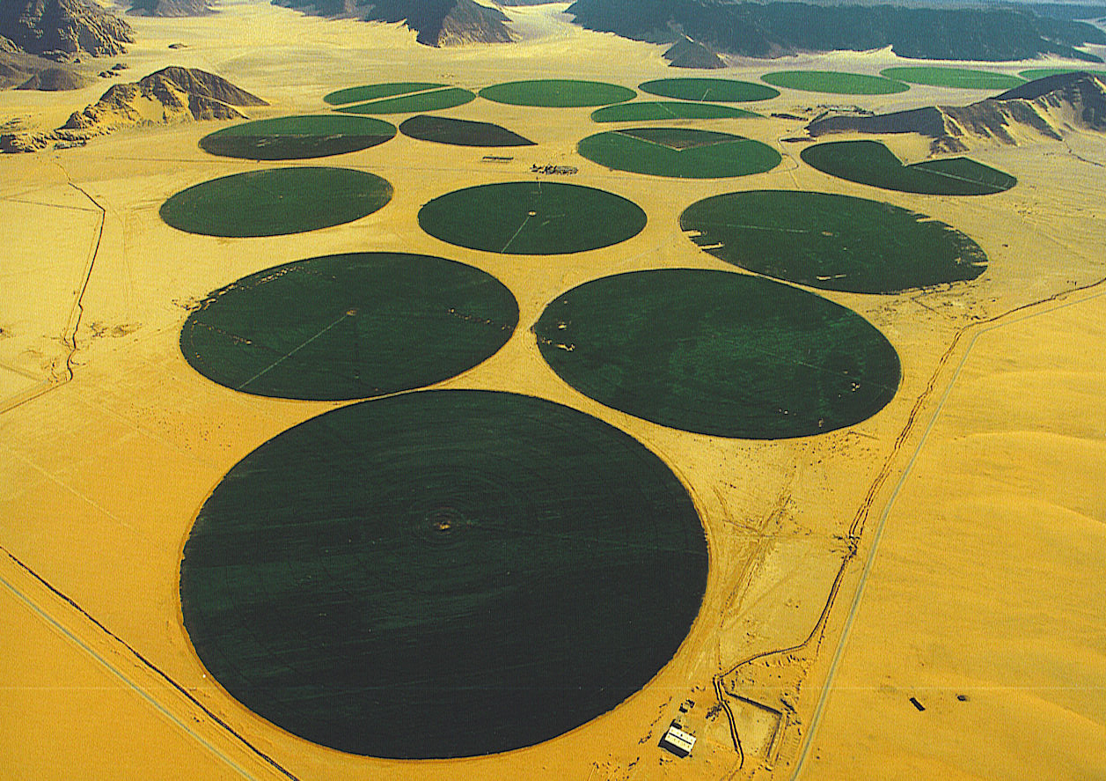
Wheat grown with pivot irrigation in the southern Negev Desert of
Jordan
Notes:
Wadi Rum-pivot irrigation in the southern Negev desert-Irrigation accounts for 2/3 of the world’s fresh water consumption

Slide 36
World Corn (Maize) Production
Fig. 10-7: The U.S. and China are the leading producers of corn (maize) in the world. Much of the corn in both countries is used for animal feed.

Slide 37
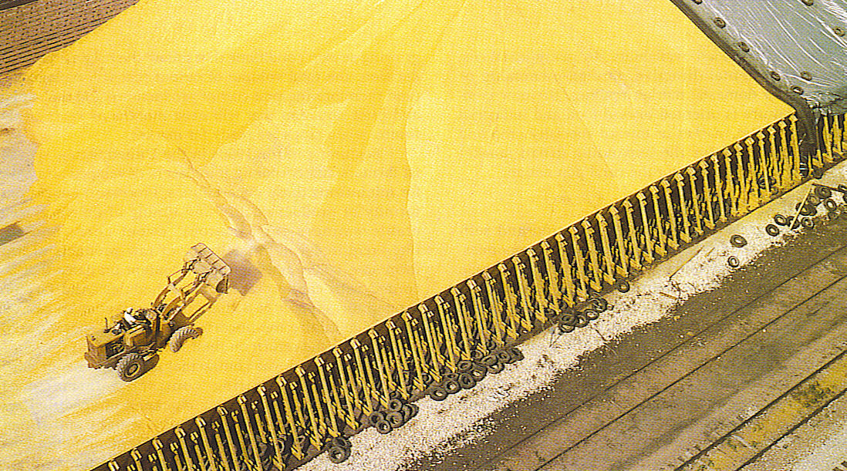
Corn 1-2 ears per stalk, 800 kernels per ear
272 million bushels of corn used for industry each year
187 million bushels for breakfast cereals, snack chips & tortillas
131 million bushels used to make beer & whiskey
5 billion bushels used for livestock feed
Notes:
Corn Harvest-Iowa- 1 million bushes.
Grain prices are up-Corn in late 2007 $4 a bushel (cost per acre to grow $330 dollars) corn has a higher yield per acre
While soybeans have gone up to $11 per bushel (cost per acre $200
Farmers rotate crops from corn to beans and back to preserve fertility-nitrogen nodules on beans renew natural nitrogen in soil and to avoid insect pests.
Costs of anhydrous ammonia most common nitrogen fertilizer has gone up due to increased oil prices

Slide 38
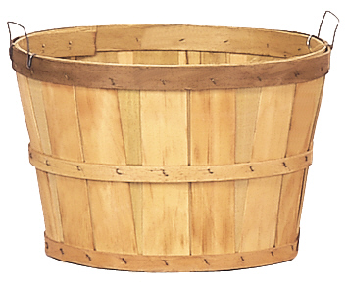
1 Bushel of corn= 8 gallons or 56 lbs

Slide 39
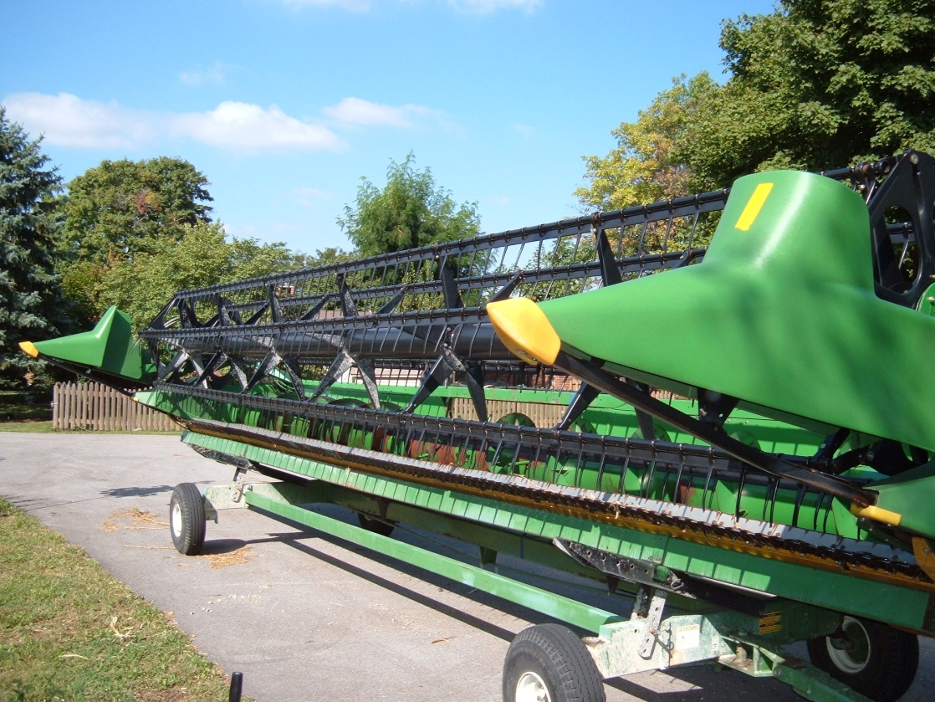
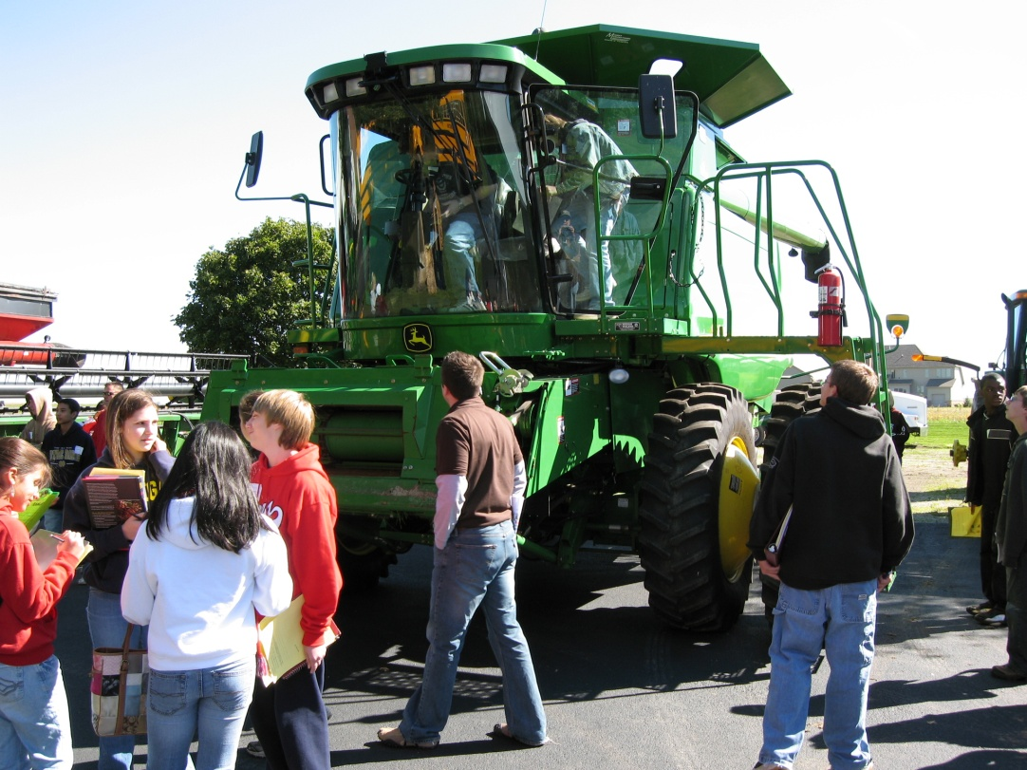
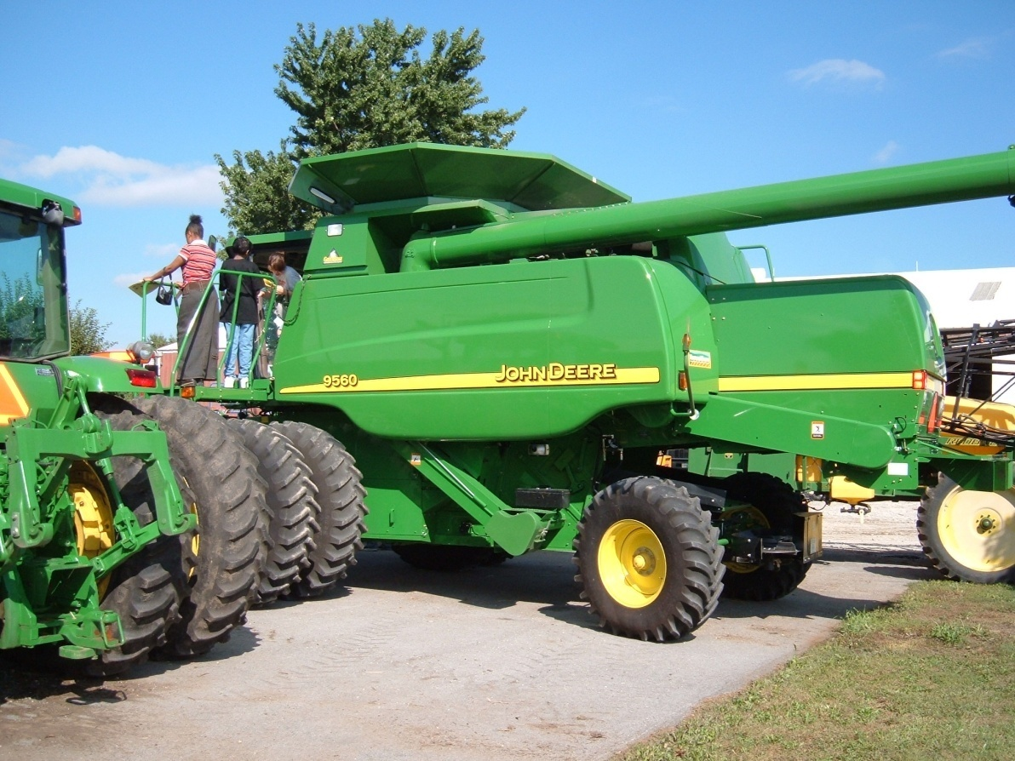
Large farm machines cost
$100,000 to over $250,000 to
purchase-fuel costs and the costs of fertilizer, herbicides and insecticides make the over all cost of farming very high with low return for the investment.
Notes:
US Farmers have the latest technology and machinery
Combine on Mr. David Peters farm 2005, 2006 field trips.
Note the attachment for harvesting wheat

Slide 40
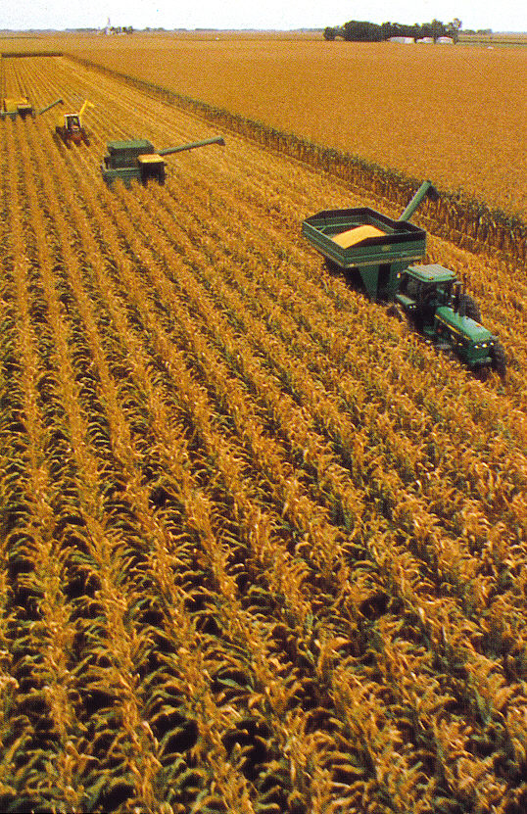
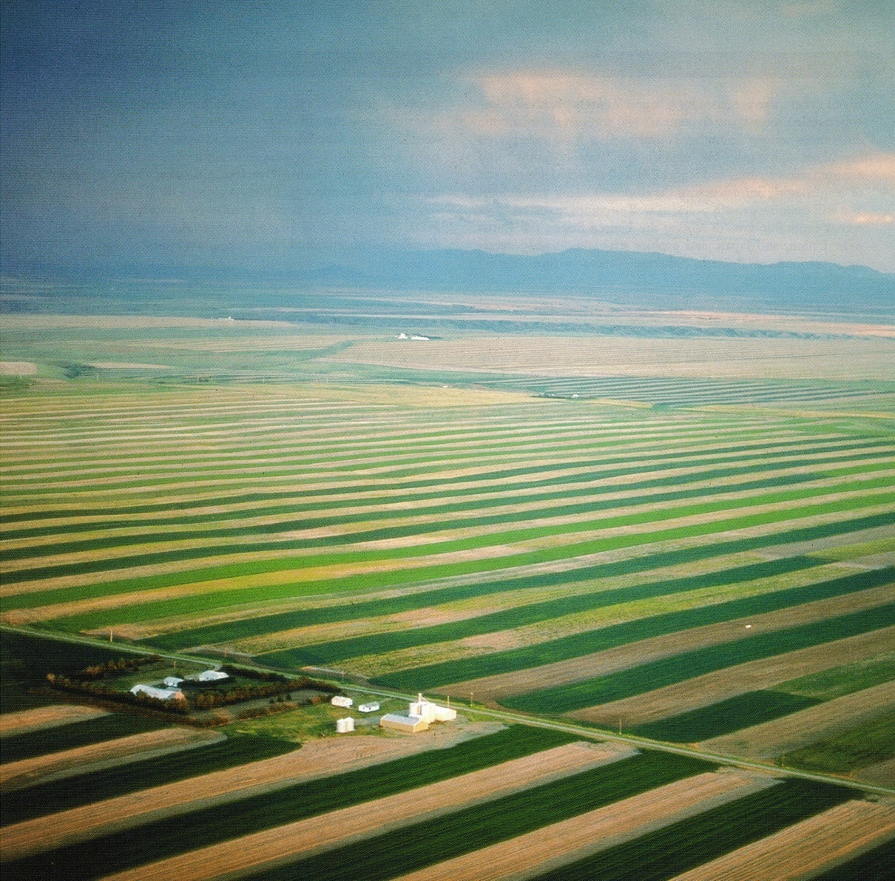
American Commercial Agriculture is
conducted at a large scale-
In 1950 1 US Farmer fed 27-today 1 US farmer feeds 135 people
Notes:
Corn harvest in Nebraska-we now export 2/3 of the world’s corn
Wheat farm in Montana
Ethanol-pros-increases demand and price for corn-(doubled between 2005-2007)
Price of land up-good for land owners-not small farmers or renters.
Con-Acre of corn takes 110 gallons of gasoline to plant, fertilize, harvest & transport
Cost of food, animal feed goes up
US exports of food go down-world hunger goes up-as does US trade deficits.( filling up an SUV with ethanol takes enough corn to feed a person for 1 year. (Mother Jones-2007)

Slide 41
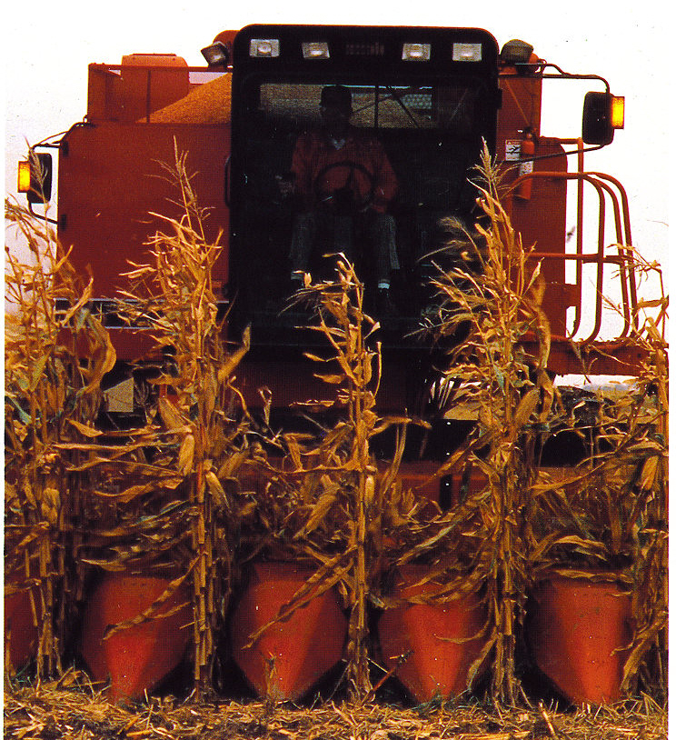
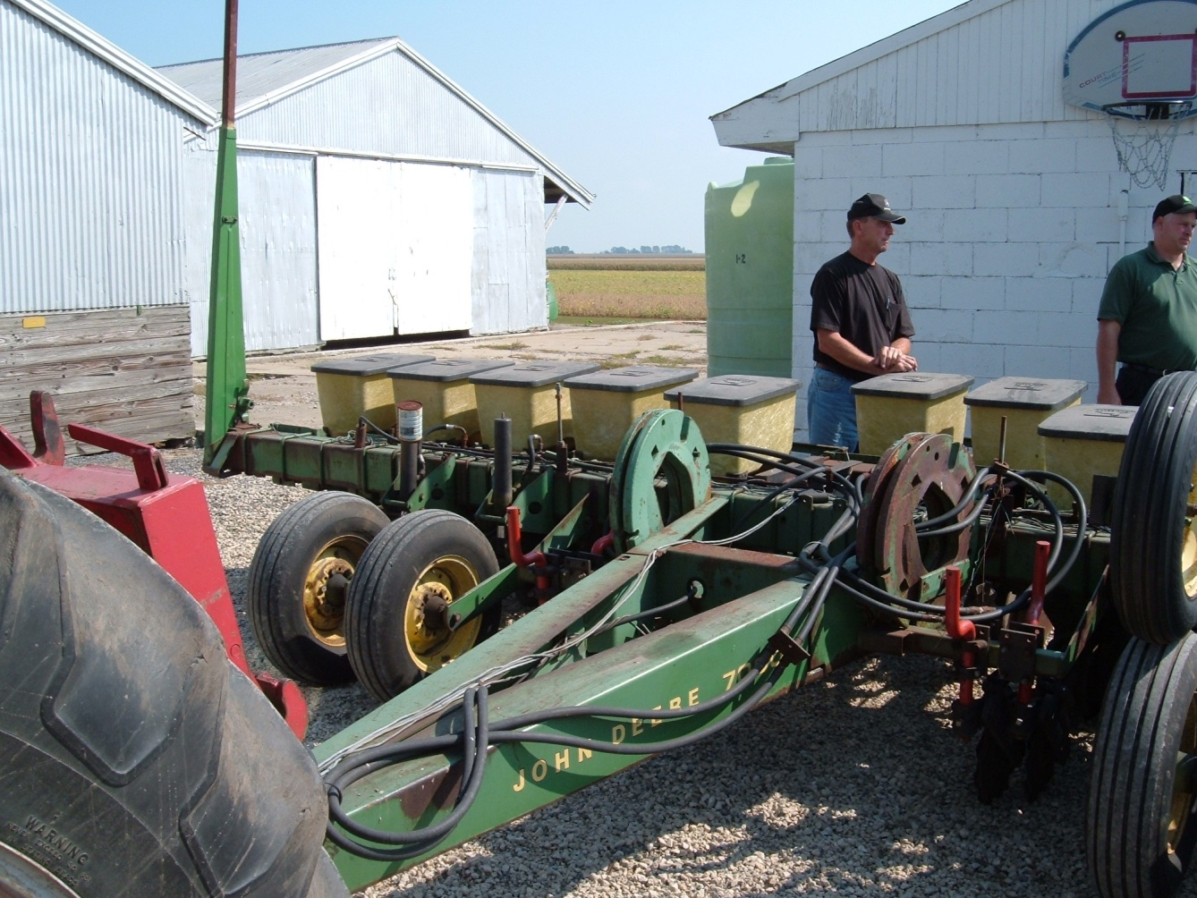
Notes:
Corn picker
Corn planter
Corn Planter at Randy Senesac’s farm in Manteno, Illinois

Slide 42
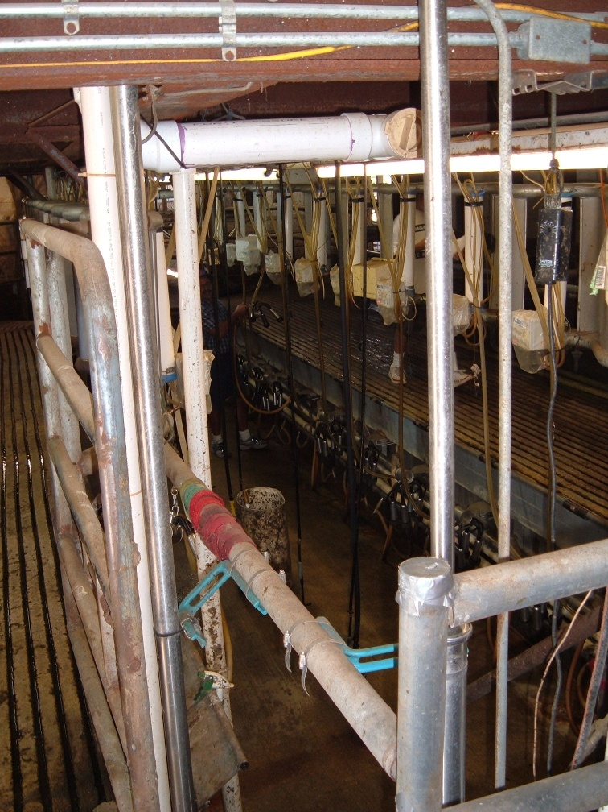
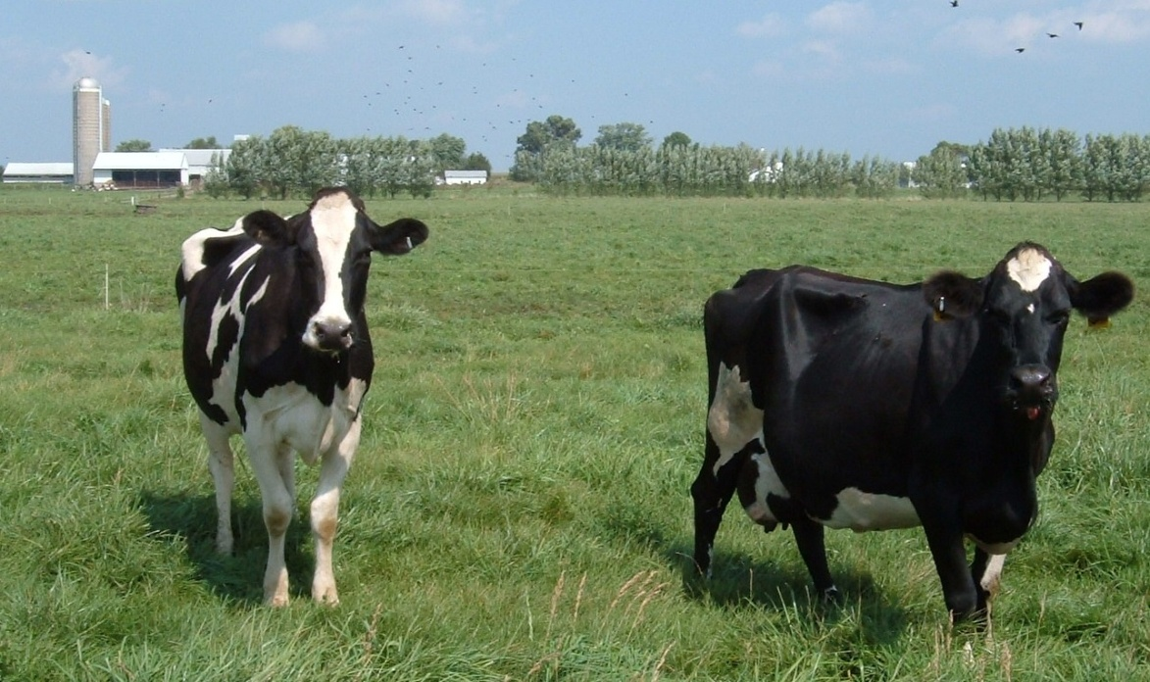
Dairy Production
Dairy farms must be located close to the consumer due to the high perishability.
The ring of dairy suppliers around a city is known as the “milkshed.”
Due to refrigerated trucks and rail cars the milkshed has dramatically increased to over 300 miles-in the early days of rail it was only 30 miles.
Notes:
Regional differences-most milk in the East is sold to consumers in New York, Boston etc.
Most milk in the west is processed into cheese and butter unless near a large city.
Wisconsin’s dairy production in processed into cheese
New Zealand devotes only 5% of dairy production to liquid milk due to a lack of consumers-it is too far from large population countries to sell fresh milk

Slide 43
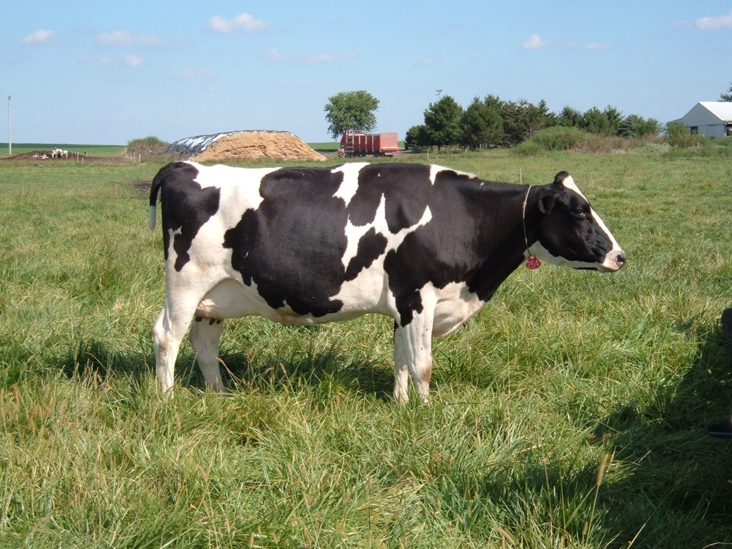
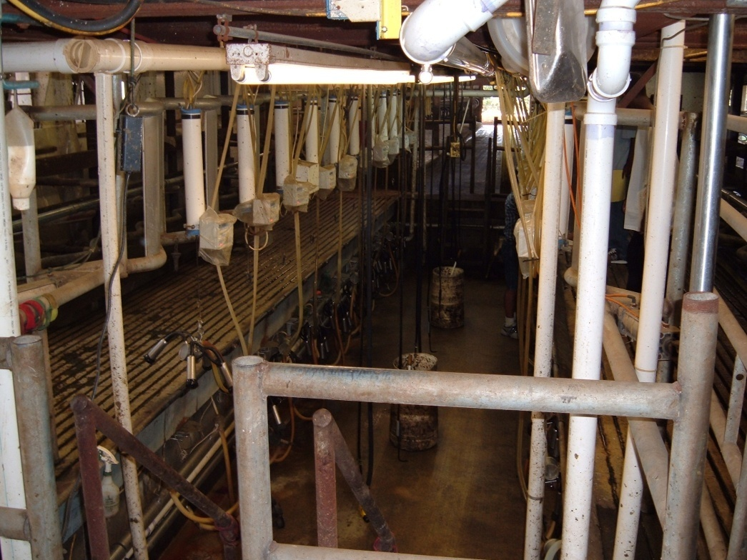
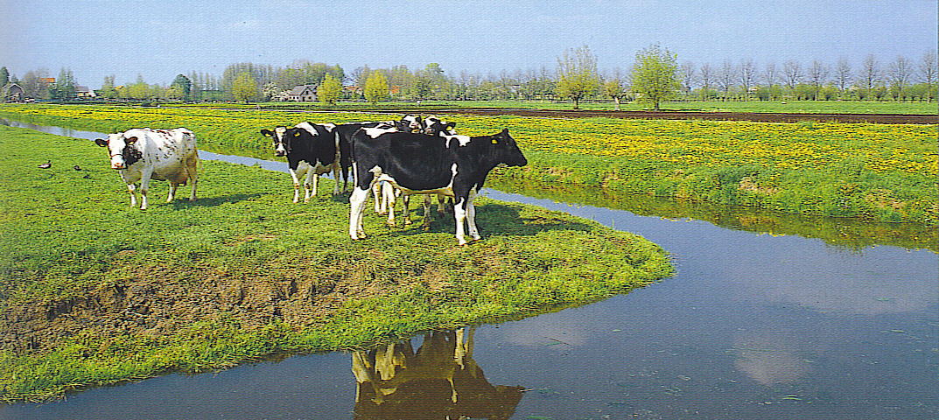
Dairy farming is very labor intensive since cows must be milked twice a day
Notes:
Dairy farm-Mr. Supernent’s farm top 2 photos
Bottom dairy cattle on a Dutch polder.

Slide 44
World Rice Production
Fig. 10-6: Asian farmers grow over 90% of the world’s rice. India and China alone account for over half of world rice production.
Notes:
1 Acre of land is the size of a football field including one end zone
Average rural Oriental family of 4 can harvest enough rice to survive on less than an acre of rice paddy
Average rice crop matures in 150 days-in subtropical areas (southern China) 2 crops can be grown in one year.

Slide 45
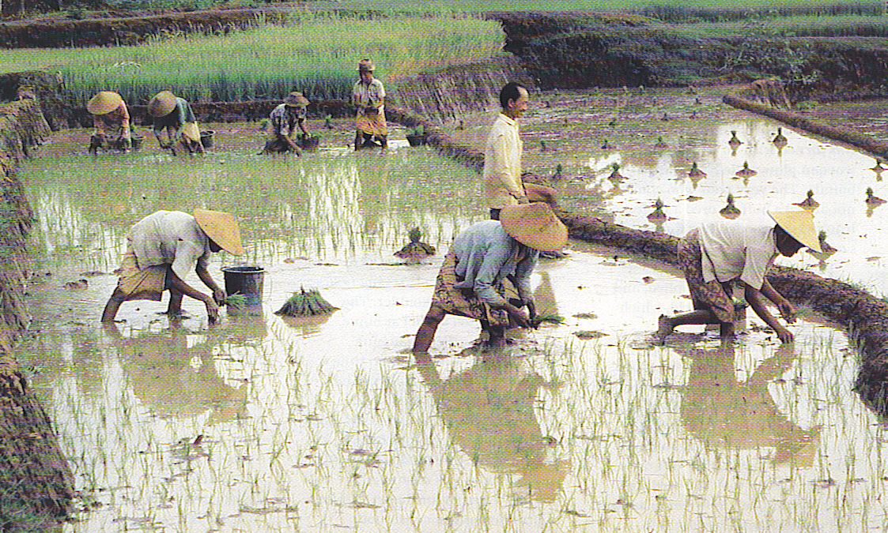
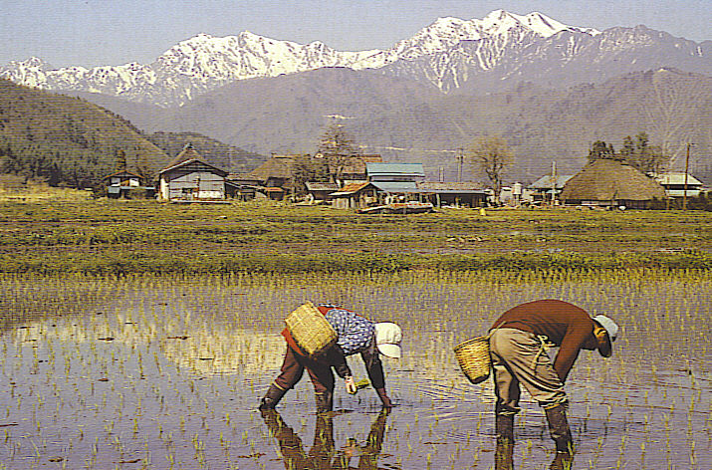
Rice production is the most important crop in East, South & Southeast Asia.
Asian farmers grow 90% of the world’s rice and China & India account for half of the world’s rice.
Rice production is very labor intensive with rice seedlings that are transplanted into flooded paddies.
Notes:
Top transplanting rice in Indonesia
Bottom transplanting rice in Japan

Slide 46
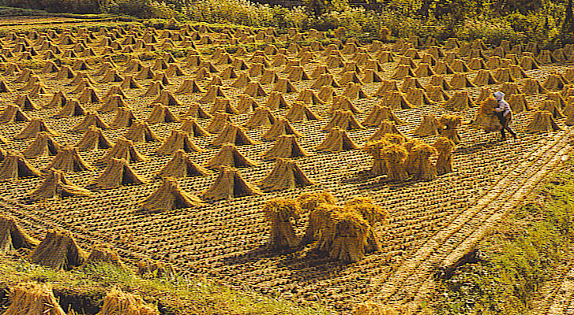
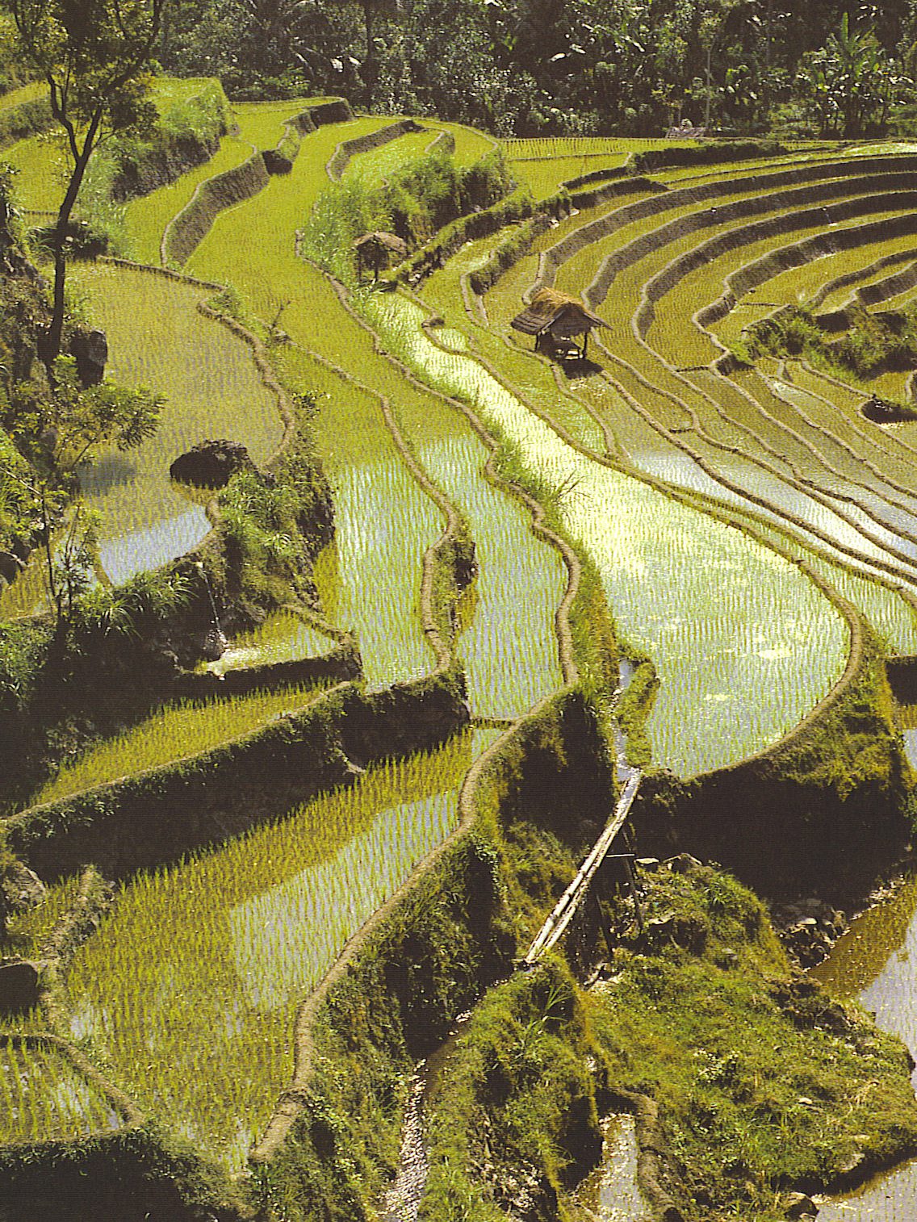
Wet Rice production must be done in flat field that can be filled with water and then drained-at right rice field terraces on Bali in Indonesia-above mature rice drying in stooks in Japan
Notes:
Rice fields in terraces on island of Bali in Indonesia
Stooks of Rice stacked to dry in Japan

Slide 47
The Valley drops 3,000 feet in the Longji or Dragon Valley in Guangxi Province, China
Rice is tended by the Zhuang people-a girl with traditional red costume and hat is weeding the fields.

Slide 48
Poultry Production
Broiler(young chickens) production has been dramatically transformed from a small scale to industrial scale production controlled by 10 companies like Tyson Foods & others.
Factory like conditions are used to grow chickens, produce eggs & poultry for meat. Much of the industry moved to the southern states like Arkansas.
Organic chickens and free range eggs

Slide 51
THE END

