Slide 1
Culture and Cultural Landscapes
Rubenstein Chapter 4
Malinowski Chapter 6
De Blij Chapter 4
Kuby Chapter 2
Greiner Chapter 2

Slide 2
Culture and Cultural Geography
Cultural geography is the study of both the distribution and diffusion of culture traits and how the culture modifies the landscape around us.
Culture can be defined as shared patterns of learned behavior, attitudes, and knowledge.
“shared patterns” means that things that are part of our culture are believed or practiced by a lot of people.
The word patterns also implies that we will find an element of a culture repeated over and over again in different places.
The word learned is important because it excludes race as part of culture.

Slide 3
Culture and Cultural Geography
Scholars refer to a single component of a culture as a culture trait.
If an area shares a large number of culture traits, geographers refer to it as a culture region.
Culture regions can be grouped into even larger areas called culture realms that are based on a few broad cultural similarities.

Slide 4
Culture Regions

Slide 5
Culture Realms

Slide 6
Types of Culture Regions
Formal Region (Uniform)- An area that contains at least one similar physical or cultural trait that unifies it
EX: France, Greece, China
Most Common traits: Language and Religion
Borders are set and distinct, several formal regions are countries

Slide 7
Types o f Culture Regions
Functional Region (Nodal)- An area with certain political, economic, or social activity that unifies it.
Contains at least one node, that is the center of activity, which is connected to surrounding locations or market area in the functional region
The node typically connects the functional region by:
Trade
Communication
Transportation
EX. A pizza business (node) and the area served by it (surrounding locations)

Slide 8
Types of Culture Regions
Perceptual Region (Vernacular): An area defined by a person’s beliefs or feelings; an area created by a person’s own associations and attachments to that area
Defined by how people perceive a certain region
May be defined by prejudices or personal thoughts
Borders are arbitrary, since they differ to different people
EX: The South in the U.S.-For instance, some believe that Kentucky is part of the South, while others do not

Slide 9
Basic Review Questions
Define culture in your own words.
What is a culture trait? Give a few examples.
Is culture inherited?
Describe the difference between the two regions, The South and Tropical Florida, that are within in Florida.
What are some ways that culture is passed along to young children?

Slide 10
Culture Complexes
When several culture traits are related, they can be referred to as a culture complex.
For example: Cars in U.S. are a social status, sign of freedom, a way to work, a job, collectible, business, etc. All of these traits are interrelated by a connection to the common car.

Slide 11
Basic Review Question
How are culture traits related to a culture complex?
The text discusses the culture complex of the car. What other important culture complexes can you identify in U.S. or Canadian society?

Slide 12
The Components of Culture
Technological subsystem is the material objects that culture produces, as well as the procedures for using those objects
An individual culture trait that falls within the technological subsystem is known as an artifact.
There is a lot of cultural convergence, when two or more cultures share culture traits to such an extent that many aspects of their cultures are very similar.

Slide 13
The Components of Culture
Sociological subsystem, this component guides how people in a culture are expected to interact with each other and how their social institutions are structured.
Culture traits in the sociological subsystem are known as sociofacts.
Social institutions are also part of a culture’s sociological subsystem.
Examples: distance between people, education, and government

Slide 14
The Components of Culture
Ideological subsystem, which is the ideas, beliefs, values, and knowledge of a culture.
Individual culture traits in this subsystem are called menifacts.
Ideas such as democracy, freedom, and justice are values that some cultures hold important, while others do not.

Slide 15
Basic Review Questions
Define and give examples of artifacts, sociofacts, and mentifacts.
What part of our lives are included in the sociological subsystem?
What is the ideological subsystem?
Identify examples of culture convergence in modern society. Specifically, what common elements of our culture are borrowed from other cultures?
What are the most important artifacts, mentifacts, and sociofacts in the culture of your country or region?

Slide 16
Cultural Diffusion
The movement of culture traits from one place to another is called cultural diffusion.
Diffusion, or innovation diffusion, consists of the movement of people, ideas, or things from one point of origin to another location over time.
The place where something begins is termed the hearth.
The diffusion of ideas or things occur through communication, observation, marketing, or a physical means.

Slide 17
Cultural Diffusion
The Tipping Point, Malcolm Gladwell came up with some interesting insights into how ideas or practices may diffuse by focusing on particular vectors.
The 1st principle “the law of the few” means that ideas and items alike are diffused through the efforts of a select group of people.
The 2nd principle the “sickness factor” refers to how well an idea resonates once it is introduced. People need to see a good reason for the idea or item and how to fit it into their lives.
The 3rd principle the “power of context” relies on prevailing conditions: the place and time have to be right to accept the new thing, otherwise, it just falls flat.

Slide 18
Cultural Diffusion
Expansion Diffusion
Contagious diffusion affects nearly uniformly all individuals and areas outward from the source region
Hierarchical Diffusion involves processes of transferring ideas first between larger places or prominent people, and later to smaller or less important points or people
During stimulus diffusion, a fundamental idea, not the trait itself, stimulates imitative behavior
Spread of the concept but not the specific system

Slide 19
Cultural Diffusion
Relocation Diffusion
The idea is physically carried to new areas by migrating individuals

Slide 20
Time-Distance Decay
“Everything is related to everything else, but near things are more related than distant things.” –Waldo Tobler, Tobler’s First Law of Geography
Distance Decay-The principle that states as things get farther away from the hearth, they become less relevant; less interaction with a culture occurs as you get farther from the hearth

Slide 21
Time-Distance Decay
The idea that the longer it takes for something to diffuse, the less likelihood of interaction with or spread of that phenomenon.
Distance makes it difficult to trade, communicate, and maintain cultural connections.

Slide 22
Time-Space Compression
Due to advances in technology and transportation, interactions between entities increases, although distance has not changed
Distance becomes less important
Trade, communication, and maintenance of cultural connection occur regardless of distance

Slide 24
Cultural Gradations
First conceptualized by geographer Donald Meining
Core-the centralized zone of concentration, or the “most pure” area that possesses all of the culture traits used to define the region
Domain-the area in which the particular culture is dominant but less intense
Sphere-the zone of outer influence where people with the culture traits in question can even be a minority within another culture region

Slide 25
Culture Changes
Assimilation | Acculturation | Syncretism
People of a given minority culture are adopted into a majority culture. | People experience cultural changes as a result of the meeting between two cultures. | The blending of beliefs and practices as a result of contact between different cultures.
Absorption of minority culture by majority culture. | Retention of some aspects of minority culture. | Majority and minority cultures are both treated on same level.
Example: A teenager abandons the folk music his family listens to and submerges himself into modern popular music | Example: Immigrants to America learn American customs and become Americans, but still retain their own culture. | Example: Certain African an d Roman Catholic traditions fused as a result of African slave trade and formed syncretic religions.

Slide 26
Review Questions
What is cultural diffusion?
Explain the difference between expansion diffusion and relocation diffusion.
What is hierarchical diffusion?
Why is migration diffusion a type of relocation diffusion?
How does Internet affect cultural diffusion in the world today?

Slide 27
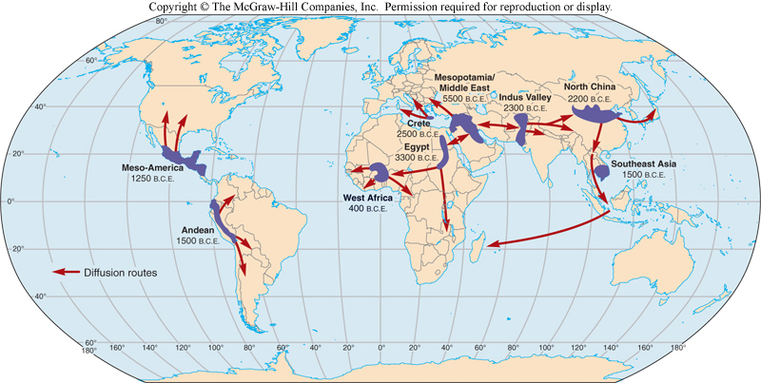
Culture Hearths
Culture hearths, areas from which important culture traits, including ideas, technology, and social structures, originated.

Slide 28
Cultural Hearths
Mesopotamia (Iraq)
Between the Tigris and Euphrates Rivers
1st Human settlement and farm
Included Sumerians, the Babylonians, and the Assyrians
Contributions include the creation of writing, innovations in mathematics and astronomy, and the development of complex legal systems- the code of Hammurabi

Slide 29
Cultural Hearths
Egypt (Nile River)
Contributions are a complex theological, political, and social system
Cultivated grain and had a complex trade system
Egyptian science, math, and technology to influence other civilizations

Slide 30
Cultural Hearths
Crete (Minoan civilization and later Mycenaean)
Greek contributions to art, philosophy, and science, and include great philosophical works of Plato and Aristotle
Romans contributed government structure, military organization, engineering, and bureaucracy.
A surviving geographic reality of the importance of Rome is the fact that large areas of Europe still speak languages derived from Latin.

Slide 31
Cultural Hearths
Indus Valley
Cities of Harappa and Mohenjo-Daro
Arranged in a grid pattern and serviced by an early but working drainage system
Had organized facilities for storing and processing grain

Slide 32
Cultural Hearths
North China
Near where the Wei and Yellow Rivers converge
Domestication of millet and rice. Later soybeans, tea and a variety of fruits and vegetables

Slide 33
Cultural Hearths
The Americas
Inca and Myan Empire
Incas built thousands of miles of roads
Strong taxes were levied to support the central government, persistence of Quechua, official language of the Incas, still used today
Mayan contributed a complex religious systems, a detailed calendar, and an effective bureaucracy

Slide 34
Cultural Hearths
West Africa (Mali, Ghana, and Songhai)
Traded in gold, salt, and other commodities at cities such as Timbuktu made the empire very wealthy and allowed art, religion, and other components of society to flourish

Slide 35
Review Questions
What is meant by culture hearth?
What are some important world culture hearths?
Where was the Mesopotamian civilization?
Where was the Harappan civilization?
Where was the culture hearth in ancient China?
What were some important culture hearths in sub-Saharan Africa?
What were some important culture hearths in the Americas?
What were the important contributions to world culture of the ancient cultural history?

Slide 36
Cultural Landscape
Environments as Controls
Environmental Determinism
The belief that the physical environment exclusively shapes humans, their actions, and thoughts
Possibilism
A reaction against environmental determinism; people are dynamic forces of development (the environment is not as dynamic like human beings)

Slide 37
Cultural Landscapes
Refers to the cultural impacts on an area, including buildings, agricultural patterns, roads, signs, and nearly everything else that humans have created
Carl Sauer’s main goal for cultural geography-using the cultural landscape to uncovers evidence of past cultures.
Cultural landscape includes material and nonmaterial culture

Slide 38
Popular Culture/Placelessness
Associated with a large, diverse group of people, influenced by mass media and production
Youth oriented
The environment tends to look the same.
Leads to placelessness, where places lose their distinctness
The culture changes rapidly
Usually a product of MDCs, because these countries have more technology and wealth
Spreads through hierarchical diffusion, starting with influential people

Slide 39
Folk Culture
Associated with a similar group of people with strong beliefs and traditions
Traditions are ancient, dating back hundreds or thousands of years
Tied to a specific area and often to an older generation
Spreads through relocation diffusion
More often in rural areas.
Independent from today’s mainstream culture

Slide 40
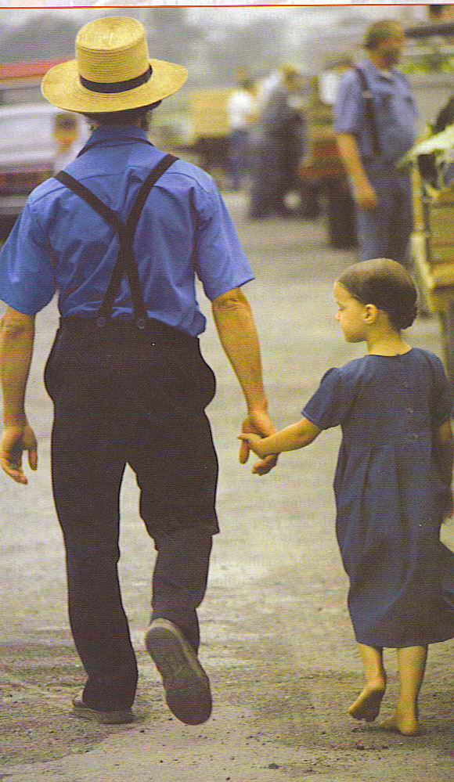
Material Culture
clothing
buildings
farming patterns
technology

Slide 41
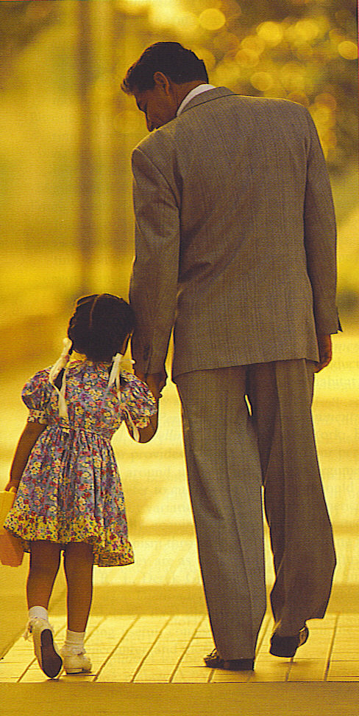
Nonmaterial Culture
Language
Religion
Political organization
Customs or traditions

Slide 42
Globalization
Watch the attached video on youtube: Globalization easily explained

Slide 43
Globalization and Technologies Impact on Culture
Globalization is a large factor in the spread of popular culture
As places become more connected, culture spreads faster from place to place
This often leads to glocalization, where global and local forces interact and are changed
It can also lead to neolocalism, a renewed interest is in protecting and sustaining the uniqueness of a place
Technology is also a large factor in the spread of popular culture
The internet provides instant spread of culture, causing globalization in the process
Television shows, music, and video games are all mass-produced, causing the spread of culture in media
Better technology even allows the mass-production of food and clothes, which especially helps to spread some of the material aspects of popular culture

Slide 44
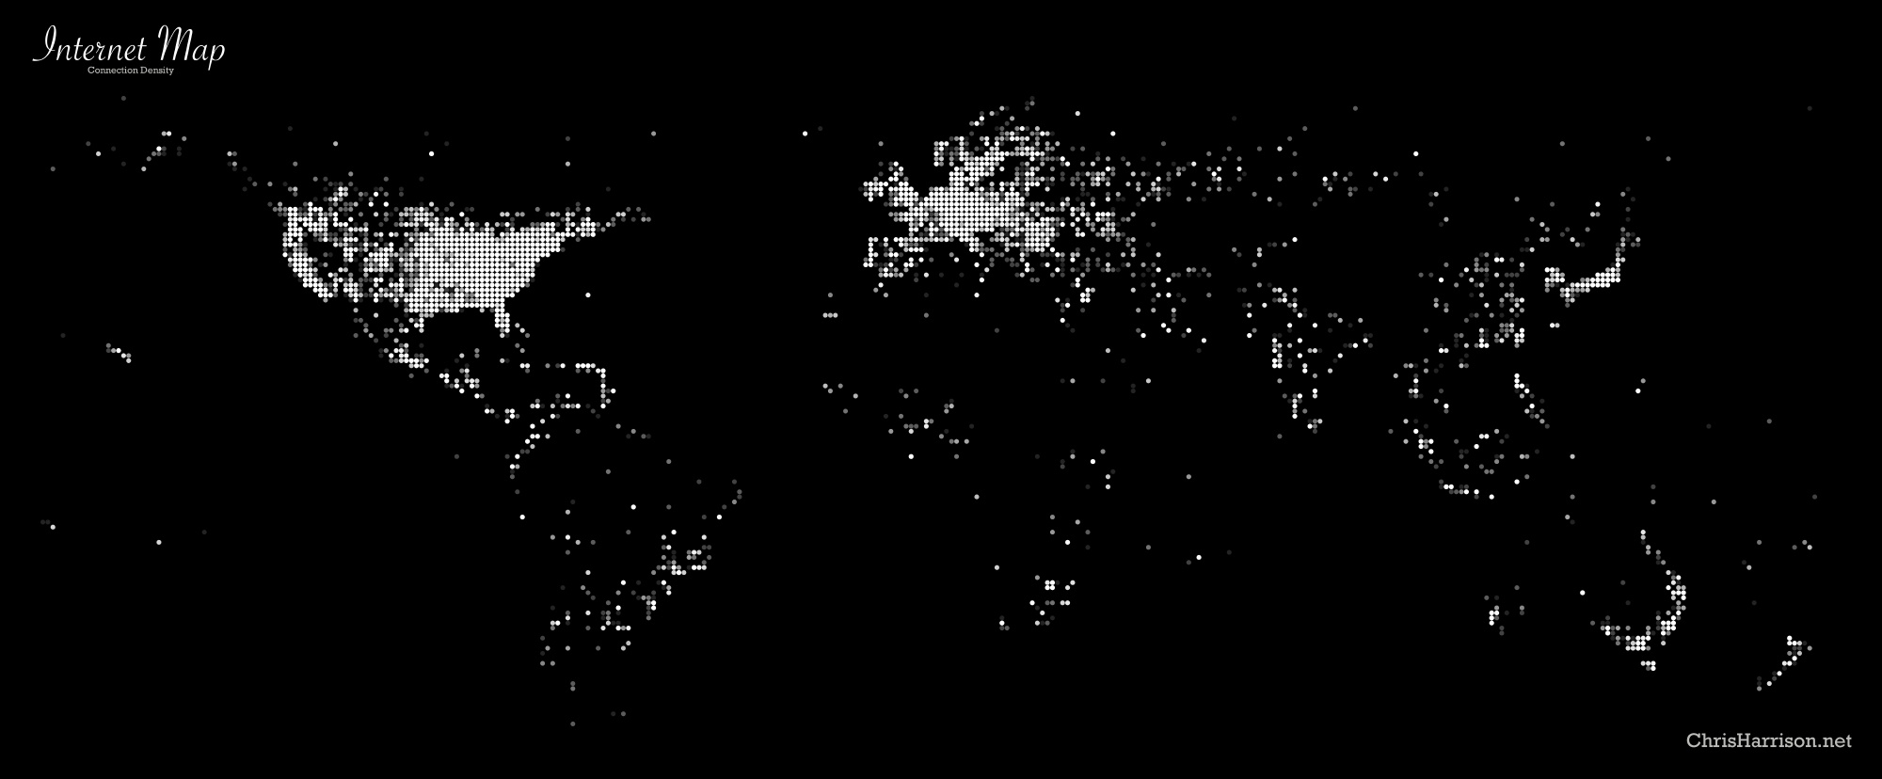
Internet Connections
The Internet is diffusing today, but access varies widely.

Slide 45
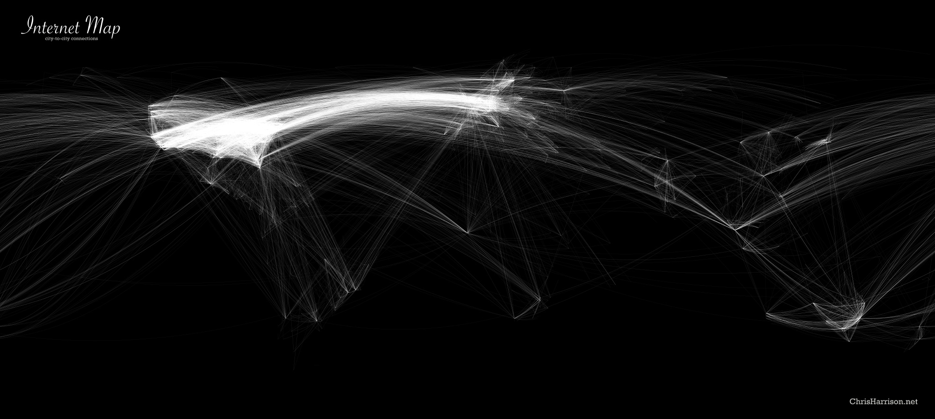
Internet Connections
The Internet is diffusing today, but access varies widely. Some countries censor the Internet, but this is much harder to do.

Slide 46
Review Question
What is environmental determinism?

Slide 47
Folk Culture and American Foodways
Folk culture generally refers to culture traits that are traditional, no longer widely practiced by a large amount of people, and generally isolated in small, often rural, areas
Popular culture refers to aspects of a culture that are widespread, fast-changing, and transmitted by the mass media.

Slide 48
Folk Culture and American Foodways
New England
Seafood dishes because the region’s population lived close to the ocean
“three sisters”: corn, beans, and squash
Molasses and honey makes food sweet

Slide 50
Folk Culture and American Foodways
Southern Food
African slaves and immigrants made a huge impact on cooking. African slaves were responsible for nearly all food preparation and they changed the traditional recipes of their English owners to reflect their own traditions.
Pork was much more common as a meat in the South, in the eighteenth and nineteenth century, and continues as a typical southern food.
Rice is also common

Slide 52
Folk Culture and American Foodways
Southwestern Food
Represent the combined geographic influences of Mexicans, Spanish settlers, Native Americans, and eastern cowboys and migrants
The use of chili peppers makes the food spicy
The Spanish are responsible for introducing more meat into the diet, pork and beef.

Slide 54
Folk Culture and American Foodways
Midwestern Food
Primarily settled by central, eastern, and northern Europeans
Make use of agricultural produce grown locally and are often simple and hearty casseroles and fruit pies
Because dairy products are abundant in the region, cheese and cream are often used in dishes
Grains are also common in the breadbasket

Slide 56
Review Question
Compare and contrast folk culture and popular culture.
How are food patterns in the United States related to the country’s cultural history?

Slide 57
Popular Culture: House types
Old buildings offer a way of examining cultural ideas of the past. People generally build new homes in the style that is popular at the time.

Slide 58
Popular Culture: House types
Early American Homes
Well-off colonial American Georgian
style home
Homes are rectangular
The roofline runs from the side of
the home to the other side
The roof rarely overhangs the walls

Slide 59
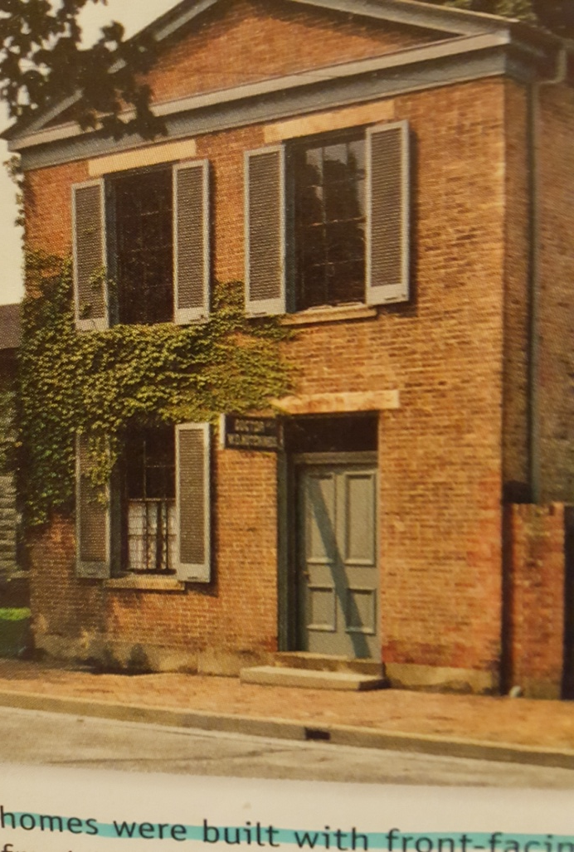
Popular Culture: House types
Early Nineteenth Century Homes
Americans were in love with ancient
Greek and Roman civilization
Often have columns and other touches
that make them look like ancient
temples
Homes were built with front-facing
gables

Slide 60
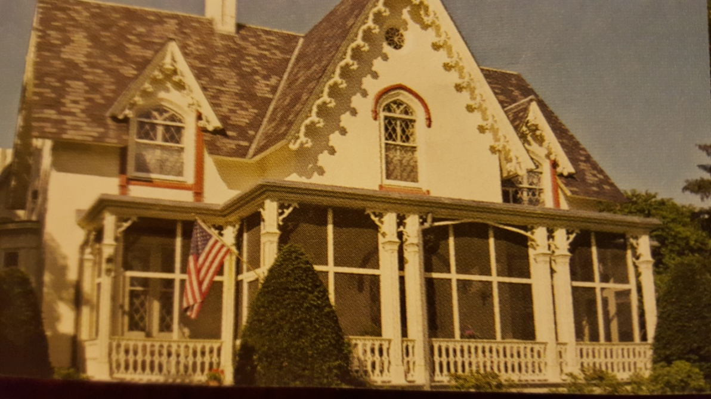
Popular Culture: House types
Mid-Nineteenth Century
Gothic Revival and the Italianate
house styles were, for the most
part, built between the 1840s
and 1870s

Slide 61
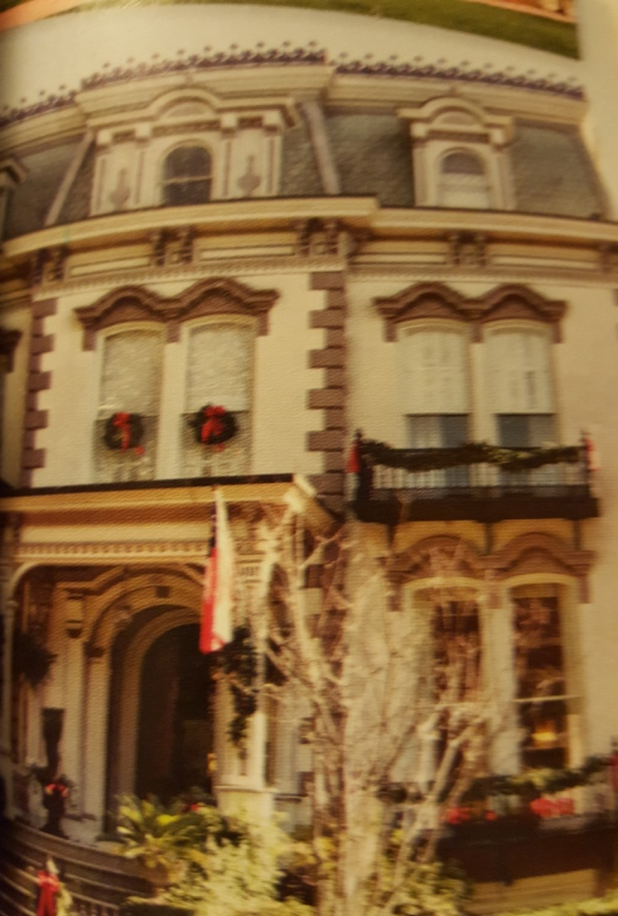
Popular Culture: House types
Second Empire Homes
Built between 1855 and about
1875
They were based on trendy styles
in Europe at the time and feature
the unique mansard roof

Slide 62
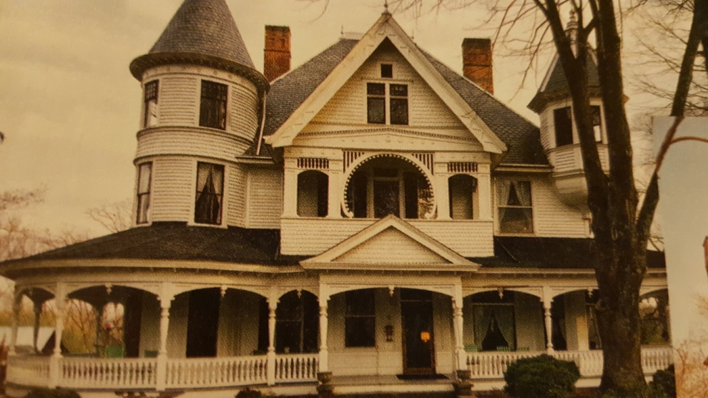
Popular Culture: House types
Victorian Homes
Built from about the 1870s
to 1900
Crazy rooflines, odd-shaped
windows, porches, and
ornamental designs on the
outside walls

Slide 63
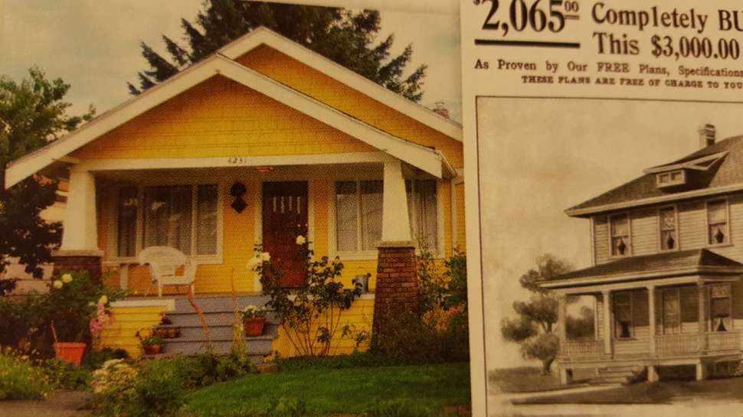
Popular Culture: House types
Early Twentieth-Century Homes
Built in the early 20th century
Included Prairie-style homes,
Tudor designs, and smaller
bungalow-style homes

Slide 64
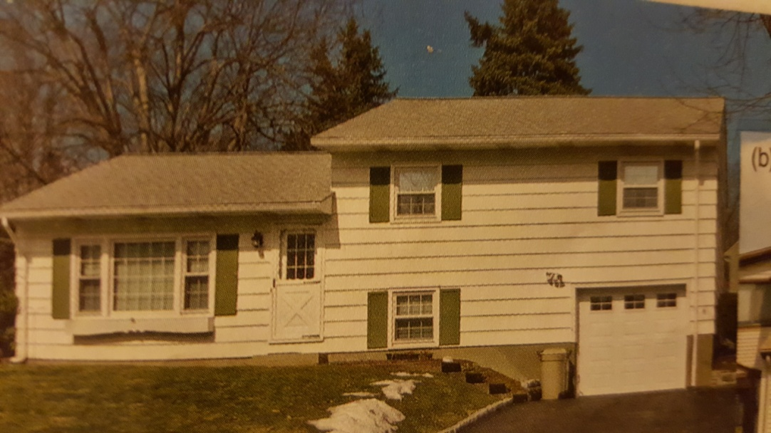
Popular Culture: House type
Post-World War II Homes
Split-level or single-level ranch-style
Flourished in the baby boom era
of the 1950s and 1960s
By the 1970s, contemporary
styles with unconventional
shapes had begun to
appear in large numbers

Slide 65
Review Questions
What is a Georgian-style home? A Gothic Revival home?
What are some differences between Classical Revival and Greek Revival homes?
When was the Victorian period?
Explain how house types can be used to date an area of the United States. Why are houses a good cultural artifact? In other words, why are homes so indicative of particular time periods and cultural attitudes at those times?

Slide 66
A Cultural Geography of Sports
Cultural Geographers believe that what we build an how we organize our cities and towns reflects our culture
Hockey was a popular sport in the north until
Technology allowed indoor rinks to be more practical
The U.S. population shifted southward and westward

