Slide 1
Von Thünen Model
A Model of Agricultural Land Use
The Von Thunen model of agricultural land use was created by farmer and amateur economist J.H. Von Thunen (1783-1850) in 1826
The Model is based on two primary costs
The cost of land vs. the distance of reaching your target market.
Next a formula for determining profit is created.
The value of a yield per hectare of land vs. the true cost to transport it market.
Example:

Slide 2
Von Thünen Model’s 4 Rings
There are four rings of agricultural activity surrounding the city. Dairying and intensive farming occur in the ring closest to the city. Since vegetables, fruit, milk and other dairy products must get to market quickly, they would be produced close to the city (remember, we didn't have refrigerated oxcarts!)
Timber and firewood would be produced for fuel and building materials in the second zone. Before industrialization (and coal power), wood was a very important fuel for heating and cooking. Wood is very heavy and difficult to transport so it is located as close to the city as possible.
The third zone consists of extensive fields crops such as grains for bread. Since grains last longer than dairy products and are much lighter than fuel, reducing transport costs, they can be located further from the city.
Ranching is located in the final ring surrounding the central city. Animals can be raised far from the city because they are self-transporting. Animals can walk to the central city for sale or for butchering.
Beyond the fourth ring lies the unoccupied wilderness, which is too great a distance from the central city for any type of agricultural product.

Slide 3
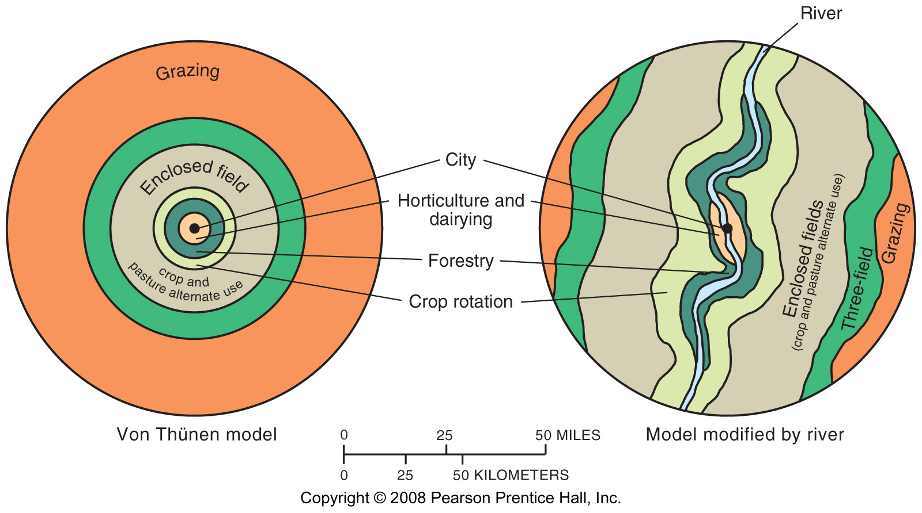
Von Thünen Model
Fig. 10-13: Von Thünen’s model shows how distance from a city or market affects the choice of agricultural activity in (a) a uniform landscape and (b) one with a river.

Slide 4
Things to consider about
Von Thunen’s Model
Von Thunen's model was created before industrialization and is based on the following limiting assumptions:
  The city is located centrally within an "Isolated State" which is self sufficient and has no external influences.
  The Isolated State is surrounded by an unoccupied wilderness.
  The land of the State is completely flat and has no rivers or mountains to interrupt the terrain.
  The soil quality and climate are consistent throughout the State.
  Farmers in the Isolated State transport their own goods to market via oxcart, across land, directly to the central city. Therefore, there are no roads.
  Farmers act to maximize profits.

Slide 5
Boserup’s 5 stages of intensification
Boserup identified the theory that, as population increases, people and cultures are compelled to develop and expand their agricultural intensification in order to feed the increasing population.
His first proposal goes through 5 stages of intensification.
  Forest fallow – 20 years
  Bush fallow – 10 years
  Short fallow – 2 years
  Annual cropping – Once a year
  Multicropping – Several times a year
The second manner in which production is increased is through the adoption of new farming methods and basic technology

Slide 6
U.S. Government Policies
Farmers are encouraged to avoid producing crops that are in excess supply
Planting fallow crops that restore nutrients to the soil and help hold the soil
Pays farmers when the difference between the market price and the target price
Government buys surplus foods and sells or donates it to foreign government

Slide 7
Economic Issues of Agriculture
Challenges for commercial farmers
  Overproduction
  Sustainable agriculture
Challenges for subsistence farmers
  Population growth
  International trade
Increasing food supply
  Oceans
  High Protein Cereals
  Improved Palatability

Slide 8
Green Revolution
The term "Green Revolution" was first used in 1968 by former USAID director William Gaud, who noted the spread of the new technologies
Stems from two basic principals
  Introduction of new higher yield seeds
  Expanded use of fertilizers
Because of the Green Revolution, agricultural productivity at a global scale has increased faster than population growth.

Slide 9
Green Revolution
Overall, the Green Revolution was a major achievement for
many developing countries and gave them an unprecedented
level of national food security. It represented the successful
adaptation and transfer of the same scientific revolution in
agriculture that the industrial countries had already
appropriated for themselves. The Green Revolution also lifted
large numbers of poor people out of poverty and helped many
nonpoor people avoid the poverty and hunger they would have
experienced had the Green Revolution not occurred. The
largest benefits to the poor were mostly indirect, in the form
of lower food prices, increased migration opportunities, and
greater employment in the rural nonfarm economy. The direct
benefits to the poor through their own on-farm adoption,
greater agricultural employment, and empowerment have been
more mixed and depend heavily on local socioeconomic
conditions. In many cases inequalities between regions and
communities that adopted Green Revolution technologies and
those that did not also worsened. At the same time, the Green
Revolution had many negative environmental impacts that have
still to be adequately redressed.
Agricultural research remains a potent force for good in the
developing world and is the key to increasing yields further to
meet the continuing growth of food needs in developing countries.
This need is especially urgent in Sub-Saharan Africa, which
has yet to experience an agricultural revolution of its own. But
simply adding to the pile of food will not be enough. The indirect
benefits for the poor are likely to be weaker in the future
as globalization and trade make food prices less responsive to
local production and as agriculture becomes less important to
the livelihoods of the poor. Policymakers will need to target the
poor more precisely to ensure that poor people receive
greater direct benefits from new technologies. New technologies
will also need to be more environmentally sustainable. By
building on the strengths of the Green Revolution while seeking
to avoid its weaknesses, scientists and policymakers can
take significant steps toward achieving sustainable food security
for all the world’s people.

Slide 10
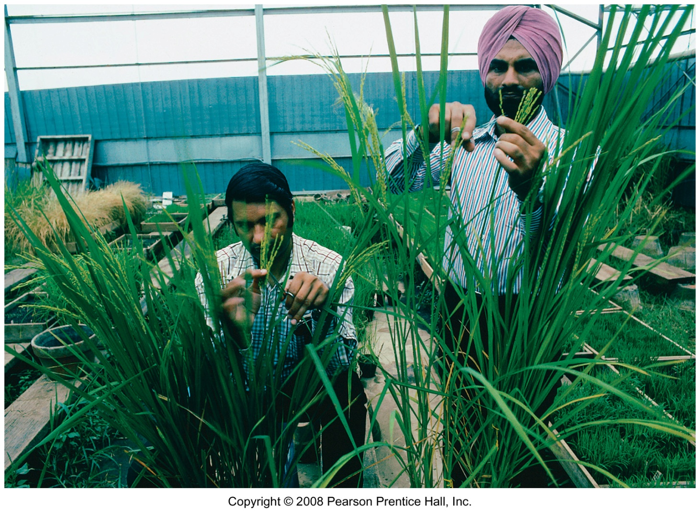
Green Revolution Experiments
Scientists at the International Rice Research Institute try to develop improved crop varieties.

Slide 11
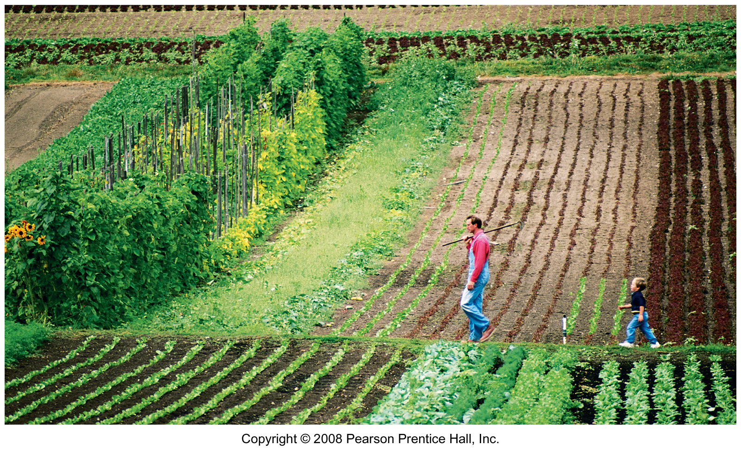
Organic Farm in Washington
There is limited use of chemicals and heavy machinery on organic farms such as this one in Whatcom County, Washington state.

Slide 12
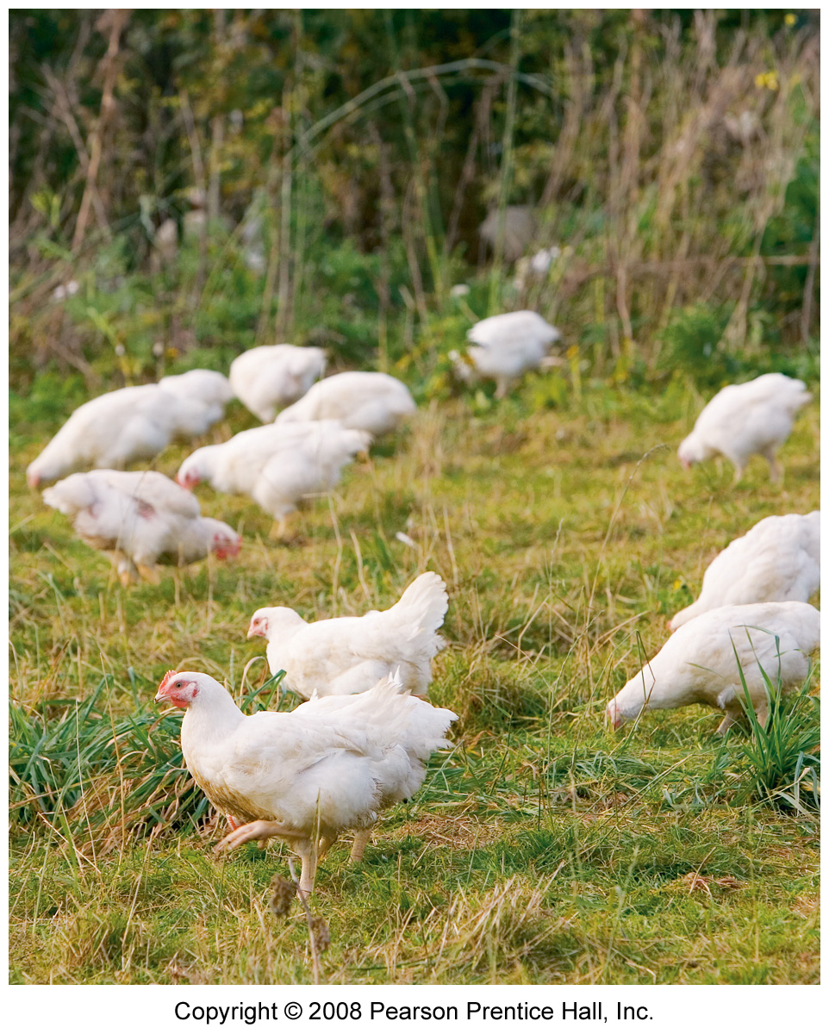
Free-range Chickens
Free-range chickens on an organic farm in England.

Slide 13
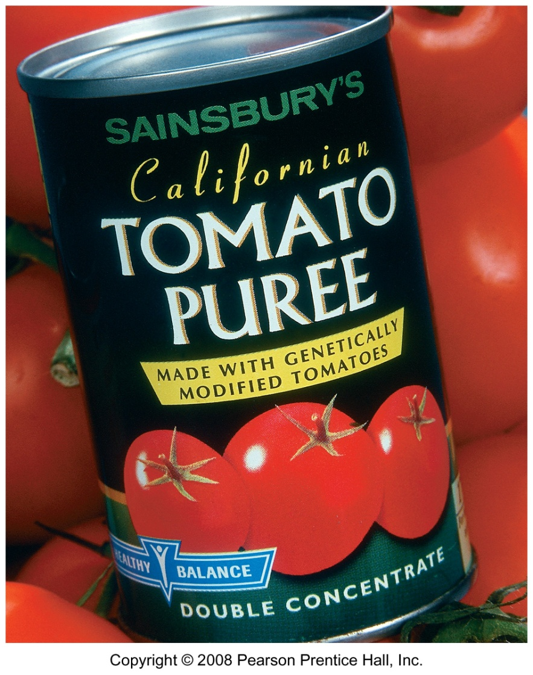
Genetically Modified Foods
Genetically modified foods must be labeled in Europe but not in the U.S.

Slide 14
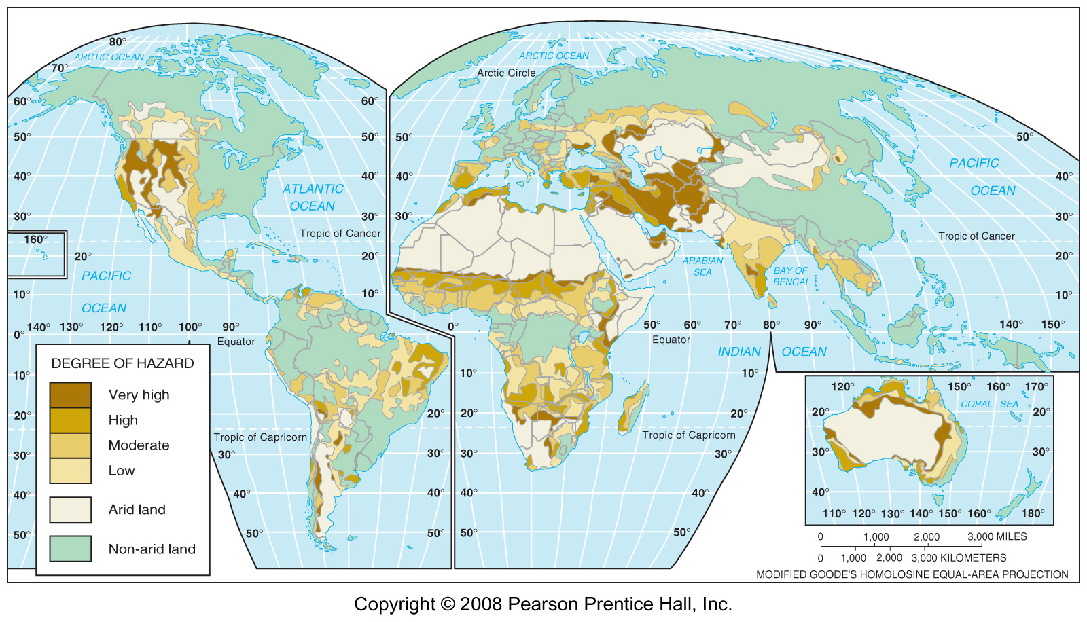
Desertification Hazard
Fig. 10-14: The most severe desertification hazard is in several parts of semiarid Africa, and parts southwestern Asia, North and South America, and Australia.

Slide 15
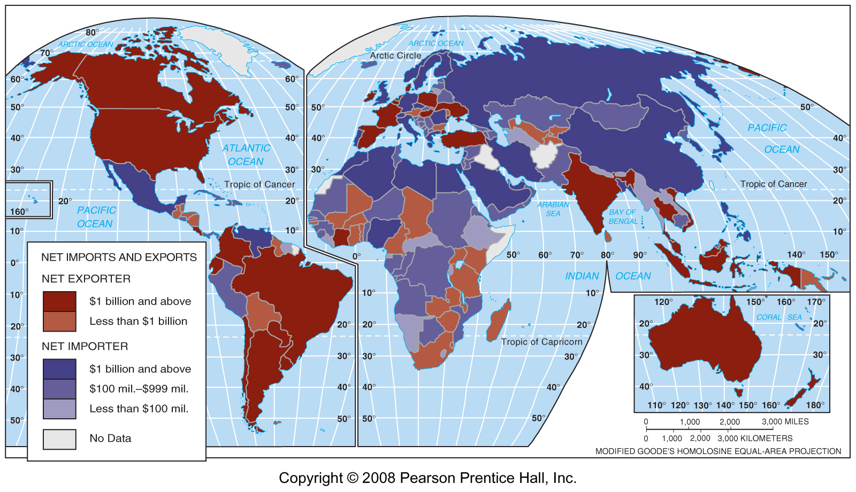
Grain Importers & Exporters
Fig. 10-15: Most countries are net importers of grain. The U.S. is the largest net exporter.

Slide 16
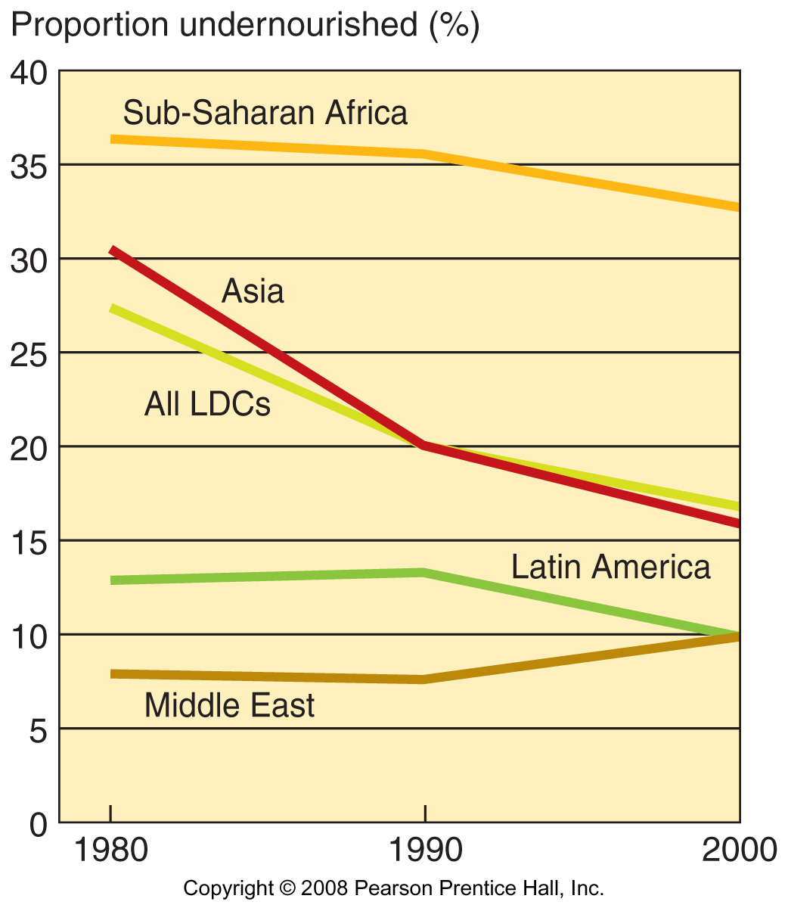
Undernourished Proportion
Fig. 10-16: The proportion of under-nourished population has declined in most LDCs, but is much higher in sub-Saharan Africa than in other areas of the world.

Slide 17
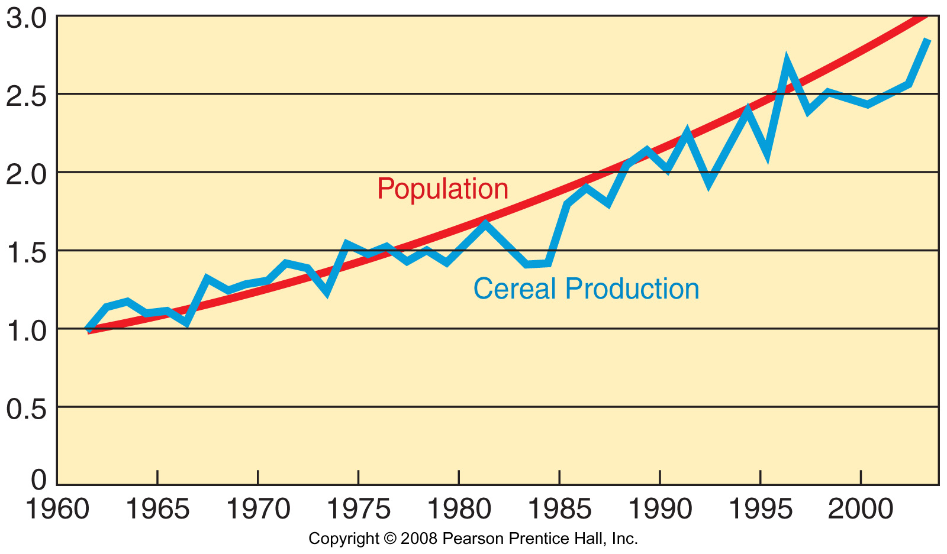
Population and Grain Production in Africa, 1961-2005
Fig. 10-17: Cereal production has not kept up with the high rate of population growth in sub-Saharan Africa. (The graph is set to a base of 1.0 in 1961).

Slide 18
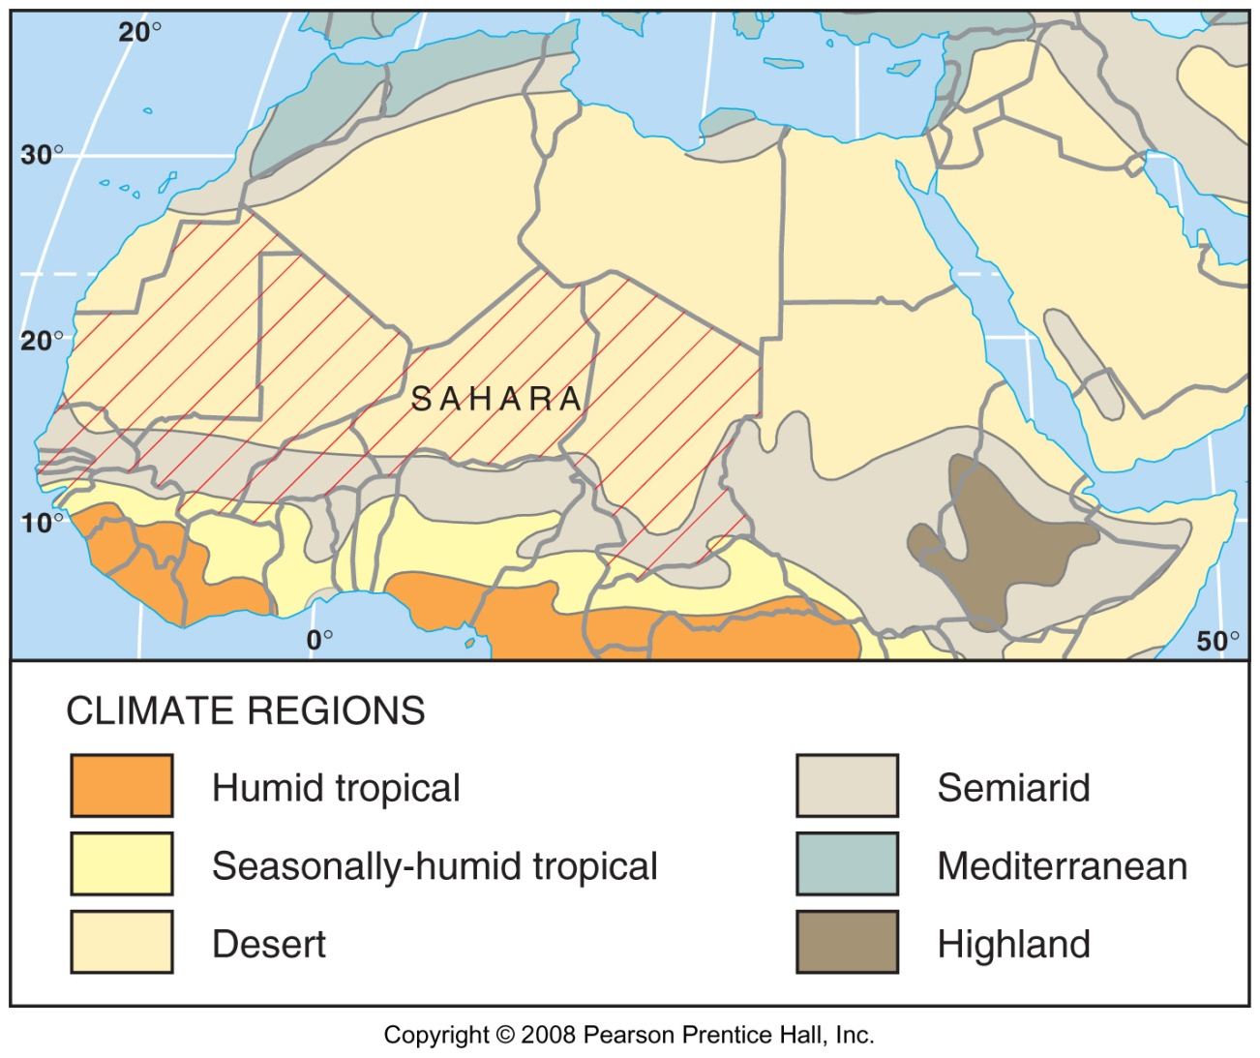
The Sahel
Fig. 10-18: The Sahel, which is south of the Sahara, frequently faces drought and food shortages, as does the Horn of Africa.

